Slide 1






Results of XRD and PAS measurements on Zirconium samples implanted at eLBRUS
Agata Kowalska
Maritime University of Szczecin, Szczecin, Poland
Contact: a.kowalska@pm.szczecin.pl
Mathieu Valat, Mateusz Kaczmarski, Natalia Targosz Ślęczka, Konrad Czerski,
Rakesh Dubey
University of Szczecin, Szczecin, Poland
Jolanta Baranowska, Justyna Słowik
West Pomeranian University of Technology, Szczecin, Poland
Krzysztof Siemek, Paweł Horodek
Institute of Nuclear Physics Polish Academy of Sciences, Krakow, Poland
15th International Workshop on Anomalies in Hydrogen Loaded Metals
Notes:
Name, affiliation, Laboratory. Thank the boss.
Present the collaboration

Slide 2

Motivation
Understand and design the metallic structure necessary for fusion reactions to occur at thermal energies.
"This effect together with the measured time dependence of the enhancement factor and the target contamination suggest that the crucial role in the screening effect might be played by crystal lattice defects and a small amount of impurities which increase the effective electron mass. This means that we could easily influence nuclear reaction yields at low energies by the changing electron band structure of the target material."[1]
[1]: Czerski, K., D. Weissbach, A. I. Kilic, G. Ruprecht, A. Huke, M. Kaczmarski, N. Targosz-Ślęczka, and K. Maass. “Screening and Resonance Enhancements of the 2 H(d, p) 3 H Reaction Yield in Metallic Environments.” EPL (Europhysics Letters) 113, no. 2 (January 1, 2016).
Notes:
Objectives:
- Nuclear experiments show crystal structure plays role
- What defects?
- How do they arrange?

Slide 3
Motivation
Local crystal structure
Crystal lattice defects
Increased diffusion of quasi free hydrogen
Binding of hydrogen
in the crystal structure
Binding of hydrogen
to crystal defects
Classical MH/cond.mat accelerator science
Observed in [1]
Increased number of nuclear collisions
Localization of conduction
electrons
Increased
effective electron mass
Enhanced electron screening
Enhancement of the nuclear reaction rates
[1]: Czerski, K., D. Weissbach, A. I. Kilic, G. Ruprecht, A. Huke, M. Kaczmarski, N. Targosz-Ślęczka, and K. Maass. “Screening and Resonance Enhancements of the 2 H(d, p) 3 H Reaction Yield in Metallic Environments.” EPL (Europhysics Letters) 113, no. 2 (January 1, 2016)
Notes:
Was difficult to find, 20 years of work of eLBRUS
One body about effect of quasi-free hydrogen
One body about binding energy to crystals
Interesting that Czserski theory joint local crystal structure and lattice defects to explain enhancement of U(e)

Slide 4
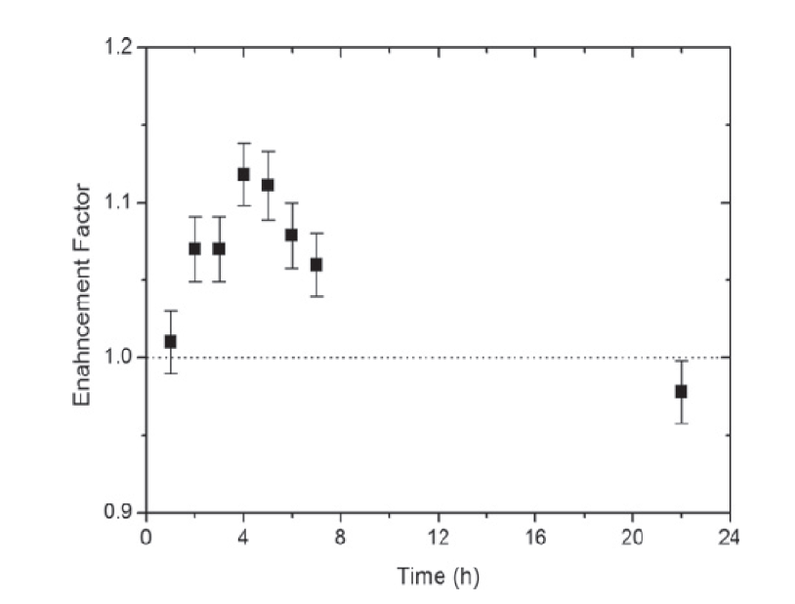


Motivation
Long duration measurements
Deuteron energy 15 keV
Zr
U_{e}=100 – 300 eV
$$U_{e}∝ \sqrt{m_{eff}}$$
impurities
crystal lattice deffects
target surface
contamination
U_{e}
U_{e}
Czerski, K., D. Weissbach, A. I. Kilic, G. Ruprecht, A. Huke, M. Kaczmarski, N. Targosz-Ślęczka, and K. Maass. “Screening and Resonance Enhancements of the 2 H(d, p) 3 H Reaction Yield in Metallic Environments.” EPL (Europhysics Letters) 113, no. 2 (January 1, 2016)
Notes:
ELBRUS labs has been investigating low energy nuclear interaction between light elements and metals.
Metals are necessary because free electrons are screening the nucleus and increasing cross-section of D+D nuclear reactions.
Probability of D+D fusion depends on screening energies Ue, because it affects the coulomb barrier (in a classical way).
Experimentally determined screening energy and therefore, the total cross section strongly depends on the number of crystal defects of the target sample.
Effective electron mass is the key to nuclear reactions are room temperature, hence our interest in the crystalline state of the sample.
The proportional equation is derived from Fermi resonance equation, we have to define what is the effect of crystal defect and mass on Ue to adapt our observations.
That's why localized electrons increase effectiveness
Large screening energies measured optically in cond mat. Ref to find

Slide 5
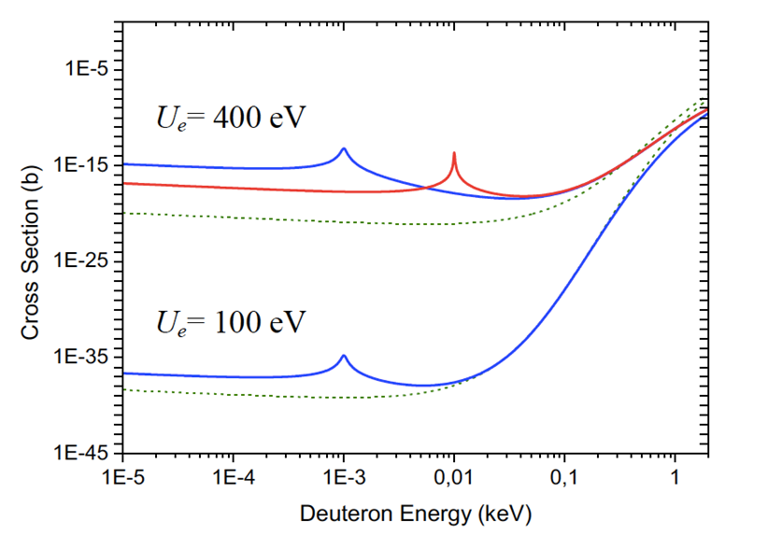

Motivation
Resonance plays an important role
Non-resonant (dotted lines) and resonant (solid lines) cross sections for Ue = 400 eV (upper part) and Ue = 100 eV (lower part). Blue lines correspond to the resonance energy of 1 eV and the red one to 10 eV. The resonance width is assumed to be 0.1 eV
=> Defects increase screening energy by 4 orders of magnitude but the cross-section improves by 20
=> The gain is in the order of 8 orders of magnitude at 400eV, only 3 at 100eV.
Czerski, Konrad. “Deuteron-Deuteron Nuclear Reactions at Extremely Low Energies.” PHYSICAL REVIEW C, 2022, 6.
Notes:
deuteron-deuteron threshold resonance in the compound 4He nucleus is necessary to explain the observed enhancement of the reaction cross section
It was observed that the total cross section strongly depends on the number of crystal defects of the target sample
Hence reinforcing the interest in exploring the defect and crystal features of the sample

Slide 6
Motivation
- Palladium with high lamination ratio shows the enhancement factor to be greatly improved at lower energy
- Uncertainty of the first dots are large and prevent a strong assessment yet
- Experiment done with tandem/inverse kinematic configuration
A. Cvetinović et al. „Electron Screening in Palladium“; Paper submitted to Physics Letters B
Notes:
Other group in CHME are exploring the effect of extreme lamination effect on modification of screening energy

Slide 7
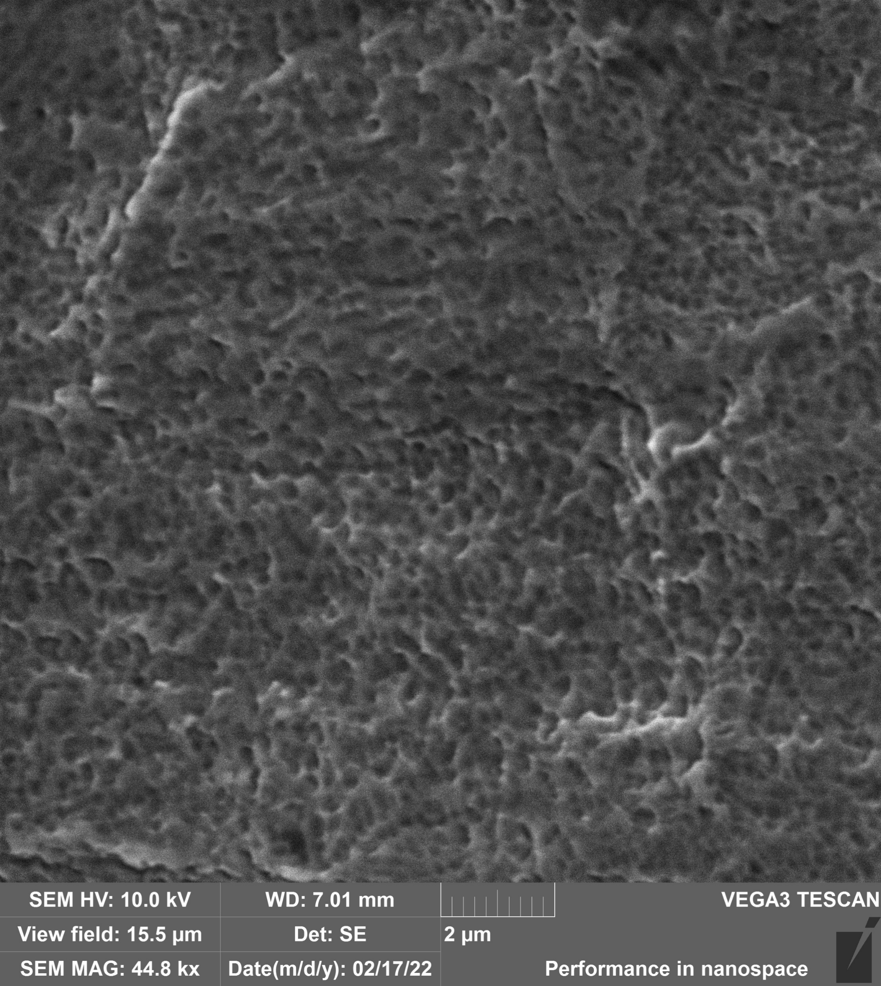
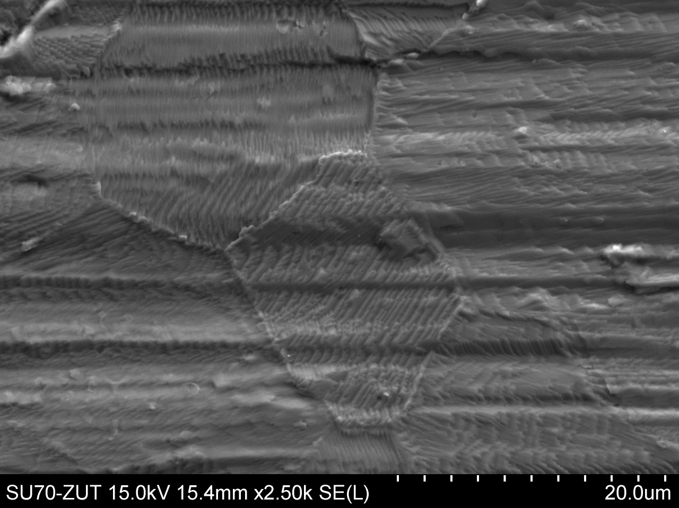
Motivation
Why Zirconium?
Zr binds deuterium very well
We are able to achieve relatively high deuteron density in a sample
We do not have to implant the entire target volume – only depths of order of
the projectile range will reach maximum deuteron density
What do we want to observe?
What defects profile after implantation of deuterium (D+, D2+), carbon and oxygen?
What hydrides are formed after implantation?
Can we see crystal lattice changes due to deuteron implantation?
Can we understand the phase transformation?
Can we anticipate the formation of specific crystal structures?

Slide 8
Motivation
Phase diagram of Zr-H system
Known crystal structure phases of the Zr-H system
Zr (rt) – α phase (hcp)
Zr (ht) – β phase (bcc)
ZrH_{1.5-1.7} – δ phase (fcc)
ZrH₂ – ε phase (fct)
Trelewicz, Jason R., Hu, Xunxiang, Mouche, Peter A., and Tang, Wei. Stability of zirconium hydride. doi:10.2172/1651341

Slide 9
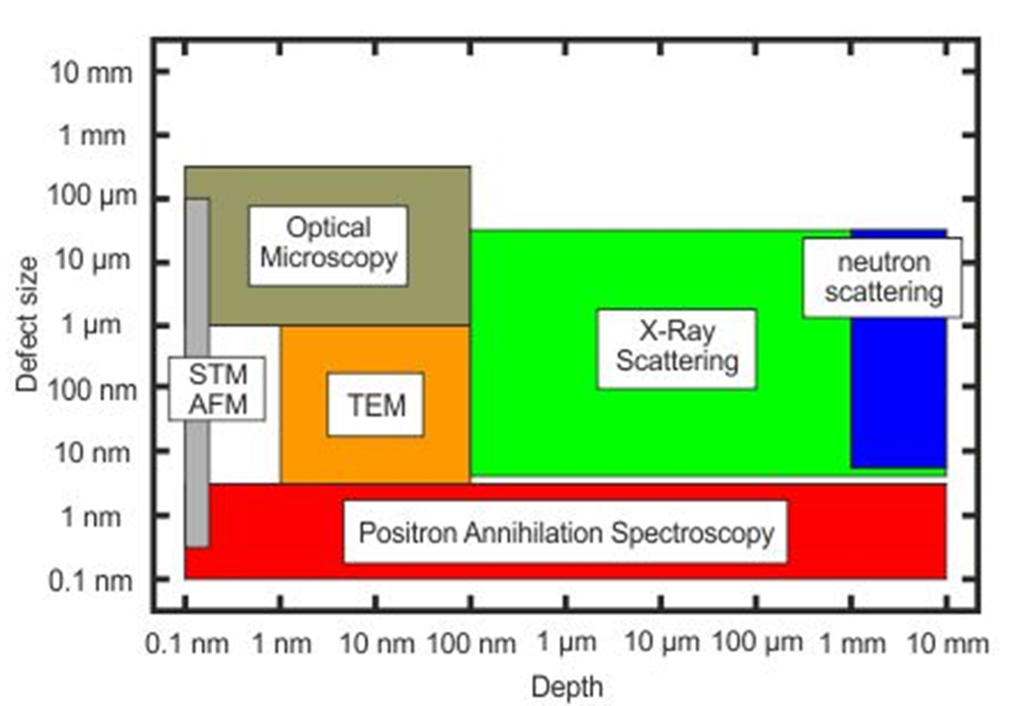
Positron Annihilation Spectroscopy (PAS)
PAS techniques allow us to find defects with the size ranging from 0.1 to 3 nm at very low concentration
PAS makes possible the detection of defects in the wide range of depths from single nanometers up to millimeters
PAS is not sensitive to local variations of the lattice constant, as in the case of X ray diffraction
Positrons directly probe vacancies and clusters with an atomic resolution that cannot be attained by TEM.
*https://www.hzdr.de/db/Cms?pNid=3581
Notes:
Main points:
- VERY sensitive, can detect low defects concentration
- Limited defect detection size
- Wide range of depth
- Ideal for what we are looking for

Slide 10
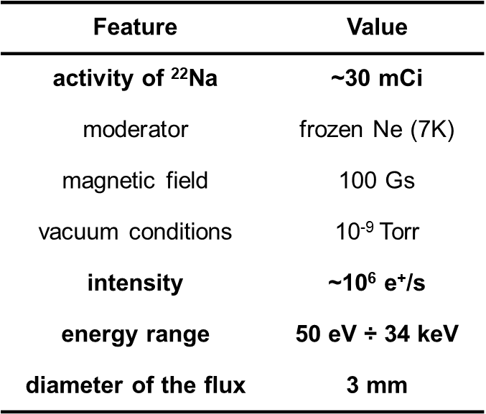
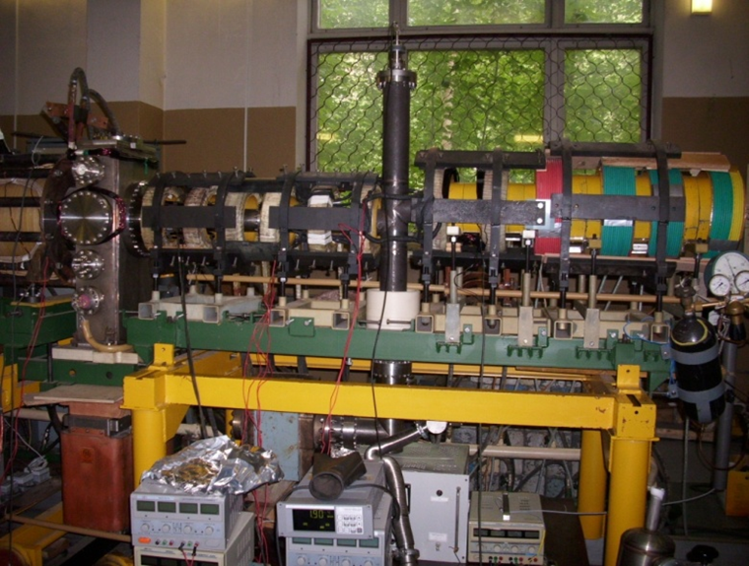
Positron Annihilation Spectroscopy (PAS)

Slide 11
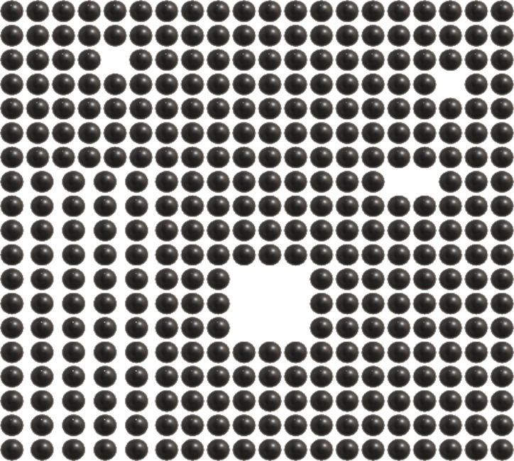
Positron Annihilation Spectroscopy (PAS)
PAS techniques
Positron Lifetime Spectroscopy (LT)
Doppler Broadening Spectroscopy (DB)
Angular correlations of gamma quanta
Possibilities
determination of defect concentration/clustering
evaluation of depth-defects profile
detection of the kind/size of defects
Applications
material failure analysis
material surface engineering
study of damage of irradiated materials
vacancy
dislocations
divacancy
cluster of
vacancies
Notes:
LT allows us to have a direct interpretation o the size of the vacancy
Deconvolution of the e+ LT values gives values of peaks and intensities
The shorter the lifetime, the smaller the defect (vac or disloc)
The peak size (in%) gives the direct concentration of each defect type

Slide 12
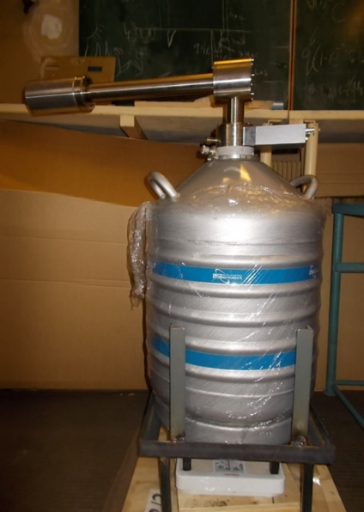
Positron Annihilation Spectroscopy (PAS)
511 keV±∆E
S parameter
ratio of the area under the central part of 511 keV line to the whole area below this line
defines the participation of e⁺e⁻ pairs with low momentum
the bigger value the bigger concentration of such defects as vacancies
W parameter
defines the participation of pairs e⁺e⁻ with high momentum
together with S parameter gives information about kind of defects
High Purity Germanium Detector
Annihilation lines for defected and non-defected samples
Notes:
Vacancies reduce broadening of the 511keV peaks. This is due to the lower loss of momenta of the electrons in vacancies.
Each peak is analyzed on the fly allow to understand the doppler broadening of the 511keV peaks.
Positron trapping model to do this analysis.
S parameter (for shape) is proportional to bigger defect concentration
W parameter (weak) produce information about the type of defect, though with limited significance

Slide 13
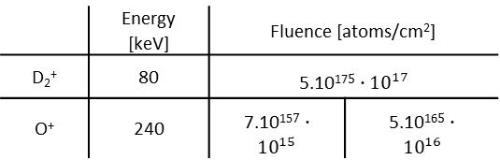
Zr-D-C system I
 | Energy [keV] | Fluence [atoms/cm²]
D₂⁺ | 80 | 5.10¹⁷$5∙10^{17}$
O⁺ | 240 | 7.10¹⁵$7∙10^{15}$ | 5.10¹⁶$5∙10^{16}$
Large increase of the vacancy density down to the deuteron range
The same depths distribution observed for targets implanted additionally with carbon
Reference sample is loaded with surface defects
Vacancy density is the same for both C fluences
=> Saturation of vacancy density?
=> Carbon is already present in the sample?
Vacancy density at large distances is smaller than for the reference sample – diffusion of vacancies towards surface?
13
Notes:
Constant error bars: Since the e+ beam is monochromatic, this technique has advantage to be independent to energy beam, and allow sustained precision in depth profile.
The first hump in the D and D+C curves is showing the surface defects have been created.
The end tail shows the bulk defects have been migrating to the surface

Slide 14
Zr-D-C system II
W parameter decreases as S increases – it confirms obtained results
Linear S(W) dependence indicates single size of defects mostly monovacancies
Spread in W=f(S) indicates reference defects are mostly dislocations
14

Slide 15
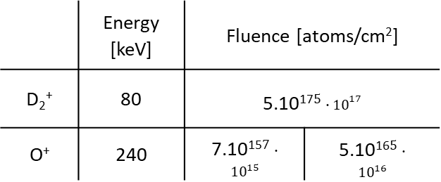
Zr-D-O system I
 | Energy [keV] | Fluence [atoms/cm²]
D₂⁺ | 80 | 5.10¹⁷$5∙10^{17}$
O⁺ | 240 | 7.10¹⁵$7∙10^{15}$ | 5.10¹⁶$5∙10^{16}$
Vacancy density for the O implanted samples is less than for D only
Vacancy density does not depend on the O fluence
Vacancy density at large distances is comparable to the reference sample
  => no diffusion of vacancies?
  => oxygen atoms binds strongly to defects?
15

Slide 16
Zr-D-O system II
W parameter decreases as S increases – it confirms obtained results
Linear S(W) dependence indicates single size of defects, mostly monovacancies
Sample | Positron difusion length L₊ [nm] | Thickness of the defected layer [nm]
reference | 19±4 | -
D | 9±3 | 504±42
D+O15 | 10±3 | 572±50
D+O16 | 10±3 | 530±48
D+C15 | 10±3 | 576±60
D+C16 | 11±3 | 541±57
L₊
Less defected sample
L₊
More defected sample
16

Slide 17
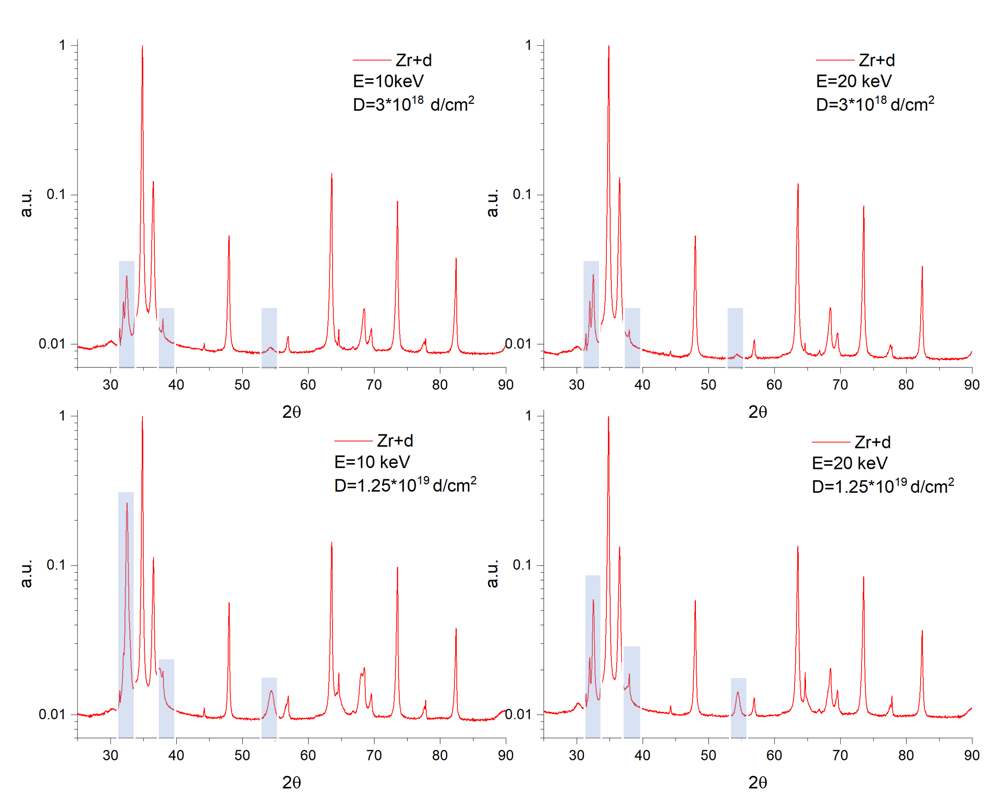
XRD spectra
Intensities of the peaks corresponding to zirconium hydrides increase with increasing fluence.
Additional peaks are more intensive for lower deuteron energy more hydrides closer to the surface.

Slide 18
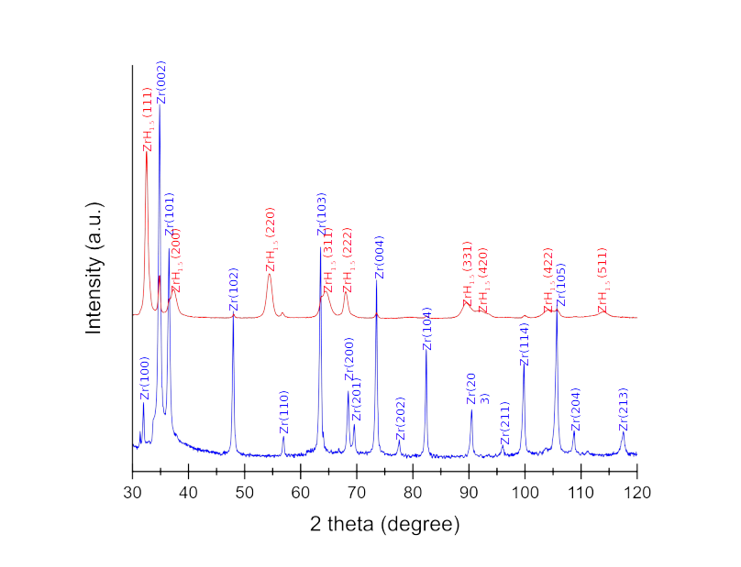
XRD spectra of Zr target exposed to D
δ phase of zirconium hydride observed (FCC), stoichiometry 1.5 after experiment
Stoichiometry estimated during nuclear experiments is 2.0
Implantation increased the number of vacancies that bind deuterium
  => experimental stoichiometry in nuclear experiments is larger than in XRD
  => This means that there is desorption after the experiment and before the measurement or XRD is unable to see the very surface of the sample (implanted surface)

Slide 19
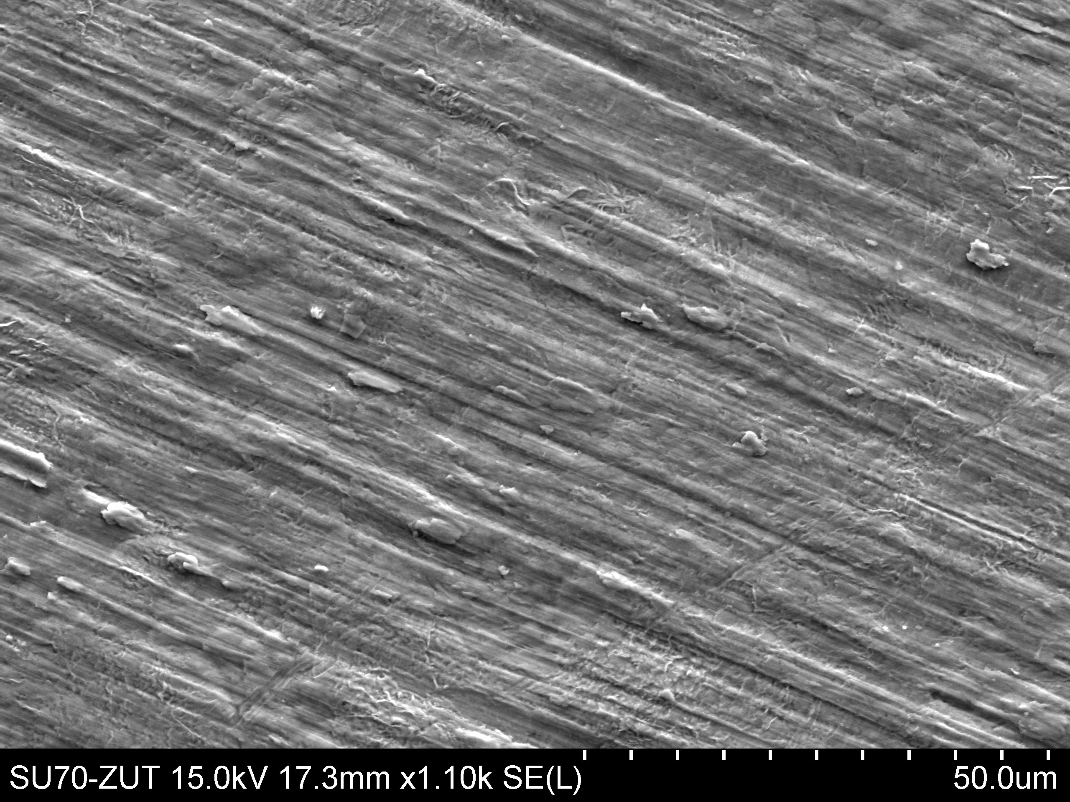
Interpretation of XRD on material changes
Significant changes of crystal structures force material to change shape
Transition from hcp-phase to bcc-phase
These phase change produce additional defects
Mimic the use of activation purpose
Makes sense to polish and pre-load the sample in the future.

Slide 20
Preloading
Phase diagram of Zr-H system
Preloading would help on multiple aspects:
Gain time on accelerator operation
Conform the material to high hydrides concentration
Better control of all the phase changes and crystalline structures
Trelewicz, Jason R., Hu, Xunxiang, Mouche, Peter A., and Tang, Wei. Stability of zirconium hydride. doi:10.2172/1651341

Slide 21
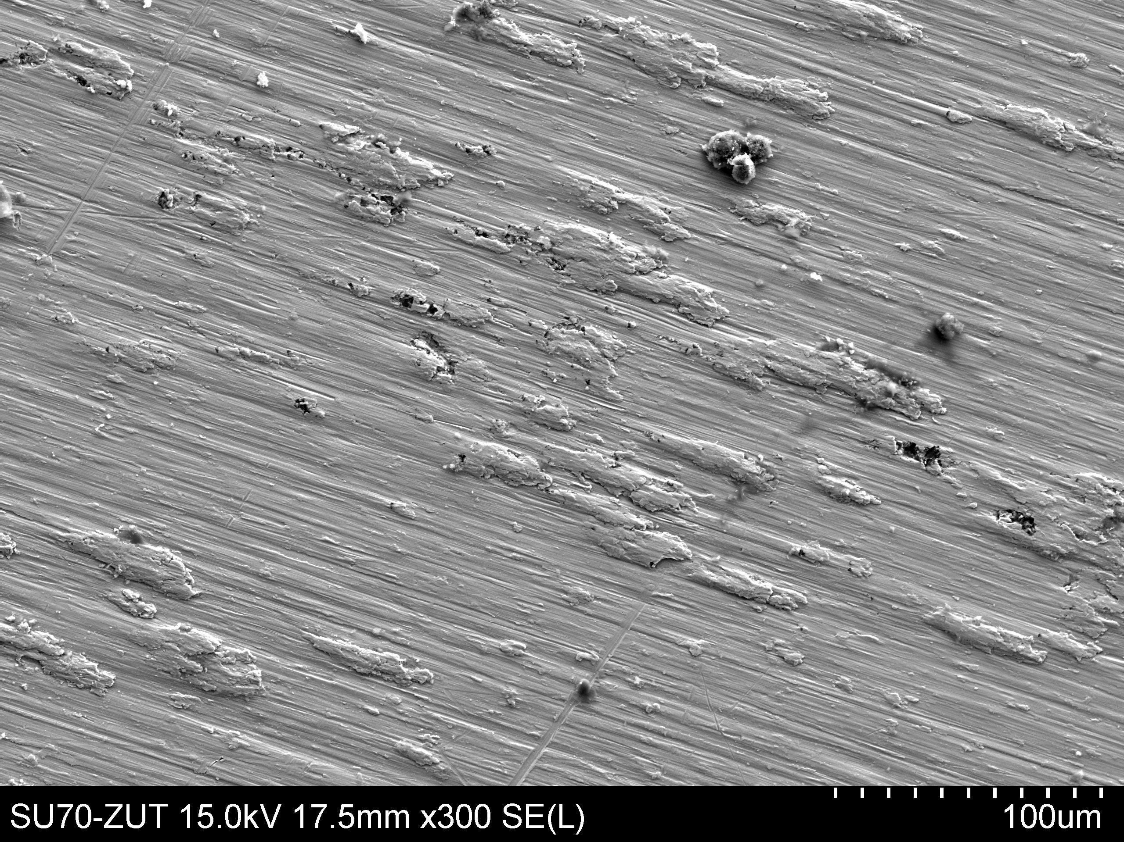
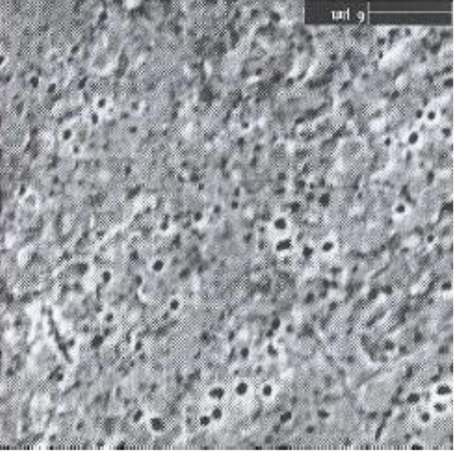
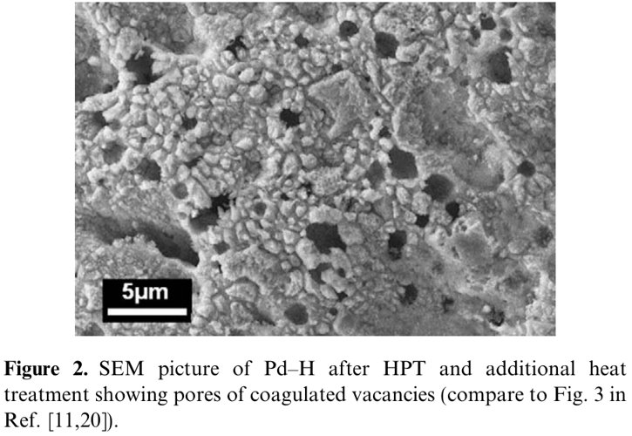
Interpretation of XRD on material changes
doi:10.1016/j.scriptamat.2009.09.025
Notes:
High concentration hydrides of Zr precipitates
Visual localization of these precipitates is easy
Right next to these precipitates, we can find abundant clusters of holes
Production of vacancies in the material
Heating up triggers their diffusion
Coalescence of the vacancies into pores
Migration of these pores to the surface of the material.

Slide 22
Conclusions
PAS and XRD are complementary diagnostic methods.
  PAS determines with high sensitivity the density of vacancies that bind deuterium atoms.
  XRD is sensitive to the change of the crystal structure as well as formation of hydrides.
  Both diagnostics are important for understanding the material features that enhance the nuclear reaction rates at room temperature.
Vacancies move towards surface during the irradiation.
XRD shows building of δ phase of zirconium hydride.
This looks like a SAV phase, but requires more work.
The larger deuteron density observed in the nuclear experiments probably is the result from binding of additional deuterons in vacancies.

Slide 23
Perspectives
Better control of the material preparation
Solving the problem of sample desorption between experiment and measurement
Future access to positron lifetime spectroscopy experiment facility
Expanding the range of metals/alloys to irradiate
Verifying the effect of carbon and oxygen on implantation on Ue
Evaluation of other contaminant (depend on the metals)
Replication of measurements of screening energies depending on metallic state
New installation to study gas-loaded powder in design as we speak

Slide 24
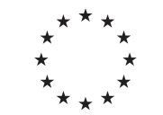
Thank you!
Any questions?
This project has received funding from the European Union’s Horizon2020
research and innovation program under grant agreement no 951974

