Slide 1
THE LANP MODEL CALIBRATION
Daniel Szumski, Independent Scholar
A Classical Physics Model
Danszumski@gmail.com
Comparison of initial isotope composition and Miley’s Isotope production rate

Slide 2
The Least Action Nuclear Process Model Fundamentals
PROCESS ENERGY
Where does the energy come from?
Where is it stored?
TRANSMUTATIONS
What kind of nuclear reactions occur?
How is the order of the nuclear reactions determined?
MODEL CALIBRATION RESULTS
Match to Miley’s Final Electrode
Energy Balance & Excess Heat
Recycle Mechanism
LANP Isotope Production
End Point of Miley’s Experiment
Danszumski@gmail.com
Comparison of initial isotope composition and Miley’s Isotope production rate

Slide 3
SOURCE OF LANP ENERGY
The Principle of Thermal Quiescence
Ni
Ni
Ni
Ni
Ni
Ni
Ni
Ni
Ni
Ni
Ni
Ni
Ni
Ni
Ni
Ni
Ni
Ni
Ni
Ni
Ni
Ni
Ni
Ni
Ni
Ni
Ni
Ni
Ni
Ni
Ni
Ni
Ni
Ni
Ni
NICLEL ELECTRODE
NICKEL LATTICE SURFACE
Ni
Ni
Ni
Ni
Ni
Ni
Ni
Ni
Ni
Ni
Ni
Ni
Ni
Ni
Ni
Ni
Ni
Ni
Ni
Ni
Ni
Ni
Ni
Ni
Ni
Ni
Ni
Ni
Ni
Ni
Ni
Ni
Ni
Ni
Ni
Ni
Ni
Ni
Ni
Ni
Ni
Ni
Ni
Ni
Ni
Ni
Ni
Ni
Ni
Ni
^{e-}
Ni
QUIETED PROTON
No kinetic energy
Ni
Ni
Ni
Ni
Ni
Ni
Ni
Ni
Ni
Ni
Ni
Ni
Ni
Ni
Ni
Ni
Ni
Ni
Ni
Ni
Ni
Ni
Ni
^{e-}
Ni
Ni
Ni
Ni
Ni
Ni
Ni
Ni
Ni
Ni
Ni
Ni
Ni
Ni
Ni
Ni
Ni
Ni
Ni
Ni
^{e-}
Ni
Ni
Ni
Ni
Ni
Ni
Ni
Ni
Ni
Ni
Ni
Ni
Ni
Ni
Ni
Ni
Ni
^{e-}
Ni
Ni
Ni
Ni
^{e-}
Ni
Ni
Ni
Ni
Ni
Ni
Ni
Ni
Ni
PROTON KINETIC ENERGY
Ni
Danszumski@gmail.com
An interesting calculation

Slide 4
SOURCE OF LANP ENERGY
Ni
Ni
Ni
Ni
Ni
Ni
Ni
Ni
Ni
Ni
Ni
Ni
Ni
Ni
Ni
Ni
Ni
Ni
Ni
Ni
Ni
Ni
Ni
Ni
Ni
Ni
Ni
Ni
Ni
Ni
Ni
Ni
Ni
Ni
Ni
NICLEL ELECTRODE
NICKEL LATTICE SURFACE
Ni
Ni
Ni
Ni
Ni
Ni
Ni
Ni
Ni
Ni
Ni
Ni
Ni
Ni
Ni
Ni
Ni
Ni
Ni
Ni
Ni
Ni
Ni
Ni
Ni
Ni
Ni
Ni
Ni
Ni
Ni
Ni
Ni
Ni
Ni
Ni
Ni
Ni
Ni
Ni
Ni
Ni
Ni
Ni
Ni
Ni
Ni
Ni
Ni
Ni
^{e-}
Ni
QUIETED PROTON
No kinetic energy
Ni
Ni
Ni
Ni
Ni
Ni
Ni
Ni
Ni
Ni
Ni
Ni
Ni
Ni
Ni
Ni
Ni
Ni
Ni
Ni
Ni
Ni
Ni
^{e-}
Ni
Number of Atomic Layers required
for $d^{2}−d^{2}$ fusion
Ni
Ni
Ni
Ni
Ni
Ni
Ni
Ni
Ni
Ni
Ni
Ni
Ni
Ni
Ni
Ni
Ni
Ni
Ni
^{e-}
Ni
Ni
Ni
Ni
Ni
Ni
Deuteron
Velocity
2.0 cm/sec
0.2 cm/sec
Number of
Atomic Layers
1
100
Ni
Ni
Ni
Ni
Ni
Ni
Ni
Ni
Ni
Ni
Ni
^{e-}
Ni
Ni
Ni
Ni
^{e-}
Ni
Ni
Ni
Ni
Ni
Ni
Ni
Ni
Ni
PROTON KINETIC ENERGY
Ni
Calculation verified by David Kidwell
At Naval Research Lab
Danszumski@gmail.com

Slide 5
COLD FUSION TRANSMUTATIONS ARE A TWO STEP PROCESS
FIRST TRANSMUTATION STEP - FUSION
nº
nº
p⁺
p⁺
nº
p⁺
p⁺
nº
p⁺
p⁺
nº
+
nº
p⁺
p⁺
nº
+
nº
p⁺
+
Energy
nº
p⁺
nº
p⁺
nº
p⁺
nº
p⁺
nº
p⁺
p⁺
nº
p⁺
nº
p⁺
p⁺
nº
p⁺
nº
nº
p⁺
nº
Harvesting of Kinetic Energy from Environment
Causes
Electrode Internal Energy Continually Increases
Danszumski@gmail.com

Slide 6
COLD FUSION TRANSMUTATIONS ARE A TWO STEP PROCESS
FIRST TRANSMUTATION STEP - FUSION
nº
nº
p⁺
p⁺
nº
p⁺
p⁺
nº
p⁺
p⁺
nº
+
nº
p⁺
p⁺
nº
+
nº
p⁺
+
Energy
nº
p⁺
nº
p⁺
nº
p⁺
nº
p⁺
nº
p⁺
p⁺
nº
p⁺
nº
p⁺
p⁺
nº
p⁺
nº
nº
p⁺
nº
Electrode Internal Energy Continually Increases
Danszumski@gmail.com

Slide 7
COLD FUSION TRANSMUTATIONS ARE A TWO STEP PROCESS
FIRST TRANSMUTATION STEP - FUSION
nº
nº
p⁺
p⁺
nº
p⁺
p⁺
nº
p⁺
p⁺
nº
+
nº
p⁺
p⁺
nº
+
nº
p⁺
+
Energy
nº
p⁺
nº
p⁺
nº
p⁺
nº
p⁺
nº
p⁺
p⁺
nº
p⁺
nº
p⁺
p⁺
nº
p⁺
nº
nº
p⁺
nº
Electrode Internal Energy Continually Increases
Danszumski@gmail.com

Slide 8
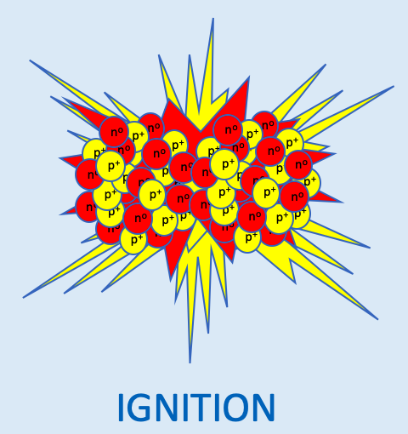
COLD FUSION TRANSMUTATIONS ARE A TWO STEP PROCESS
FIRST TRANSMUTATION STEP - FUSION
nº
nº
p⁺
nº
p⁺
p⁺
p⁺
nº
nº
p⁺
p⁺
nº
nº
p⁺
p⁺
p⁺
nº
p⁺
p⁺
nº
p⁺
nº
+
p⁺
nº
p⁺
nº
+
nº
p⁺
+
p⁺
p⁺
+/- Energy
nº
p⁺
Energy
nº
p⁺
nº
+
nº
p⁺
nº
nº
p⁺
p⁺
nº
p⁺
nº
p⁺
nº
p⁺
p⁺
p⁺
p⁺
nº
p⁺
nº
nº
p⁺
nº
p⁺
nº
p⁺
p⁺
nº
p⁺
nº
nº
p⁺
nº
p⁺
p⁺
nº
p⁺
nº
p⁺
nº
p⁺
nº
nº
nº
FUSION
Danszumski@gmail.com

Slide 9
COLD FUSION TRANSMUTATIONS ARE A TWO STEP PROCESS
FIRST TRANSMUTATION STEP - FUSION
nº
nº
p⁺
nº
p⁺
p⁺
p⁺
nº
nº
p⁺
p⁺
nº
nº
p⁺
p⁺
p⁺
nº
p⁺
p⁺
nº
p⁺
nº
+
p⁺
nº
p⁺
nº
+
nº
p⁺
+
p⁺
p⁺
+/- Energy
nº
p⁺
Energy
nº
p⁺
nº
+
nº
p⁺
nº
nº
p⁺
p⁺
nº
p⁺
nº
p⁺
nº
p⁺
p⁺
p⁺
p⁺
nº
p⁺
nº
nº
p⁺
nº
p⁺
nº
p⁺
p⁺
nº
p⁺
nº
nº
p⁺
nº
p⁺
p⁺
nº
p⁺
nº
p⁺
nº
p⁺
nº
nº
nº
SECOND TRANSMUTATION STEP – LANP DECAY
p⁺
nº
p⁺
+
(He-4)
nº
nº
nº
p⁺
p⁺
nº
nº
p⁺
p⁺
p⁺
p⁺
nº
nº
p⁺
p⁺
p⁺
nº
+
p⁺
p⁺
nº
nº
p⁺
nº
nº
p⁺
p⁺
nº
+
+ Energy
nº
p⁺
p⁺
p⁺
p⁺
nº
p⁺
nº
p⁺
nº
p⁺
nº
p⁺
nº
p⁺
nº
nº
p⁺
nº
p⁺
p⁺
nº
p⁺
p⁺
p⁺
nº
p⁺
nº
nº
nº
nº
p⁺
nº
p⁺
nº
Followed by: RARE ISOTOPE DECAY PROCESSES – theoretically possible / unlikely
and/or NUCLEAR FISSION – Theoretically capable of spontaneous fission
Danszumski@gmail.com

Slide 10
What is a Least Action Nuclear Process?
The process is Nuclear
&
Every next step in the process is determined
by the Principle of Least Action…
… The smallest mass/energy change
All of the possible next steps
Danszumski@gmail.com

Slide 11
Complex Nuclear Reaction
Nickel-58 + Silver-107 + 1 Neutron => Rhenium-166
${}_{47}^{107}{Ag}+{}_{28}^{58}{Ni+{}_{0}^{1}n}\underset{→}{fusion}$ ${}_{75}^{166}{Re}\underset{→}{β^{+}}$ ${}_{74}^{166}W \underset{→}{β^{+}}$ ${}_{73}^{166}{Ta}\underset{→}{β^{+}}$ ${}_{72}^{166}{Hf}\underset{→}{β^{+}}$ ${}_{71}^{166}{Lu}\underset{→}{β^{+}}$ ${}_{70}^{166}{Yb}\underset{→}{EC}$ ${}_{69}^{166}{Tm}\underset{→}{β^{+}}{}_{68}^{166}{Er}$
α
α
Erbium
α
${}_{73}^{162}{Ta}\underset{→}{β^{+}}$ ${}_{72}^{162}{Hf}$
$${}_{66}^{162}{Dy}$$
Hafnium
Dysprosium
α
6 STABLE
END PRODUCTS
Decay Key
${}_{71}^{158}{Lu}\underset{→}{β^{+}}$ ${}_{70}^{158}{Yb}\underset{→}{β^{+}}$ ${}_{69}^{158}{Tm}\underset{→}{β^{+}}{}_{68}^{158}{Er\underset{→}{EC}{}_{67}^{158}{Ho}\underset{→}{β^{+}}}{}_{66}^{158}{Dy}$
β⁻
α
α
Dysprosium
β⁺
, EC
$${}_{69}^{154}{Tm}\underset{→}{β^{+}}{}_{68}^{154}{Er\underset{→}{β^{+}}{}_{67}^{154}{Ho}\underset{→}{β^{+}}}{}_{66}^{154}{Dy}\underset{→}{{ β}^{+}β^{+} } {}_{64}^{154}{Gd}$$
α
α
α
α
Gadolinium
$${}_{67}^{150}{Ho}\underset{→}{β^{+}} {}_{66}^{150}{Dy}\underset{→}{β^{+}} {}_{65}^{150}{Tb}\underset{→}{β^{+}} {}_{64}^{150}{Gd}\underset{→}{{ β}^{+}β^{+} }{}_{62}^{150}{Sm}$$
α
α
Samarium
31 Isotopes
25 Intermediate radioactive isotopes
6 stable isotopes
$${}_{64}^{146}{Gd}\underset{→}{EC} {}_{63}^{146}{Eu}\underset{→}{β^{+}}{}_{62}^{146}{Sm}$$
α
$${}_{60}^{142}{Nd}$$
Neodymium
Danszumski@gmail.com
Comparison of initial isotope composition and Miley’s Isotope production rate

Slide 12
Complex Nuclear Reaction
${}_{47}^{107}{Ag}+{}_{28}^{58}{Ni+{}_{0}^{1}n}\underset{→}{fusion}$ ${}_{75}^{166}{Re}\underset{→}{β^{+}}$ ${}_{74}^{166}W \underset{→}{β^{+}}$ ${}_{73}^{166}{Ta}\underset{→}{β^{+}}$ ${}_{72}^{166}{Hf}\underset{→}{β^{+}}$ ${}_{71}^{166}{Lu}\underset{→}{β^{+}}$ ${}_{70}^{166}{Yb}\underset{→}{EC}$ ${}_{69}^{166}{Tm}\underset{→}{β^{+}}{}_{68}^{166}{Er}$
THERE CAN BE ONLY ONE
TRANSMUTATION THAT
SATISFIES THE SMALLEST
MASS/ENERGY CONSTRAINT
OF THE
PRINCIPLE OF LEAST ACTION]
α
α
Erbium
α
${}_{73}^{162}{Ta}\underset{→}{β^{+}}$ ${}_{72}^{162}{Hf}$
$${}_{66}^{162}{Dy}$$
Hafnium
α
Decay Key
${}_{71}^{158}{Lu}\underset{→}{β^{+}}$ ${}_{70}^{158}{Yb}\underset{→}{β^{+}}$ ${}_{69}^{158}{Tm}\underset{→}{β^{+}}{}_{68}^{158}{Er\underset{→}{EC}{}_{67}^{158}{Ho}\underset{→}{β^{+}}}{}_{66}^{158}{Dy}$
β⁻
α
α
Dysprosium
β⁺
, EC
$${}_{69}^{154}{Tm}\underset{→}{β^{+}}{}_{68}^{154}{Er\underset{→}{β^{+}}{}_{67}^{154}{Ho}\underset{→}{β^{+}}}{}_{66}^{154}{Dy}\underset{→}{{ β}^{+}β^{+} } {}_{64}^{154}{Gd}$$
α
α
α
α
Gadolinium
$${}_{67}^{150}{Ho}\underset{→}{β^{+}} {}_{66}^{150}{Dy}\underset{→}{β^{+}} {}_{65}^{150}{Tb}\underset{→}{β^{+}} {}_{64}^{150}{Gd}\underset{→}{{ β}^{+}β^{+} }{}_{62}^{150}{Sm}$$
α
α
Samarium
31 Isotopes
25 Intermediate radioactive isotopes
6 stable isotopes
$${}_{64}^{146}{Gd}\underset{→}{EC} {}_{63}^{146}{Eu}\underset{→}{β^{+}}{}_{62}^{146}{Sm}$$
α
$${}_{60}^{142}{Nd}$$
Neodymium
Danszumski@gmail.com

Slide 13
Complex Nuclear Reaction
Least
Action
Pathway
THIS IS THE LEAST ACTION DECAY PATH
IT MAKES THE PROCESS
ABSOLUTELY DETERMINISTIC
[The Hallmark of Classical Physics]
${}_{47}^{107}{Ag}+{}_{28}^{58}{Ni+{}_{0}^{1}n}\underset{→}{fusion}$ ${}_{75}^{166}{Re}\underset{→}{β^{+}}$ ${}_{74}^{166}W \underset{→}{β^{+}}$ ${}_{73}^{166}{Ta}\underset{→}{β^{+}}$ ${}_{72}^{166}{Hf}\underset{→}{β^{+}}$ ${}_{71}^{166}{Lu}\underset{→}{β^{+}}$ ${}_{70}^{166}{Yb}\underset{→}{EC}$ ${}_{69}^{166}{Tm}\underset{→}{β^{+}}{}_{68}^{166}{Er}$
α
α
Erbium
α
${}_{73}^{162}{Ta}\underset{→}{β^{+}}$ ${}_{72}^{162}{Hf}$
$${}_{66}^{162}{Dy}$$
Hafnium
α
Decay Key
${}_{71}^{158}{Lu}\underset{→}{β^{+}}$ ${}_{70}^{158}{Yb}\underset{→}{β^{+}}$ ${}_{69}^{158}{Tm}\underset{→}{β^{+}}{}_{68}^{158}{Er\underset{→}{EC}{}_{67}^{158}{Ho}\underset{→}{β^{+}}}{}_{66}^{158}{Dy}$
β⁻
α
α
Dysprosium
β⁺
, EC
$${}_{69}^{154}{Tm}\underset{→}{β^{+}}{}_{68}^{154}{Er\underset{→}{β^{+}}{}_{67}^{154}{Ho}\underset{→}{β^{+}}}{}_{66}^{154}{Dy}\underset{→}{{ β}^{+}β^{+} } {}_{64}^{154}{Gd}$$
α
α
α
α
Gadolinium
$${}_{67}^{150}{Ho}\underset{→}{β^{+}} {}_{66}^{150}{Dy}\underset{→}{β^{+}} {}_{65}^{150}{Tb}\underset{→}{β^{+}} {}_{64}^{150}{Gd}\underset{→}{{ β}^{+}β^{+} }{}_{62}^{150}{Sm}$$
α
α
Samarium
31 Isotopes
25 Intermediate radioactive isotopes
6 stable isotopes
$${}_{64}^{146}{Gd}\underset{→}{EC} {}_{63}^{146}{Eu}\underset{→}{β^{+}}{}_{62}^{146}{Sm}$$
α
$${}_{60}^{142}{Nd}$$
Neodymium
Danszumski@gmail.com

Slide 14
How is cold fusion energy stored?
The energy is localization is between covalent nuclei
where a single gamma energy photon is resonant
between adjacent nuclei
The localization is Mossbauer Resonance
It is a reversible thermodynamic process
Think of it as a covalent bond between electrons
It produces a work product: covalent bond
It consumes no energy
It emits no exhaust
It produces no entropy change
it is perpetual
Danszumski@gmail.com

Slide 15
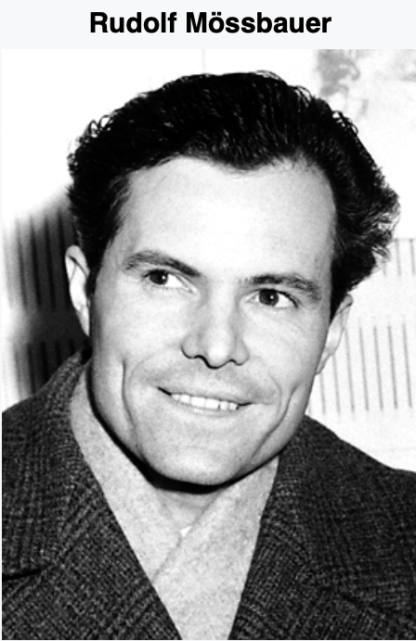
MöSSBAUER RESONANCE
$$E_{γ}=hν_{γ}$$
nº
nº
p⁺
p⁺
nº
Gamma
Emitter
p⁺
p⁺
nº
nº
p⁺
p⁺
nº
p⁺
nº
p⁺
Indium-191 nucleus
p⁺
nº
p⁺
nº
nº
p⁺
nº
p⁺
p⁺
nº
p⁺
nº
Absorbed Gamma
1957 Discovery of recoilless nuclear resonance fluorescence,
Danszumski@gmail.com

Slide 16
MöSSBAUER RESONANCE
$$E_{γ}=hν_{γ}$$
nº
nº
p⁺
p⁺
nº
p⁺
p⁺
nº
Gamma
Detector
nº
p⁺
p⁺
nº
p⁺
nº
p⁺
Indium-191 nucleus
p⁺
nº
p⁺
nº
nº
p⁺
nº
p⁺
p⁺
nº
p⁺
nº
Emitted Gamma
1957 Discovery of recoilless nuclear resonance fluorescence ,
Danszumski@gmail.com
Danszumski@gmail.com

Slide 17
MöSSBAUER RESONANCE
$$E_{γ}=hν_{γ}$$
nº
nº
p⁺
p⁺
nº
p⁺
p⁺
nº
Gamma
Detector
nº
p⁺
p⁺
nº
p⁺
nº
p⁺
Indium-191 nucleus
p⁺
nº
p⁺
nº
nº
p⁺
nº
p⁺
p⁺
nº
p⁺
nº
Mössbauer discovered:
Emitted Gamma $≡Absorbed$ Gamma
No Energy Change
No Entropy Change
1957 Discovery of recoilless nuclear resonance fluorescence ,
1961 Nobel Prize in Physics
Danszumski@gmail.com
Danszumski@gmail.com

Slide 18
Let me advance our understanding
of Mossbauer’s discovery?
i.e. energy storage
Danszumski@gmail.com

Slide 19
MöSSBAUER RESONANCE
$$E_{γ}=hν_{γ}$$
nº
nº
p⁺
p⁺
nº
p⁺
p⁺
nº
nº
p⁺
p⁺
nº
p⁺
nº
p⁺
p⁺
nº
p⁺
nº
nº
p⁺
nº
p⁺
p⁺
nº
p⁺
nº
Replace Emitter with a
Nucleus that Emits a Gamma Photon
Danszumski@gmail.com

Slide 20
MöSSBAUER RESONANCE
$$E_{γ}=hν_{γ}$$
nº
nº
nº
nº
p⁺
p⁺
p⁺
p⁺
nº
nº
p⁺
p⁺
nº
p⁺
p⁺
nº
nº
p⁺
p⁺
nº
nº
p⁺
p⁺
nº
p⁺
p⁺
nº
p⁺
nº
p⁺
p⁺
nº
p⁺
nº
p⁺
nº
p⁺
nº
nº
p⁺
nº
p⁺
p⁺
nº
p⁺
nº
p⁺
p⁺
nº
p⁺
nº
nº
p⁺
nº
Replace the Detector
with an identical Nucleus
Danszumski@gmail.com

Slide 21
ENERGY STORAGE BETWEEN NUCLEI
$$E=hν$$
nº
nº
nº
nº
p⁺
p⁺
p⁺
p⁺
nº
nº
p⁺
p⁺
nº
p⁺
p⁺
nº
nº
p⁺
p⁺
nº
nº
p⁺
p⁺
nº
p⁺
p⁺
nº
p⁺
nº
p⁺
p⁺
nº
p⁺
nº
p⁺
nº
p⁺
nº
nº
p⁺
nº
p⁺
p⁺
nº
p⁺
nº
p⁺
p⁺
nº
p⁺
nº
nº
p⁺
nº
That Absorbs the Gamma Photon
Without any Change…
Danszumski@gmail.com

Slide 22
ENERGY STORAGE BETWEEN NUCLEI
$$E=hν$$
nº
nº
nº
nº
p⁺
p⁺
p⁺
p⁺
nº
nº
p⁺
p⁺
nº
p⁺
p⁺
nº
nº
p⁺
p⁺
nº
nº
p⁺
p⁺
nº
p⁺
p⁺
nº
p⁺
nº
p⁺
p⁺
nº
p⁺
nº
p⁺
nº
p⁺
nº
nº
p⁺
nº
p⁺
p⁺
nº
p⁺
nº
p⁺
p⁺
nº
p⁺
nº
nº
p⁺
nº
… and Re-emits It, Again
Without any Change…
Danszumski@gmail.com

Slide 23
ENERGY STORAGE BETWEEN NUCLEI
$$E=hν$$
nº
nº
nº
nº
p⁺
p⁺
p⁺
p⁺
nº
nº
p⁺
p⁺
nº
p⁺
p⁺
nº
nº
p⁺
p⁺
nº
nº
p⁺
p⁺
nº
p⁺
p⁺
nº
p⁺
nº
p⁺
p⁺
nº
p⁺
nº
p⁺
nº
p⁺
nº
nº
p⁺
nº
p⁺
p⁺
nº
p⁺
nº
p⁺
p⁺
nº
p⁺
nº
nº
p⁺
nº
And … It Is Completely Absorbed
by the original Nucleus…
Danszumski@gmail.com

Slide 24
ENERGY STORAGE BETWEEN NUCLEI
$$E=hν$$
nº
nº
nº
nº
p⁺
p⁺
p⁺
p⁺
nº
nº
p⁺
p⁺
nº
p⁺
p⁺
nº
nº
p⁺
p⁺
nº
nº
p⁺
p⁺
nº
p⁺
p⁺
nº
p⁺
nº
p⁺
p⁺
nº
p⁺
nº
p⁺
nº
p⁺
nº
nº
p⁺
nº
p⁺
p⁺
nº
p⁺
nº
p⁺
p⁺
nº
p⁺
nº
nº
p⁺
nº
… And Re-emits It, Again
Without any Change…
Danszumski@gmail.com

Slide 25
ENERGY STORAGE BETWEEN NUCLEI
$$E=hν$$
nº
nº
nº
nº
p⁺
p⁺
p⁺
p⁺
nº
nº
p⁺
p⁺
nº
p⁺
p⁺
nº
nº
p⁺
p⁺
nº
nº
p⁺
p⁺
nº
p⁺
p⁺
nº
p⁺
nº
p⁺
p⁺
nº
p⁺
nº
p⁺
nº
p⁺
nº
nº
p⁺
nº
p⁺
p⁺
nº
p⁺
nº
p⁺
p⁺
nº
p⁺
nº
nº
p⁺
nº
…And so on, indefinitely.
Danszumski@gmail.com

Slide 26
What are the consequences of energy localization
between nuclei?
Proton loading continually increases the internal energy in the cathode.
Loading increases the energy of the gamma photons between nuclei.
This has profound consequences.
Illustrate
Danszumski@gmail.com

Slide 27
Consequence of Increasing
Energy Storage Between Nuclei
nº
nº
nº
nº
p⁺
p⁺
p⁺
p⁺
nº
nº
p⁺
p⁺
nº
p⁺
p⁺
nº
nº
p⁺
p⁺
nº
nº
p⁺
p⁺
nº
p⁺
p⁺
nº
p⁺
nº
p⁺
p⁺
nº
p⁺
nº
p⁺
nº
p⁺
nº
nº
p⁺
nº
p⁺
p⁺
nº
p⁺
nº
p⁺
p⁺
nº
p⁺
nº
nº
p⁺
nº
LOG TEMP
(⁰K)
V ₁
V ₂
V ₃
FREQUENCY – t⁻¹
Danszumski@gmail.com

Slide 28
Consequence of Increasing
Energy Storage Between Nuclei
nº
nº
nº
nº
p⁺
p⁺
p⁺
p⁺
nº
nº
p⁺
p⁺
nº
p⁺
p⁺
nº
nº
p⁺
p⁺
nº
nº
p⁺
p⁺
nº
p⁺
p⁺
nº
p⁺
nº
p⁺
p⁺
nº
p⁺
nº
p⁺
nº
p⁺
nº
nº
p⁺
nº
p⁺
p⁺
nº
p⁺
nº
p⁺
p⁺
nº
p⁺
nº
nº
p⁺
nº
LOG TEMP
(⁰K)
V ₁
V ₂
V ₃
FREQUENCY – t⁻¹
Danszumski@gmail.com

Slide 29
Consequence of Increasing
Energy Storage Between Nuclei
nº
nº
nº
nº
p⁺
p⁺
p⁺
p⁺
nº
nº
p⁺
p⁺
nº
p⁺
p⁺
nº
nº
p⁺
p⁺
nº
nº
p⁺
p⁺
nº
p⁺
p⁺
nº
p⁺
nº
p⁺
p⁺
nº
p⁺
nº
p⁺
nº
p⁺
nº
nº
p⁺
nº
p⁺
p⁺
nº
p⁺
nº
p⁺
p⁺
nº
p⁺
nº
nº
p⁺
nº
LOG TEMP
(⁰K)
V ₁
V ₂
V ₃
FREQUENCY – t⁻¹
Danszumski@gmail.com

Slide 30
Consequence of Increasing
Energy Storage Between Nuclei
nº
nº
nº
nº
p⁺
p⁺
p⁺
p⁺
nº
nº
p⁺
p⁺
nº
p⁺
p⁺
nº
nº
p⁺
p⁺
nº
nº
p⁺
p⁺
nº
p⁺
p⁺
nº
p⁺
nº
p⁺
p⁺
nº
p⁺
nº
p⁺
nº
p⁺
nº
nº
p⁺
nº
p⁺
p⁺
nº
p⁺
nº
p⁺
p⁺
nº
p⁺
nº
nº
p⁺
nº
LOG TEMP
(⁰K)
V ₁
V ₂
V ₃
FREQUENCY – t⁻¹
Danszumski@gmail.com

Slide 31
Consequence of Increasing
Energy Storage Between Nuclei
nº
nº
nº
nº
p⁺
p⁺
p⁺
p⁺
nº
nº
p⁺
p⁺
nº
p⁺
p⁺
nº
nº
p⁺
p⁺
nº
nº
p⁺
p⁺
nº
p⁺
p⁺
nº
p⁺
nº
p⁺
p⁺
nº
p⁺
nº
p⁺
nº
p⁺
nº
nº
p⁺
nº
p⁺
p⁺
nº
p⁺
nº
p⁺
p⁺
nº
p⁺
nº
nº
p⁺
nº
LOG TEMP
IGNITION
(⁰K)
V ₁
V ₂
V ₃
FREQUENCY – t⁻¹
Danszumski@gmail.com

Slide 32
How well does a model like this work?
Will it predict Miley’s finale electrode composition?
New isotope appearance?
Order of isotope appearance?
Excess heat?
Are there unexpected results?
Recycle
Experimental end point
Nuclei production rates
How the LANP Model work?
Danszumski@gmail.com

Slide 33
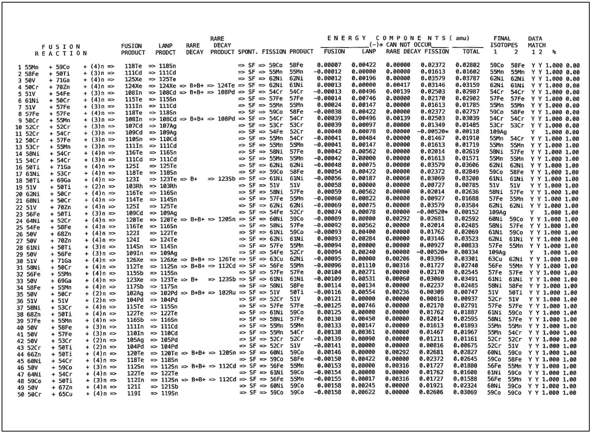
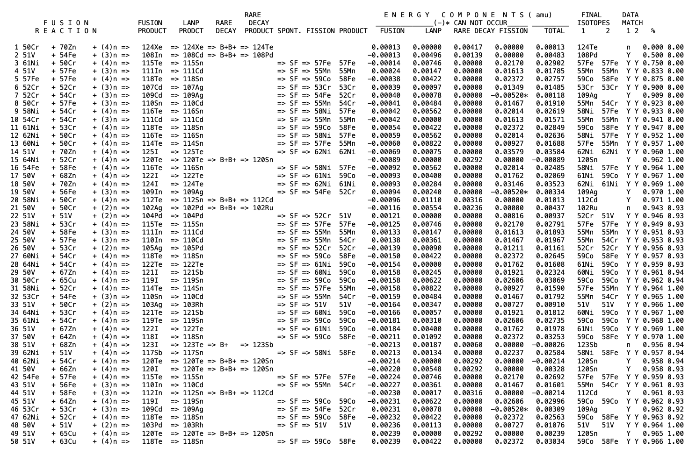
ALL OF THE POSSIBLE FUSION REACTIONS
Order by FUSION ENERGY THRESHOLD
CALCULATED ENERGY BALANCE
CALIBRATION
MATCH TO MILEY?
Danszumski@gmail.com

Slide 34
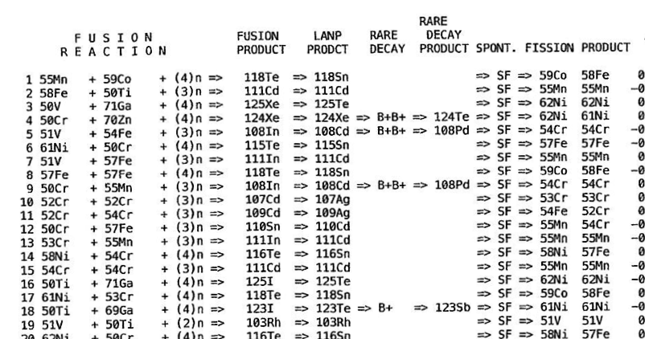
Fusion
Danszumski@gmail.com

Slide 35
Least Action Decay
Rare $β^{+}$ $β^{+}$ Decay
Danszumski@gmail.com

Slide 36
Spontaneous Fission
Danszumski@gmail.com

Slide 37
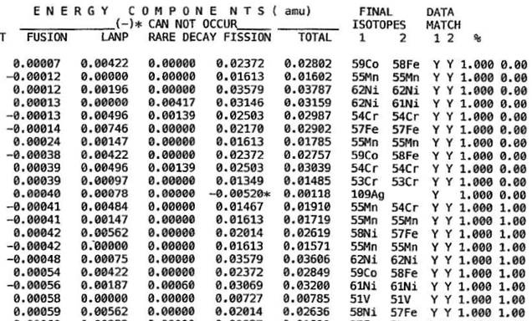
Pd-108
Reaction’s
Energy
Threshold
Step 1
Decay Process can only
be Exo-thermal
Step 2
Excess
Heat
Example: Match to
Cr-54 & Cr-54
In Final Electrode

Slide 38
Step 1
Step 2
Excess
Heat
First New isotopes
In Final Electrode
Mn-55
Co-59
Additional Energy
Cannot Be Added
in Step 2
$$Σ=0.2744, n=19$$
$$E_{aver}=0.0144amu$$
$=$ 2.69 watts
66% Recycle
Danszumski@gmail.com
Two Steps

Slide 39
What is Miley’s Electrode Telling Us?
Single 1000 Ni bead electrode => 2-4 watts , 12 days
LANP Process is strictly sequential
Danszumski@gmail.com

Slide 40
What is Miley’s Electrode Telling Us?
Single 1000 Ni bead electrode => 2-4 watts , 12 days
Process is strictly sequential
How Do You Amplify the Excess Heat?
1000 Single bead Electrodes 2-4 K-watts , ½ hour
Think: Rossi Experiment
Danszumski@gmail.com

Slide 41
What Other Experment Should We Be Doing?
99.99% pure Ni-58
99.999% pure mono-isotopic Element: i.e. Sc As
Frequent sampling
Monitor: New isotopes appearance
Order of new isotope appearance
Check against LANP order of appearance
Danszumski@gmail.com

Slide 42
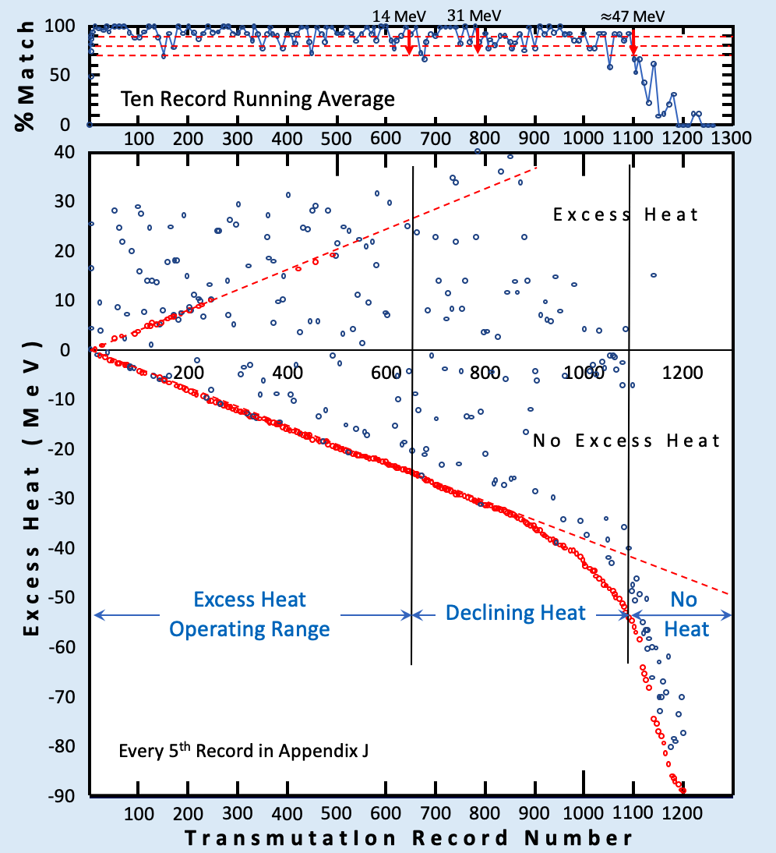
Either Rare Decay or Fission
Danszumski@gmail.com

Slide 43
Either Rare Decay or Fission
Both Rare Decay and Fission
Danszumski@gmail.com

Slide 44
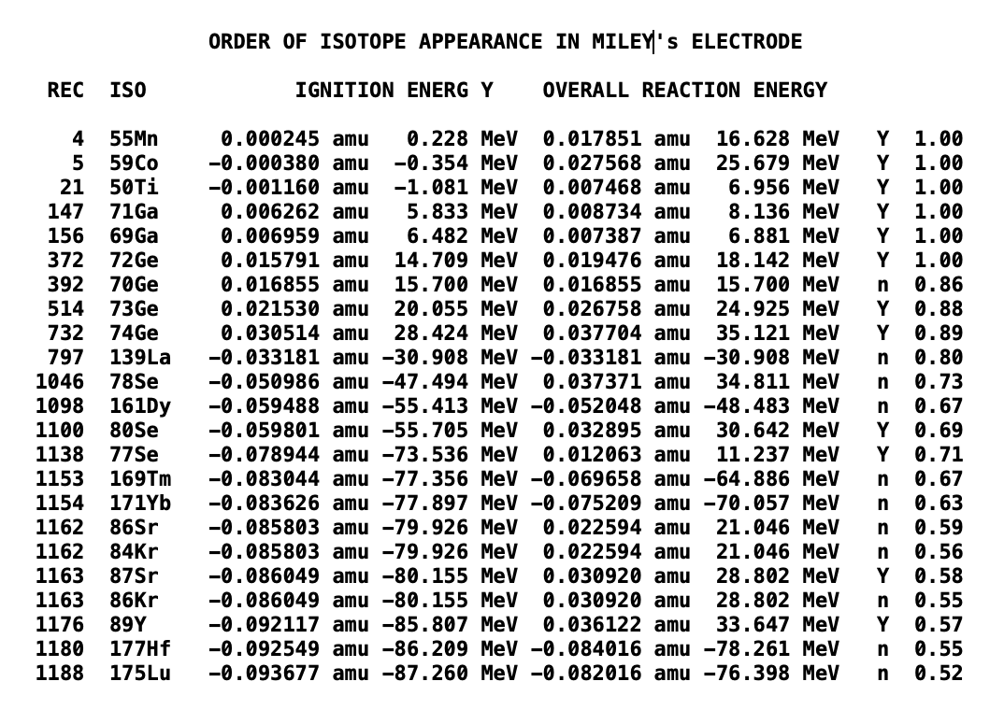
BOTH
What is theoretically possible?
$$NCP= \frac{16.628 MeV}{0.228 MeV} = 73$$
Nuclear Coefficient of Performance
Danszumski@gmail.com

Slide 45
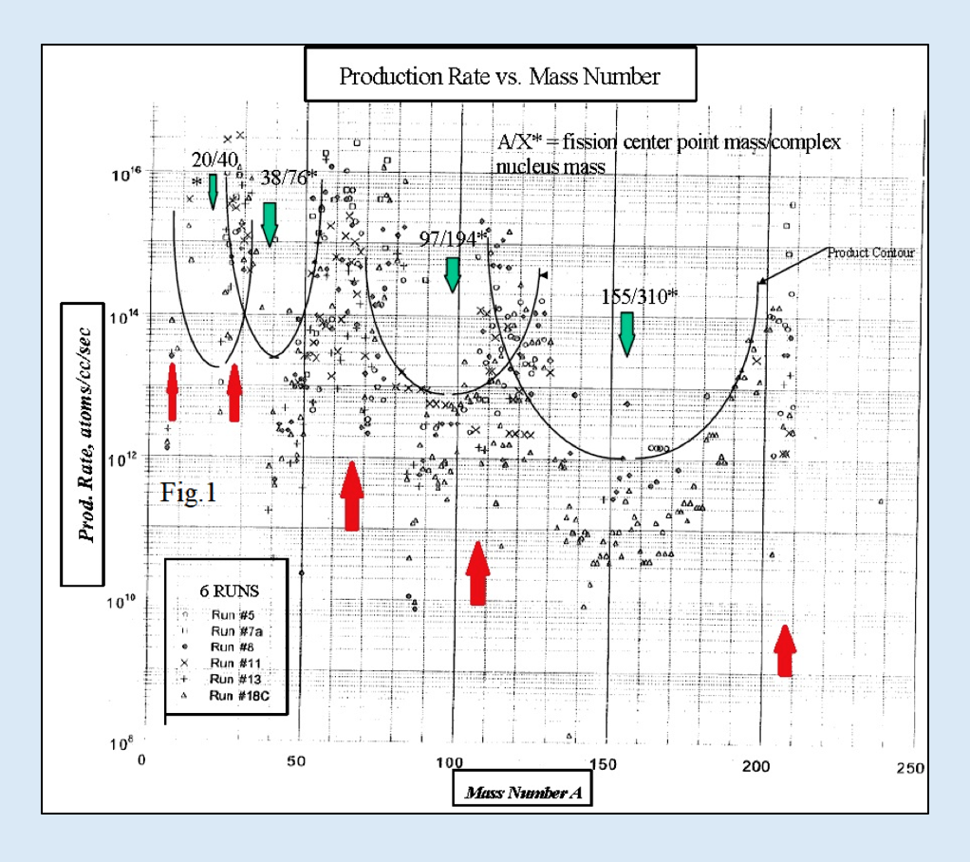
MILEY’S RAW ISOTOPE PRODUCTION DATA
Danszumski@gmail.com

Slide 46
MILEY’S RAW ISOTOPE PRODUCTION DATA
V Cr Ni
Fe Cu Zn
Ag
Miley’s Initial Isotopes
Danszumski@gmail.com

Slide 47
Miley’s Raw Isotope Production Data
Recycle
V Cr Ni
Fe Cu Zn
Ag
Miley’s Initial Isotopes
Danszumski@gmail.com

Slide 48
COMPARISON OF MILEY’S ISOTOPE PRODUCTION RATES
TO LANP MODEL
Miley Published Experiment: Production Rate vs Mass Number
$${10}^{17}$$
x
x
$$⊡$$
$$⊡$$
$${10}^{16}$$
+
$$⊡$$
$$∆$$
o
o
+
o
$$∆$$
x
o
+
$$∆$$
o
+
o
o
x
+
o
o
o
o
$$∆$$
x
o
$$∆$$
$$∆$$
$$∆$$
$$∆$$
x
$$⊡$$
$$⊡$$
$$⊡$$
$$⊡$$
$$⊡$$
x
o
$$∆$$
$$∆$$
x
o
$$∆$$
$$⊡$$
o
$$∆$$
o
x
x
$${10}^{15}$$
o
o
o
o
+
+
$$∆$$
x
x
o
$$∆$$
x
o
$$⊡$$
o
x
+
o
$$⊡$$
o
x
$$∆$$
$$∆$$
o
$$∆$$
o
+
o
x
o
+
o
$$∆$$
o
$$∆$$
+
x
+
o
+
o
+
o
o
$$⊡$$
o
+
x
$$∆$$
o
o
o
$$∆$$
+
$$∆$$
o
$${10}^{14}$$
$$∆$$
o
x
o
$$∆$$
o
o
$$∆$$
$$∆$$
x
o
$$∆$$
$$∆$$
x
o
o
o
x
+
o
x
o
o
x
x
o
x
o
o
+
o
o
$$∆$$
o
$$⊡$$
$$∆$$
x
+
x
$$∆$$
$$∆$$
$$⊡$$
+
o
o
$$∆$$
x
o
+
o
o
$$∆$$
o
$$∆$$
$$∆$$
$$∆$$
x
x
$$∆$$
o
$$∆$$
+
x
o
x
o
x
o
o
o
$$∆$$
+
o
x
o
o
$$∆$$
$$∆$$
o
o
o
+
+
x
o
o
x
x
o
x
x
o
x
o
o
+
$${10}^{13}$$
o
x
$$∆$$
$$∆$$
$$∆$$
$$∆$$
+
$$∆$$
x
$$∆$$
x
o
o
x
o
x
$$∆$$
o
+
$$∆$$
o
o
o
o
$$∆$$
o
$$∆$$
o
$$∆$$
o
x
o
x
x
$$∆$$
o
+
o
+
$$∆$$
o
o
$$∆$$
$$∆$$
$$∆$$
$$∆$$
o
o
$$∆$$
o
$$∆$$
$$∆$$
$$∆$$
x
+
o
o
Production Rate, atoms/cc/sec
$$∆$$
o
o
+
o
x
$$∆$$
$$∆$$
o
o
x
x
x
x
$$∆$$
o
o
o
x
$$∆$$
$$∆$$
$$∆$$
$$∆$$
+
+
$$∆$$
$$∆$$
$$∆$$
$$∆$$
$$∆$$
+
$$∆$$
o
o
o
$${10}^{12}$$
+
+
o
x
$$∆$$
o
x
$$∆$$
$$∆$$
$$∆$$
$$∆$$
o
$$∆$$
o
$$∆$$
$$∆$$
+
o
$$∆$$
+
$$∆$$
$$∆$$
$$∆$$
$$∆$$
o
o
$$∆$$
o
$$∆$$
o
+
o
o
o
x
$$∆$$
$$∆$$
o
o
$$∆$$
$$∆$$
+
o
$$∆$$
$$∆$$
o
+
$$∆$$
$$∆$$
o
$$∆$$
$$∆$$
o
+
$$∆$$
$$∆$$
$$∆$$
$${10}^{11}$$
$$∆$$
$$∆$$
$$∆$$
$$∆$$
$$∆$$
$$∆$$
$$∆$$
$$∆$$
$$∆$$
o
$$∆$$
$$∆$$
o
o
o
o
$$∆$$
o
$$∆$$
$$∆$$
$$∆$$
$$∆$$
o
$$∆$$
o
$$∆$$
V Cr Ni
Fe Cu Zn
Ag
$$∆$$
$$∆$$
$$∆$$
$$∆$$
$$∆$$
$$∆$$
$$∆$$
$$∆$$
$$∆$$
$$∆$$
$${10}^{10}$$
6 Runs
o
$$∆$$
$$∆$$
7a
8
11
13
18c
o
$$∆$$
$$∆$$
$$⊡$$
o
o
Miley’s Initial
Isotopes
$$∆$$
$${10}^{9}$$
x
$$∆$$
$$∆$$
$$∆$$
+
$$∆$$
$$∆$$
$$∆$$
$${10}^{8}$$
0
50
100
150
200
250
Mass Number, A
LANP Model Calibration: Miley’s Published Data
$${10}^{4 }$$
$${10}^{3 }$$
+
+
First Amend
+
First Pass
+
+
+
Number of New Atoms Produced
$${10}^{2 }$$
+
+
+
+
+
+
+
+
+
$${10}^{ }$$
+
+
+
+
+
+
+
+
+
$$1$$
+
+
0
50
100
150
200
250
Mass Number, A
Danszumski@gmail.com

Slide 49
COMPARISON OF MILEY’S ISOTOPE PRODUCTION RATES
TO LANP MODEL
Miley Published Experiment: Production Rate vs Mass Number
$${10}^{17}$$
$$12$$
$↓$
$$17$$
$$25$$
$↓$
$$35$$
x
$$50−70$$
100$−140$
$$200+$$
x
$$⊡$$
$$⊡$$
$${10}^{16}$$
+
$$⊡$$
$$∆$$
o
o
+
o
$$∆$$
x
o
+
$$∆$$
o
+
o
o
x
+
o
o
o
o
$$∆$$
x
o
$$∆$$
$$∆$$
$$∆$$
$$∆$$
x
$$⊡$$
$$⊡$$
$$⊡$$
$$⊡$$
$$⊡$$
x
o
$$∆$$
$$∆$$
x
o
$$∆$$
$$⊡$$
o
$$∆$$
o
x
x
$${10}^{15}$$
o
o
o
o
+
+
$$∆$$
x
x
o
$$∆$$
x
o
$$⊡$$
o
x
+
o
$$⊡$$
o
x
$$∆$$
$$∆$$
o
$$∆$$
o
+
o
x
o
+
o
$$∆$$
o
$$∆$$
+
x
+
o
+
o
+
o
o
$$⊡$$
o
+
x
$$∆$$
o
o
o
$$∆$$
+
$$∆$$
o
$${10}^{14}$$
$$∆$$
o
x
o
$$∆$$
o
o
$$∆$$
$$∆$$
x
o
$$∆$$
$$∆$$
x
o
o
o
x
+
o
x
o
o
x
x
o
x
o
o
+
o
o
$$∆$$
o
$$⊡$$
$$∆$$
x
+
x
$$∆$$
$$∆$$
$$⊡$$
+
o
o
$$∆$$
x
o
+
o
o
$$∆$$
o
$$∆$$
$$∆$$
$$∆$$
x
x
$$∆$$
o
$$∆$$
+
x
o
x
o
x
o
o
o
$$∆$$
+
o
x
o
o
$$∆$$
$$∆$$
o
o
o
+
+
x
o
o
x
x
o
x
x
o
x
o
o
+
$${10}^{13}$$
o
x
$$∆$$
$$∆$$
$$∆$$
$$∆$$
+
$$∆$$
x
$$∆$$
x
o
o
x
o
x
$$∆$$
o
+
$$∆$$
o
o
o
o
$$∆$$
o
$$∆$$
o
$$∆$$
o
x
o
x
x
$$∆$$
o
+
o
+
$$∆$$
o
o
$$∆$$
$$∆$$
$$∆$$
$$∆$$
o
o
$$∆$$
o
$$∆$$
$$∆$$
$$∆$$
x
+
o
o
Production Rate, atoms/cc/sec
$$∆$$
o
o
+
o
x
$$∆$$
$$∆$$
o
o
x
x
x
x
$$∆$$
o
o
o
x
$$∆$$
$$∆$$
$$∆$$
$$∆$$
+
+
$$∆$$
$$∆$$
$$∆$$
$$∆$$
$$∆$$
+
$$∆$$
o
o
o
$${10}^{12}$$
+
+
o
x
$$∆$$
o
x
$$∆$$
$$∆$$
$$∆$$
$$∆$$
o
$$∆$$
o
$$∆$$
$$∆$$
+
o
$$∆$$
+
$$∆$$
$$∆$$
$$∆$$
$$∆$$
o
o
$$∆$$
o
$$∆$$
o
+
o
o
o
x
$$∆$$
$$∆$$
o
o
$$∆$$
$$∆$$
+
o
$$∆$$
$$∆$$
o
+
$$∆$$
$$∆$$
o
$$∆$$
$$∆$$
o
+
$$∆$$
$$∆$$
$$∆$$
$${10}^{11}$$
$$∆$$
$$∆$$
$$∆$$
$$∆$$
$$∆$$
$$∆$$
$$∆$$
$$∆$$
$$∆$$
o
$$∆$$
$$∆$$
o
o
o
o
$$∆$$
o
$$∆$$
$$∆$$
$$∆$$
$$∆$$
o
$$∆$$
o
$$∆$$
V Cr Ni
Fe Cu Zn
Ag
$$∆$$
$$∆$$
$$∆$$
$$∆$$
$$∆$$
$$∆$$
$$∆$$
$$∆$$
$$∆$$
$$∆$$
$${10}^{10}$$
6 Runs
o
$$∆$$
$$∆$$
7a
8
11
13
18c
o
$$∆$$
$$∆$$
$$⊡$$
o
$$∆$$
o
Miley’s Initial
Isotopes
$$∆$$
$$∆$$
$$∆$$
$${10}^{9}$$
x
$$∆$$
+
$$∆$$
$$∆$$
$${10}^{8}$$
0
50
100
150
200
250
Mass Number, A
$$12$$
$↓$
$$17$$
$$25$$
$↓$
$$35$$
LANP Model Calibration: Miley’s Published Data
$${10}^{4 }$$
$$50−70$$
100$−140$
$$200+$$
$${10}^{3 }$$
+
+
First Amend
+
First Pass
+
+
+
Number of New Atoms Produced
$${10}^{2 }$$
+
+
+
+
+
+
+
+
+
$${10}^{ }$$
+
+
+
+
+
+
+
+
+
$$1$$
+
+
0
50
100
150
200
250
Mass Number, A
Danszumski@gmail.com

Slide 50
Conclusions
LANP provides an explanation for the origin of thermo-nuclear energy
Danszumski@gmail.com

Slide 51
Conclusions
LANP provides the only explanation for the origin of thermo-nuclear energy
LANP provides a theory for energy localization in the electrode
Danszumski@gmail.com

Slide 52
Conclusions
LANP provides the only explanation for the origin of thermo-nuclear energy
LANP provides the only theory for energy localization in the electrode
LANP provides a possible mechanism for overcoming the coulomb barrier
Danszumski@gmail.com

Slide 53
Conclusions
LANP provides the only explanation for the origin of thermo-nuclear energy
LANP provides the only theory for energy localization in the electrode
LANP provides a possible mechanism for overcoming the coulomb barrier
LANP Model predicts new isotopes in Miley’s Final Electrode
with better than 96% accuracy
Danszumski@gmail.com

Slide 54
Conclusions
LANP provides the only explanation for the origin of thermo-nuclear energy
LANP provides the only theory for energy localization in the electrode
LANP provides a possible mechanism for overcoming the coulomb barrier
LANP Model predicts new isotopes in Miley’s Final Electrode
with better than 96% accuracy
LANP model verifies Miley’s 2-4 watts of excess heat
Danszumski@gmail.com

Slide 55
Conclusions
LANP provides the only explanation for the origin of thermo-nuclear energy
LANP provides the only theory for energy localization in the electrode
LANP provides a possible mechanism for overcoming the coulomb barrier
LANP Model predicts new isotopes in Miley’s Final Electrode
with better than 96% accuracy
LANP model verifies Miley’s 1-2 watts of excess heat
Model calculations approximate Miley’s isotope production graph
Danszumski@gmail.com

Slide 56
Conclusions
LANP provides the only explanation for the origin of thermo-nuclear energy
LANP provides the only theory for energy localization in the electrode
LANP provides a possible mechanism for overcoming the coulomb barrier
LANP Model predicts new isotopes in Miley’s Final Electrode
with better than 96% accuracy
LANP model verifies Miley’s 1-2 watts of excess heat
Model calculations approximate Miley’s isotope production graph
Available on request
Calibration for Miley’s published transmutation data.
The LANPDESIGN program and files
My book:
The Least Action Nuclear Process Theory of Cold Fusion, 3rd Ed., Amazon.com
Danszumski@gmail.com

Slide 57
Danszumski@gmail.com
Comparison of initial isotope composition and Miley’s Isotope production rate

Slide 60
BOTH

Slide 61
MILEY’S MEASURED ISOTOPE PRODUCTION RATES
Danszumski@gmail.com

Slide 62
Danszumski@gmail.com

Slide 63
Danszumski@gmail.com

Slide 64
How is cold fusion energy stored?
The energy localization is between covalent nuclei
where a single gamma energy photon is resonant
between adjacent nuclei
The localization is Mossbauer Resonance
It is a reversible thermodynamic process
Danszumski@gmail.com

