Slide 1
THE LEC DEVICE – EXPLORING THE PARAMETER SPACE
Alan Smith. Net Zero Scientific Ltd.(UK)

Slide 2
WHAT IS A LEC?
To (loosely) quote Frank Gordon/Harper Whitehouse, a LEC:-
Spontaneously produces ionizing radiation and electrical energy based on the thermal energy in its hydrogen or deuterium occluded lattice.
Produces sustained ionizing radiation and electrical output when the lattice material is in fluidic contact with a gas.
Does not require radioactive materials.
Easy to replicate and simple to construct and test but the physics of it is not fully understood.

Slide 3
LEC – Design (Di Stefano) : LEC Construction Gordon/Whitehouse.
Working Electrode
Counter Electrode
Gas Inlet Valve

Slide 4
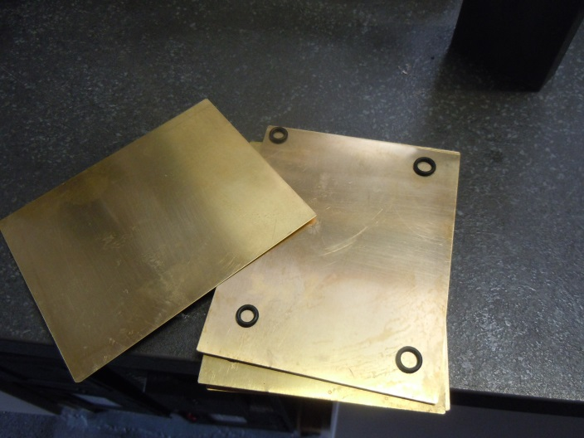
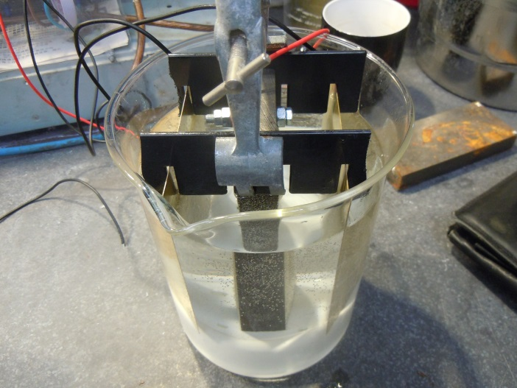
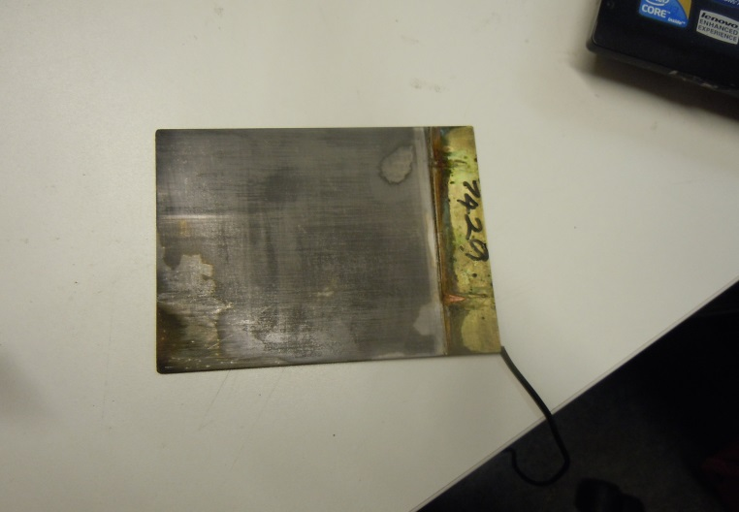
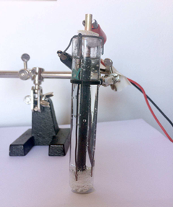
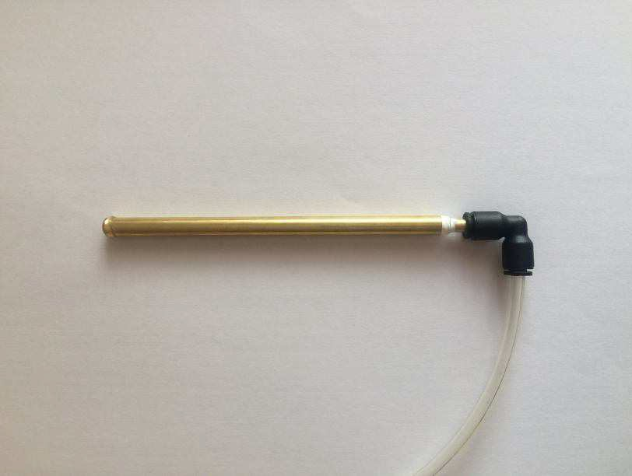
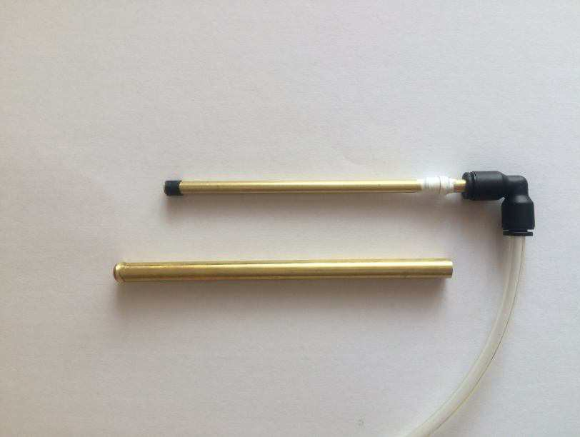
FORM FACTORS- PLATES OR TUBES?
Above – NZS, stacked brass plates: Below- Di Stefano tubes

Slide 5
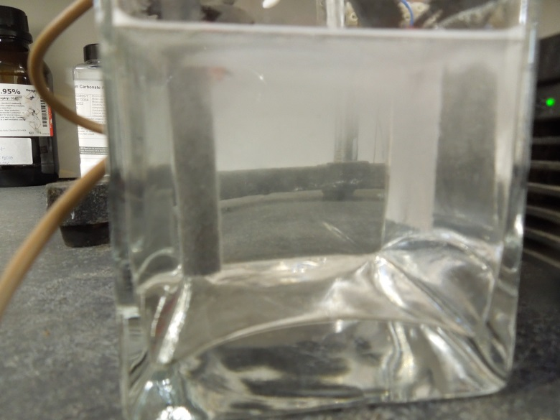
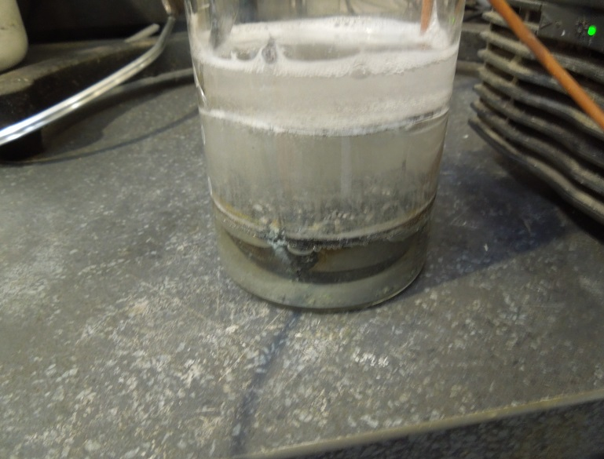
OTHER KINDS OF LEC.
I realised that the LEC was a rugged enough system not to need co-deposition or a closed tube and used different methods, flat plates and powder electrodes work and can be tested in air.

Slide 6
BREAKING THE RULES?
Do Working Electrodes (WE) need to be Pd or Fe? NO
Are exotic metals or gases required? NO
Is co-deposition an absolute requirement? NO
Are dangerous/costly electrolytes required? NO
Do you need heavy water to make it work? NO
Do WE and CE need divergent work functions? NO
Has radioactivity been detected from a LEC? NO
Is the LEC safe and simple to replicate? YES
Is a positive result easy and cheap to detect? YES
Could students build a LEC? YES

Slide 7
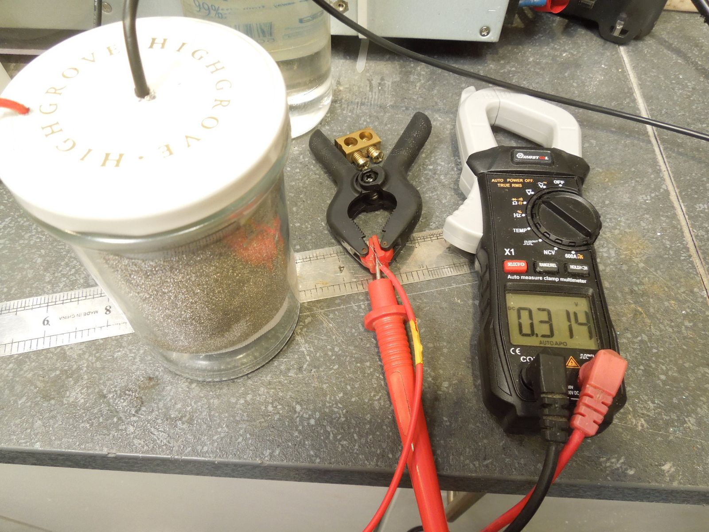
MARMALADE JAR Ni/Ni LEC
THE JAR CONTAINS A CIRCULAR NICKEL FOAM COUNTER ELECTRODE AROUND THE OUTER DIAMETER. INSIDE THAT IS AN INSULATING CYLINDER OF STIFF NYLON FLY-SCREEN MESH. THE CENTRAL WIRE IS SOLDERED ONTO ANOTHER PIECE OF NICKEL FOAM, A WORKING ELECTRODE ELECTROLYSED IN D/W AND K2CO3 USING A CARBON ANODE FOR 48Hrs. 3.5V 1W INPUT.
NO CO-DEP, NO MAJOR WORK FUNCTION DIFFERENCE, NO HYDROGEN GAS – MEASURED IN AIR – THE EFFECT DECLINES BUT LASTS FOR OVER A WEEK .

Slide 8
WHAT WORKED, AND WHAT DID NOT.
WE - Cathode | Anode | Counter Electrode | Electrolyte | T (hrs) | V1 mV T+2h | V2 mV T+24h
Aluminium Plate | Carbon Rod | Aluminium Plate | K₂CO₃ | 48 | 120 | 24
Aluminium Plate | Carbon Rod | Zinc Plate | K₂CO₃ | 48 | 144 | 21
Carbon Rod | Carbon Rod | Zinc Plate | K₂CO₃ | 48 | 0 | 0
Ferrocerium (soft) | Carbon Rod | Zinc Plate | K₂CO₃ | 48 | 610 | 444
Ferrocerium (hard) | Carbon Rod | Zinc Plate | K₂CO₃ | 48 | 340 | 120
Nickel Plate | Carbon Rod | Zinc Plate | K₂CO₃ | 48 | 240 | 188
Nickel Foam/Mesh | Carbon Rod | Nickel Foam/Mesh | K₂CO₃ | 48 | 314 | 163
Nickel Foam/Mesh | Carbon Rod | Zinc Plate | K₂CO₃ | 48 | 342 | 226
Lead Plate | Lead Plate | Zinc Plate | K₂CO₃ | 48 | 0 | 0
S/Steel (304) Plate | Zinc | Zinc Plate | K₂CO₃ | 48 | 10 | 3
Ti (Powdered) | Carbon Rod | Zinc Plate | K₂CO₃ | 48 | 5 | 0
Terbium Chips | Lead Plate | Lead Plate | K₂CO₃ | 48 | 462 | 355
Zirconium Plate | Carbon Rod | Zinc Plate | K₂CO₃ | 48 | 0 | -
SmCo Powder | Lead Plate | Lead Plate | K₂CO₃ | 48 | 0 | -
Samarium Plate | Carbon Rod | Zinc Plate | K₂CO₃ | 48 | 330 | 212

Slide 9
The closer the WE/CE are the higher the output, The best spacers are both thin, and porous, lightweight fly-screen nylon mesh being the most effective separator tested so far.
Impervious film –like polythene- cuts output to zero.
The table is of interest, it shows output vs time for a
WE/CE pair in air after short circuiting with an earthed
wire, the intention being to drain away stray charges etc.
This is not galvanism, but some other little-known effect
cannot be ruled out entirely, tests are eliminating
them one by one.
Is it scale-able by the 14 orders of magnitude Frank Gordon hopes it is? Maybe.
WHAT DOES IT DO?
TIME – Secs | Output - mV
0 | 100 (instantly)
30 | 140
60 | 132
90 | 146
120 | 152
150 | 158
180 | 152

Slide 10
Thanks for content extracts and support to:-
Dr. Frank E. Gordon, Dr. Harper Whitehouse (USA)
Antonio Di Stefano (Italy) Alan Goldwater (USA)
Jean-Paul Biberian (France)
LENR-forum.com team, plus Matthew Neimerg, Mike Hill
Luke Jobling, Lee Kerr, and Ed Storms for inspiration.

Slide 11
THANKS FOR STAYING AWAKE !
Inventors and Patent Holders, Lattice Energy Converter. Frank Gordon, Harper Whitehouse. Inovl Inc. San Diego, CA, USA. Email: feg@inovl.com. Phone +1-858-349-7869
Net Zero Scientific Ltd. Research and Development Laboratory, Romford,
Essex UK . Email: lubetkin1934@yahoo.co.uk. Phone +44 7944 847870.
More discussion, experiments, arguments and commentary about the LEC can be found on LENR-Forum.com. The public face of cold fusion.

