Slide 1



Natalia Targosz-Ślęczka
University of Szczecin, Szczecin, Poland
natalia.targosz-sleczka@usz.edu.pl
Overview of enhanced fusion reactions in accelerator-driven studies
Konrad Czerski, Rakesh Dubey, Mateusz Kaczmarski, Mathieu Valat
University of Szczecin, Szczecin, Poland
Agata Kowalska
Maritime University of Szczecin, Szczecin, Poland
This project has received funding from the European Union’s Horizon2020 research and innovation programme under grant agreement no 951974.
This work reflects only the author's view and the European Commission is not responsible for any use that may be made of the information it contains.

Slide 2

Motivation
Over 25 years of LENR studies in accelerator-driven experiments in different environments.
Metallic structures loaded with hydrogen are substantial for energy production in nuclear fusion reactions at room temperatures.
Electron screening effect causes an exponential-like enhancement of the nuclear reaction cross section.
It is strongest in metallic environments due to quasi-free electrons screening the Coulomb barrier between reacting nuclei.
The probability of tunnel transition is greater thus the cross section is enhanced.
Since 1998 the electron screening effect has been confirmed in many laboratory investigations.
We will show an overview of the experimental efforts and the most interesting results.
Comparison between experimental outcomes is difficult due to systematic experimental errors & diverse techniques for data acquisition and analysis.
Sept 27, 2022
@ 15th International Workshop on Anomalies in Hydrogen Loaded Metals, Assisi, Italy
2

Slide 3
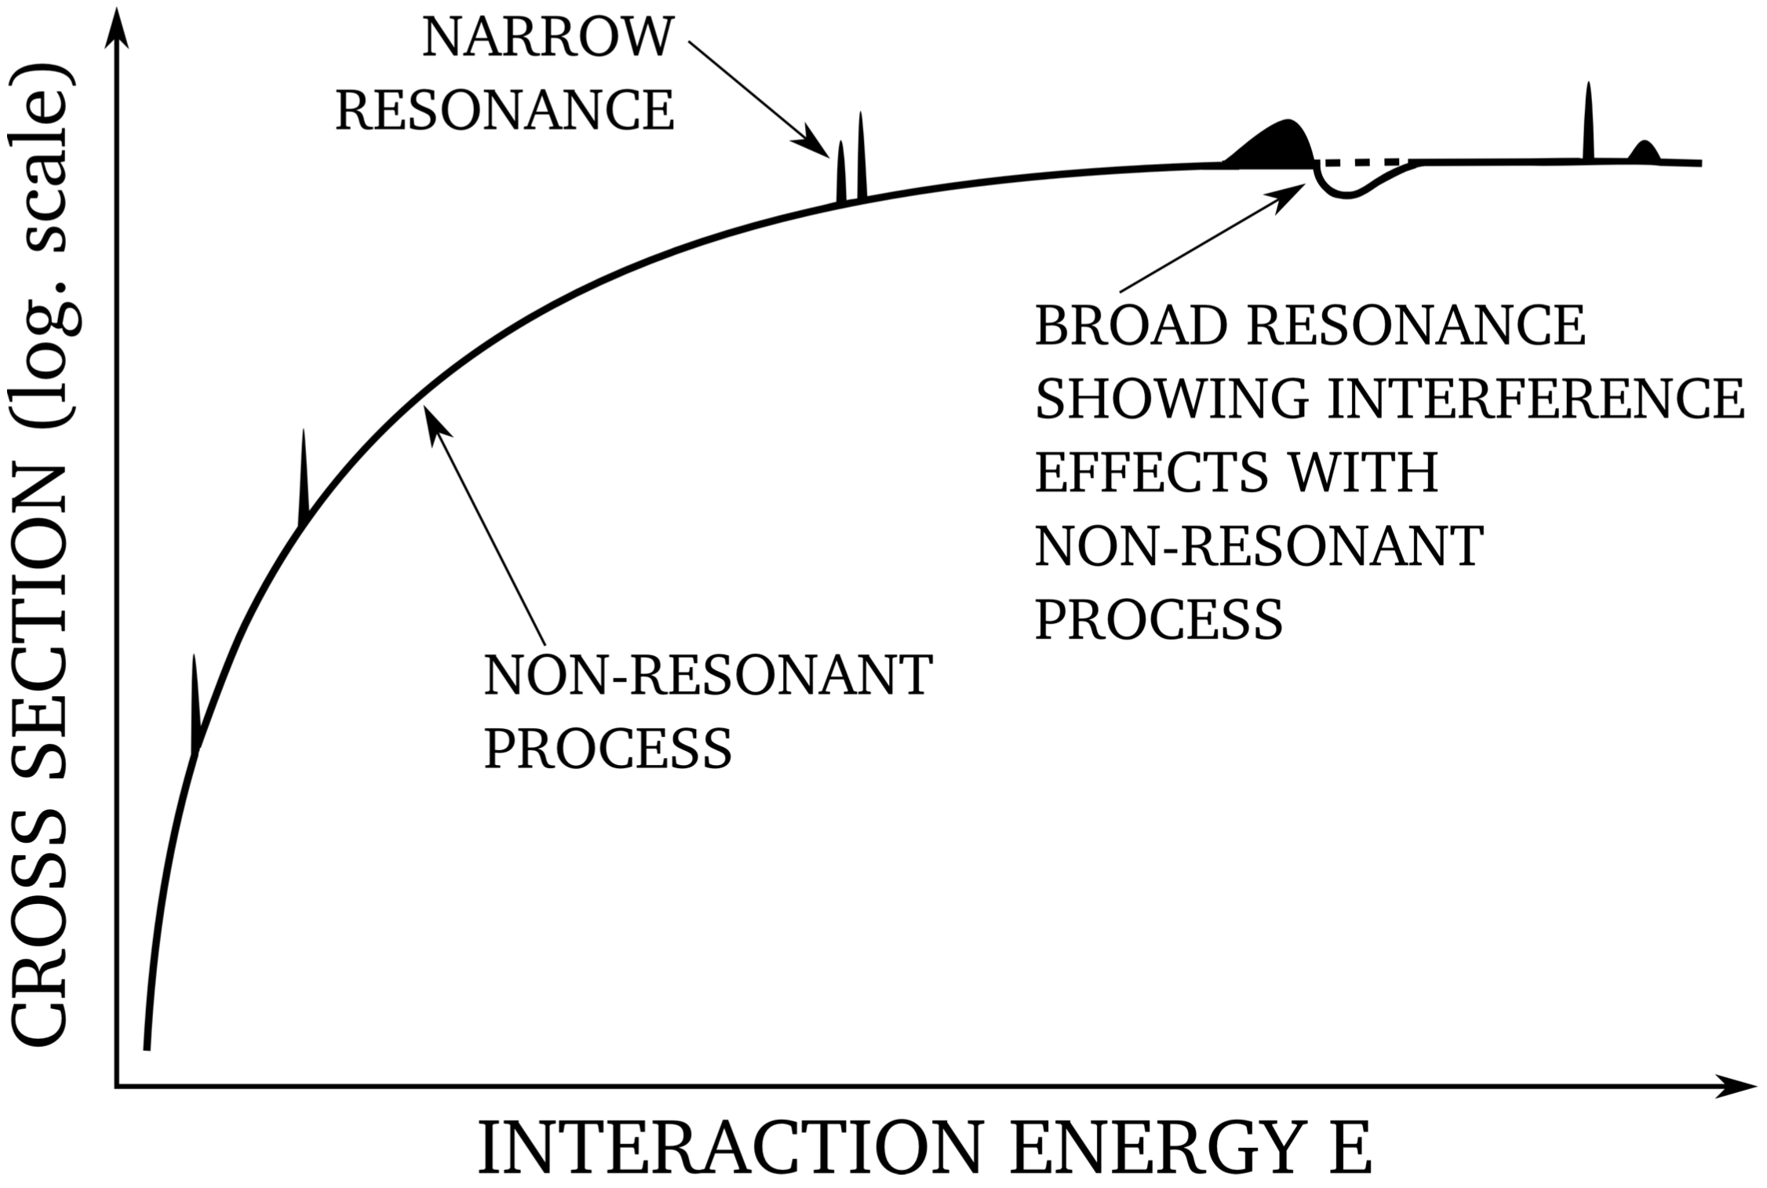
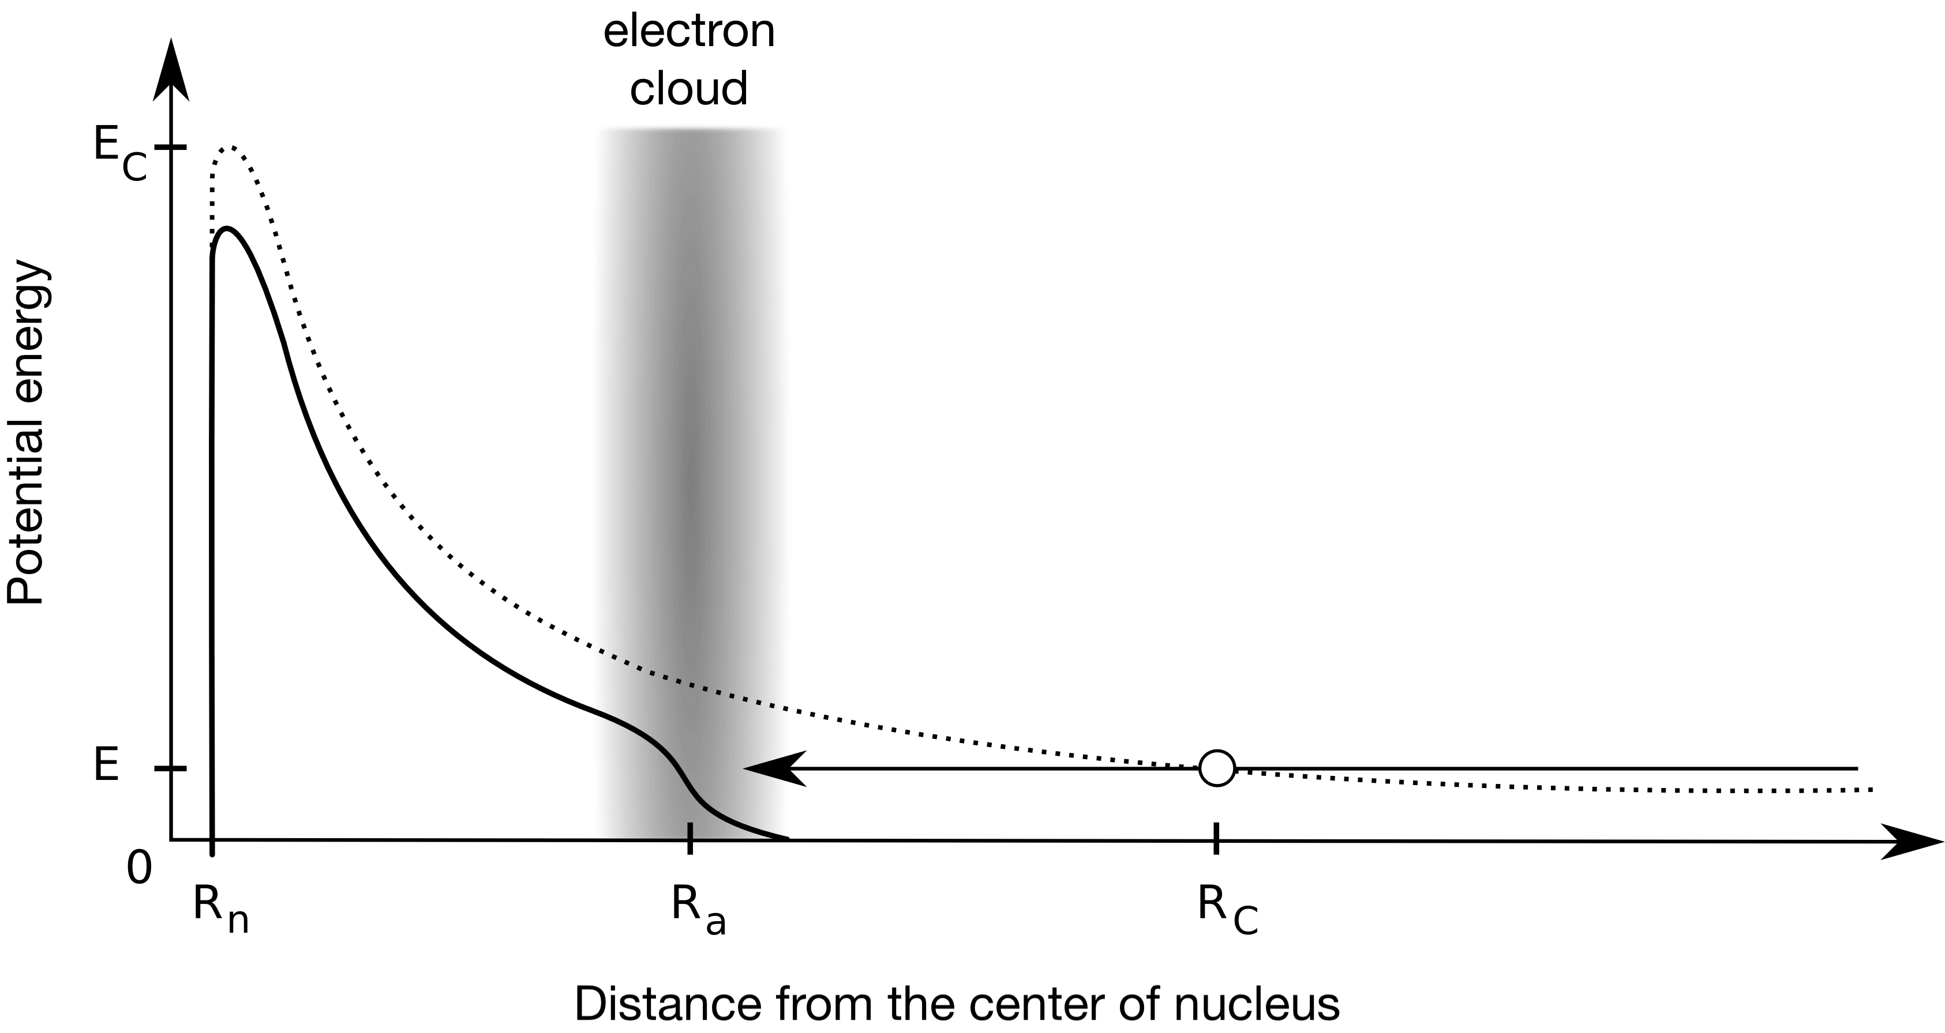
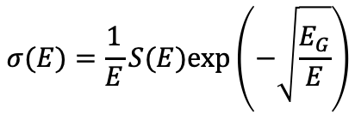
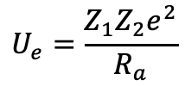
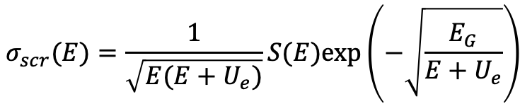
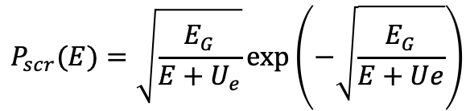
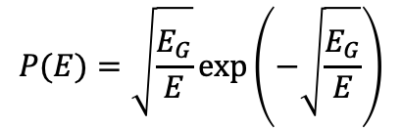
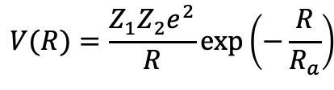

Introduction
Electrostatic potential with screening function
Screening energy
$$V(R)=\frac{Z_{1}Z_{2}e^{2}}{R}$$
$$V(R)=\frac{Z_{1}Z_{2}e^{2}}{R}exp\left(−\frac{R}{R_{a}}\right)$$
$$U_{e}=\frac{Z_{1}Z_{2}e^{2}}{R_{a}}$$
$$P(E)=\sqrt{\frac{E_{G}}{E}}exp\left(−\sqrt{\frac{E_{G}}{E}}\right)$$
$$P_{scr}(E)=\sqrt{\frac{E_{G}}{E+U_{e}}}exp\left(−\sqrt{\frac{E_{G}}{E+Ue}}\right)$$
$$σ(E)=\frac{1}{E}S(E)exp\left(−\sqrt{\frac{E_{G}}{E}}\right)$$
$$σ_{scr}(E)=\frac{1}{\sqrt{E(E+U_{e})}}S(E)exp\left(−\sqrt{\frac{E_{G}}{E+U_{e}}}\right)$$
Sept 27, 2022
@ 15th International Workshop on Anomalies in Hydrogen Loaded Metals, Assisi, Italy
3

Slide 4
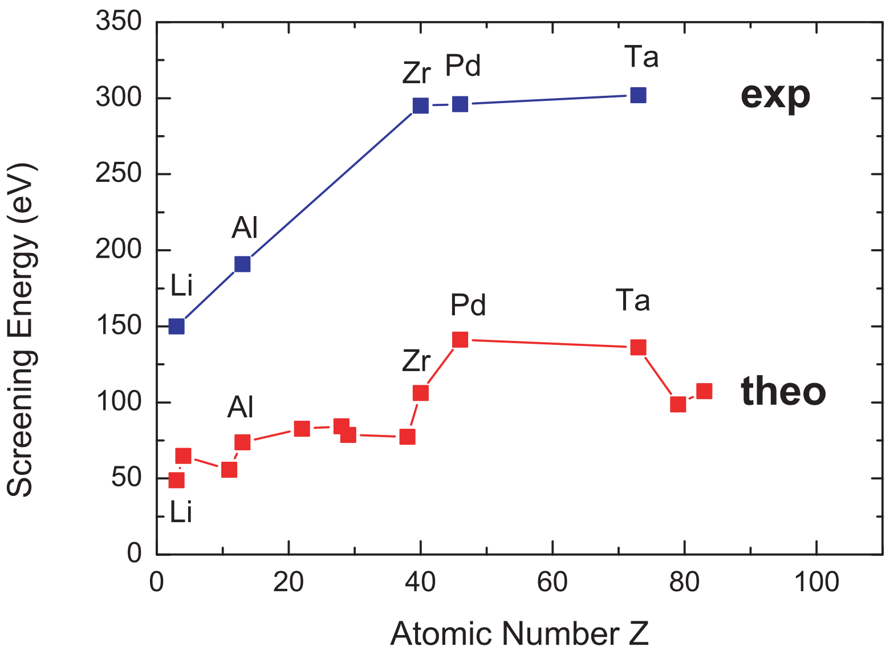
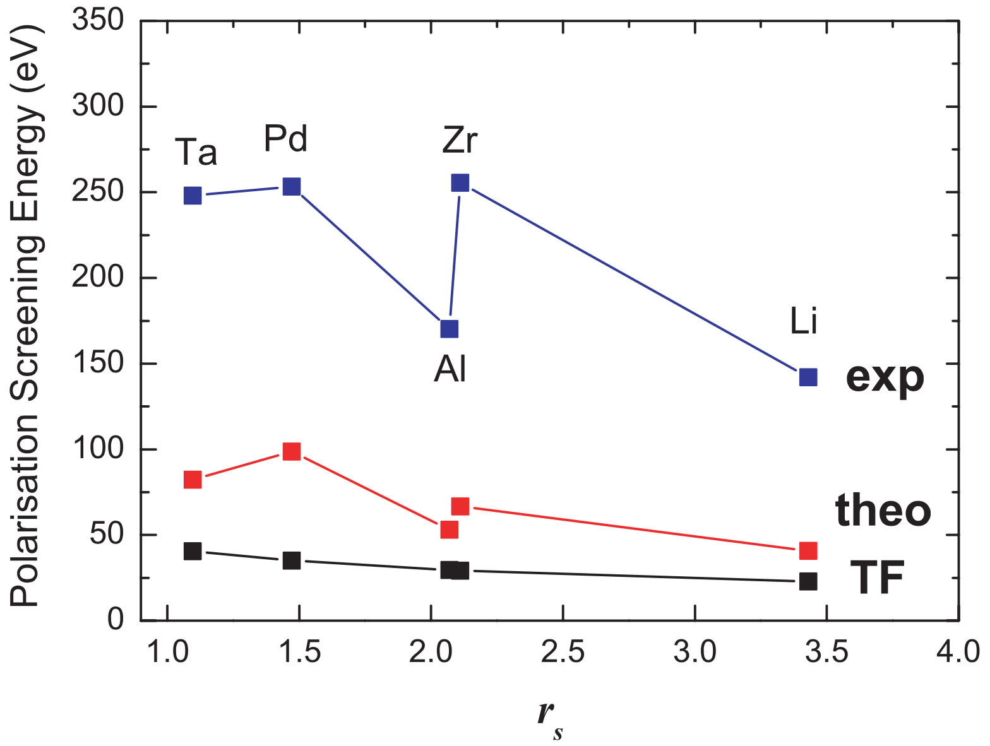
History
Nuclear reactions in dense astrophysical plasmas:
E. E. Salpeter, Aust. J. Phys. 7, 373 (1954);
Laboratory investigations:
Theoretical description: H. J. Assenbaum et al., Z. Phys. A 327, 461 (1987);
Experimental observations in gas: C. Rolfs et al., Nucl. Instum. Methods B, 297 (1995);
Metallic environments: K. Czerski et al., Nuclei in the Cosmos V (1998), proceedings of the International Symposium on Nuclear Astrophysics, p. 152 and independently J. Kasagi.
HV
HV
Czerski K, Eur. Phys. J. A 27, 83 (2006)
Sept 27, 2022
@ 15th International Workshop on Anomalies in Hydrogen Loaded Metals, Assisi, Italy
4

Slide 5
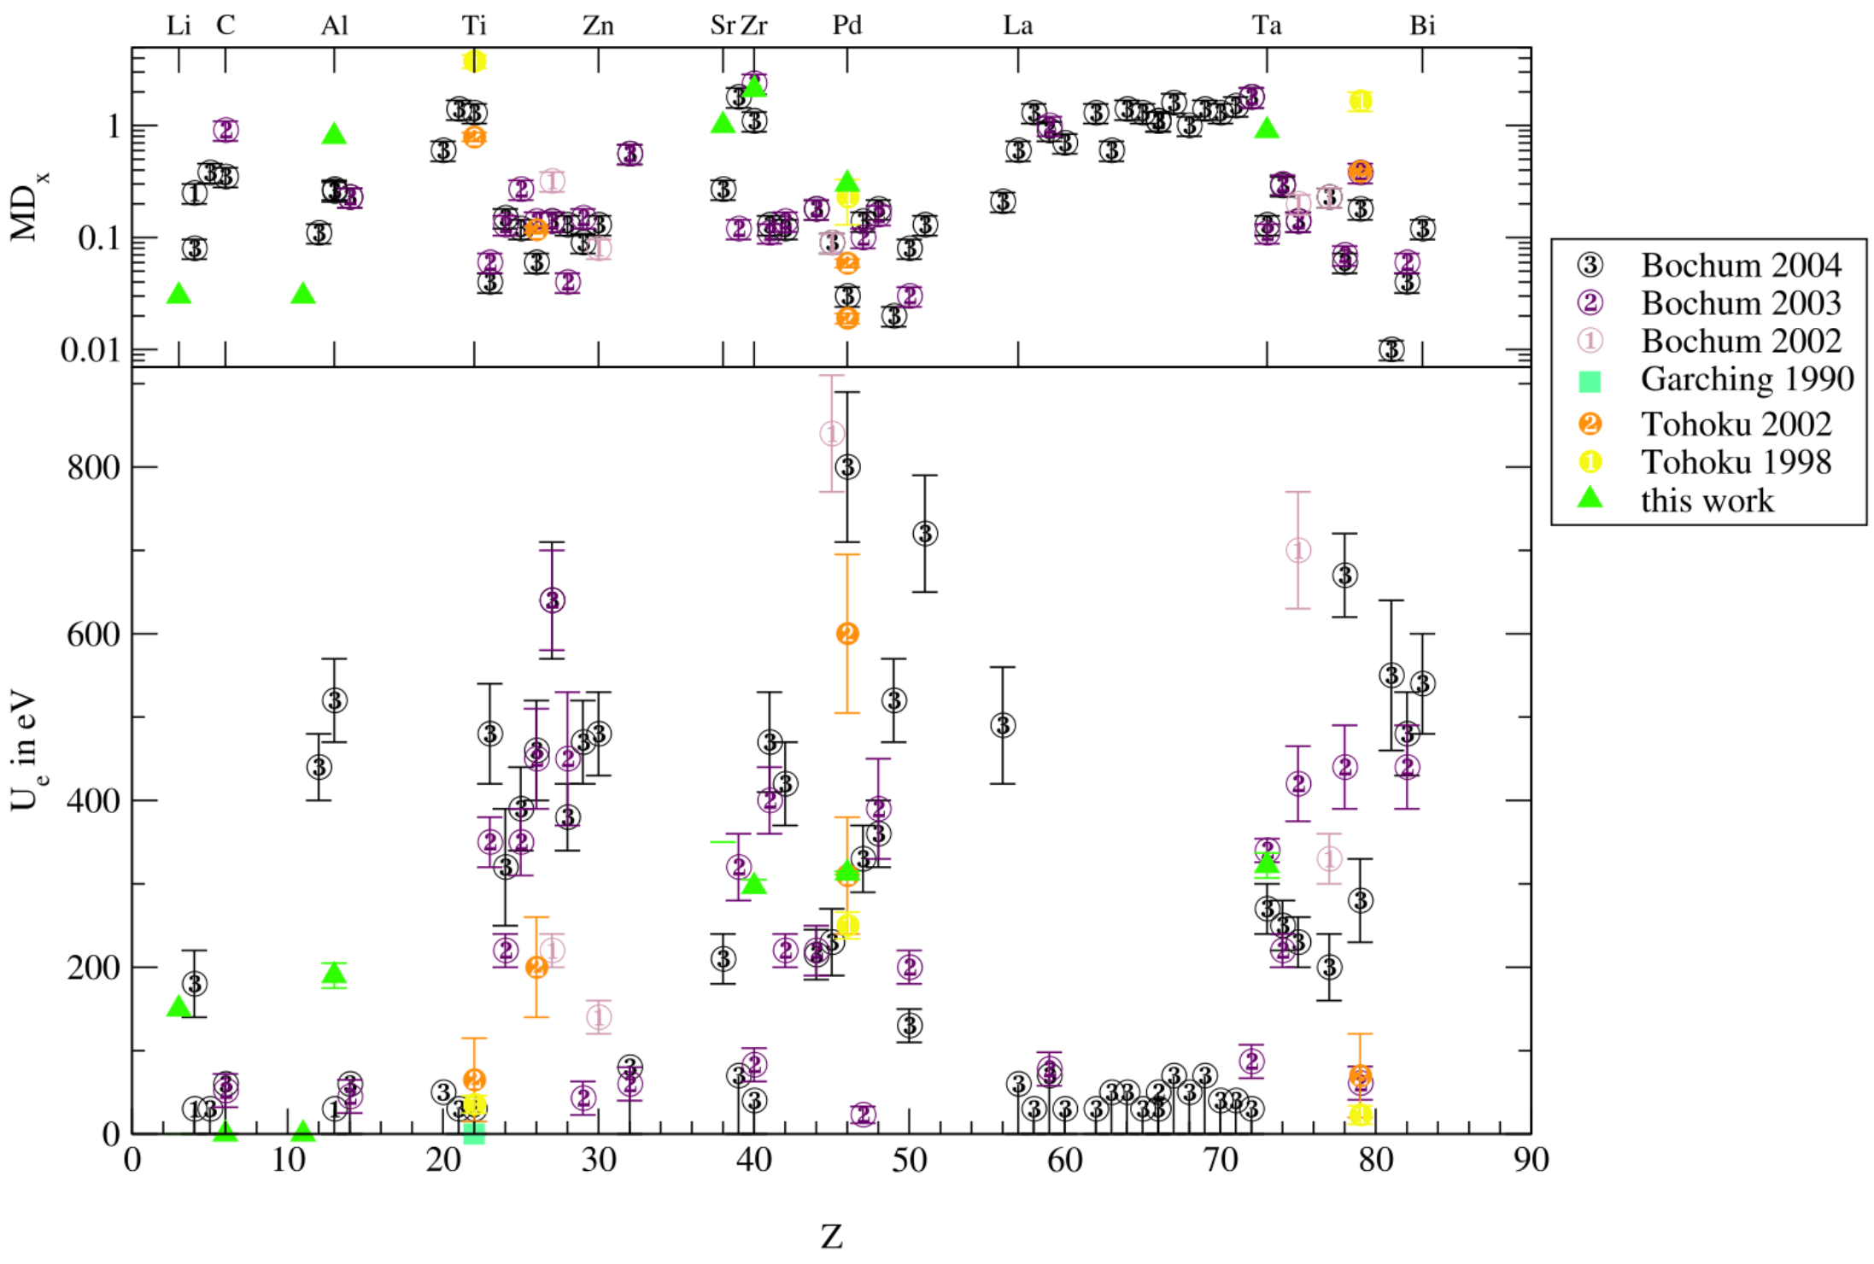
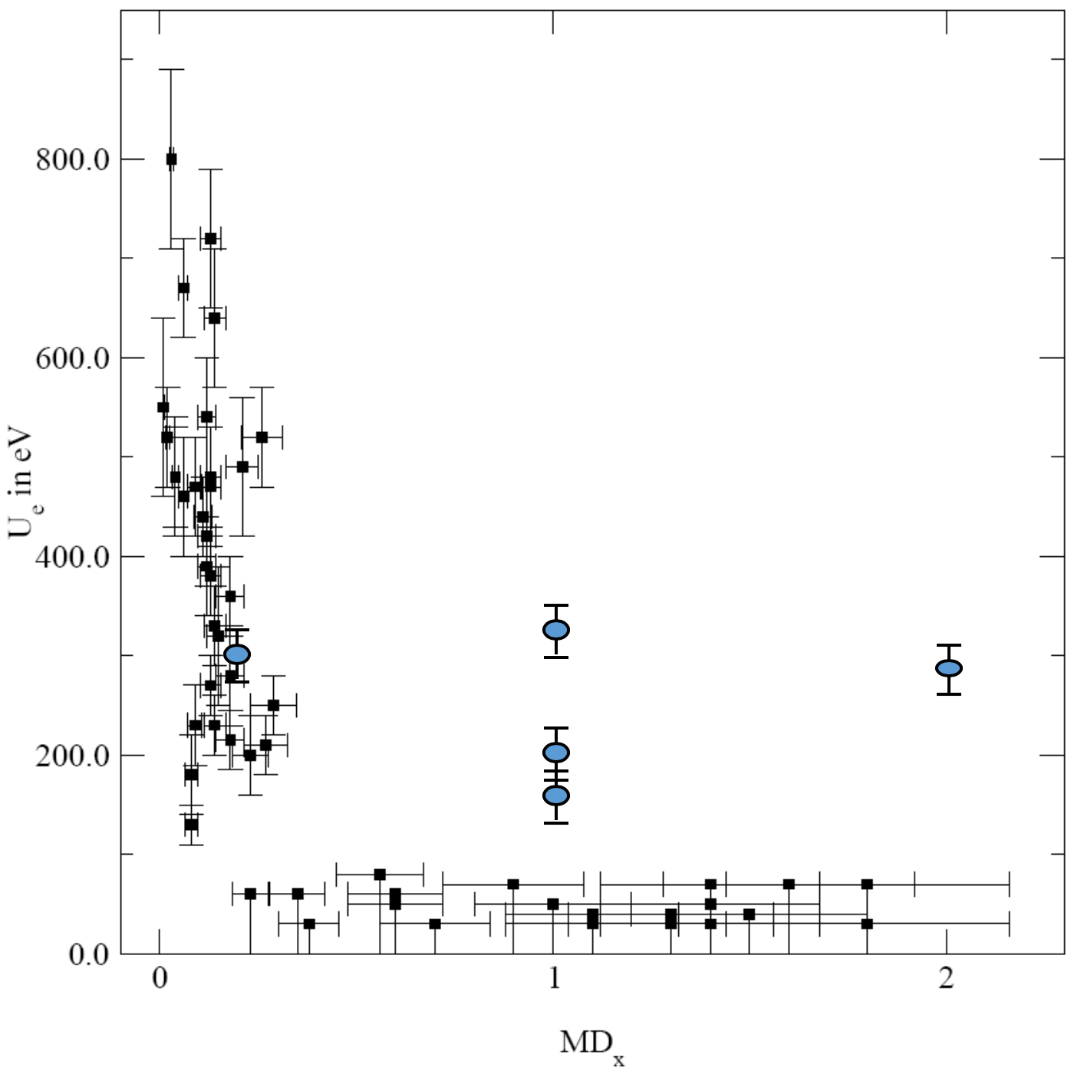
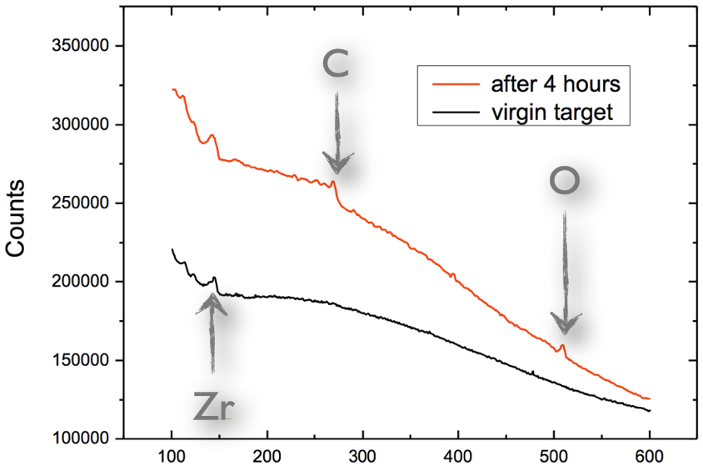
Extensive studies
Systematic study of target material dependence of U_{e} for over 50 different metals and some insulators.
Discrepancies in experimental values due to oxidation of target surface and unstable deuteron density profiles within the target.
The d+d fusion reactions are studied as the simplest model for fusion of nuclei composed of more than single nucleon and due to fairly low Coulomb barier.
Huke A, Phys. Rev. C 78, 015803 (2008)
Sept 27, 2022
@ 15th International Workshop on Anomalies in Hydrogen Loaded Metals, Assisi, Italy
5

Slide 6
Interresting results for dd fusion in pure metals
Material | U_{e} (eV) for dd
Pd | 800 ± 90
Rh | 840 ± 70
Sb | 720 ± 70
Re | 700 ± 70
Pt | 670 ± 50
Co | 640 ± 70
Fe, Al, Tl, Zn, Ba, Bi, Cu, In, Nb, Pb, V, Sm | ≈ 500
Systematic errors, diverse techniques… High screening are probably exaggerated.
Data acquisition & analysis are affected by formations of surface contamination layers under beam irradiation, hydrogen density in the studied environments, understanding of nuclear and solid-state processes taking place.
Kasagi J., J. Phys. Soc. Jpn 71 (2002)
Raiola F., Phys. Lett. B 547 (2002)
Bonomo C., Nucl. Phys. A 719 (2003)
Raiola F., Eur.Phys. J. A 19 (2004)
Tie-Shan W., Chin. Phys. Lett. 24 (2007)
Huke A, Phys. Rev. C 78, 015803 (2008)
Sept 27, 2022
@ 15th International Workshop on Anomalies in Hydrogen Loaded Metals, Assisi, Italy
6

Slide 7
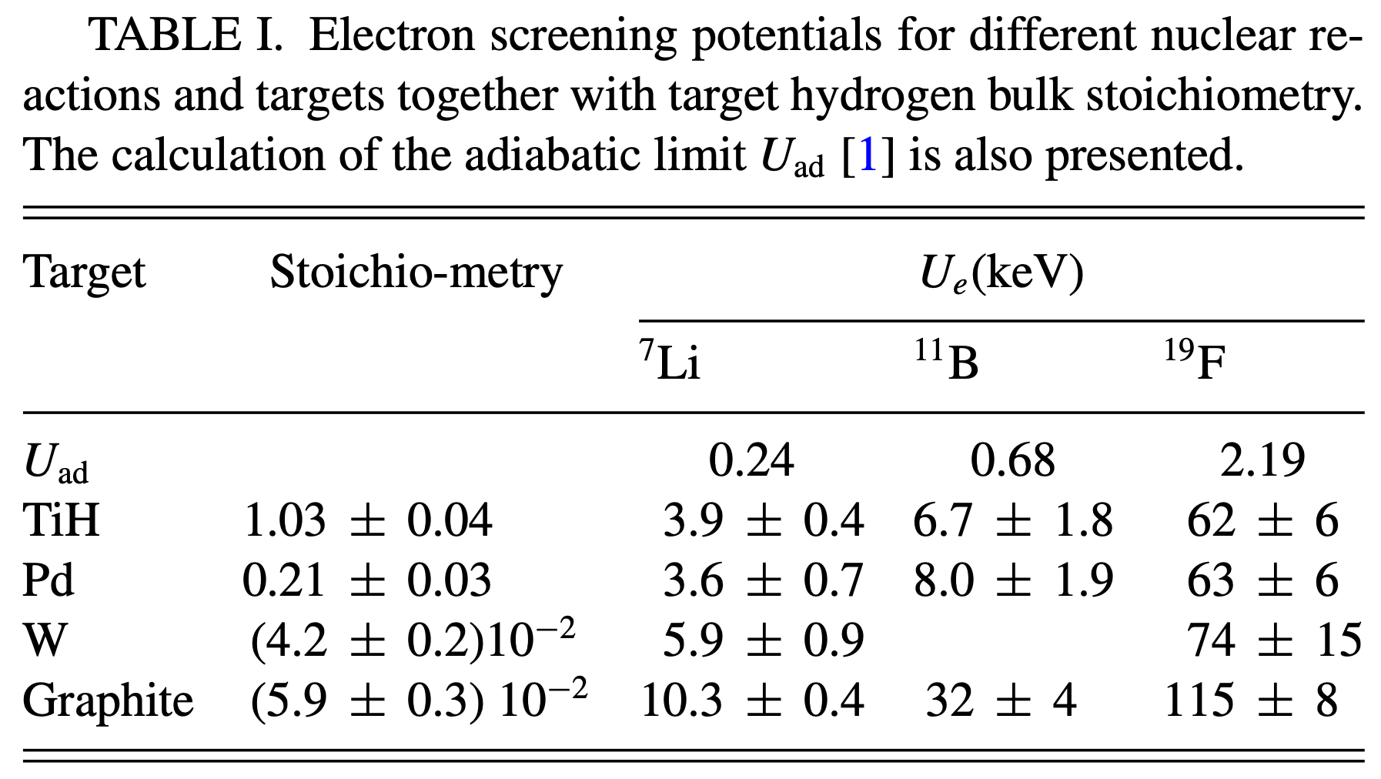
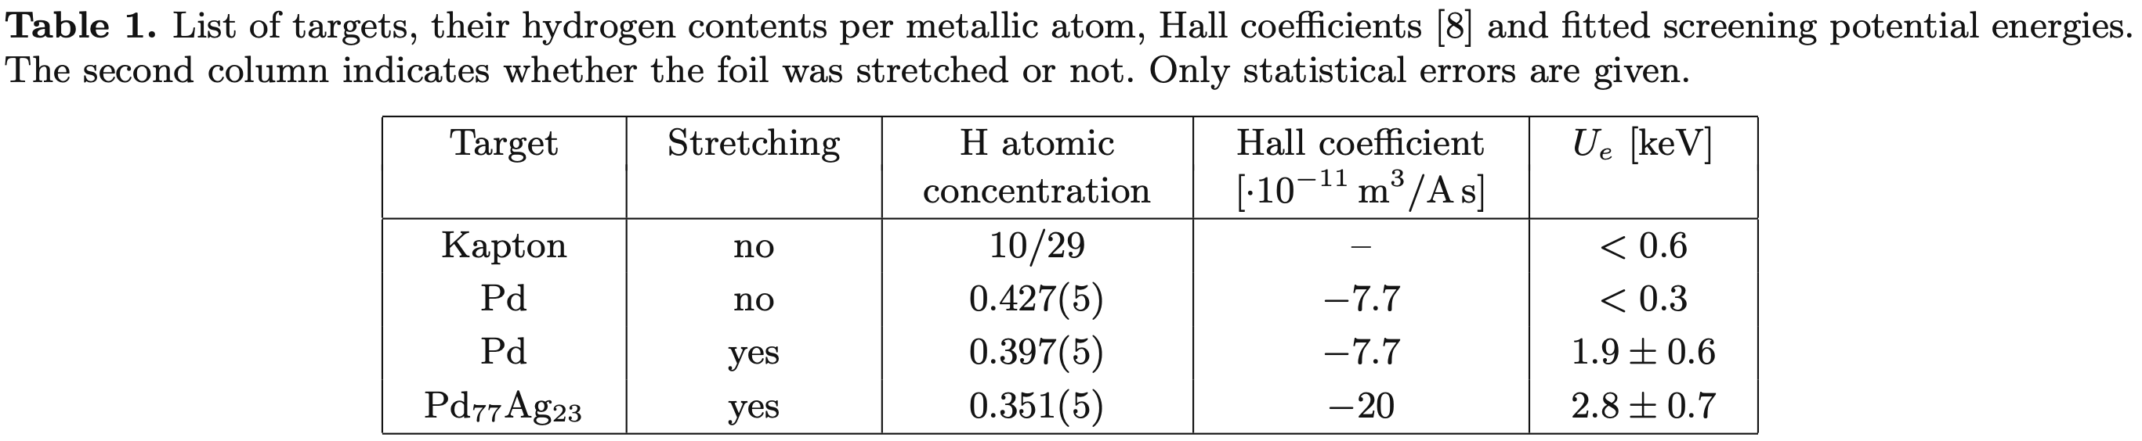
Experiments with heavier nuclei
Material | U_{e} (eV) for ^{6,7}Li(d,𝛼)^{4,5}He ^{6,7}Li(p,𝛼)^{3,4}He
Pd [Kasagi, d beam] | 1500
Li [Cruz, p beam] | 1230 – 1280
PdLi_{1%} [Cruz, p beam] | 3760 – 3790
Kasagi: The enhancement in Pd cannot be explained by electron screening alone but suggests the existence of an additional and important mechanism in metal.
Lipoglavsesk: Large electron screening only when foils were under tensile stress.
Cruz J., Phys. Lett. B 625 (2005)
Kasagi J., J. Phys. Soc. Jpn. 73 (2004)
Cvetinovic A., Phys. Rev. C 92 (2015)
Lipoglavsek M., Eur. Phys. J. A 44 (2010)
Sept 27, 2022
@ 15th International Workshop on Anomalies in Hydrogen Loaded Metals, Assisi, Italy
7

Slide 8
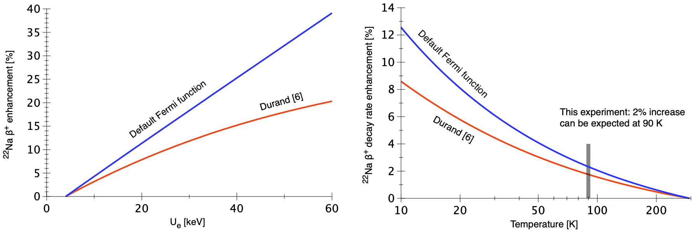
Radioactive decay of embeded nuclei
Are there temperature effects in the lifetime od certain radioactive nuclei if the decaying ⍺ or β⁺ emiter is hosted in a metallic environment?
²²Na was hosted in Aluminium.
Screening Energy at room temperature is estimated by multiplying dd screening value for Al by the charge numer of the ²²Na daughter nucles.
2% increase expected in β⁺ decay 0.2% while cooling to 12 K [Limata et al. Eur. Phys. J. A 28 (2006)]
0.45% while cooling to 90 K [Ruprecht et al., PoS(NIC-IX)171 (2006)]
Ruprecht G., PoS (NIC-IX) 171 (2006)
Sept 27, 2022
@ 15th International Workshop on Anomalies in Hydrogen Loaded Metals, Assisi, Italy
8

Slide 9
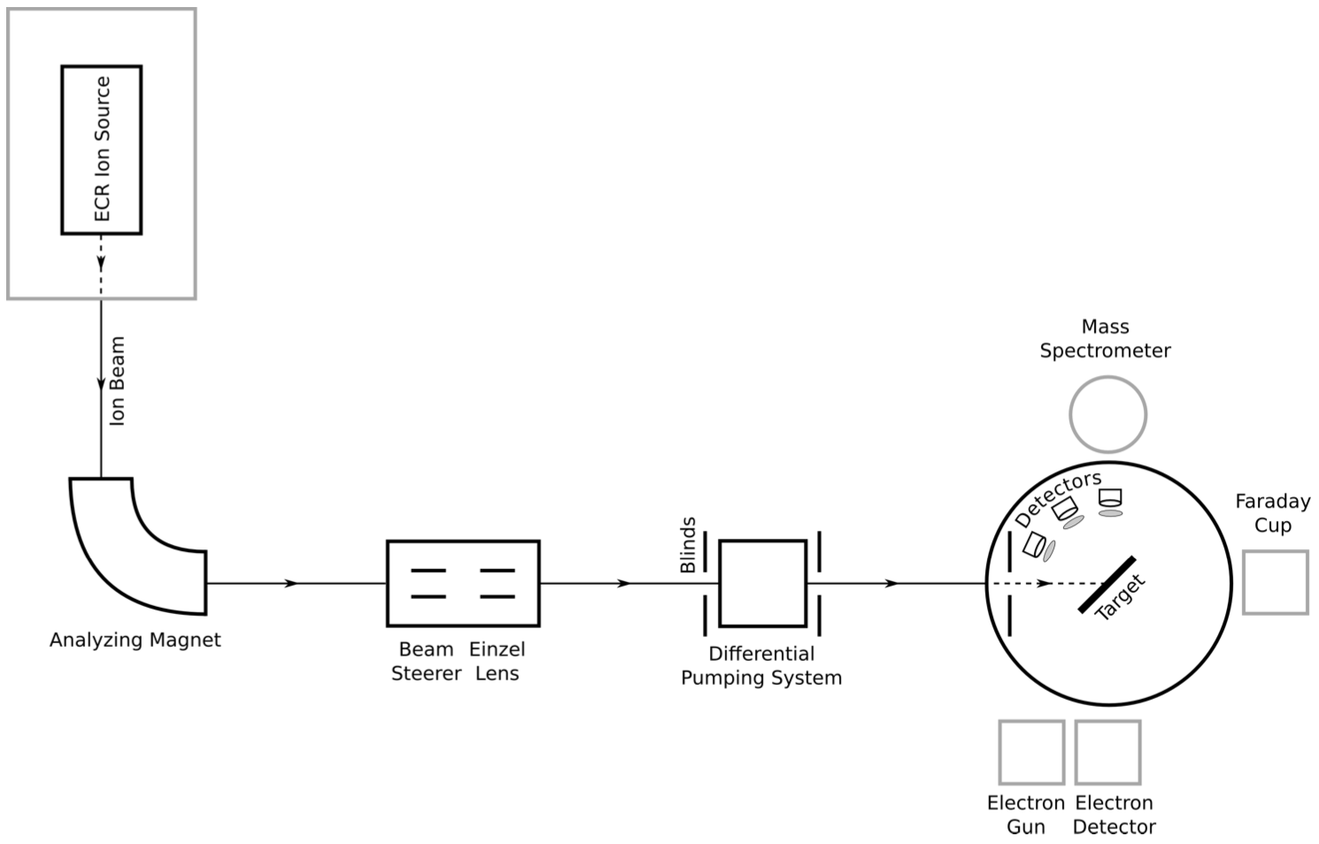

USz experimental set-up
p=10-10 mbar
p=10-11 mbar, LN2
Targosz-Ślęczka N, PhD Thesis, University of Szczecin (2012)
p=10⁻¹⁰ mbar
p=10⁻¹¹ mbar, LN₂
Sept 27, 2022
@ 15th International Workshop on Anomalies in Hydrogen Loaded Metals, Assisi, Italy
9

Slide 10
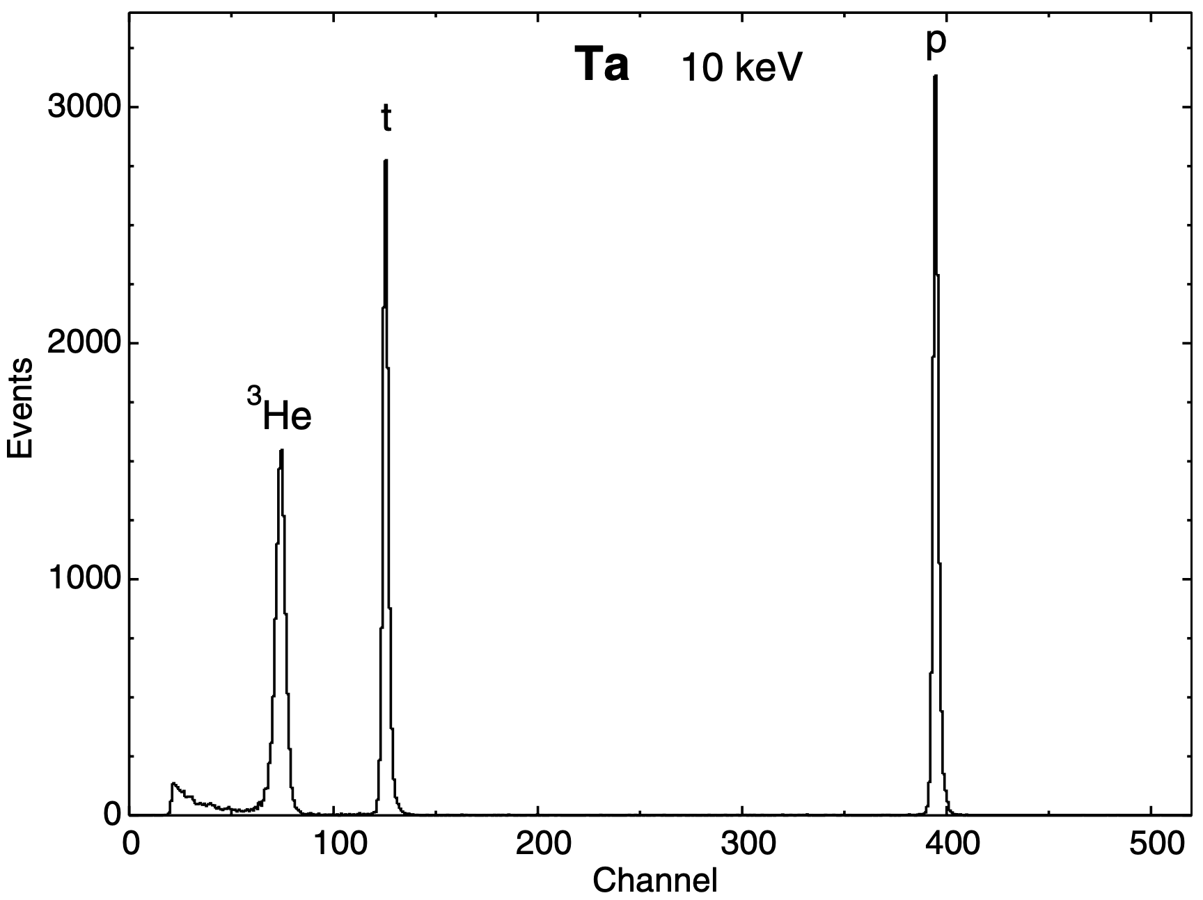
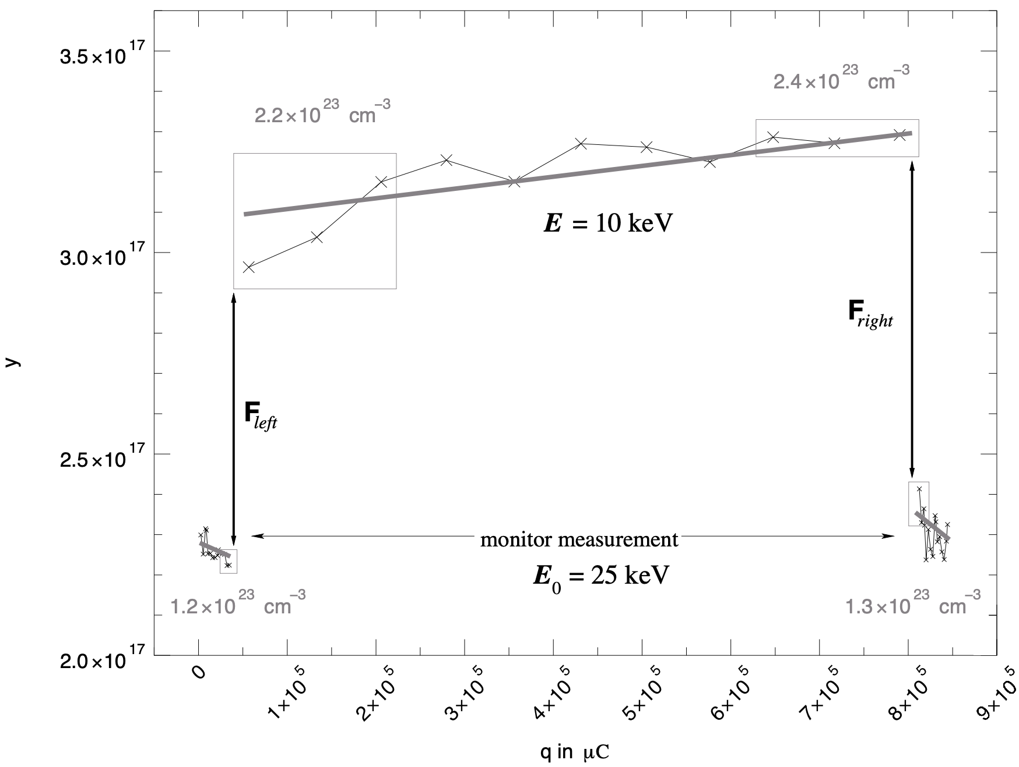
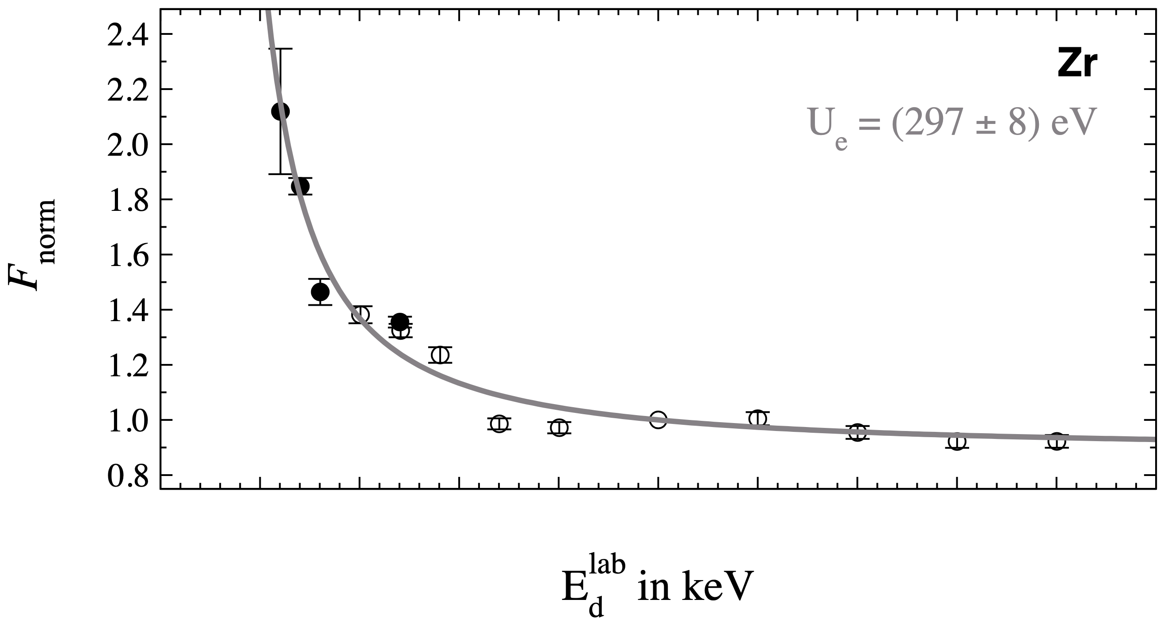
USz data acquisition and analysis
Differential counting number is measured and total charge at the target N(𝛉) & q
Huke A, Phys. Rev. C 78, 015803 (2008)
Sept 27, 2022
@ 15th International Workshop on Anomalies in Hydrogen Loaded Metals, Assisi, Italy
10

Slide 11
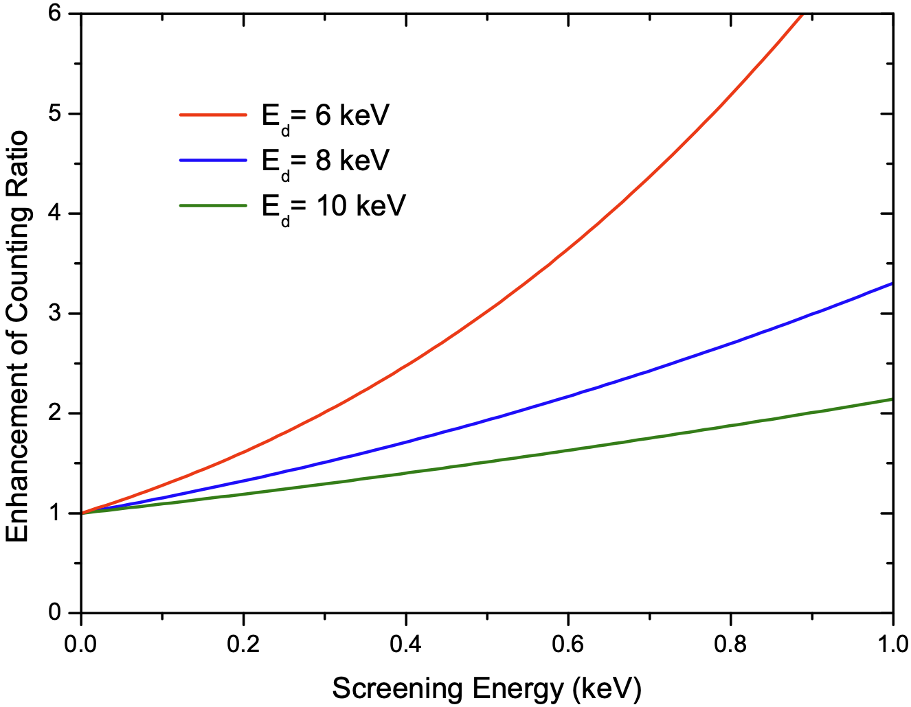
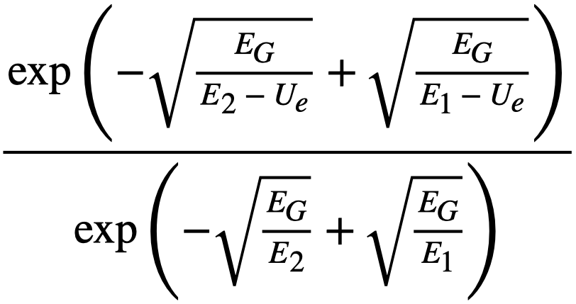
Usz screening energy estimation
A two-point method for estimation of the screening energy allows to evaluate whether a specific target is worth to be studied in details or not.
It takes ratio between enhancement in counting rates at two different deuteron energies E₁ (=20 keV) and E₂ (low energy).
Huke A, Phys. Rev. C 78, 015803 (2008)
Sept 27, 2022
@ 15th International Workshop on Anomalies in Hydrogen Loaded Metals, Assisi, Italy
11

Slide 12
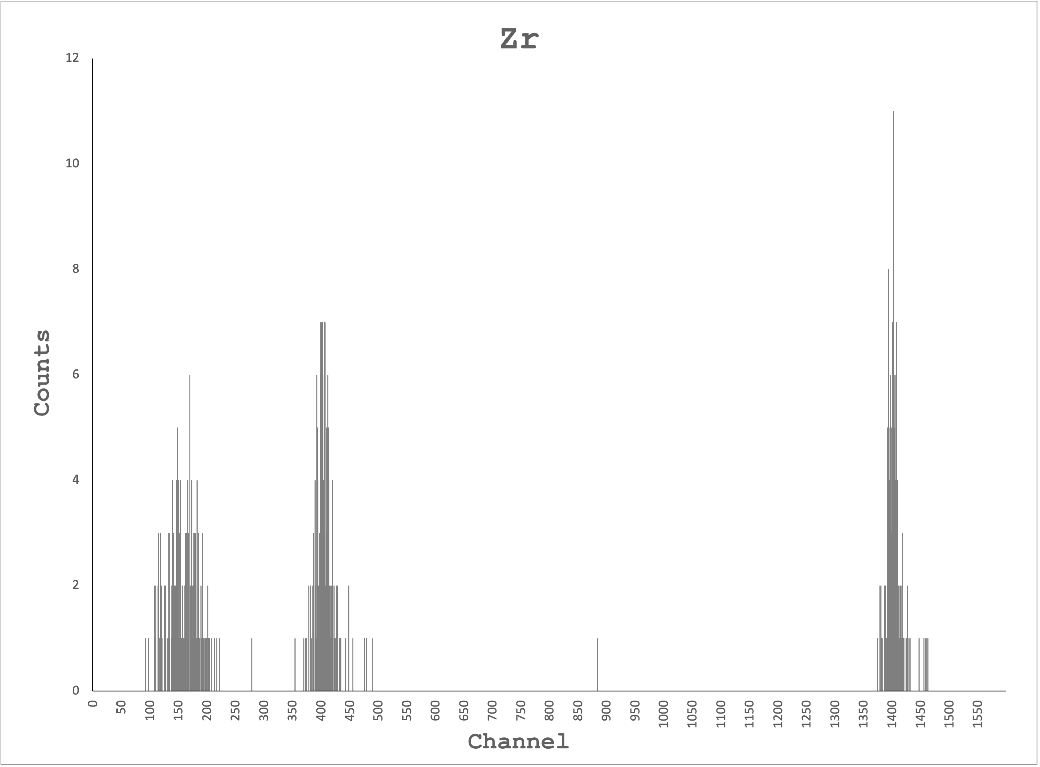
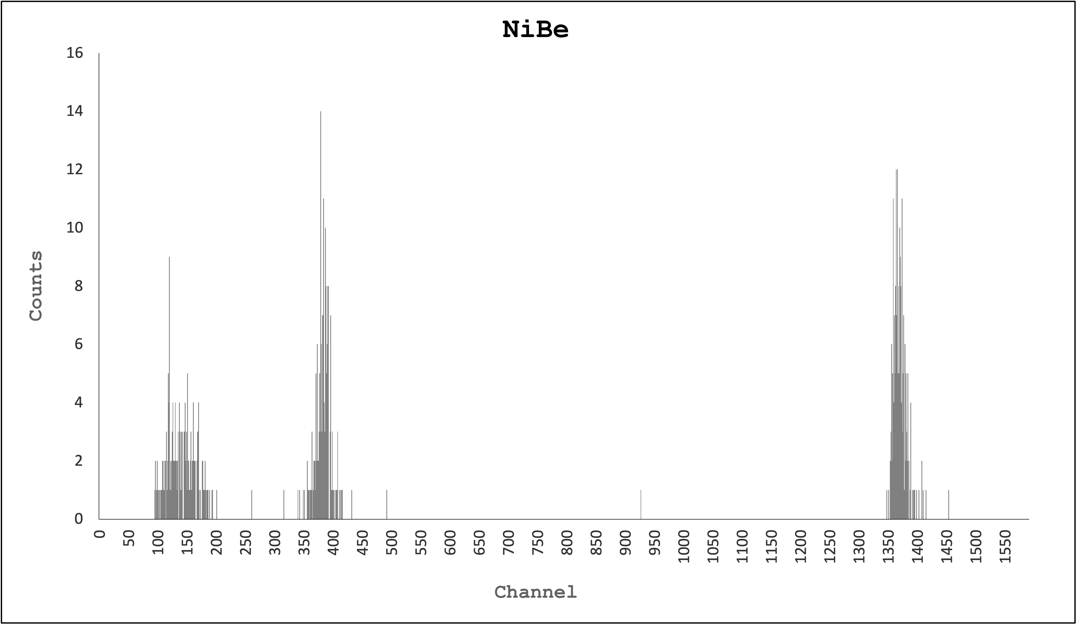
USz latest results
Zr deuterated target
d(d,p)t and d(d,n)³He at 5, 8, 10 and 20 keV
I_{tar} = 180 μA, T_{tar} = 165°C
NiBe deuterated target
d(d,p)t and d(d,n)³He at 8 and 20 keV
I_{tar} = 50 μA, T_{tar} = 80°C
NiLi deuterated target
  d(d,p)t and d(d,n)³He at 8 and 20 keV
  I_{tar} = 85 μA, T_{tar} = 63°C
NiLi clean target
⁶Li(p,𝛼)³He and ⁷Li(p,𝛼)𝛼 at 20 keV
I_{tar} = 100 μA, T_{tar} = 35°C
U_{e} ≅ 100 eV
U_{e}^{theo} = 109 eV
HV
U_{e} ≅ 450 eV
PRELIMINARY RESULTS
U_{e} ≅ 300 eV
only few counts of 𝛼
Sept 27, 2022
@ 15th International Workshop on Anomalies in Hydrogen Loaded Metals, Assisi, Italy
12

Slide 13
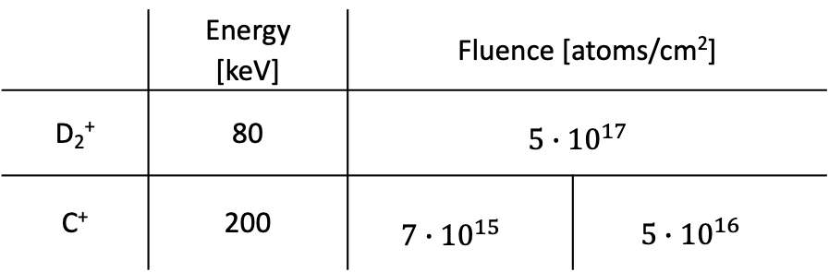
Surface and bulk studies with PAS for Zr+D+C
 | Energy [keV] | Fluence [atoms/cm²]
D₂⁺ | 80 | $$5∙10^{17}$$
C⁺ | 200 | $$7∙10^{15}$$ | $$5∙10^{16}$$
The higher S parameter the higher concentration od defects.
Large amount of vacancies in the deuteron range.
The same depths distribution observed for targets implanted additionally with carbon.
Vacancy density is the same for different C amounts – saturation of vacancy density?
Vacancy density at large depth is smaller than for the reference sample – diffusion of vacancies towards surface?
For details see: M. Valat, Wednesday 9:30
Sept 27, 2022
@ 15th International Workshop on Anomalies in Hydrogen Loaded Metals, Assisi, Italy
13

Slide 14
s
Colclusions
There are experimental results showing very high electron screening energies, but some of them are too optimistic due to specific drawbacks in the experimental and analytical procedures.
The experimental studies of LENR using accelerator at University of Szczecin were driven to determine usefulness of targets like: Zr, NiBe and NiLi. Further experiments and detailed data analysis is needed.
A new fast analysis is implemented, allowing for enhancement estimation. For Zr experimentally observed screening energy agrees with the theoretical predictions.
Cross section can be enhanced due to crystal lattice defects, resulting in larger effective electron mass. The formation of metal oxide layers is common in vacuum systems, therefore surface and bulk analysis needs to be regularly implemented in further study.
Clean targets, as well as very contaminated, show low screening. ’Slight’ contaminations increase the screening energy. Presumably, we could manipulate the cross section by controlling the number of crystal defects in the metallic lattice.
Sept 27, 2022
@ 15th International Workshop on Anomalies in Hydrogen Loaded Metals, Assisi, Italy
14

Slide 15
Thank you!
Any questions?
This project has received funding from the European Union’s Horizon2020 research and innovation programme under grant agreement no 951974.
This work reflects only the author's view and the European Commission is not responsible for any use that may be made of the information it contains.

