Slide 1
A technological foresight for the future deployment of different types of HME energy sources
Frank Ballarano – Erick Braquet – Cyril Calatrava – Philippe Koehl Jacques Ruer*
IWAHLM15 - Assisi – September 2022
The CleanHME project has received funding from the European Union’s Horizon2020 research and innovation programme under grant agreement no 951974

Slide 2
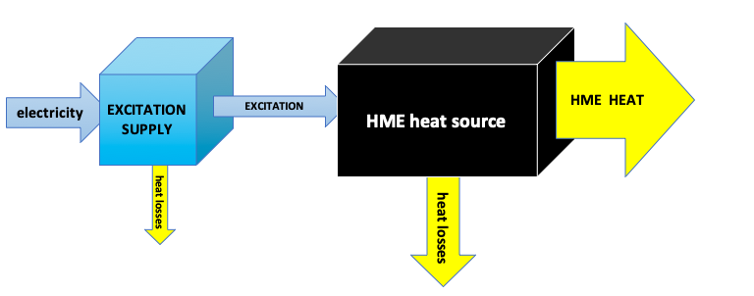
HME Heat source
Assumption: HME reactor that generates heat
What can we do with it ?
What are the uses of heat that
could benefit from HME ?
Study included as one CleanHME task
First part of the study : What are the
present uses of heat
September 2022
IWAHLM15 – Assisi

Slide 3
HME is a new source of heat
Use of the heat
Source of energy
HEAT
HME reactors may displace:
Combustion of fossil fuels
Nuclear reactors
Solar collectors
Electrical heating
September 2022
IWAHLM15 – Assisi

Slide 4
Direct and indirect use of heat
DIRECT USE OF HEAT
Use of the heat
Source of energy
HEAT
INDIRECT USE OF HEAT
Use of the entity
Source of energy
HEAT
Conversion in another entity
September 2022
IWAHLM15 – Assisi

Slide 5
Examples of direct use of heat
Use of the heat
Source of energy
HEAT
Space heating
Metal melting
Distillation
Etc..
September 2022
IWAHLM15 – Assisi

Slide 6
Examples of indirect use of heat
Internal Combustion Engine → Mobility
Metal foundry → Metallic goods
Steam turbine → Electricity
Etc..
Use of the entity
Source of energy
HEAT
Conversion in another entity
DIRECT or INDIRECT depend on the point of view
September 2022
IWAHLM15 – Assisi

Slide 7
Direct and indirect use of heat
DIRECT USE OF HEAT
Use of the heat
Source of energy
HEAT
HME
HME
INDIRECT USE OF HEAT
Use of the entity
Source of energy
HEAT
Conversion in another entity
WE MUST CONSIDER BOTH
September 2022
IWAHLM15 – Assisi

Slide 8
Investigation of the present heat uses
Information desired:
Type of uses – Number of users in the world at the different temperature levels and power levels – power density –
Source of information:
Statistics from governments and institutions (EU – DOE – IEA – national bodies)
Statistics from particular professional organisations (BP World review – Oil & Gas Refineries – Cement – Iron & Steel – Pulp & paper – etc…)
Review of the literature
September 2022
IWAHLM15 – Assisi

Slide 9
Investigation of the present heat uses
First remarks:
No sources give the information required directly
Different studies use different reference frames to describe the industry
Studies dating from a few years ago must be reanalysed to take the evolution into account
Statistics for EU28 and EU27 make comparison difficult in Europe
Recent economic situation (COVID) complicates the reanalysis – reference year : 2019 or 2020
September 2022
IWAHLM15 – Assisi

Slide 10
Investigation of the present heat uses
Difficulties:
A major source of statistical data are devoted to the consumption of the fossil fuels or the emissions of CO₂
Coherence with other sources of information is not always observed
Data for residential and commercial sectors are only meaningful in OECD countries
Different units (Quadrillion Btu – EJ – PJ – Mtoe – MWh – etc..)
September 2022
IWAHLM15 – Assisi

Slide 11
Investigation of the present heat uses
Some careful analysis is requested. For examples:
Iron production in blast furnace: Not all the coal and coke consumed should be accounted as energy because some carbon is used for iron ore reduction
Aluminium industry: Production of alumina uses heat at low temperature (Bayer process) and at high temperature (alumina firing) while production of aluminium uses electricity
Power stations electricity output is not heat input
Etc…
September 2022
IWAHLM15 – Assisi

Slide 12
Investigation of the present heat uses
Methodology :
Necessity to simplify the data collected especially for the industrial uses
Extrapolations are used to translate regional data into global data – this introduces distortion and inaccuracies
Introduction of average users for the different categories – the number of users can only be approximated
Future trends are not considered for the moment but will be in the continuation of the study if justified
September 2022
IWAHLM15 – Assisi

Slide 13
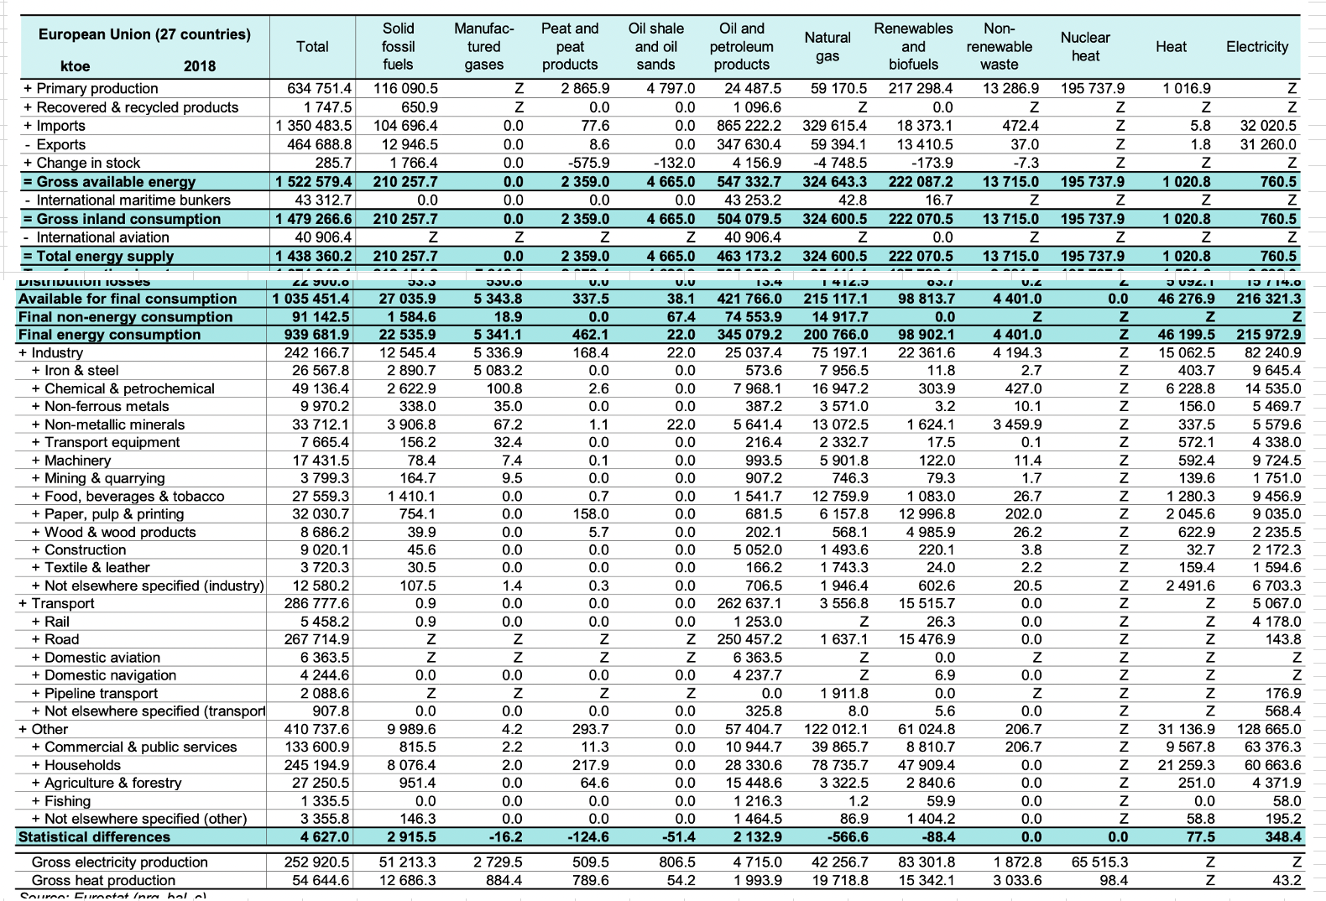
Investigation of the present heat uses
EXAMPLE : EUROSTAT – Energy data – 2020 edition
September 2022
IWAHLM15 – Assisi

Slide 14
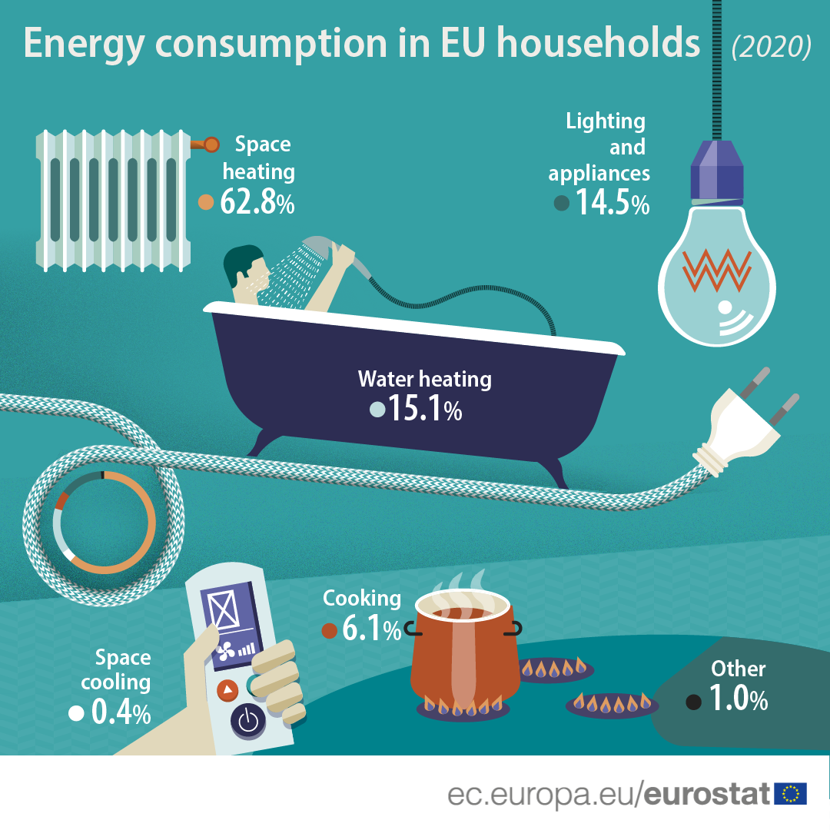
Investigation of the present heat uses
Residential :
How many appliances and devices ?
EU 28:
6400kWh/a per capita
USA :
11000kWh/a per capita
MANY COUNTRIES:
Much less
EUROSTAT – Energy data – 2020 edition
September 2022
IWAHLM15 – Assisi

Slide 15
Industrial uses of heat :
Energy-intensive sectors
PJ (10¹⁵J) | Low temperature (<100°C- | Medium temperature (100°C – 400°C) | High temperature (>400°C) | Sum | Energy intensive industries
Iron and Steel | 50 | 53 | 1044 | 1147 | 1147
Non-ferrous metals | 10 | 5 | 98 | 113 | 113
Chemicals | 351 | 180 | 346 | 877 | 877
Mineral products | 57 | 53 | 826 | 936 | 936
Ore extraction | 7 | 5 |  | 12
Food and beverages | 256 | 162 |  | 418 | 418
Textile | 23 | 36 | 13 | 72
Paper | 175 | 246 | 92 | 513 | 513
Transport equipment | 29 | 10 | 4 | 43
Machinery | 67 | 22 | 10 | 99
Other industries | 119 | 58 | 29 | 206
TOTAL (PJ/a) | 1144 | 830 | 2462 | 4436 | 4004
Total Mtoe/a | 27,32 | 19,82 | 58,8 | 105,94
Quantification of the European industrial heat demand by branch and temperature level
Tobias Naegler*,†, Sonja Simon, Martin Klein and Hans Christian Gils
INTERNATIONAL JOURNAL OF ENERGY RESEARCH Int. J. Energy Res. 2015; 39:2019–2030
Energy-intensive = 90% of total
Industry analysis: limited to energy-intensive industries
September 2022
IWAHLM15 – Assisi

Slide 16
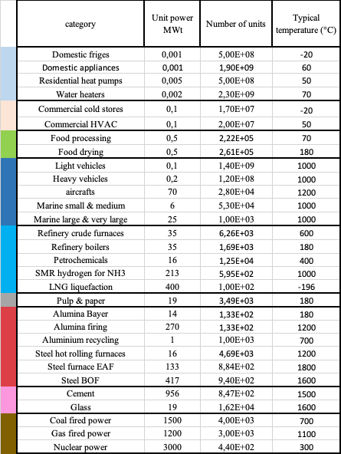
World uses of heat
Estimates of number of users per sector
Estimations only !
Industry: Only selected energy-intensive sectors
(Many industries missing)
Residential and commercial: extrapolations from EU or OECD statistics
September 2022
IWAHLM15 – Assisi

Slide 17
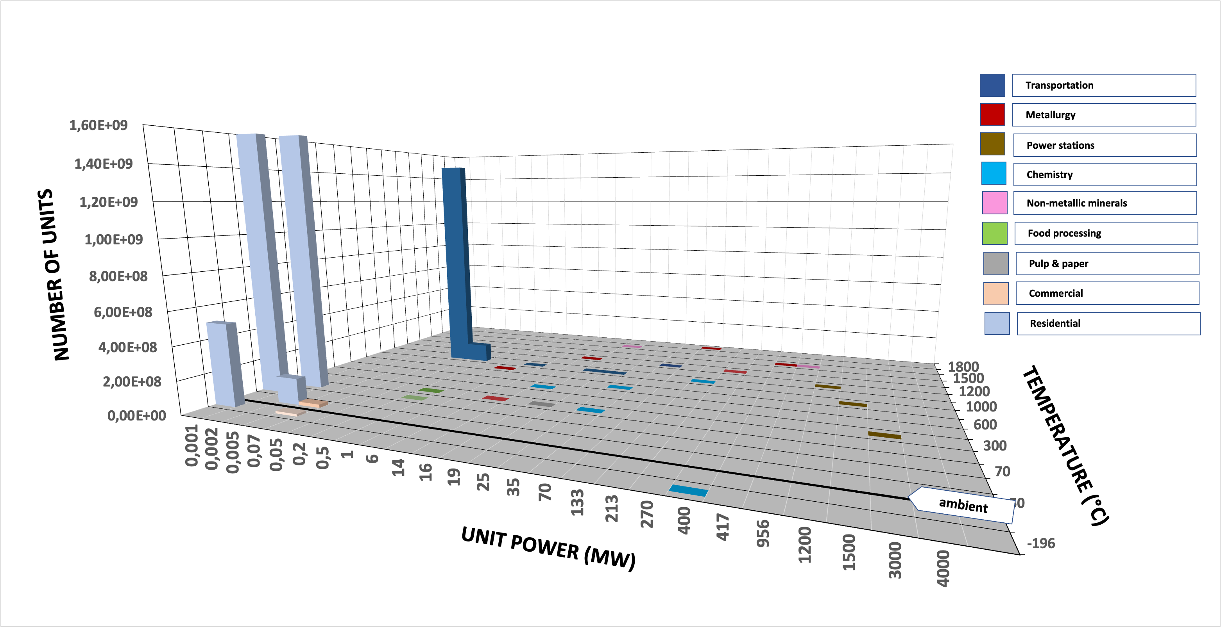
Overview of Heat Users
September 2022
IWAHLM15 – Assisi

Slide 18
Overview of Heat Users
Linear scale
Residential appliances
Cars
September 2022
IWAHLM15 – Assisi

Slide 19
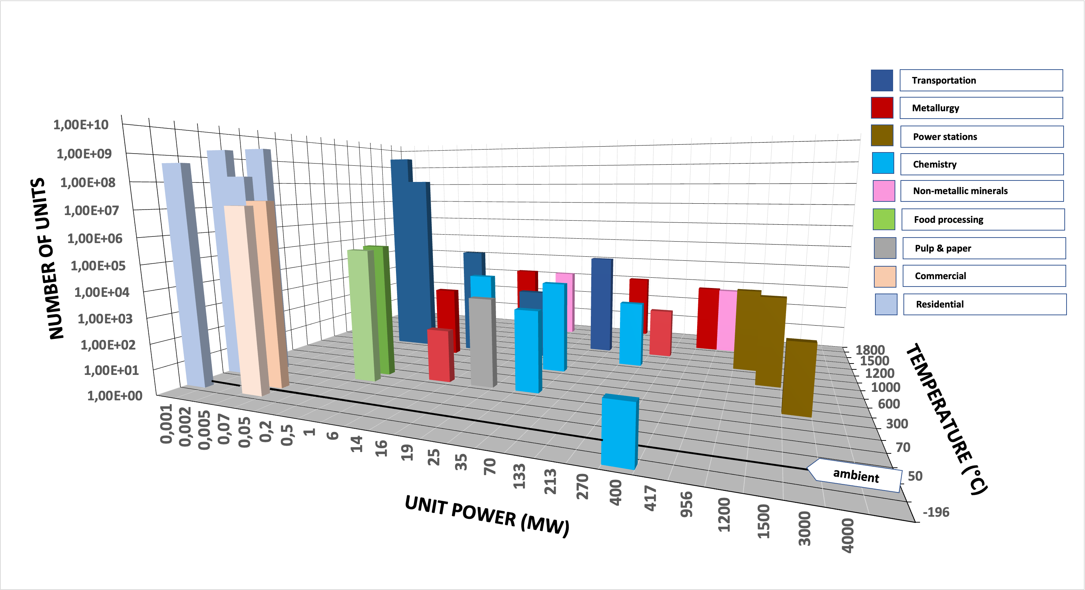
Overview of Heat Users
September 2022
IWAHLM15 – Assisi

Slide 20
Overview of Heat Users
Logarithmic scale
440
Nuclear reactors
1 400 000 000 automobiles
Power levels, typical temperatures and numbers of users are only indicative
September 2022
IWAHLM15 – Assisi

Slide 21
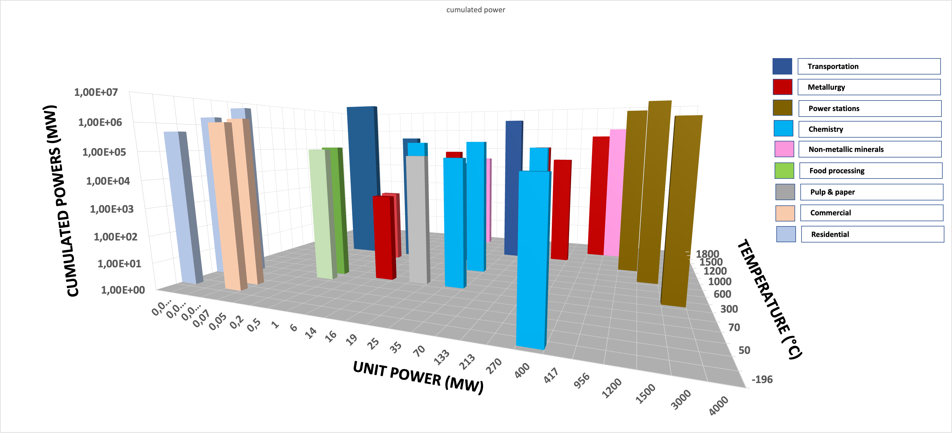
Cumulated installed power per sector
Cumulated powers - Logarithmic scale
September 2022
IWAHLM15 – Assisi

Slide 22
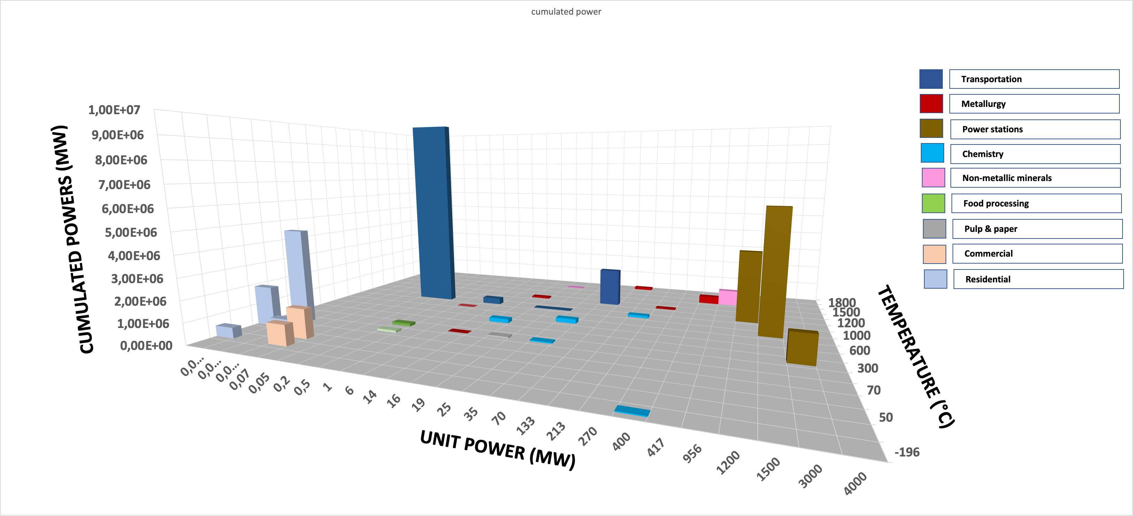
Cumulated installed power per sector
7.2 E7
Cumulated powers - Linear scale
September 2022
IWAHLM15 – Assisi

Slide 23
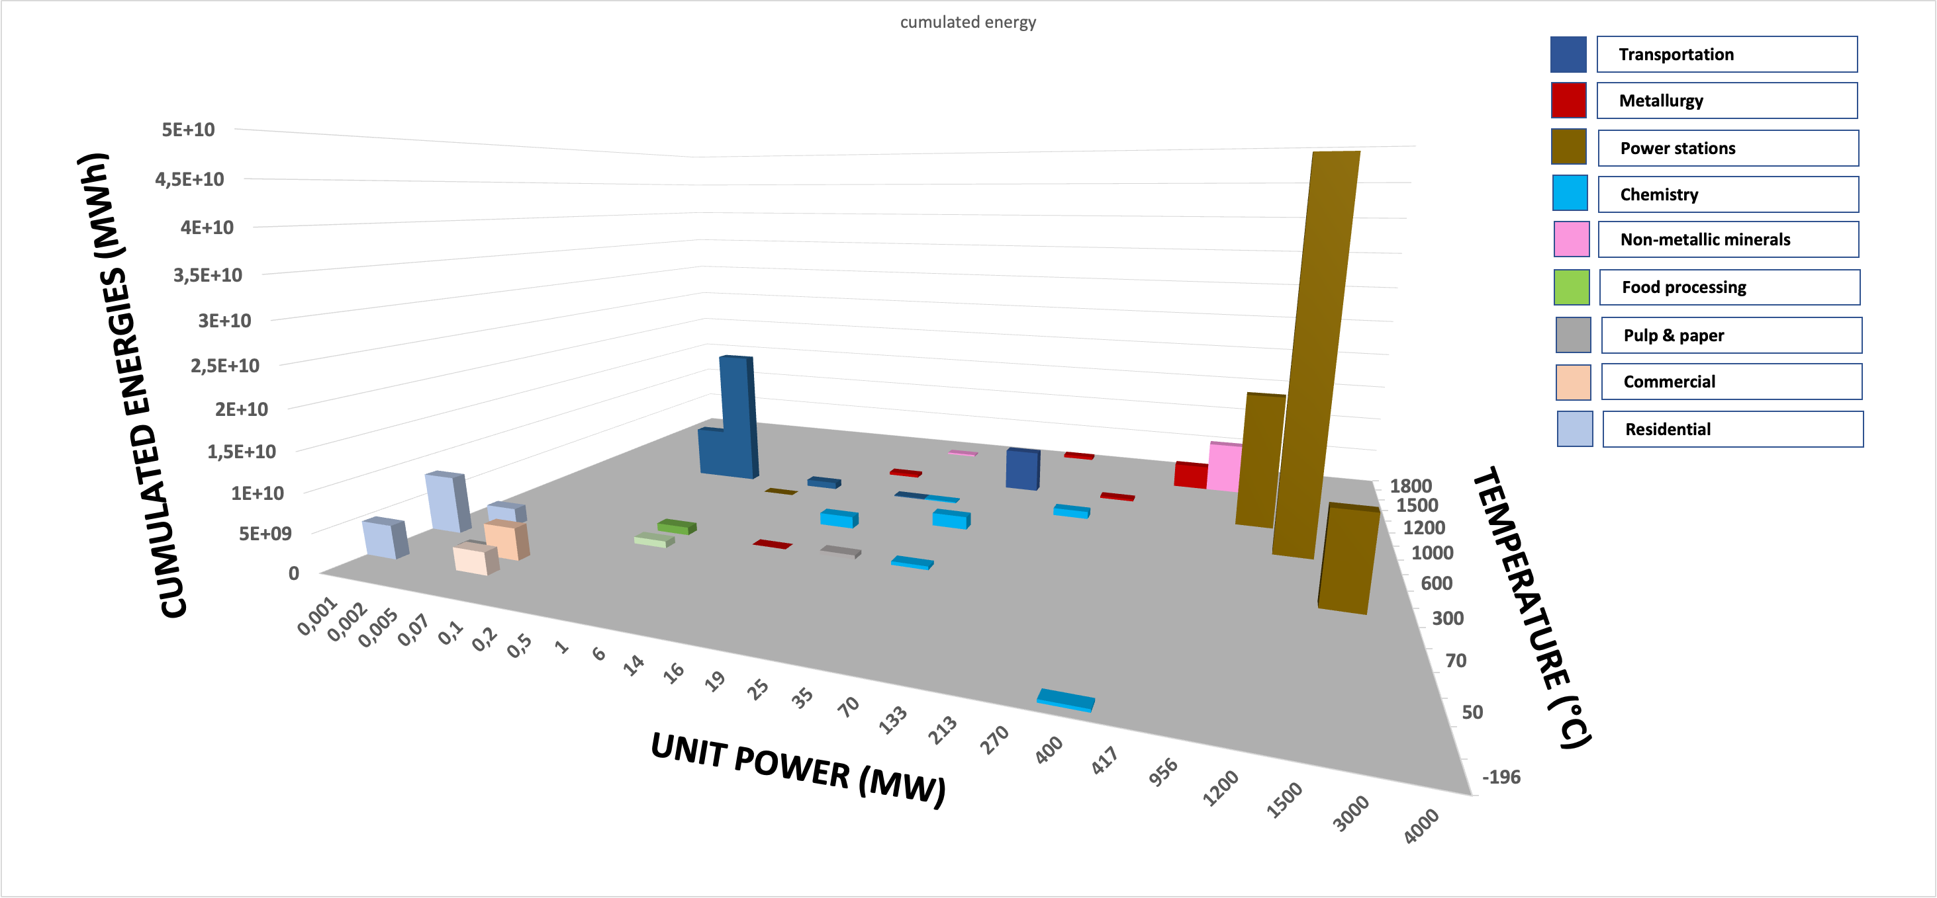
Cumulated HEAT consumed per sector
Cumulated energies - Logarithmic scale
September 2022
IWAHLM15 – Assisi

Slide 24
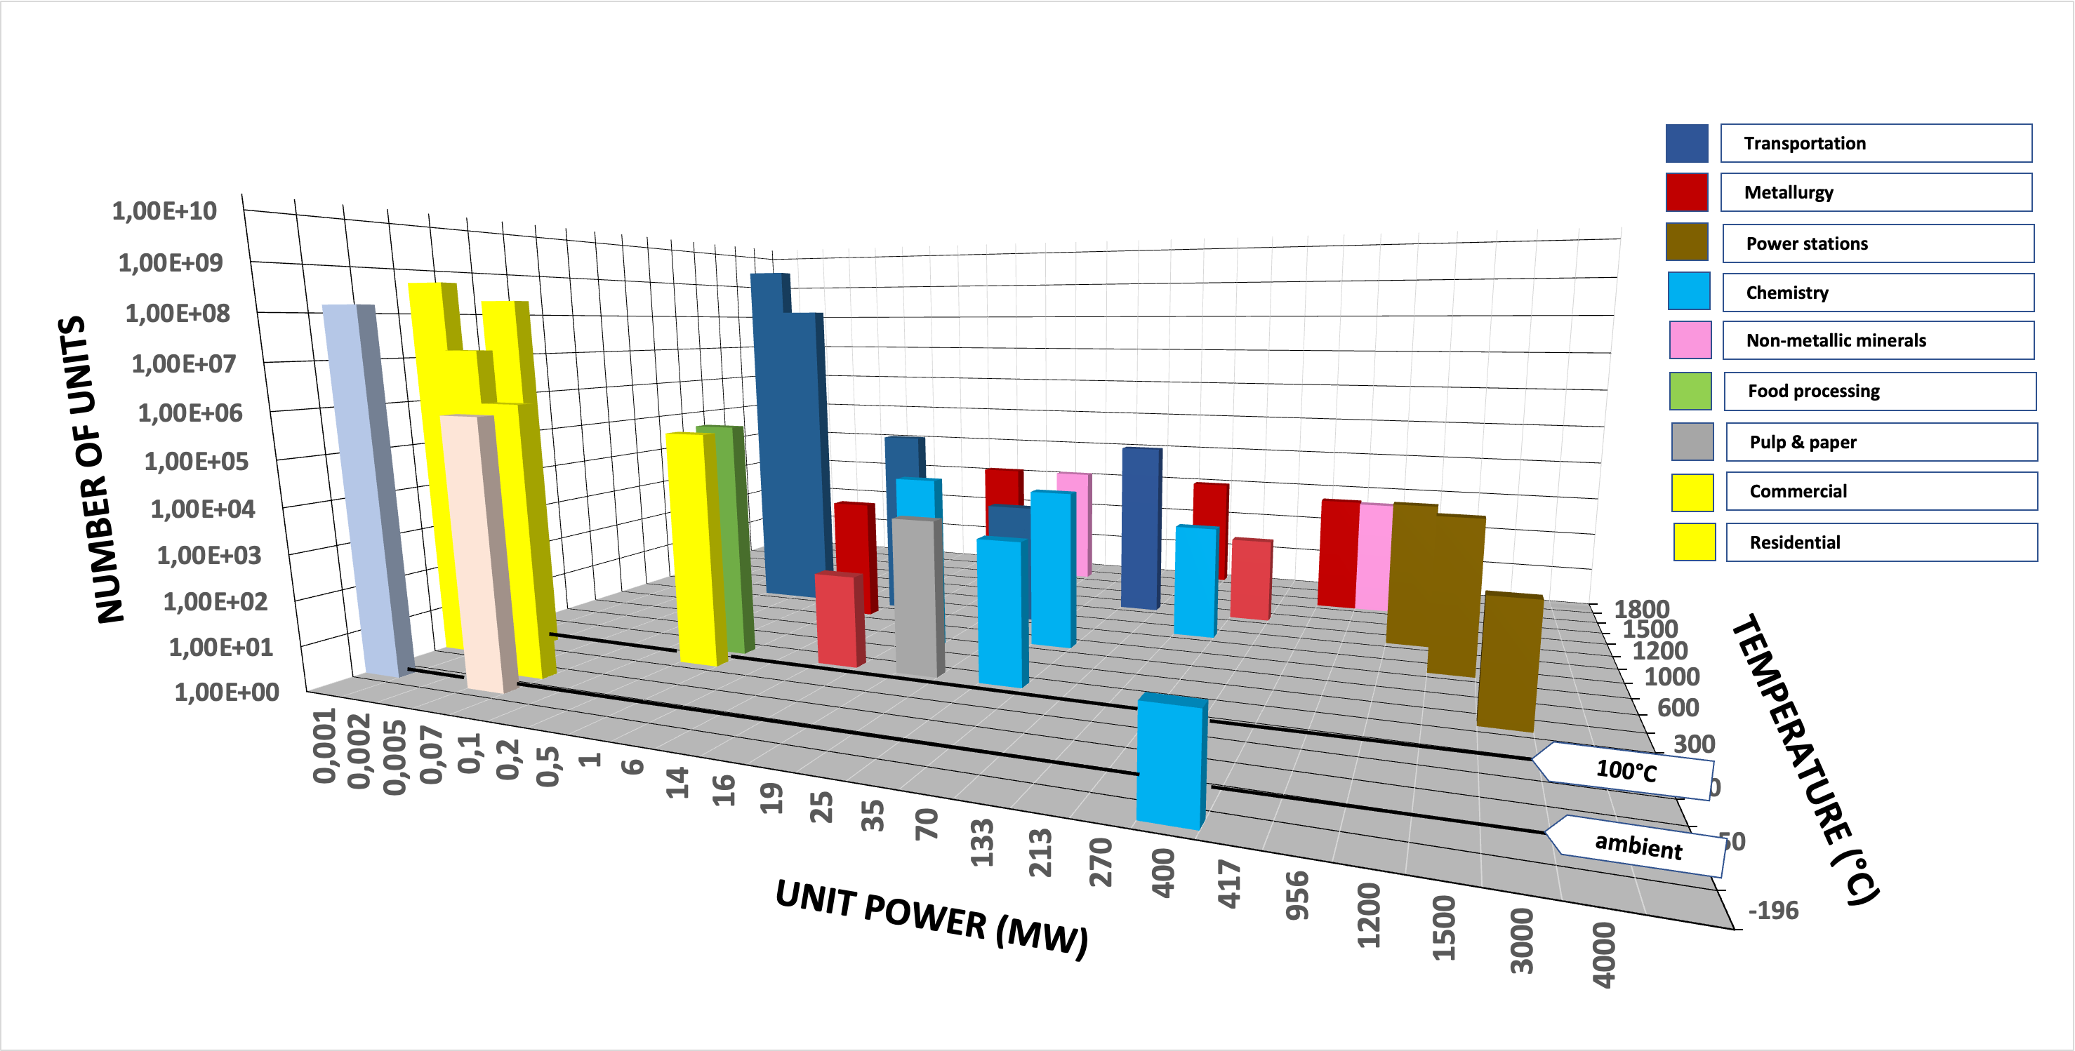
Introduction of 100°C Class HME
100°C sources : huge market for residential and commercial uses
September 2022
IWAHLM15 – Assisi

Slide 25
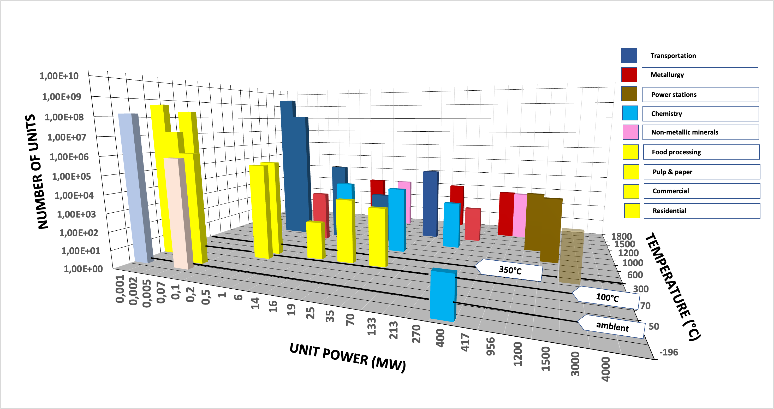
Introduction of 350°C Class HME
200°C to 350°C sources : large market for industrial boilers
September 2022
IWAHLM15 – Assisi

Slide 26
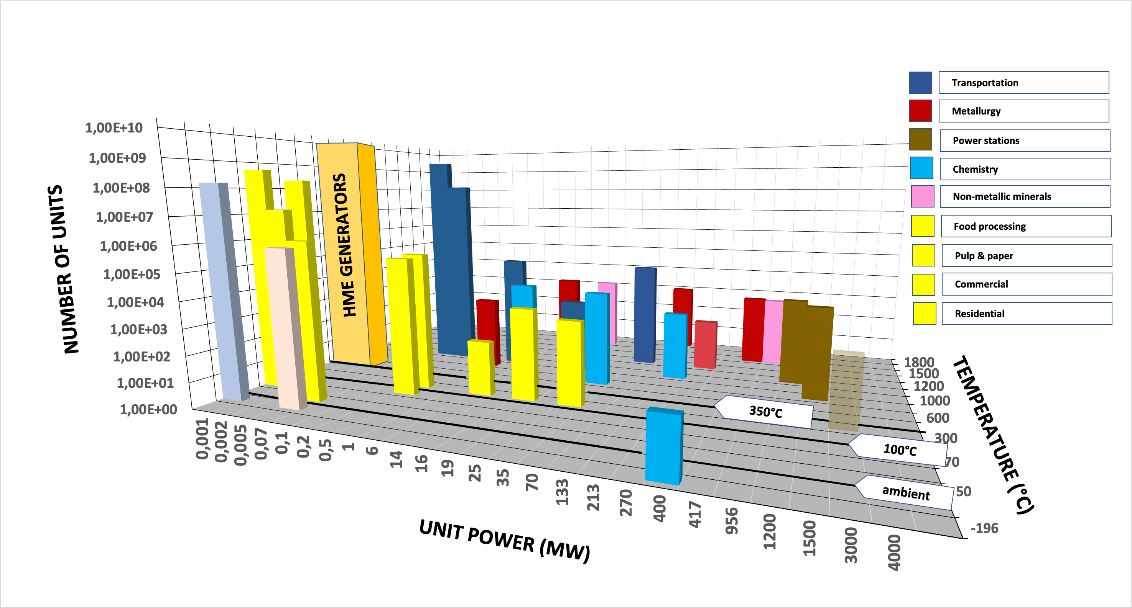
Introduction of HME Generators
350°C+ sources : Heat conversion in electricity
September 2022
IWAHLM15 – Assisi

Slide 27
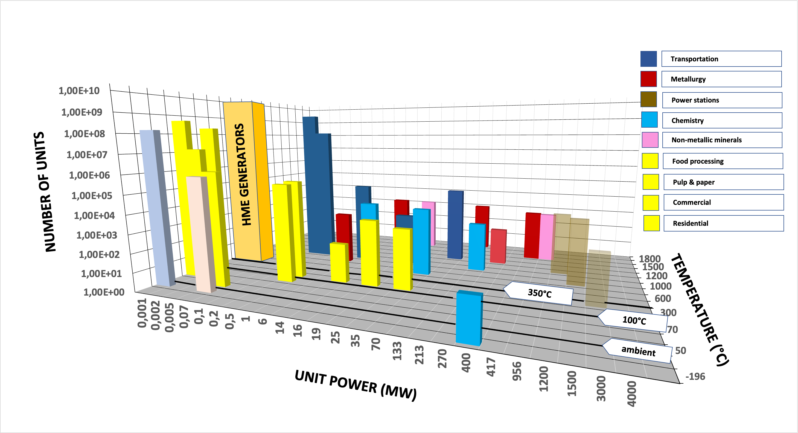
HME generators replace power stations
350°C+ sources : All power stations progressively displaced
September 2022
IWAHLM15 – Assisi

Slide 28
HME generators can supply all users
350°C+ sources : Industrial uses of fossil fuels progressively displaced
September 2022
IWAHLM15 – Assisi

Slide 29
What about mobility ?
Road
Marine
Air
Internal Combustion Engines and Aircraft Engines : Indirect use – heat conversion
Fossil fuels offer a unique high specific energy density
September 2022
IWAHLM15 – Assisi

Slide 30
What about mobility ?
Road
Marine
Air
Mobile equipment :
Difficult to supply the heat that is used indirectly
Necessity of high power density (> 1kW/liter)
May be satisfied indirectly:
Electricity for recharge of electric vehicles
Supply of hydrogen
Synthetic fuels via H₂ and CO₂ (Direct Air Capture)
Internal Combustion Engines and Aircraft Engines : Indirect use – heat conversion
Fossil fuels offer a unique high specific energy density
September 2022
IWAHLM15 – Assisi

Slide 31
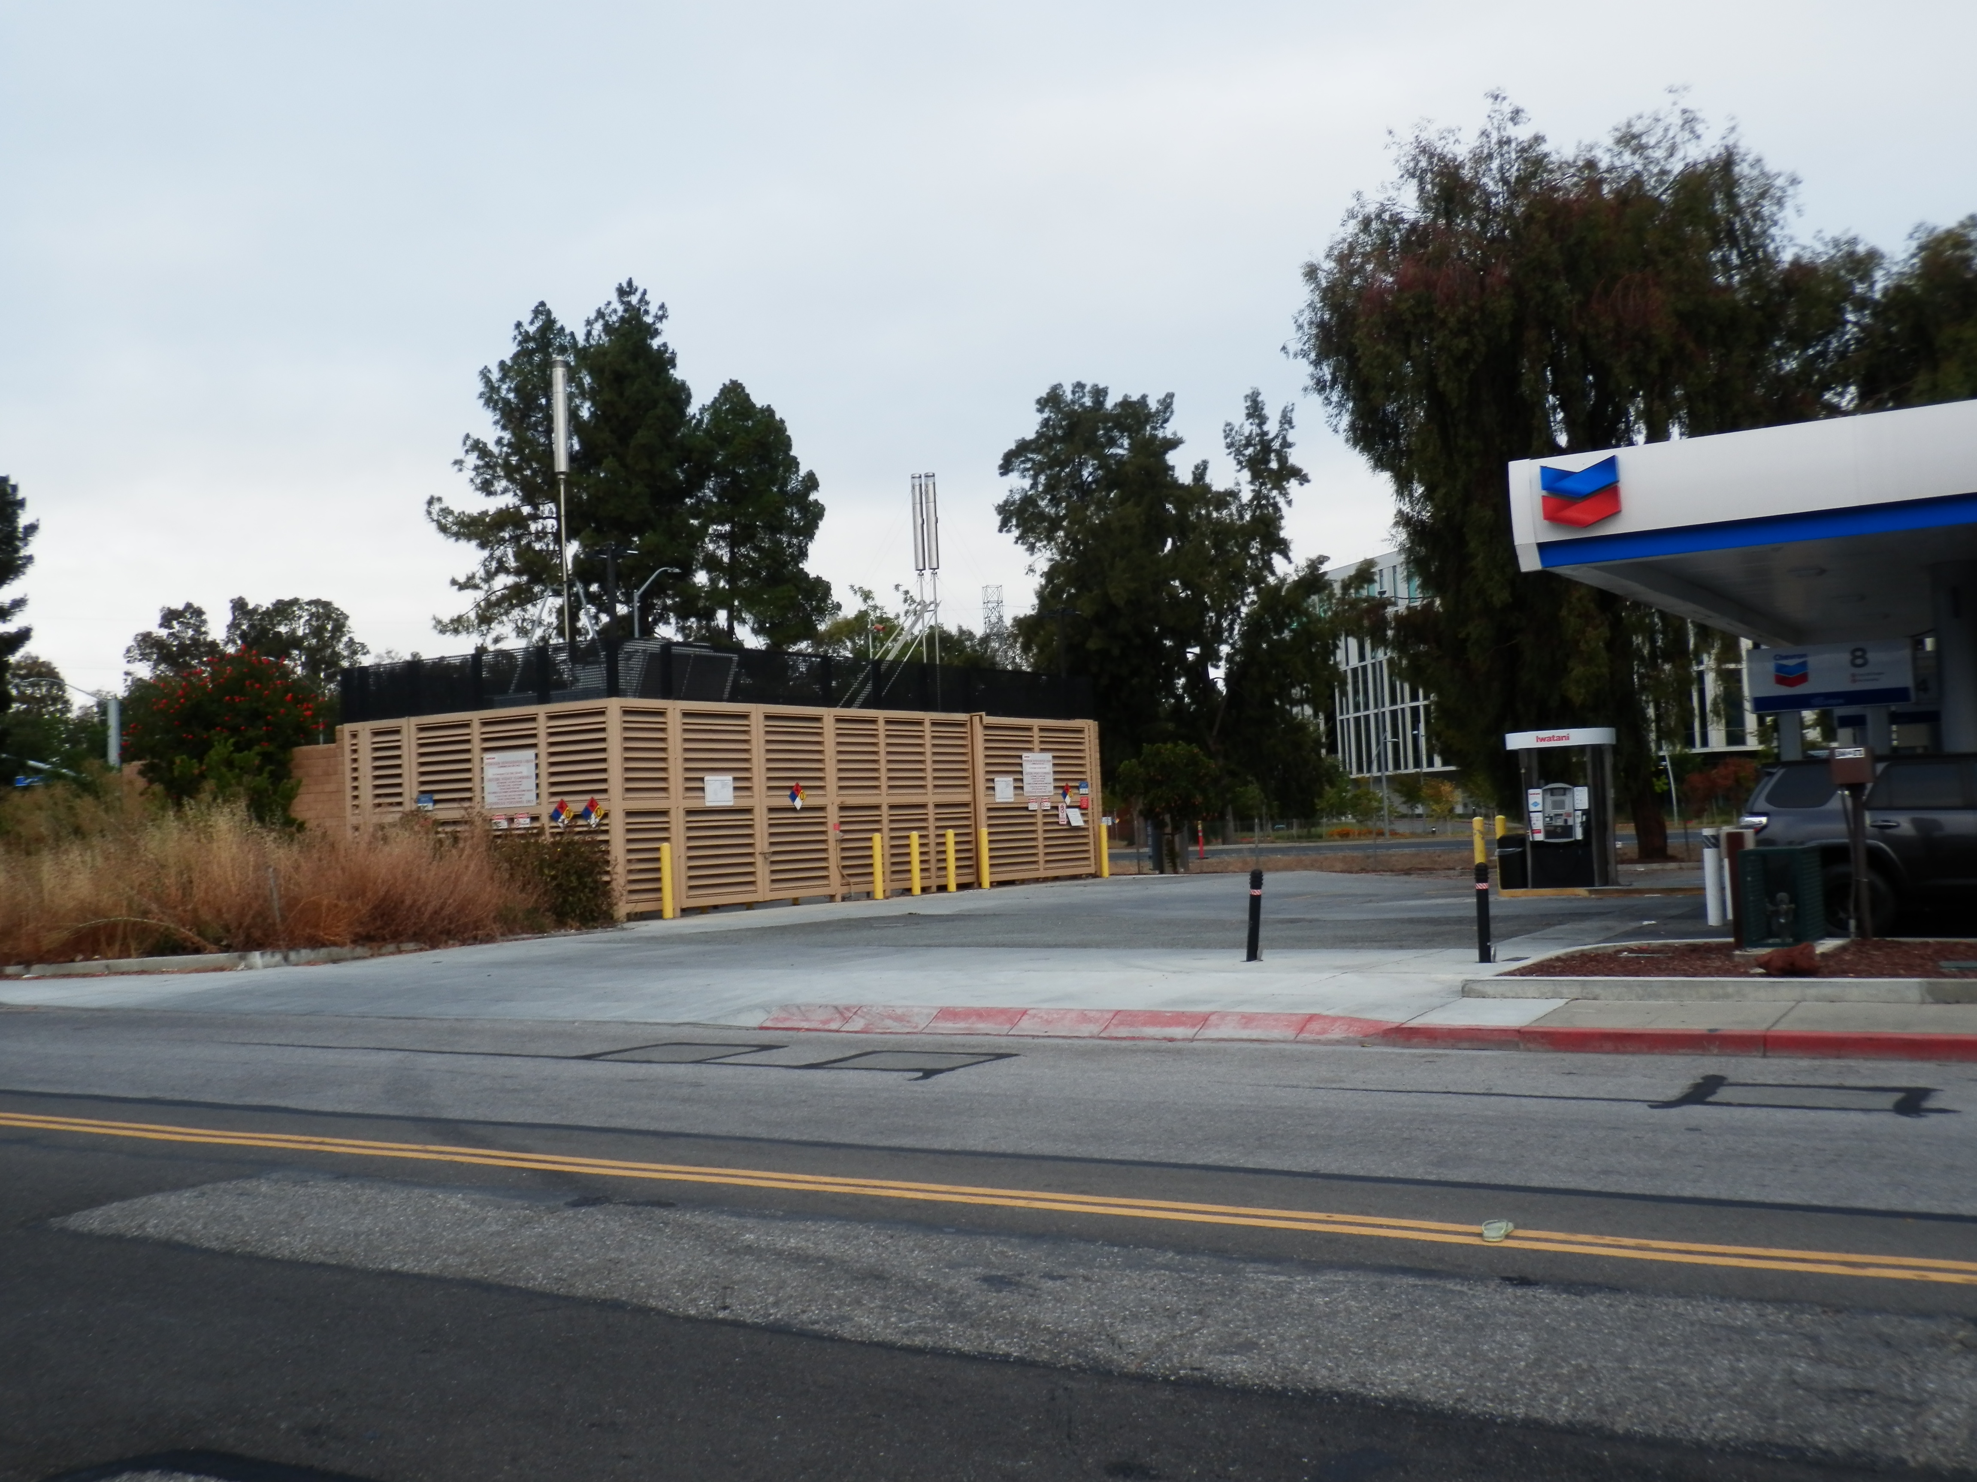
What about mobility ?
Hydrogen refuelling station in Mountain View : The future?
September 2022
IWAHLM15 – Assisi

Slide 32
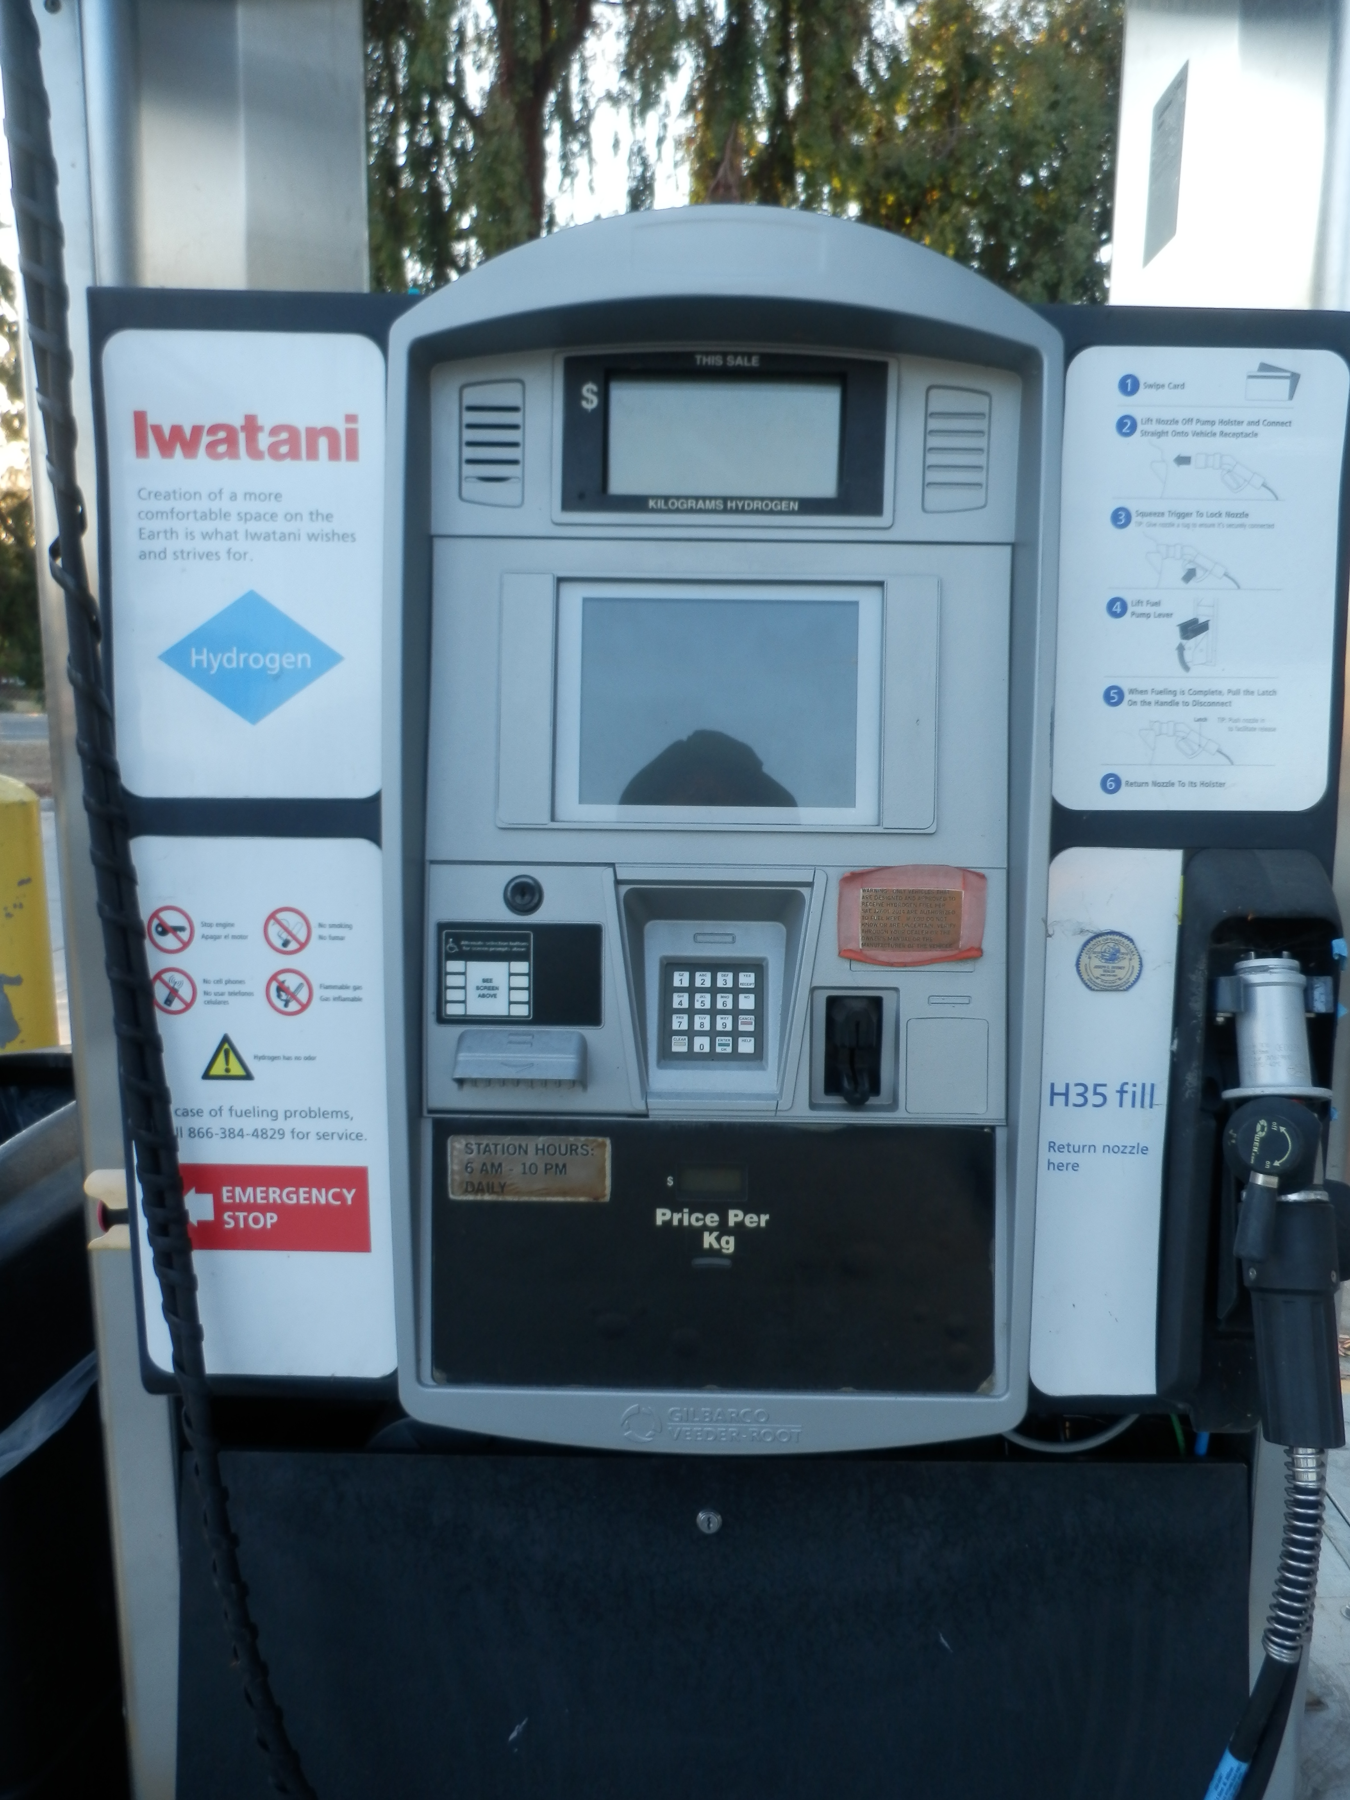
What about mobility ?
Hydrogen refuelling station in Mountain View : The future?
September 2022
IWAHLM15 – Assisi

Slide 33
Addressable market
HME temperature: | < 100°C | <200°C | < 300°C | > 300°C
HME HEAT SOURCES | Residential heating x 10⁹ units kW | Commercial & industrial heating x 10⁶ units 100_{S} kW
HME HEAT SOURCES | Residential heating x 10⁸ units Several kW | Low pressure Boilers x 10⁶ units 100_{S} kW -MW | High pressure boilers x 10⁵ units 100_{S} kW -MW | Process heat x 10⁴ units 100_{S} kW -MW
HME GENERATORS |  | Autonomous systems x 10⁶ units 100_{S} kW -MW | Steam turbines x 10⁵ units 100_{S} kW -MW | Power generators x 10⁹ units kW - MW
SOLID STATE | Future developments
September 2022
IWAHLM15 – Assisi

Slide 34
Prime market
HME temperature: | < 100°C | <200°C | < 300°C | > 300°C
HME HEAT SOURCES | Residential heating x 10⁹ units kW | Commercial & industrial heating x 10⁶ units 100_{S} kW
HME HEAT SOURCES | Residential heating x 10⁸ units Several kW | Low pressure Boilers x 10⁶ units 100_{S} kW -MW | High pressure boilers x 10⁵ units 100_{S} kW -MW | Process heat x 10⁴ units 100_{S} kW -MW
HME GENERATORS |  | Autonomous systems x 10⁶ units 100_{S} kW -MW | Steam turbines x 10⁵ units 100_{S} kW -MW | Power generators x 10⁹ units kW - MW
SOLID STATE | Future developments
September 2022
IWAHLM15 – Assisi

Slide 35
Learning curve
HME temperature: | < 100°C | <200°C | < 300°C | > 300°C
HME HEAT SOURCES | Residential heating x 10⁹ units kW | Commercial & industrial heating x 10⁶ units 100_{S} kW
HME HEAT SOURCES | Residential heating x 10⁸ units Several kW | Low pressure Boilers x 10⁶ units 100_{S} kW -MW | High pressure boilers x 10⁵ units 100_{S} kW -MW | Process heat x 10⁴ units 100_{S} kW -MW
HME GENERATORS |  | Autonomous systems x 10⁶ units 100_{S} kW -MW | Steam turbines x 10⁵ units 100_{S} kW -MW | Power generators x 10⁹ units kW - MW
SOLID STATE | Future developments
September 2022
IWAHLM15 – Assisi

Slide 36
Major market : Electrical generators
HME temperature: | < 100°C | <200°C | < 300°C | > 300°C
HME HEAT SOURCES | Residential heating x 10⁹ units kW | Commercial & industrial heating x 10⁶ units 100_{S} kW
HME HEAT SOURCES | Residential heating x 10⁸ units Several kW | Low pressure Boilers x 10⁶ units 100_{S} kW -MW | High pressure boilers x 10⁵ units 100_{S} kW -MW | Process heat x 10⁴ units 100_{S} kW -MW
HME GENERATORS |  | Autonomous systems x 10⁶ units 100_{S} kW -MW | Steam turbines x 10⁵ units 100_{S} kW -MW | Power generators x 10⁹ units kW - MW
SOLID STATE | Future developments
September 2022
IWAHLM15 – Assisi

Slide 37
Next steps of the study
Evaluate the HME potential development once the characteristics of the reactors are better defined
Examine the technological gaps for the development
Consider the ongoing energy transition and the competition of renewable energies
September 2022
IWAHLM15 – Assisi

Slide 38
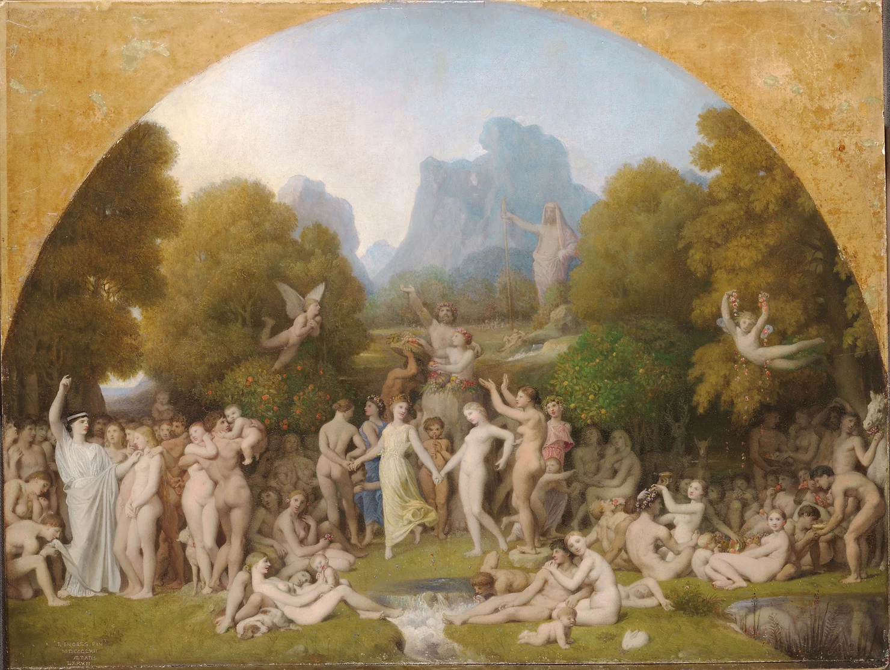
The end of our Golden Age
As we are nearing the launch of applications it is now time to remember that there are always several solutions to a problem
HME will not conquer a virgin World but will face competition in many sectors.
HME will be adopted only where it is better than other existing options
Jean-Auguste-Dominique Ingres - L'Âge d'or, 1862, - Fogg Art Museum, Cambridge
September 2022
IWAHLM15 – Assisi

Slide 39
The end of our Golden Age
As we are nearing the launch of applications it is now time to remember that there are always several solutions to a problem
HME will not conquer a virgin World but will face competition in many sectors.
HME will be adopted only where it is better than other existing options
September 2022
IWAHLM15 – Assisi

Slide 40
Competition ahead ? : An example
HME reactor
Use of the heat
Electricity
HEAT
September 2022
IWAHLM15 – Assisi

Slide 41
Competition ahead ? : An example
HME reactor
Use of the heat
Electricity
HEAT
Heat Pump
September 2022
IWAHLM15 – Assisi

Slide 42
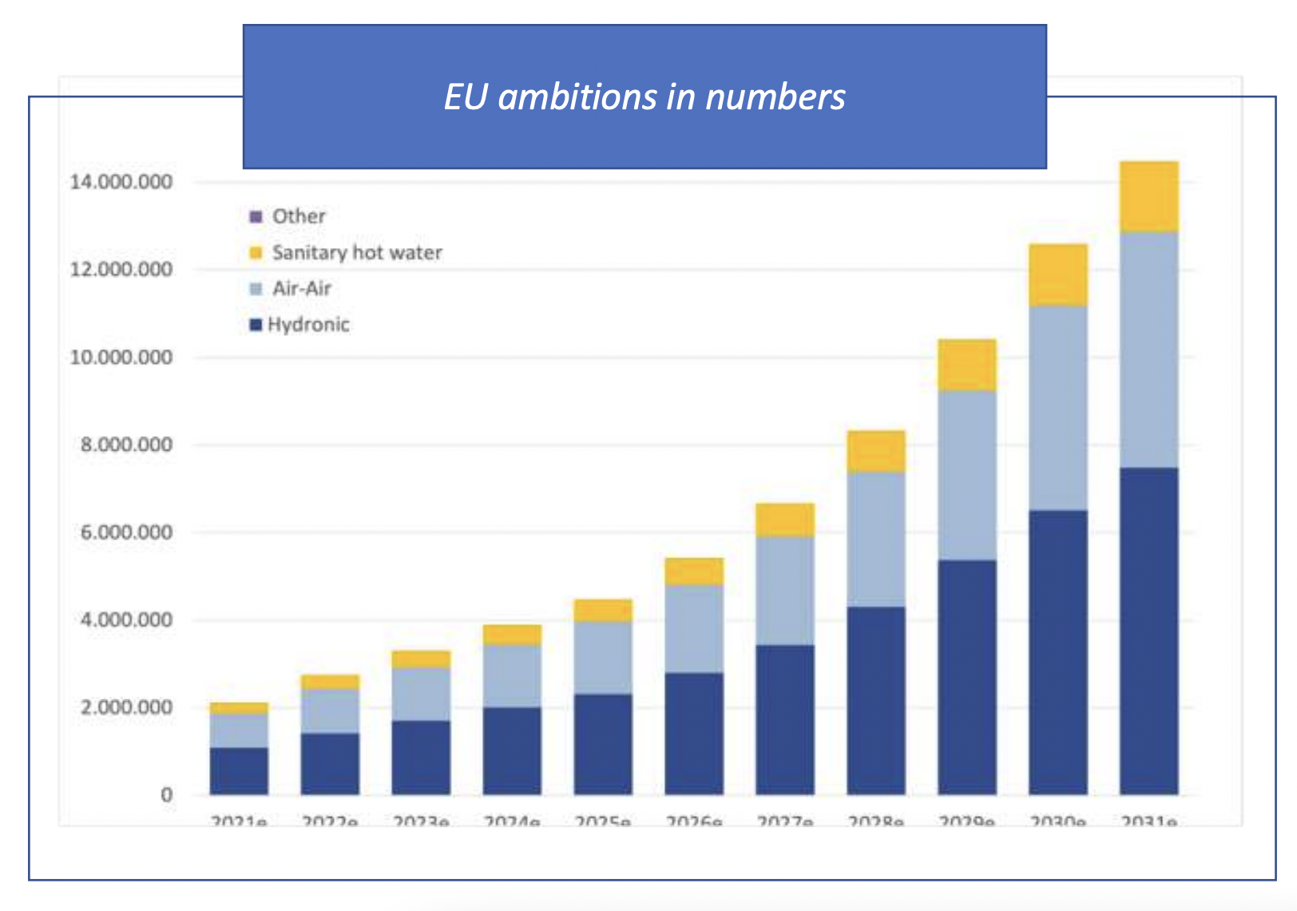
Competition ahead ? :
Example : Heat Pumps
September 2022
IWAHLM15 – Assisi

Slide 43
CONCLUSIONS
HME heat sources may find a large use for space heating and water heating – Many units with low thermal power
The learning curve will give access to larger units and higher temperatures
Development of large units will open the market for industrial boilers
HME electricity generators will find applications at all scales of power
Transportation requires high HME specific power – May be accessed indirectly via the synthesis of fuels, with no modification of the existing engines and energy distribution infrastructure
Competition will exist
September 2022
IWAHLM15 – Assisi

Slide 44
Thank you! Any questions?
The CleanHME project has received funding from the European Union’s Horizon2020 research and innovation programme under grant agreement no 951974
This work reflects only the author's view and the European Commission is not responsible for any use that may be made of the information it contains.

