Slide 1



A classification of the different types of HME heat sources
Frank Ballarano – Erick Braquet – Cyril Calatrava – Philippe Koehl Jacques Ruer*
IWAHLM15 - Assisi – September 2022
The CleanHME project has received funding from the European Union’s Horizon2020
research and innovation programme under grant agreement no 951974

Slide 2
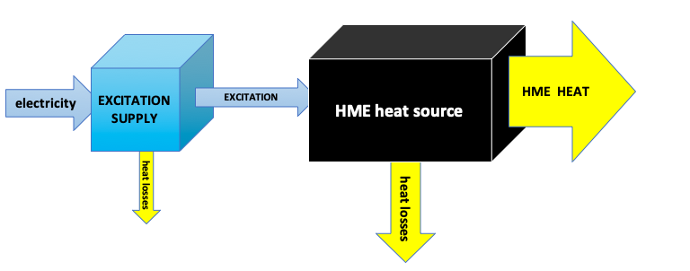

HME Heat source
Assumption: HME is a reactor that generates heat
September 2022 IWAHLM15 - Assisi

Slide 3
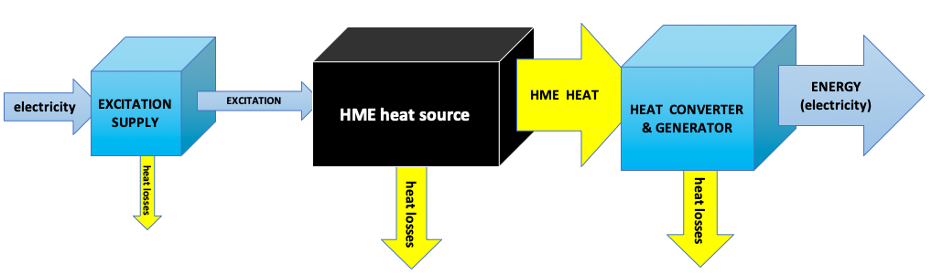
HME Heat source
Assumptions:
  HME heat may supply a thermodynamic converter
  The converter may generate electricity
September 2022 IWAHLM15 - Assisi

Slide 4
HME Heat source
Assumptions:
  HME heat may supply a thermodynamic converter
  The converter may generate electricity
feedback
  Feedback possible
September 2022 IWAHLM15 - Assisi

Slide 5
Types of HME heat sources
The following classification will probably be temporary, as explained below
TYPE 1 : Excitation energies include some heat
TYPE 2 : Excitation does not include heat
TYPE 3 : Self-sustained system – production of electricity exceeds excitation consumption
TYPE 4: Solid state technology self-sustained (not discussed further here)
September 2022 IWAHLM15 - Assisi

Slide 6
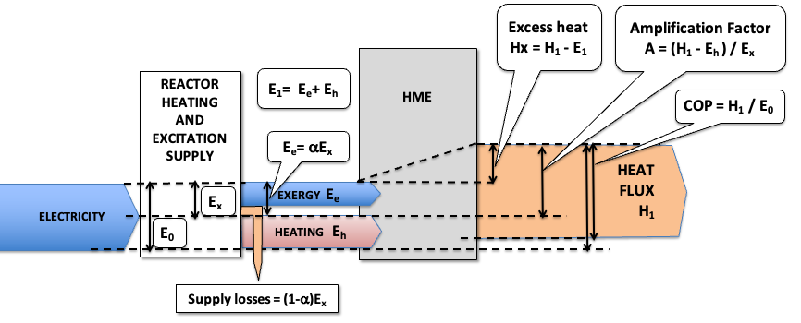
Type 1 – Heating + Excitation
Electrical energy input for :
heating + supply for high exergy excitation
September 2022 IWAHLM15 - Assisi

Slide 7
Type 1 – Heating + Excitation
Electrical energy input for :
heating + supply for high exergy excitation
High exergy = Any form of energy other than heat
September 2022 IWAHLM15 - Assisi

Slide 8
Heating + Exergy Excitation
Why make a distinction between heating and exergy excitation ?
September 2022 IWAHLM15 - Assisi

Slide 9
Heating + Exergy Excitation
Why make a distinction between heating and exergy excitation ?
It is a problem of power control
September 2022 IWAHLM15 - Assisi

Slide 10
Heating + Exergy Excitation
If the excitation is only heat you must control the cooling carefully
September 2022 IWAHLM15 - Assisi

Slide 11
Heating + Exergy Excitation
If the excitation is only heat you must control the cooling carefully
If you don’t you risk a runaway !
September 2022 IWAHLM15 - Assisi

Slide 12
Heating + Exergy Excitation
Cooling method for stable operation if the excitation is only heat
HME power curve
Cooling power curve
HME Operating point
Heat is recovered at this temperature
Heat flow
Reaction is controlled by adjusting the coolant temperature
ΔT
Temperature
September 2022 IWAHLM15 - Assisi

Slide 13
Heating + Exergy Excitation
If the excitation includes some exergy there is an additional method to control the power
September 2022 IWAHLM15 - Assisi

Slide 14
Type 1 – Heating + Excitation
Electrical energy input for :
heating + supply for high exergy excitation
DEFINITIONS:
Excess Heat = Heat output – Energies input to the reactor
Coefficient of Performance =
Heat output / Electricity to excitation supply unit
Amplification factor =
Heat surplus output /Supply of high exergy excitation
September 2022 IWAHLM15 - Assisi

Slide 15
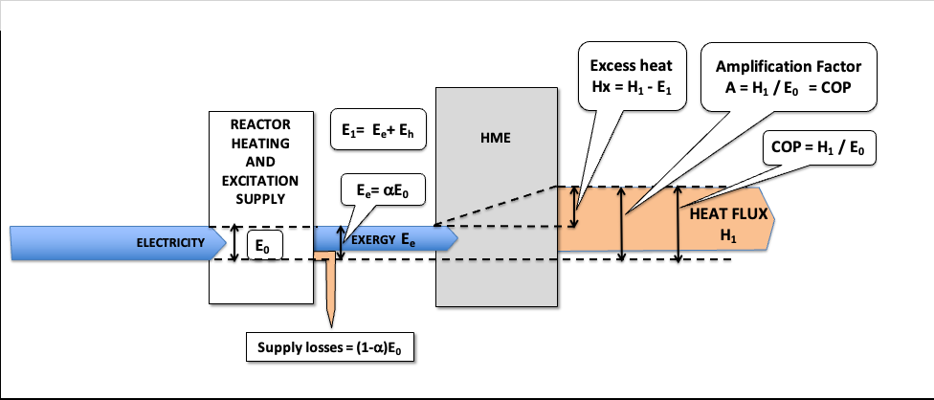
From Type 1 to Type 2
Excess Heat = Not changed by insulation
Amplification factor = Not changed by insulation
Coefficient of Performance = changed by insulation
Low thermal insulation
Good thermal insulation
September 2022 IWAHLM15 - Assisi

Slide 16
From Type 1 to Type 2
Excess Heat = Not changed by insulation
Amplification factor = Not changed by insulation
Coefficient of Performance = changed by insulation
COP is not the relevant metrics
AMPLIFICATION FACTOR and
EXCESS HEAT SPECIFIC ENERGY (W/kg)
should be preferred to evaluate the performance of a HME reactor
September 2022 IWAHLM15 - Assisi

Slide 17
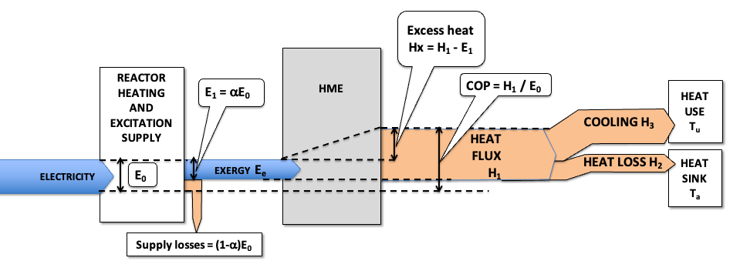
Type 2 : Heat export
Excess Heat = heat loss + heat export
Useful heat exported for uses
Heat loss may be recovered for other uses
September 2022 IWAHLM15 - Assisi

Slide 18
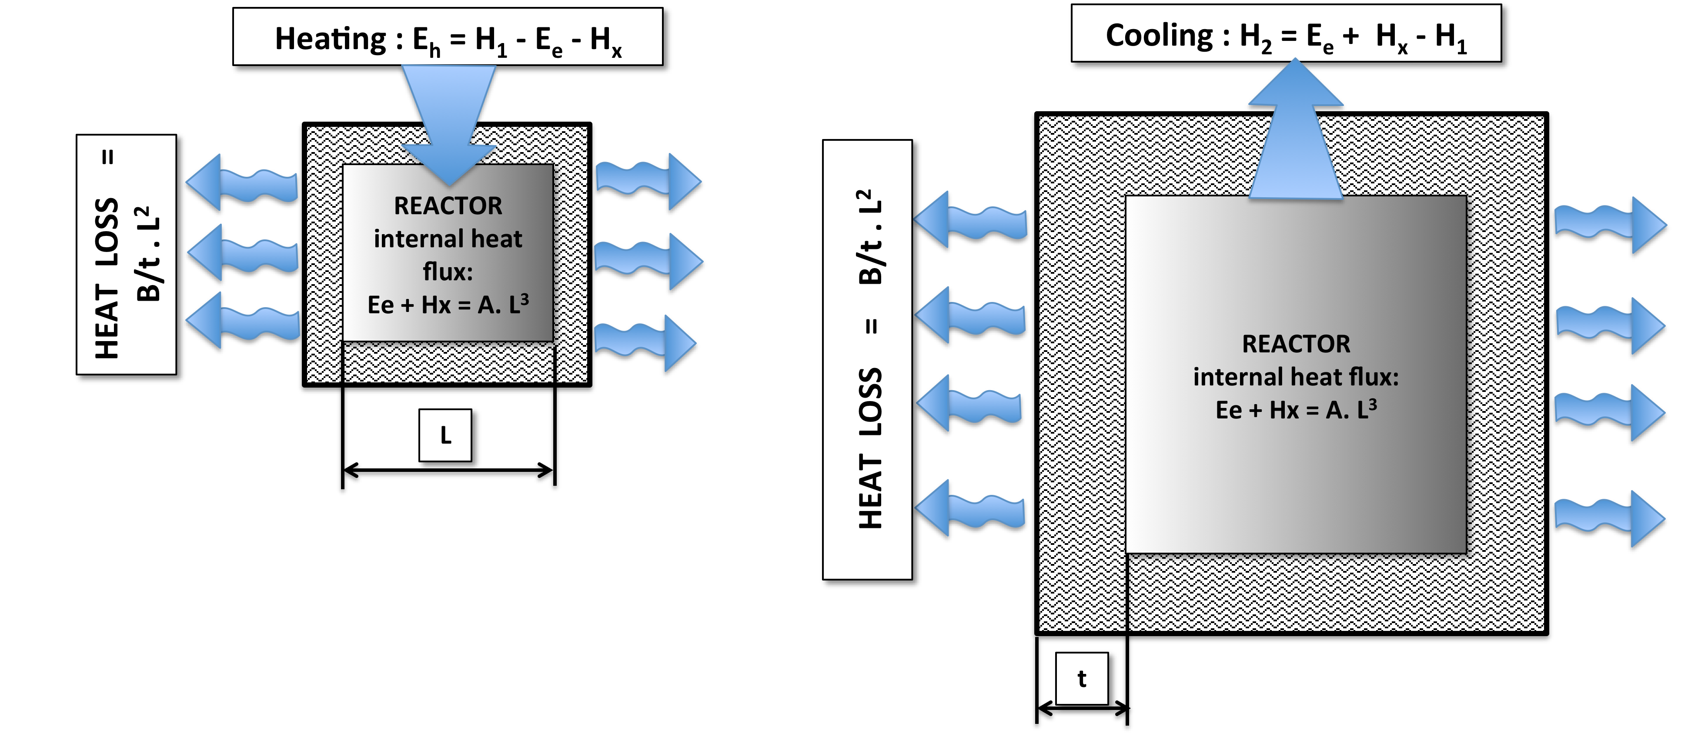
Difference between Type 1 and Type 2
The difference is linked to the relative importance of the heat losses compared to heat generation
Small reactor
Heat loss > Internal heat flux
Type 1
Large reactor
Heat loss < Internal heat flux
Type 2
September 2022 IWAHLM15 - Assisi

Slide 19
Difference between Type 1 and Type 2
The difference is linked to the relative importance of the heat losses compared to heat generation
Small reactor
Heat loss > Internal heat flux
Type 1
Large reactor
Heat loss < Internal heat flux
Type 2
September 2022 IWAHLM15 - Assisi

Slide 20
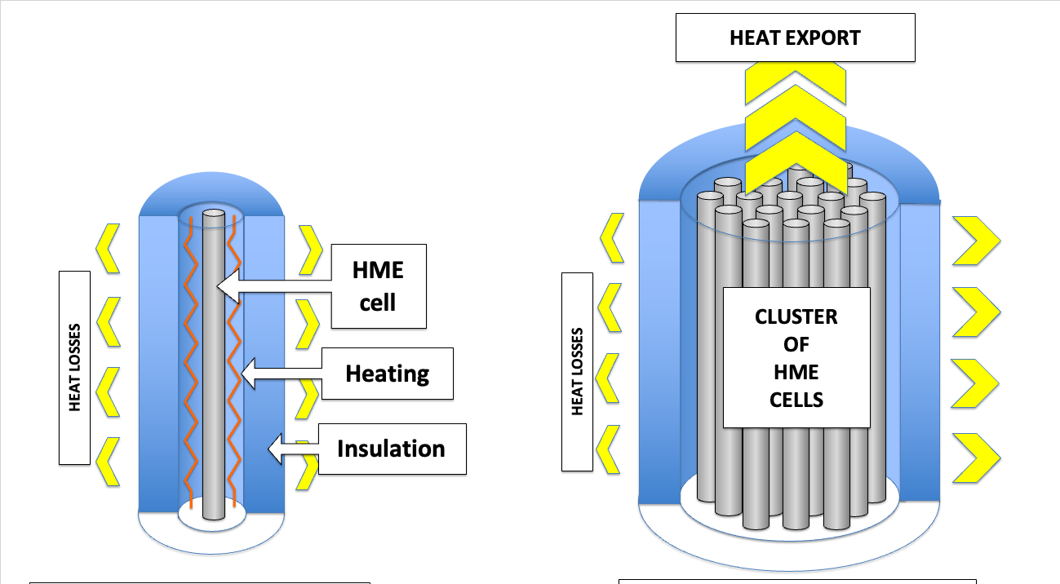
Difference between Type 1 and Type 2
The difference is linked to the relative importance of the heat losses compared to heat generation and to the size of the reactor
Single laboratory cell
Industrial cluster of cells
September 2022 IWAHLM15 - Assisi

Slide 21
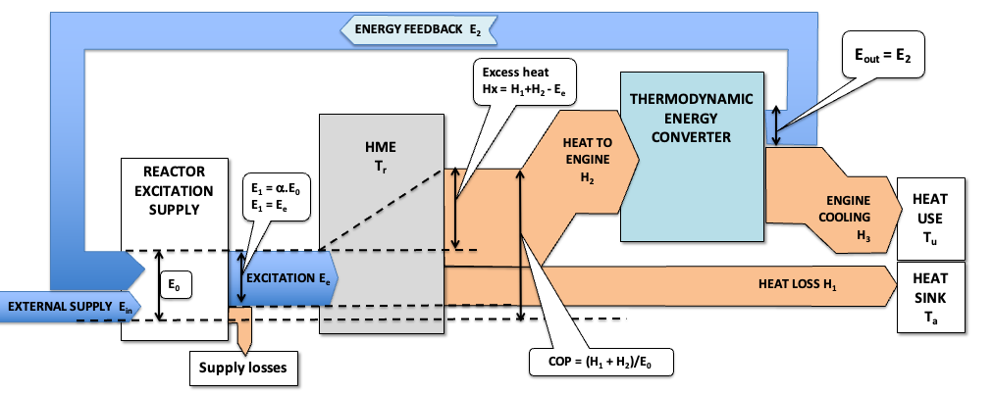
Coupling HME + Converter
Heat transferred to a thermodynamic heat converter
Production of some electricity
September 2022 IWAHLM15 - Assisi

Slide 22
TYPE 2 HME + Converter
Heat transferred to a thermodynamic heat converter
Production of some electricity
TYPE 2 :
Electricity production < excitation consumption
September 2022 IWAHLM15 - Assisi

Slide 23
TYPE 2 HME + Converter
Heat transferred to a thermodynamic heat converter
Production of some electricity
TYPE 2 :
Electricity production < excitation consumption
HEAT
Elec.
September 2022 IWAHLM15 - Assisi

Slide 24
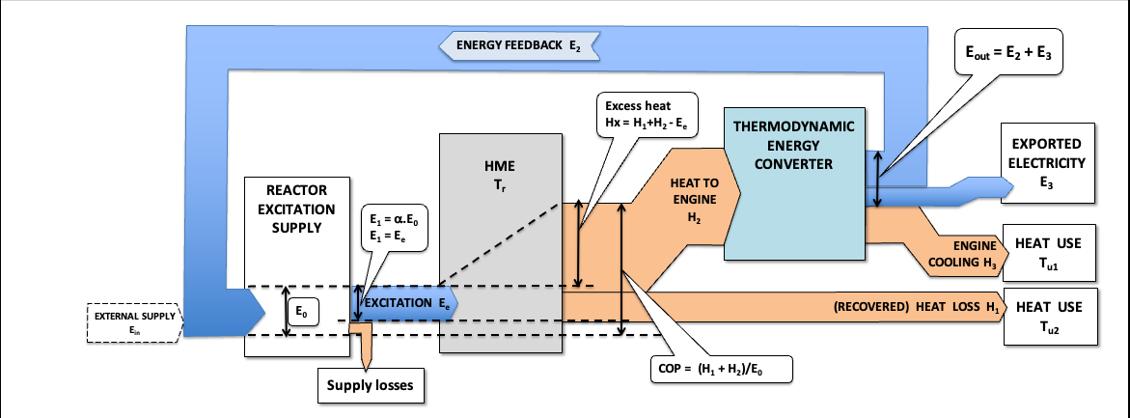
TYPE 3 : Self-sustained
TYPE 3 :
Electricity production > excitation consumption
Export of electrical energy
Export of heat: engine losses + insulation losses
September 2022 IWAHLM15 - Assisi

Slide 25
TYPE 3 : Self-sustained
TYPE 3 :
Electricity production > excitation consumption
Export of electrical energy
Export of heat: engine losses + insulation losses
Elec.
+
Heat
September 2022 IWAHLM15 - Assisi

Slide 26
Condition for self-sustained operation
(HEAT OUTPUT – HEAT LOSS)
X
CONVERSION EFFICIENCY (η) -----------------------------------
> EXCITATION ENERGY INPUT
September 2022 IWAHLM15 - Assisi

Slide 27
TYPE 3 involves thermodynamic converters
Thermal engines transform the heat into mechanical power
Conversion efficiency limited by Carnot’s law:
η_{c} = (1 – Tcold / Thot)
Conversion efficiency of an engine: η = η_{r} x η_{c}
η_{r} : Relative efficiency
September 2022 IWAHLM15 - Assisi

Slide 28
Thermodynamic converters
η_{r} : Relative efficiencies (typical)
Ericsson engine - - - - - - - - - - - - - - - - - - - - - - - 0.70
Stirling engine - - - - - - - - - - - - - - - - - - - - - - - - 0.60
Steam turbine - - - - - - - - - - - - - - - - - - - - - - - 0.65
Organic Rankine Cycles - - - - - - - - - - - - - - - - - 0.50
Thermoelectric converters - - - - - - - - - - - - - - - 0.30
Johnson thermo-electrochemical converters - - 0.70
September 2022 IWAHLM15 - Assisi

Slide 29
Conversion efficiencies
September 2022 IWAHLM15 - Assisi

Slide 30
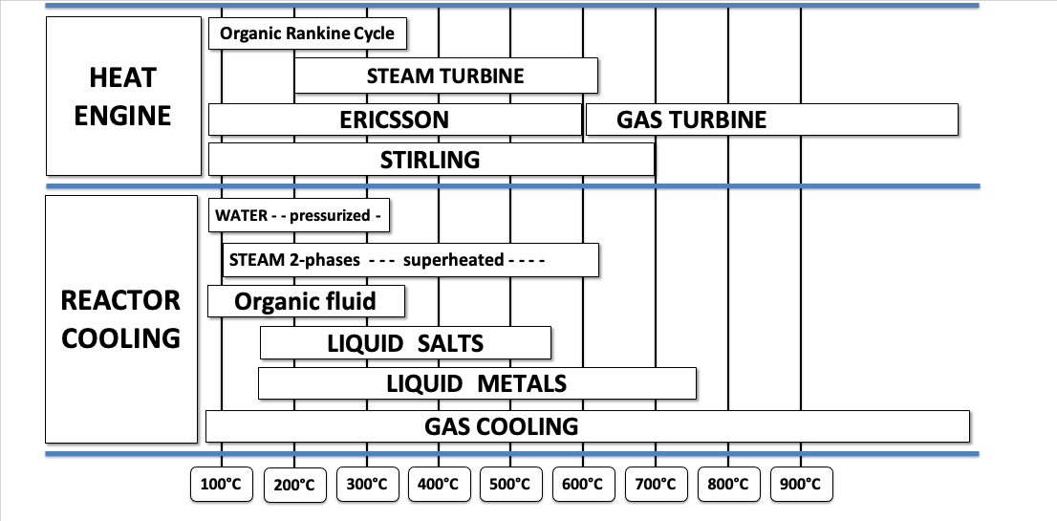
Converters applicability
September 2022 IWAHLM15 - Assisi

Slide 31
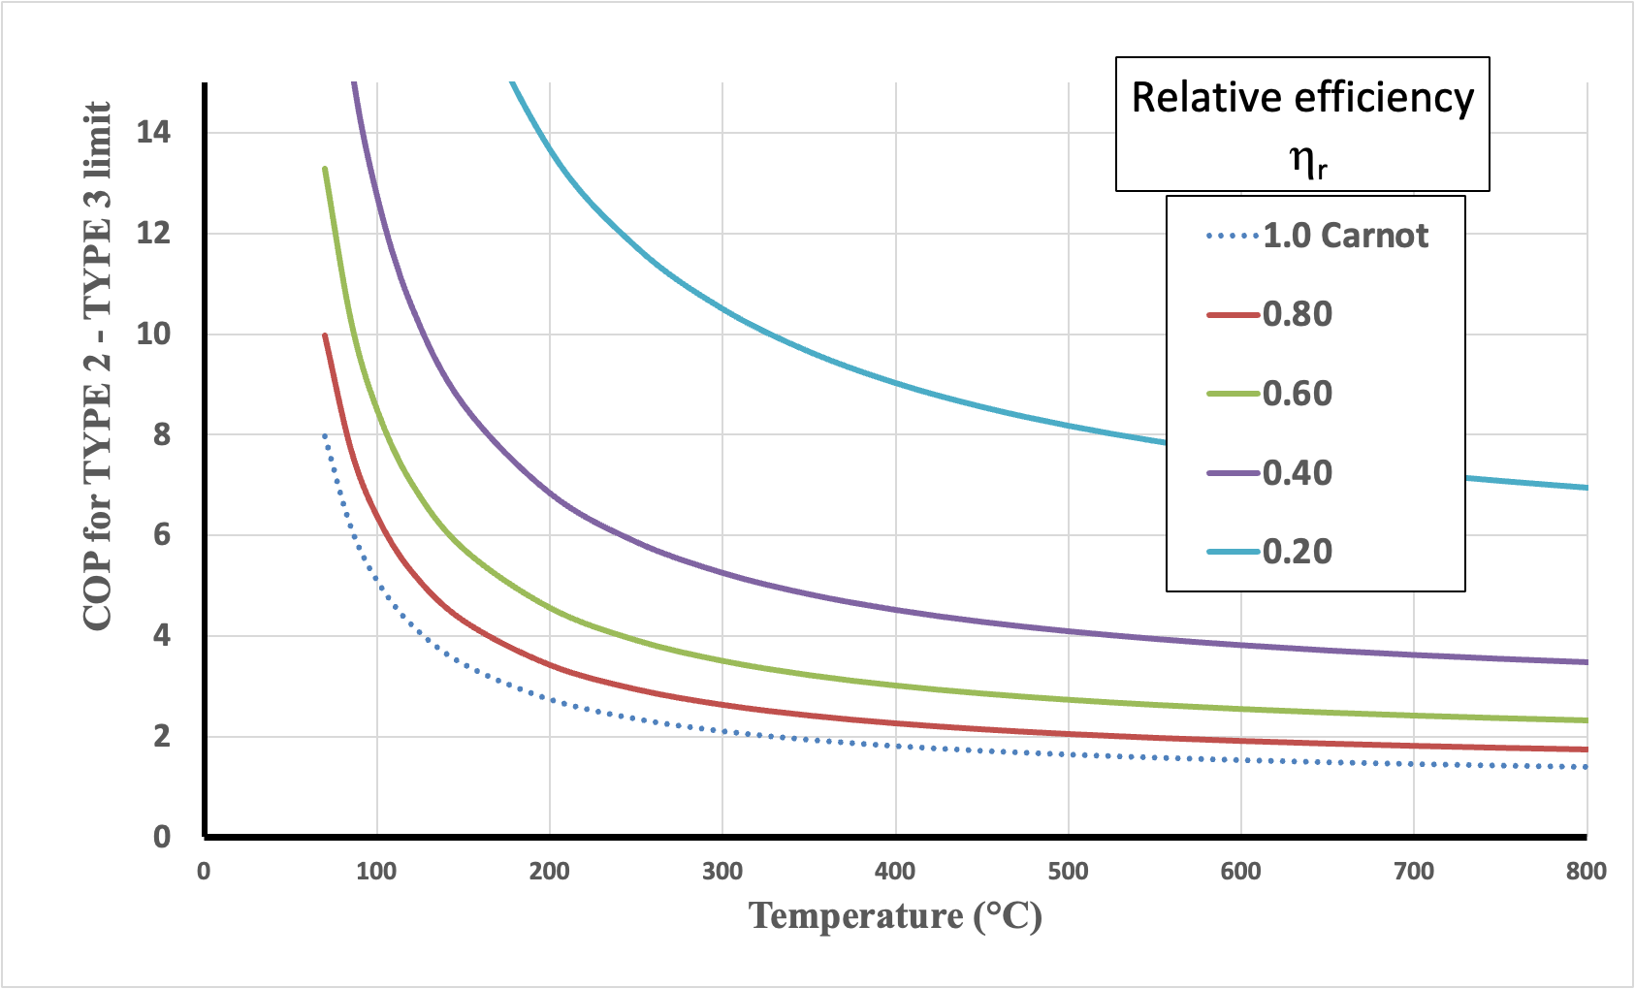
Influence of conversion efficiency on self-sustained operation
Theoretical minimum COP for transition from TYPE 2 to TYPE 3
(Tcold = 300K – No heat loss – Perfect excitation supply)
September 2022 IWAHLM15 - Assisi

Slide 32
Conclusion: Simplified classification
The distinction between Type 1 and Type 2 will only last during the development period of the devices (laboratory setups)
All useful heat sources will be at least Type 2
The distinction between Type 2 and type 3 is given by the output: HEAT or ELECTRICITY
It is proposed to use a simplified classification that would remain meaningful in the future:
HME Heat Sources → HME-HS
HME Power Sources → HME-PS
September 2022 IWAHLM15 - Assisi

Slide 33

Thank you for your attention

Slide 34
Thank you!
Any questions?
The CleanHME project has received funding from the European Union’s Horizon2020
research and innovation programme under grant agreement no 951974
This work reflects only the author's view and the European Commission is not responsible for any use that may be made of the information it contains.

