Slide 1
Analysis of Frank Gordon’s LEC Device
© 2022 Alan Goldwater Magicsound Lab
Last Revision 18 September 2022

Slide 2
Abstract
In their ICCF23 paper Frank Gordon and Harper Whitehouse reported a gas-mode metal cell that produced a DC current and voltage when the metal cathode was prepared in a certain way. They named the device a Lattice Energy Converter, or LEC. It has been replicated and discussed by several other researchers, and an update to the paper was given at ICCF24.
Following that conference a working LEC device was provided by Gordon and Whitehouse for study. It consists of a ~ 3 cm square of stainless steel mesh plated with Pd. The mesh is sealed between two insulators made of PTFE plastic, with the center of the mesh exposed. Measurements of the cell electrical characteristics, and its morphology using SEM/EDX were done.

Slide 3
Operating Measurements
For testing, an anode plate was made from mild steel sheet with yellow zinc chromate finish. The two pieces were clamped securely together with insulated Pony spring clamps and placed on a support in the test area. Resistance of the assembled cell was measured to confirm insulation between the mesh and the anode plate. The active area was 2.1 cm dia. = 3.5 cm²
The device was then connected to a Labjack T7 DAQ system and to a Tektronix TDS3054 oscilloscope. The scope probe input termination of 10 megohms served as the cell load resistor. A 0.1 uf ceramic capacitor was added to suppress RFI at the DAQ input. An Amptek X123 Cd-Te x-ray spectrometer was placed at less than 1 cm above the mesh.

Slide 4
Test Setup

Slide 5
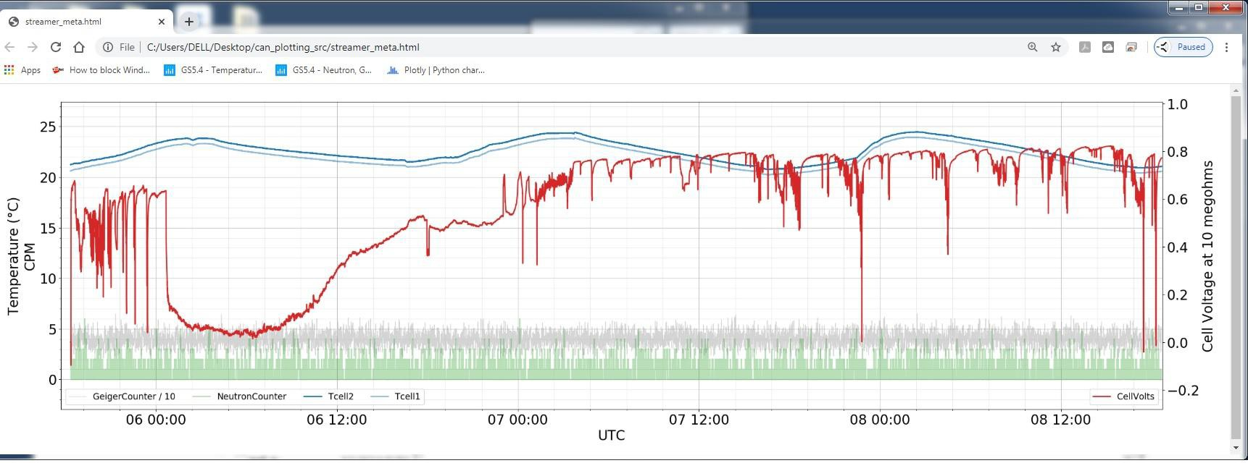
The DAQ input channel was adjusted to correct for input bias offset by setting to 0 volts with the cell connection removed and the scope probe connection in place. When connected to the cell, initial voltage was in excess of 0.6 volts. Residual RFI was ~10 mV p-p as seen by the scope.
Cell measurement continued for a total of 72 hours. Voltage across 10 megohms was generally 0.6 volts or more, with instability, noise and several drops to near zero. The grey trace is Geiger-Mueller counts and the green is Neutron counts. No significant radiation above background was seen

Slide 6
During this time, successive x-ray spectra were collected in 8-12 hour increments and stored as separate files. The composite graph of these data sets shows generally consistent distribution of energy, broadly elevated between 50 and 100 keV. The spectra were not normalized for time, so longer samples have higher average counts on the graph.

Slide 7
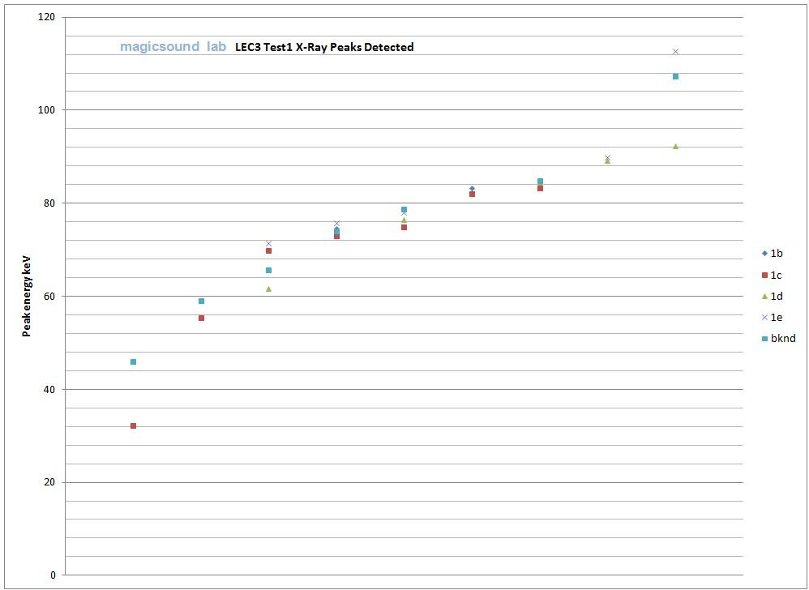
The set of spectra were examined, and significant peaks 50% or more above background in each were noted for comparison. There appears to be some correlation of these peaks between the sample sets. At conclusion of testing, the sample was removed and a 19 hour measurement of the background spectrum at the test location was recorded. Several peaks in the background data align with those seen in the active sample data. The environment includes 200 kg of Lead shielding about a meter from the test stand, and K band transitions of Pb at 74.9 and 84.8 keV are close to lines seen during LEC testing.

Slide 8
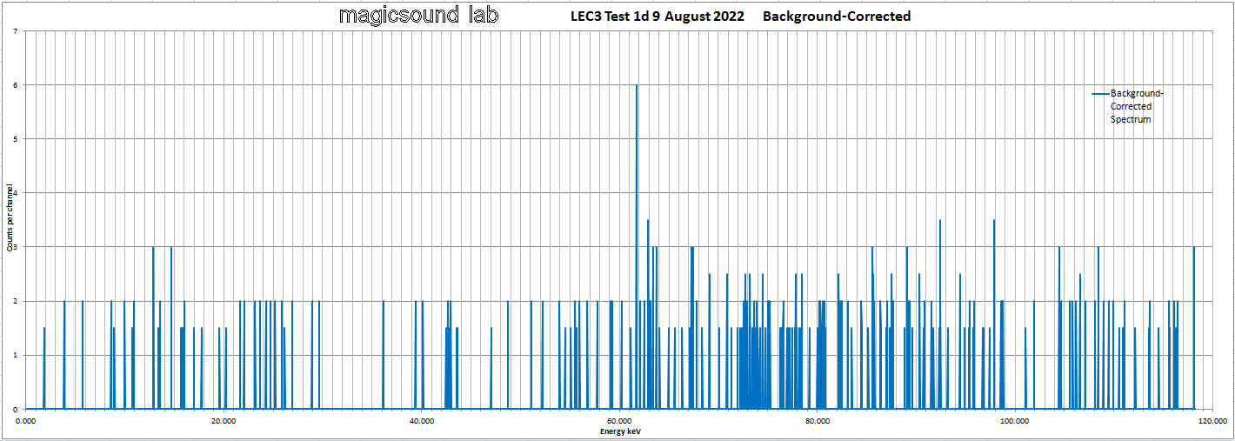
Spectrum 1d was acquired over 508 minutes (8.5 hours) at 4 mm from the sample LEC device. The background sample at the same location was normalized and subtracted from the data to create the following graph. The peak at 61.723 keV is well above background, but the low overall count rate makes its significance questionable.

Slide 9
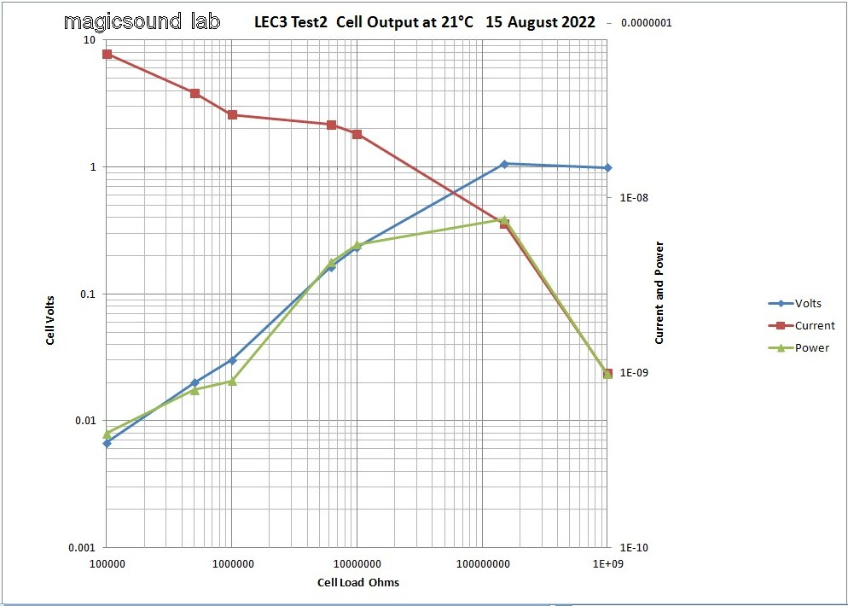
The cell anode plate was removed and cleaned to eliminate possible dust and handling contamination that might have caused the voltage instability seen. On reassembly, output was stable but lower than initially seen. Measurement was done over a wide range of resistance loading to determine the power characteristics of the cell.

Slide 10
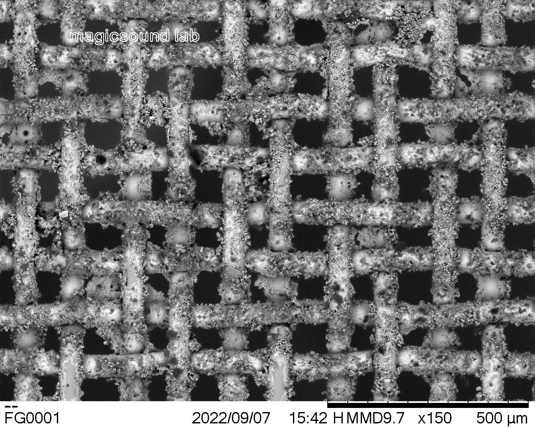
SEM/EDX Analysis
The working electrode was installed in a Hitachi TM3030+ SEM with Bruker EDX. The threaded sample mounting post was inserted directly through the edge of the sample, providing proper grounding contact. The LEC active material was thus in free space in the chamber, with nothing under it. At low magnification the co-deposited coating was seen to be granular and well-distributed over the mesh substrate.

Slide 11
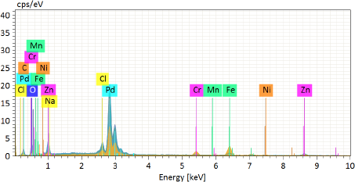
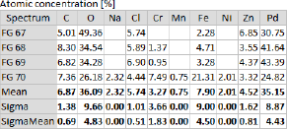
EDX showed both Zn and Na were present in significant quantities.
FG70
Location FG70 is a partly exposed section of the mesh wire, with composition typical of Stainless Steel, and some Pd as well.

Slide 12
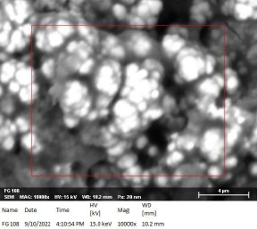
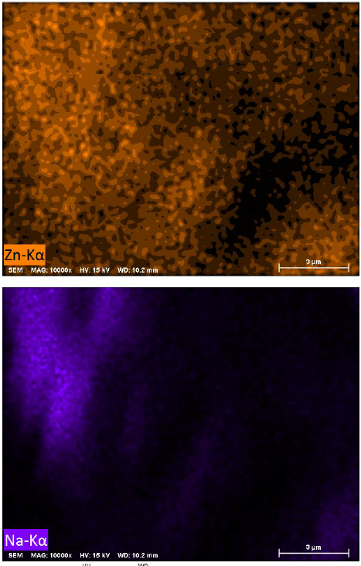
High magnification of an area where 11% Zn was detected.
Note the broader detection of Zn over this area, compared to the more local concentration of Na. This seems to confirm the presence of both elements on the sample, with different distribution for each.

Slide 13
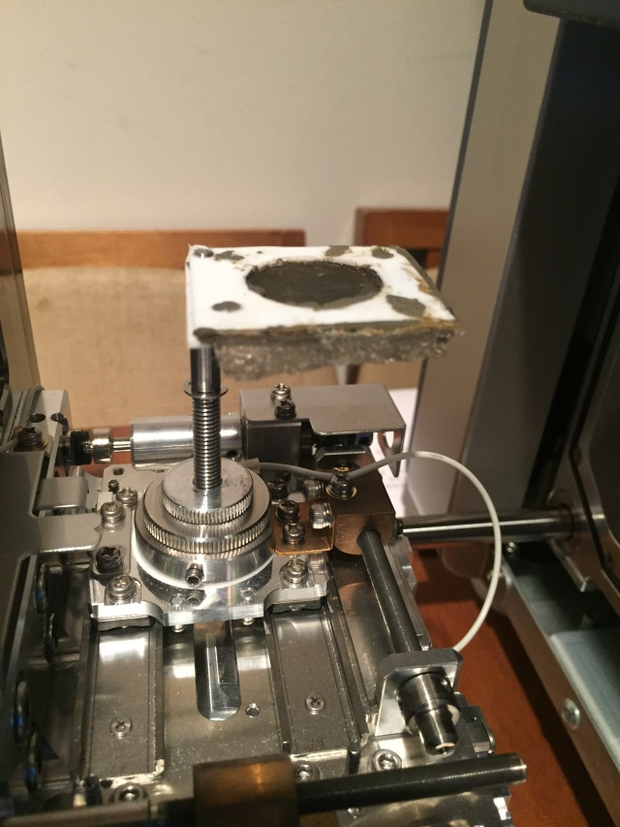
The sample was positioned to place it directly in front of the Si-PIN detector of the EDX system when the stage was inserted. A one-hour spectrum sample was taken in vacuum, with the SEM electron beam turned off. The detector did not see any emission in its range of 150 eV to 100 keV. The noise floor for this data collection was at least 10³ below the usual EDX operating level.

Slide 14
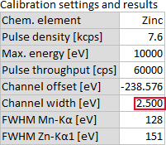
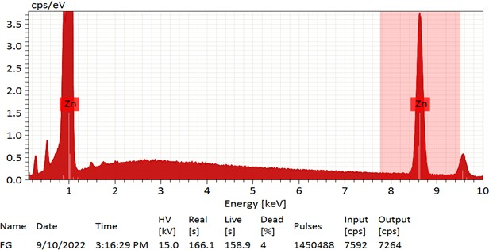
Post-calibration of the EDX system confirmed the accurate detection of the Zn La1 line, so as to separate it from the nearby Ka1 line of Na.

Slide 15
Conclusions
The sample cell produced ~220 nW / cm2 , and up to 1 volt into 100 megohms.
Surface morphology is complex and granular, with particles ranging <100 nm to 2 um.
The co-deposition layer contains substantial amounts of Zinc and Sodium.
There is no significaant x-ray emission from the sample cell in the range 150 eV...100 keV.

