Slide 1


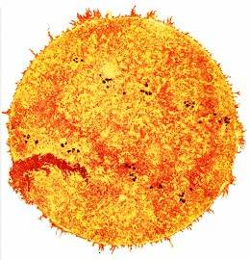

Interplay between electron screening effect and threshold resonance in the DD cold fusion
d
d
+
³He + n
+
³H + p
K. Czerski, R. Dubey, M. Kaczmarski, A. Kowalska, N. Targosz-Slęczka, M. Valat
15th International Workshop on Anomalies in Hydrogen
Loaded Metals, 26 .08.- 29.09.2022, Assisi, Italy
Konrad Czerski
Consortium CleanHME

Slide 2
Main Problems Solved
1. Penetration through the tunnel barrier
Electron screening: Reaction rates increased by 40 orders of magnitude
2. Branching ratios
Threshold resonance: Change of the DD branching ratios, ⁴He channel
dominates, internal e⁺e⁻ pair production
3. Poor reproducibility
Local changes of the screening energy: Crystal defects, impurities,
observation of spikes.

Slide 3
Electron Screening in Nuclear Reactions
Z₁ Z₂ e ²
exp (- r /a )
V(r) =
r
Z₁ Z₂ e ²
- U_{e}
≈
r
Z₁ Z₂ e ²
U_{e} =
R
a
a
screening energy
P(E)
P(E+U_{e})
s-wave penetration factor
Talk of N. Targosz-Sleczka

Slide 4
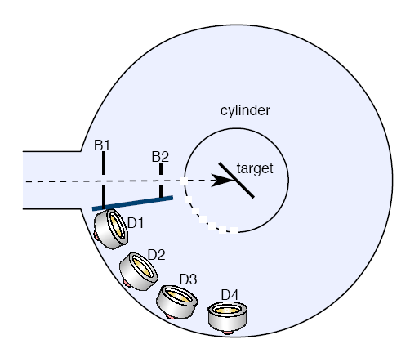
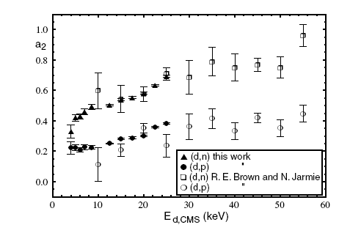
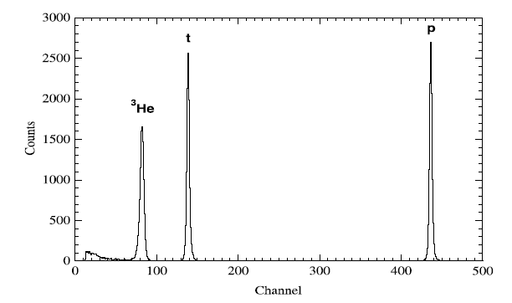
Accelerator Experiments (HV)
A₂
angular distribution
EPL 2001

Slide 5
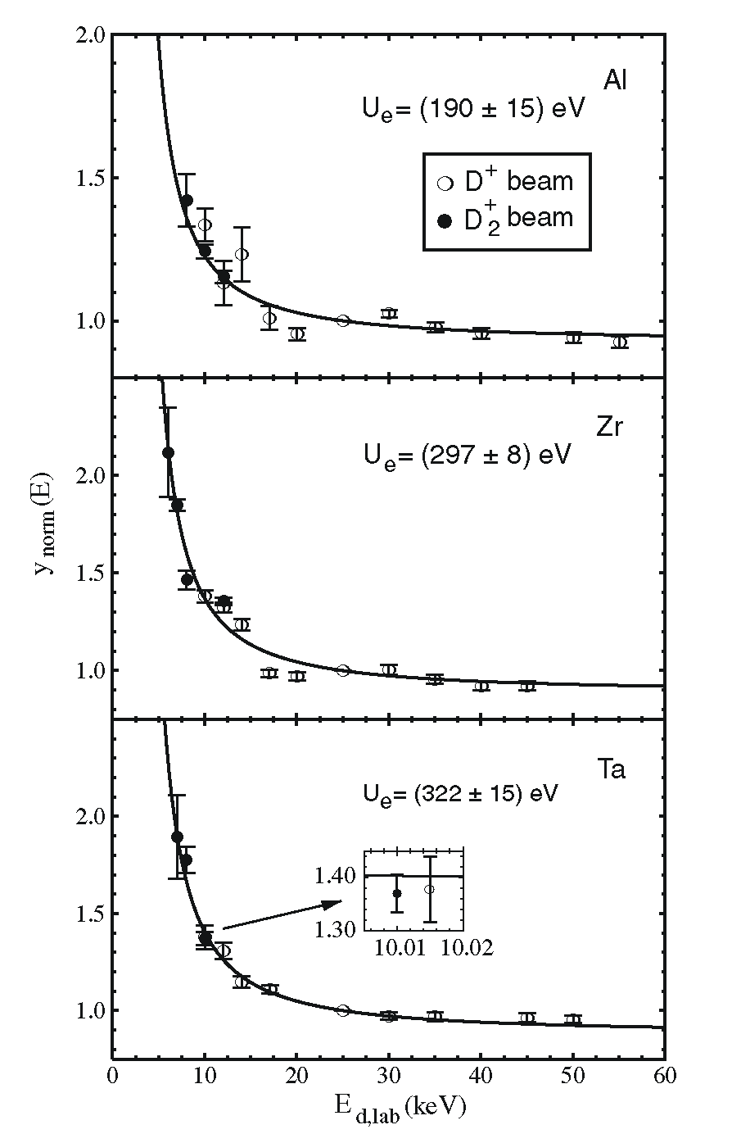
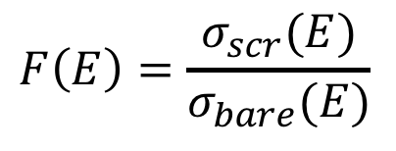
Accelerator Experiments (HV) II
d + d
³He + n
d + d
³H + p
Enhancement Factor
metal target
Europhys. Lett. 54 (2001) 449
J. Kasagi et al., J.Phys.Soc.Jap. 71 (2002) 2281
F. Raiola et al., Eur.Phys.J. A13 (2002) 337
F. Raiola et al., Eur.Phys.J. A19 (2004) 283
gas target
U_{e} = 25±5 eV
U.Greife et al., Z.Phys. A351 (1995) 107
$$F\left(E\right)=\frac{σ_{scr}(E)}{σ_{bare}(E)}$$
Enhancement Factor:

Slide 6
Discharge Experiments
Neutron Yield
I : 0.2-1.2 A
V: 2-13 kV
P: 0.5-2.0 mbar
Enhancement Factor
up to 10⁴
Th. Schenkel et al., Journal of Applied Physics 126 (2019) 203302

Slide 7

Experimental (HV) and Theoretical Results
dielectric function theory:
free and bound electron polarization
cohesion screening
electron-gas parameter r_{s}
Crystal lattice defects:
effective electron m*
$$U_{e}∝\sqrt{m^{∗}}$$
Europhys. Lett. 2004, Phys. Rev. C 2008, talk of N. Targosz-Sleczka and M. Valat

Slide 8
UHV Electron Screening – Resonance Contribution
Proton Channel
Zr
Gas Target
U_{e} = 110 eV
Γ_{p}=40 meV
U_{e} = 20 eV
Γ_{p}=10 meV
Europhys. Lett. 2016, Phys. Rev. C (Letters) 2022

Slide 9
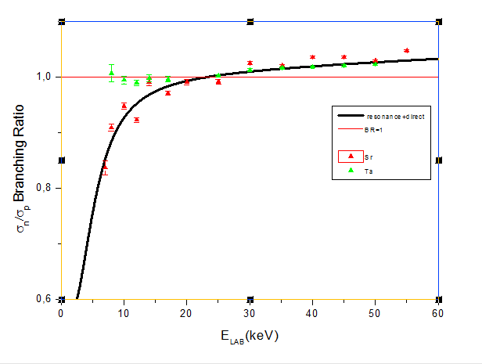
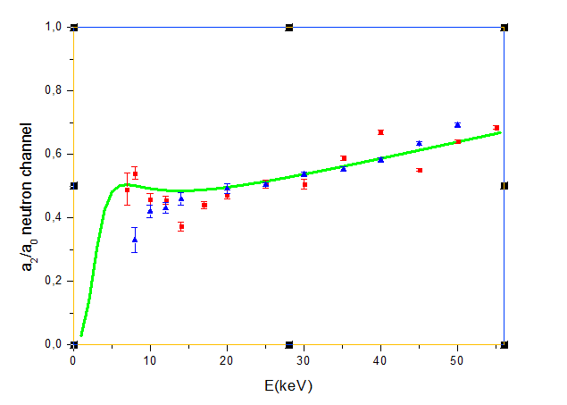
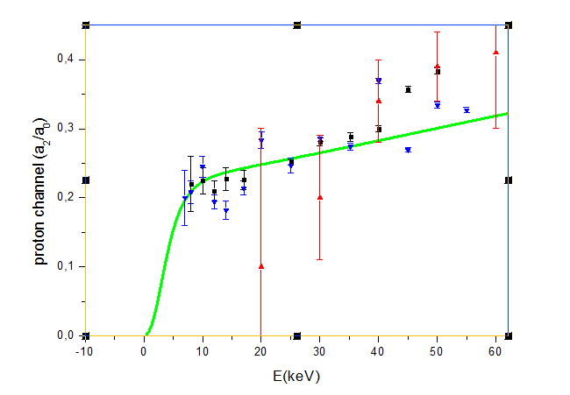
n/p Branching Ratio & Angular Distribution
neutron channel
Γ_{n}=10 meV, Γ_{p}=40 meV
proton channel

Slide 10
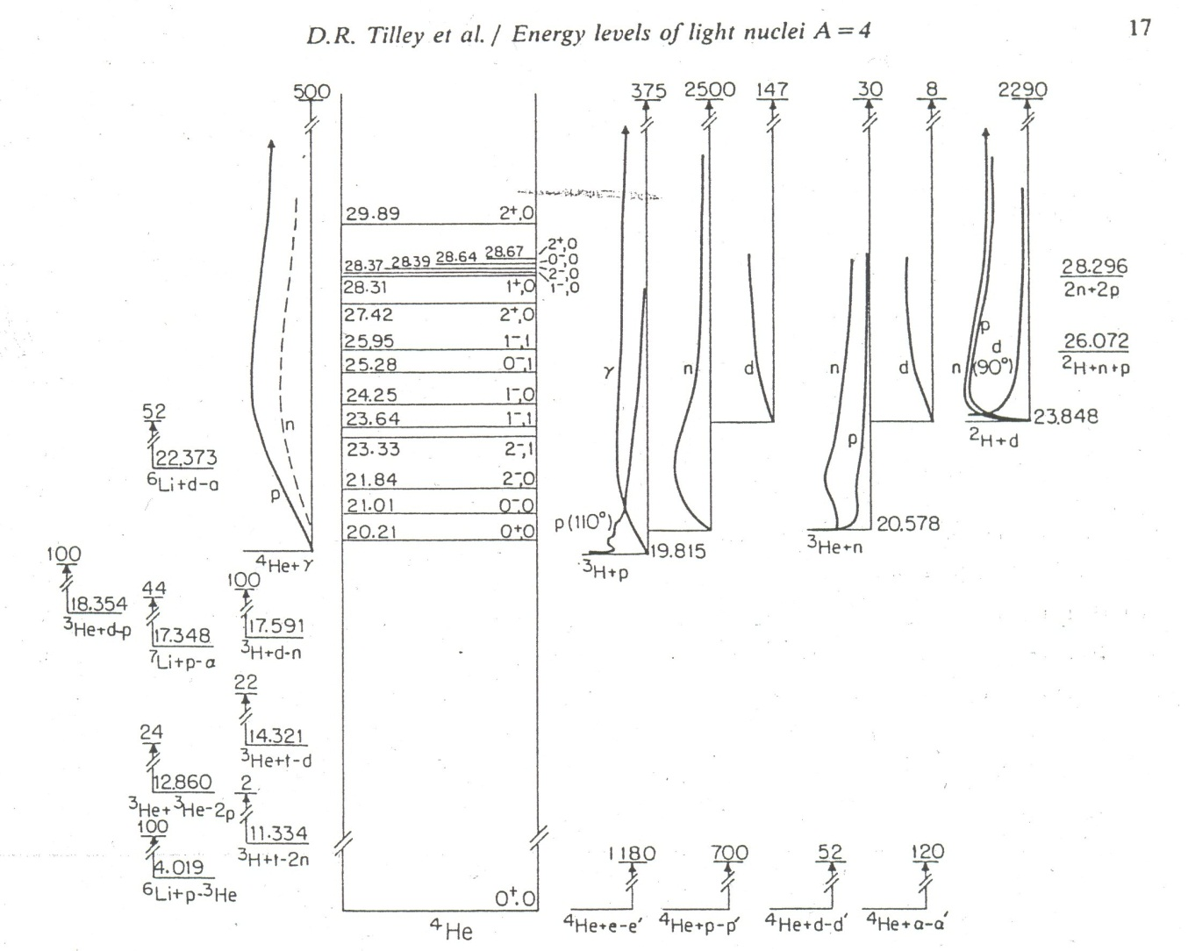
Compound Nucleus ⁴He

Slide 11
Weak Coupling in ⁴He
V (MeV)
4
+
4
8
r (fm)
-4
2⊕2
cluster
double Coulomb barrier
in anology to isomeric states
-24
1⊕3
weak coupling between
1⊕3 and 2⊕2 states
cluster

Slide 12
Analogy
Helium Burning in Massive Stars:
Hoyle’s Resonance
3α-Process
⁴He + ⁴He ⁸Be _{g.s.}
⁸Be + ⁴He ¹²C*(7.65 MeV) ¹²C_{g.s.} + 2γ
300•10⁶ K
~ 300 keV
ε ∝ T⁴¹
Helium-Flash
¹²C

Slide 13











Decay Channels of the 0⁺ Resonance
Internal Pair
Production
Internal Electron
Conversion
Internal Deuteron
Conversion
$$e^{−}$$
$$e^{+}$$
$$e^{−}$$
$E_{e−}{+ E}_{e+}$= 23 MeV
$E_{e−}$= 24 MeV
$E_{d}$= 16 MeV ,
$E_{α}$= 8 MeV
$E_{γ}$= 0.511 MeV
electron cont. spectrum
E0 sum rule
single energy line
two energy lines
$Γ_{e−e+}≥$ 100 meV
$Γ_{e−}<$ 1 meV
$Γ_{dα}=$ ? meV

Slide 14
Charged Particle Spectra
E_{d} = 6 – 16 keV
ZrD₂
target
deuteron
beam
detector
5 µm thick Al foil
Observed part of the spectrum: 0.6 – 1.0 MeV, 42%
submitted to Phys. Rev. Lett., talk of R. Dubey

Slide 15
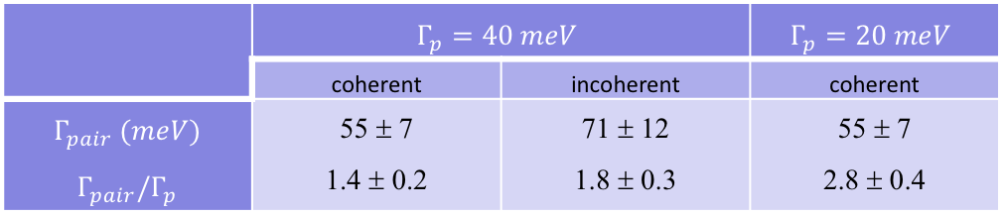
Electron-Proton Branching Ratio
 | $$Γ_{p}=40 meV$$ |  | $$Γ_{p}=20 meV$$
 | coherent | incoherent | coherent
$$Γ_{pair} (meV)$$ $$Γ_{pair}/Γ_{p}$$ | 55 ± 7 1.4 ± 0.2 | 71 ± 12 1.8 ± 0.3 | 55 ± 7 2.8 ± 0.4

Slide 16
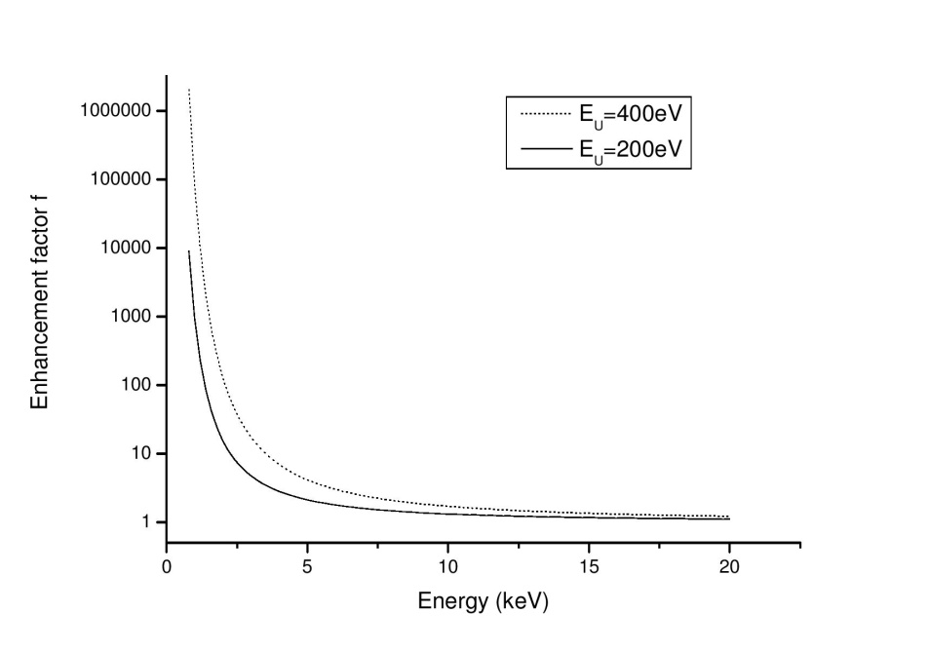
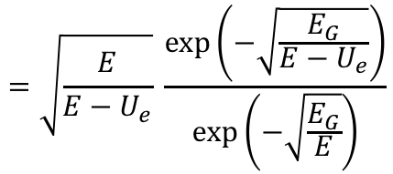


Screening vs. Resonance
Enhancement Factor
resonance
narrowing
F(E) = $\frac{P(E+U_{e})}{P(E)}$ =
$$=\sqrt{\frac{E}{E−U_{e}}} \frac{exp⁡\left(−\sqrt{\frac{E_{G}}{E−U_{e}}}\right)}{exp⁡\left(−\sqrt{\frac{E_{G}}{E}}\right)}$$
$$Γ_{d}(E)=2kP\left(E+U_{e}\right) {\left|γ\right|}^{2}$$

Slide 17


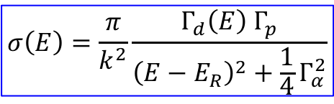
D + D Reactions: Room Temperature
Resonance cross section:
d + d → ³H + p
$$σ\left(E\right)=\frac{π}{k^{2}}\frac{Γ_{d}\left(E\right) Γ_{p}}{{\left(E−E_{R}\right)}^{2}+\frac{1}{4}Γ_{α}^{2}}$$
Resonance contribution
also depends on the
screening energy:
$$Γ_{d}(E)=2kP\left(E+U_{e}\right) {\left|γ\right|}^{2}$$
$$Γ_{pc}=0.1 eV$$
Resonance energy depends
on the screening energy
Phys. Rev. C Letters 2022

Slide 18
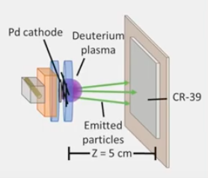
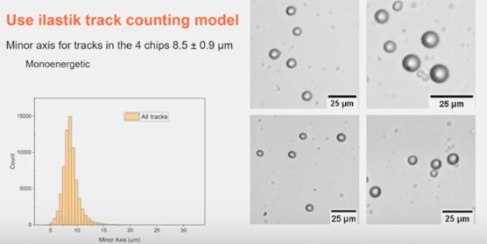
Low Energy Discharge Experiment
I : 0.8 A
V: 0.5 kV
P: 0.5 mbar
alpha particles of about 100 keV
= recoil energy 80 keV ?
Erik Ziehm , University of Illinois, ICCF24

Slide 19
D+D rections: Conclusions
1. Electron screening
electron screening locally enhanced by impurities and crystal defects
nuclear reaction rates at room temperature can change dramatically (spikes)
U_{e}=100 – 500 eV
2. 0⁺ threshold resonance in ⁴He
balance between the resonance and electron screening
explains ⁴He production and increases reaction rates at room temperature
up to seven orders of magnitude, changes the branching ratios
3. Resonance decay: what can be detected
electron-positron pair creation: electron continuous spectrum, 511 keV 𝛄’s,
bremsstrahlung
This project has received funding from the European Union’s Horizon2020 research and innovation programme
under the Grant Agreement no 951974.

Slide 20

Invitation
25th International Conference on Condensed Matter Nuclear Science ICCF-25
Szczecin, Poland, August 28 -31, 2023

