Slide 1
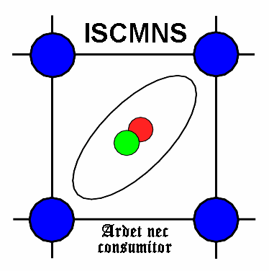
ISCMNS 12th General Meeting 17:30 Tuesday 27 September 2022 IWAHLM15. Hotel Domus Pacis, Assisi.
The International Society for
Condensed Matter Nuclear Science
Bill Collis
Chief Executive
N.B. Non ISCMNS members are welcome to attend.

Slide 2
Chief Executive’s Report presented by Bill Collis
Objectives of ISCMNS
Balance sheet Results.
New medals
Proposal to suspend membership fees!
Which payment system is preferred – PayPal or bank transfer?
Reorganization of JCMNS
(No formal decisions (resolutions) are proposed at this meeting)

Slide 3
ISCMNS – Objectives for the benefit public
To organize meetings.
To promote or carry out research.
To provide advice and consultancy services.
To publish or distribute information.
To co-operate with other bodies.
To support, administer, reorganize as, or set up not for profit institutions.
To raise funds.
To sell, acquire or hire property of any kind.
To award prizes and medals and to make grants or loans; and to support and subscribe to any charitable or public object.

Slide 4
What does the ISCMNS motto mean?
“Ardet nec consumitur”
(It burns but is not consumed.)
Anomalous heat.

Slide 5
ISCMNS Balance Sheet at 31 December
2020 2021
REVENUE RESERVES €uros
Reserves Brought Forward 17,496 16,418
Profit and (Loss) Account (1,078) 2,862
------- -------
Net Assets in Euros 16,418 19,280 ISCMNS made a loss in 2020 as there was no workshop due to Covid.

Slide 6
What about taxes?
Currently ISCMNS pays no corporation taxes and no Valued Added Tax.
This will not change with conversion to CIO.
Notes:
US Non profit also possible

Slide 7
Financial Objectives
ISCMNS mainly uses its reserves as working capital to finance scientific meetings. Its income and expenditure are unpredictable and variable. The Society aims to steadily increase its reserves to the greater of €20,000 or 35% of expected future annual income / expenditure. (This is possible only when a surplus is realized.) [Abridged extract from 2013 Report of the Trustees]
More accurately, ISCMNS uses the surplus from conferences to pay for JCMNS and medals.

Slide 8
Executive Committee Recruitment
We need younger committee members.
Good English skills
Good IT skills?
Understanding administrative tasks
Entrepreneurial outlook
Appreciation of the science

Slide 9
Regulation & Bureaucracy
The major UK bodies regulating ISCMNS are:-
Companies House
Charity Commission
HM Revenue & Customs

Slide 10
Regulation & Bureaucracy
The major UK bodies regulating ISCMNS are:-
Companies House – Getting less bureaucratic
Charity Commission – No change
HM Revenue & Customs – No tax
Brexit – Poor access to H2020 ☹
No constitutional changes proposed.

Slide 11
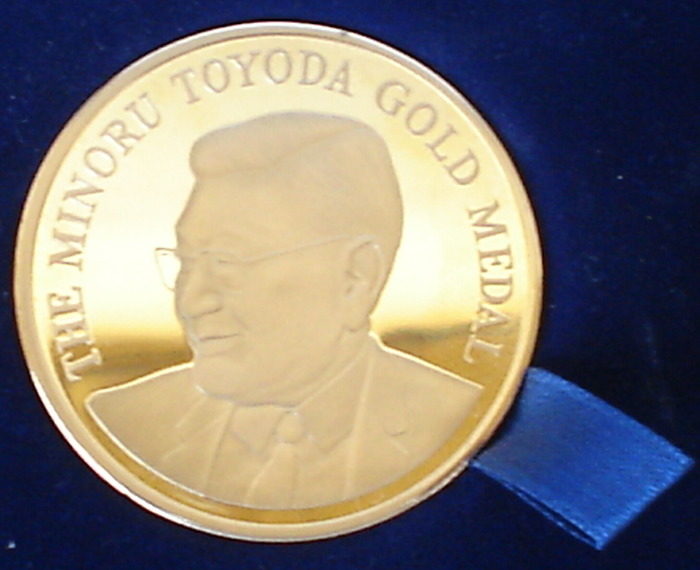
The Minoru Toyoda Gold Medal awarded to Ed Storms at ICCF24

Slide 12
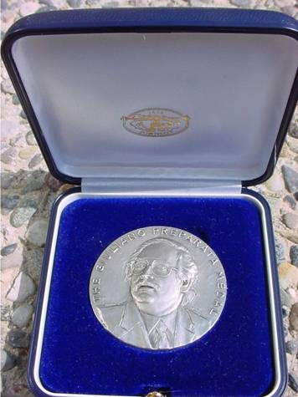
25 New Giuliano Preparata Medals minted

Slide 13
Membership Dues / Fees
ISCMNS isn’t rich but we are a “going concern” living off modest profits of conferences and donations.
In order to encourage membership growth, particularly among younger people, it is proposed to abolish membership fees (currently EUR 30 per year).

Slide 14
Making Payments to ISCMNS PayPal or Bank Transfer?
Discounted PayPal Charges 2-3%
Delays (suspension of account!)
Unfamiliarity
Bureaucracy

Slide 15
This presentation will be online at http://www.iscmns.org/admin/Collisagm1.ppt

Slide 16
Any Questions?
This presentation will also be online at http://www.iscmns.org/work15/Collis
We will now discuss JCMNS reorganization.

