Slide 1
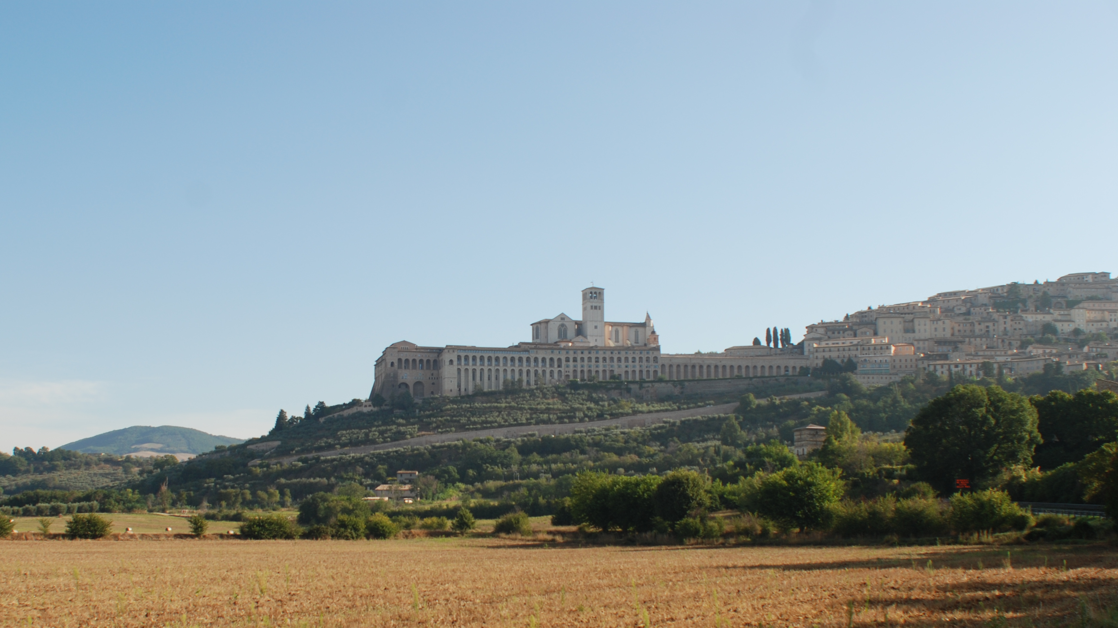
A Conventional Explanation for a Pd-²d LENR with Considerations of the NAE and Secondary Reactions
N. L. Bowen
Adjunct Professor, Colorado Mountain College
Conclusion: LENR is explained.
Notes:
Welcome to my talk, “A Conventional Explanation for a palladium-deuterium LENR with Considerations of the NAE and Secondary Reactions”. Currently, Low Energy Nuclear Reactions do not have a good theoretical explanation, at least not one accepted by conventional physicists. I’m going to give you a preview of the conclusion. This IS a conventional explanation for LENR--without needing any kind of unusual theories or new physics.

Slide 2
Outline
Review of Previous Presentation
Description of NAE
Example Calculation of an LENR
  Scattering of primary child product
  Reaction of primary child products
  Scattering of secondary child products
  Subsequent ²d to ²d chain reactions
Examination of neutron scattering and absorption
Notes:
Here is the outline of my talk. A brief review of my previous presentation, a description of NAE, then a calculation of an example reactor, followed by a look at neutrons emissions.

Slide 3
Review of Previous Talk—Primary and Secondary Reaction in a LENR
Consider a Low Energy Nuclear Reactor (LENR) in steady state. (³t is ³H. ²d is ²H.)
  Two Primary reactions:
    ²d+²d→³t+p and ²d+²d→³He+n.
  Secondary reactions:
    ²d+³t→⁴He+n and ²d+³He→⁴He+p.
    No gamma radiation.
    No neutron suppression.
    No enhanced ²d+²d→⁴He+γ reaction.
    No unusual physics to overcome Coulomb barrier.
  Standard physics and standard engineering can explain it.
  As in fission, the by-products of the reactions sustain the chain reaction.
    Can we confirm this mathematically?
    That is the topic of THIS talk.
The Mechanism:
  Child products collide with the cold ²d
  Frequently enough and energetically enough
  Sustains the ²d to ²d reaction.
  The conditions must be right
    High ²d loading.
    The crystal defects in the Nuclear Active Environment.
Start-up condition:
If conditions for chain reaction in the NAE are right, then:
  Reaction rate grows from the first initial start-up reaction to steady state.
  However, this first initial reaction is caused by random external influences.
Notes:
I want to start with a review of my previous talk on this topic, “Primary and Secondary Reactions in an LENR”. Now some of you may think that the concept of Primary and Secondary reactions is strange. However, the concept that more than one reaction might be occurring in a reactor is not bizarre. Actually the converse is true. It is quite incorrect to think that there is only one reaction occurring in a reactor. All nuclear reactors--fission, fusion, hot, cold--have many reactions occurring inside the reactor. The two primary reactions are the usual ones, seen HERE. These child products go on to react again in secondary reactions, shown HERE. No gamma radiation occurs. No neutron suppression. No enhancement of the ²d+²d→⁴He+γ reaction. No need for unusual physics to explain how to overcome the Coulomb barrier. I show that standard physics and conventional engineering can explain it. Now, just as is occurring in a fission reactor, the nuclear by-products of the reactions are what sustain the chain reaction. The mechanism is that the child products collide with the cold D-2, doing so frequently and energetically enough to sustain the D-2 to D-2 reaction. If the conditions in the reactor core are right, then from the very first initial reaction, the reaction rate will grow to steady state. Unfortunately, that very first initial reaction is caused by fairly random external events.

Slide 4
Understanding the Nuclear Active Environment
The Nuclear Active Environment (NAE) is critical for LENR.
  Should not be ignored by theorists.
  Not well studied.
The NAE:
  Is not a flawless crystal Pd lattice.
  Crystal defects in the lattice.
  Higher concentration of ²d, about 10 times more.
  Created during loading—cracks and fissures.
Formation depends on:
  ²d infusion rate
  Size and shape of Pd core
  Pressure, voltage, current, temperature
  Substrates.
Optimum value of these parameters--unknown.
Inside the Palladium lattice:
  ²d is ionic and interstitial.
Inside the NAE:
  ²d is atomic or molecular.
  Cannot re-enter the lattice.
  Higher density.
When defect forms
    Initially a vacuum inside.
  Quickly fills with ²d ions and electrons.
  No underlying lattice to prevent hydrogen-electron combination
Notes:
The Nuclear Active Environment, or NAE, is critical for LENR, and should not be ignored. Although it is experimentally confirmed, it is not well studied. The NAE is not a flawless crystal lattice, rather it is the defects in the lattice that create this optimum environment. It has a higher concentration of D-2, estimated to be about 10 times more than in the lattice. These crystal defects are created during the loading process, in the form of the cracks and fissures. The formation of the crystal defects is dependent on many factors, shown HERE, but the optimum values are unknown. Inside the Palladium lattice, the D-2 is ionic and interstitial. Inside the NAE, it is atomic or molecular. It cannot re-enter the lattice--which is why it has a higher density.

Slide 5
Calculations for an Example LENR Reactor
Consider an example LENR
  Using reasonable values.
  One watt of power, total, from primary reactions.
  ²d density 10X value of a 100% loaded Pd lattice.
    2.26 gm/cm³.
  The NAE’s have increased the sample dimensions by 20%.
  The released energy of primary and secondary reactions:
    Kinetic energy of the child products.
    Eight different child products, total.
  This energy is transferred to the cold ²d via collisions.
    Causing a subsequent ²d to ²d reaction.
  Negligible energy transferred to Pd lattice.
  The reaction rate is 1.71 x 10¹² reactions/sec.
    8.55 x 10¹¹ reactions/second for each of two primary reactions.
    The palladium core is 1 cm³.
  ¹H, ²d, ³,t ³He, and ⁴He are trapped in NAE.
  Energetic neutrons pass through. Escape the Palladium core.
    The neutrons react in the Lithium electrolyte, the Borosilicate beaker, or the water bath.
    No neutrons escape the reactor set-up.
Notes:
Let’s look at an example of an LENR, using some reasonable values. One watt of power total from the two primary reactions. The D-2 density in the NAE is 10 times value of a palladium lattice at 100% loading. This is 2.26 gm/cubic cm. The total NAE’s have increased the sample dimensions by 20%. The released energy of both the primary and secondary reactions is the kinetic energy of the child products. This energy is transferred to the cold D-2 via collisions, allowing a subsequent D-2 to D-2 reaction to occur. Negligible energy is transferred to the palladium lattice. For one watt of power from the primary reactions, the reaction rate is 1.71 times 10 to the 12 reactions per second. Charged-child products stay in the NAE, but neutrons do not. I will discuss the fate of these escaped neutrons towards the end of this presentation, after I calculate the possibility of a chain reaction.

Slide 6
Overview of the Four-Part Calculation
Part 1: Determine the Number and Average Energy of Scattered ²d from Child Products of Primary Reactions.
A brief review of particle scattering concepts.
  Calculate for protons with ²d.
  Calculate for ³t with ²d.
  Calculate for ³He with ²d.
A brief review of neutron scattering concepts.
  Calculate for neutrons with ²d.
Part 2: Determine the reaction rate of the two secondary reactions.
A brief review of the reaction rate concepts.
  Calculate for secondary reaction: ³t+²d→⁴He+n.
  Calculate for secondary reaction: ³He+²d→⁴He+p.
Part 3: Determine the Number and Average Energy of Scattered ²d from Child Products of Secondary Reactions.
  For ⁴He with ²d.
  For neutrons with ²d.
  For ⁴He with ²d.
  For protons with ²d.
Part 4: Determine the reaction rate of the subsequent ²d+²d reaction.
  Sum number of the energetic ²d.
  Calculate average energy of energetic ²d.
  Calculate rate of subsequent ²d + ²d reaction.
  Determine if a chain reaction might occur.
All of these calculations use standard equations and standard engineering.
Notes:
This calculation is done in four parts. Part 1. Determine the number, and average energy, of the scattered D-2 from the primary child products. Part 2. Determine the reaction rate of the two secondary reactions. These first two parts will be the most time-consuming sections of this calculation, then things will go much faster. Part 3 repeats the scattering calculations for the child products of the secondary reactions. And part 4 determines the reaction rate of the subsequent D-2 to D-2 reaction. All of these calculations use conventional engineering to make these determinations.

Slide 7
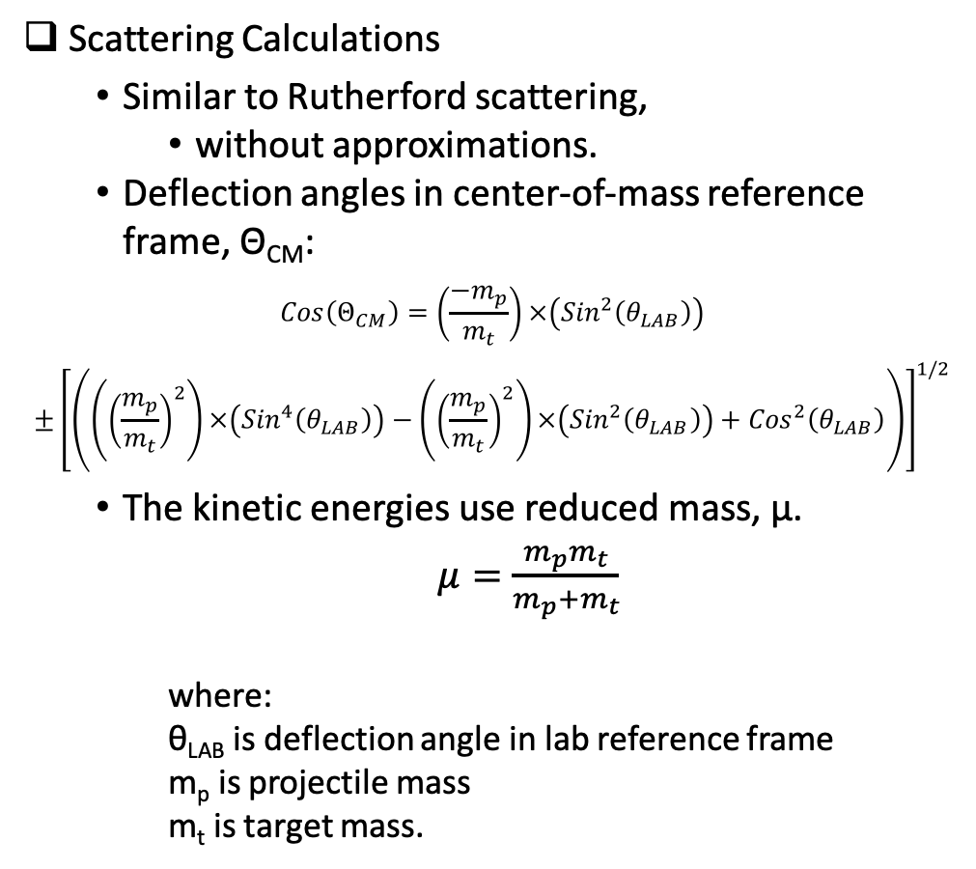
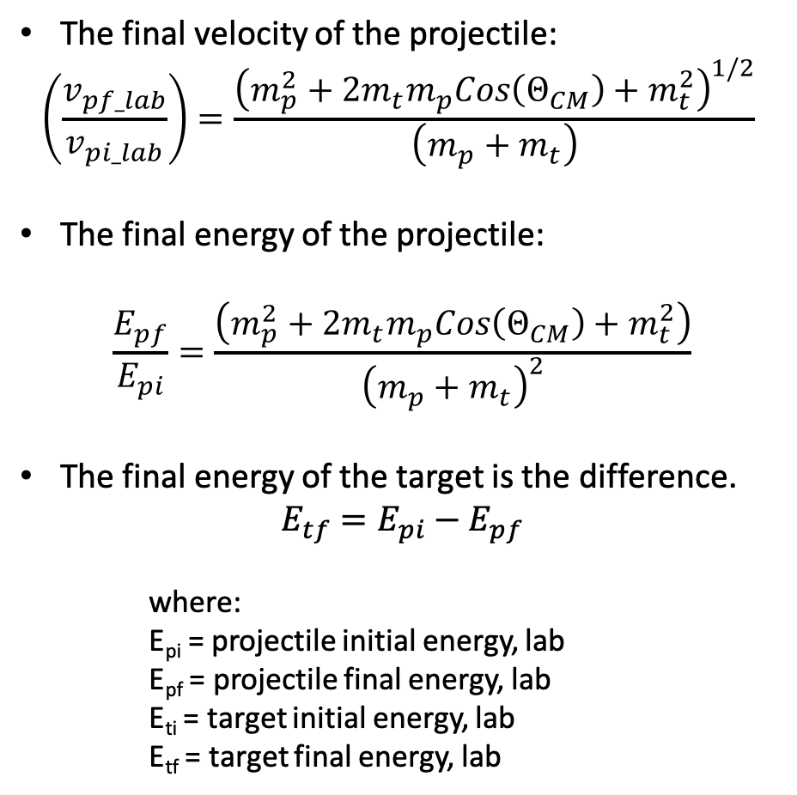
Particle Scattering for Charged Particles
Scattering Calculations
  Similar to Rutherford scattering,
    without approximations.
  Deflection angles in center-of-mass reference frame, Θ_{CM}:
$$Cos\left(Θ_{CM}\right)=\left(\frac{{−m}_{p}}{m_{t}}\right)×\left({Sin}^{2}\left(θ_{LAB}\right)\right)$$
$$±{\left[\left(\left({\left(\frac{m_{p}}{m_{t}}\right)}^{2}\right)×\left({Sin}^{4}\left(θ_{LAB}\right)\right)−\left({\left(\frac{m_{p}}{m_{t}}\right)}^{2}\right)×\left({Sin}^{2}\left(θ_{LAB}\right)\right)+{Cos}^{2}\left(θ_{LAB}\right)\right)\right]}^{1/2}$$
  The kinetic energies use reduced mass, μ.
  $μ=\frac{m_{p}m_{t}}{m_{p}+m_{t}}$
    where:
    θ_{LAB} is deflection angle in lab reference frame
    m_{p} is projectile mass
    m_{t} is target mass.
The final velocity of the projectile:
$$\left(\frac{v_{pf_lab}}{v_{pi_lab}}\right)=\frac{{\left(m_{p}^{2}+2m_{t}m_{p}Cos\left(Θ_{CM}\right)+m_{t}^{2}\right)}^{1/2}}{\left(m_{p}+m_{t}\right)}$$
The final energy of the projectile:
$$\frac{E_{pf}}{E_{pi}}=\frac{\left(m_{p}^{2}+2m_{t}m_{p}Cos\left(Θ_{CM}\right)+m_{t}^{2}\right)}{{\left(m_{p}+m_{t}\right)}^{2}}$$
The final energy of the target is the difference.
$$E_{tf}=E_{pi}−E_{pf}$$
    where:
    E_{pi} = projectile initial energy, lab
    E_{pf} = projectile final energy, lab
    E_{ti} = target initial energy, lab
    E_{tf} = target final energy, lab
Eq. 1
Notes:
Here is a brief overview of scattering for charged particles. It is similar to Rutherford scattering, but without the approximations. The calculations must be done in the center-of-mass reference frame, using reduced mass. Here are the equations for that. The final velocity of the projectile can be found, as well as the final energy. The energy transferred to the target...is the difference.

Slide 8
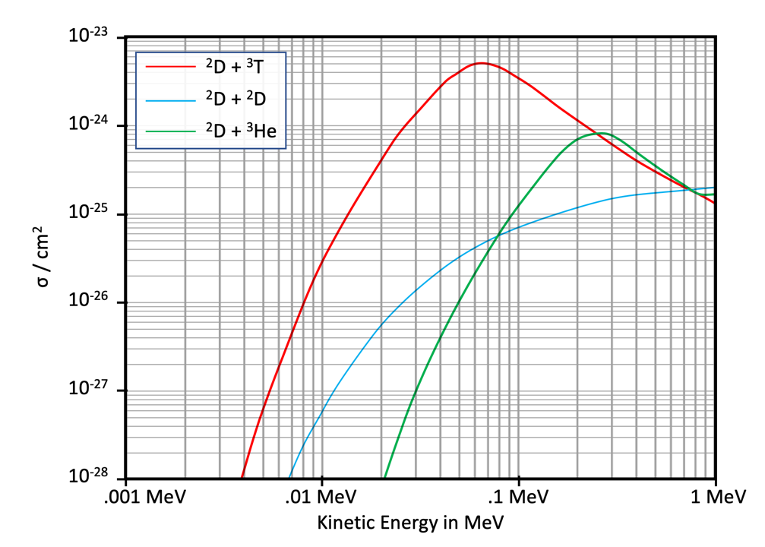
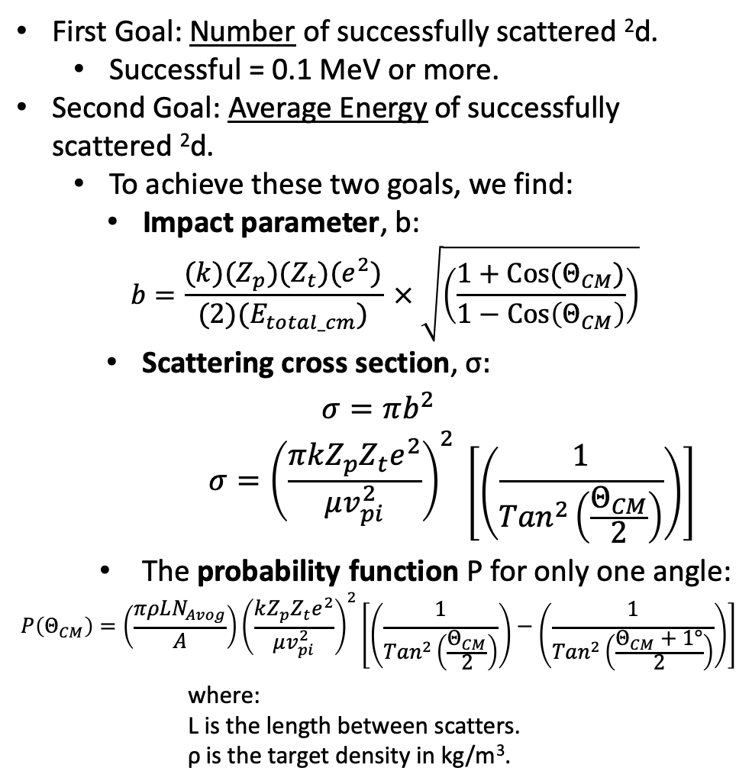
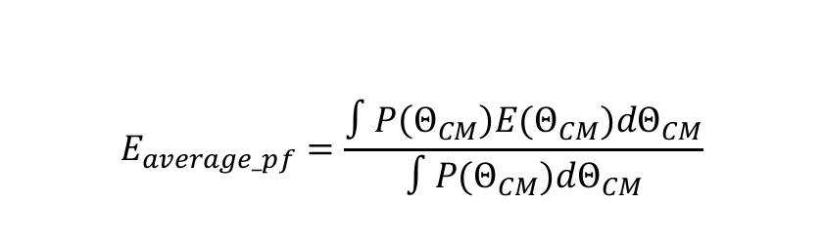
Continued--Particle Scattering for Charged Particles
First Goal: Number of successfully scattered ²d.
  Successful = 0.1 MeV or more.
Second Goal: Average Energy of successfully scattered ²d.
  To achieve these two goals, we find:
    Impact parameter, b:
    $$b=\frac{(k)(Z_{p})(Z_{t})(e^{2})}{{(2)(E}_{total_cm})} × \sqrt{\left(\frac{1+Cos⁡(Θ_{CM})}{1−Cos⁡\left(Θ_{CM}\right)}\right)}$$
    Scattering cross section, σ$:$
$$σ=πb^{2}$$
      $$σ={\left(\frac{πkZ_{p}Z_{t}e^{2}}{μv_{pi}^{2}}\right)}^{2} \left[\left(\frac{1}{{Tan}^{2}\left(\frac{Θ_{CM}}{2}\right)}\right)\right]$$
    The probability function P for only one angle:
$$P\left(Θ_{CM}\right)=\left(\frac{πρLN_{Avog}}{A}\right){\left(\frac{kZ_{p}Z_{t}e^{2}}{μv_{pi}^{2}}\right)}^{2}\left[\left(\frac{1}{{Tan}^{2}\left(\frac{Θ_{CM}}{2}\right)}\right)−\left(\frac{1}{{Tan}^{2}\left(\frac{Θ_{CM}+1°}{2}\right)}\right)\right]$$
      where:
      L is the length between scatters.
      ρ is the target density in kg/m³.
Threshold value for ²D+²D reaction cross section is around 0.1 MeV. (blue arrow.)
The probability function, combined with the energy function (Eq. 1), allows us to calculate number and average energy of successfully scattered ²d:
$$E_{average_pf}=\frac{∫P\left(Θ_{CM}\right)E(Θ_{CM})dΘ_{CM}}{∫P(Θ_{CM})dΘ_{CM}}$$
Notes:
Our first goal is to find the number of successfully scattered D-2, defined as a transfer of 0.1 MeV or more, to a cold D-2. A second goal is to find the average energy of these successfully scattered D-2. To achieve these two goals, we need the impact parameter, the scattering cross section, and the probability function for scattering. The probability function for only one angle is shown HERE. This probability function, combined with the energy function, allows us to calculate the number of successfully scattered D-2, as well as their average energy. The curve here is the experimentally determined reaction cross sections. The blue curve is for D-2 to D-2. As you can see, the reaction decreases as the energy goes down to lower energies, but it does not fall to zero with a cliff-like drop off. At lower energies, there is still a non-zero probability of a reaction. And THIS is what we want to utilize. The blue arrow is where the reaction rate has fallen off to a level too low to be considered important. This is 0.1 MeV of energy.

Slide 9
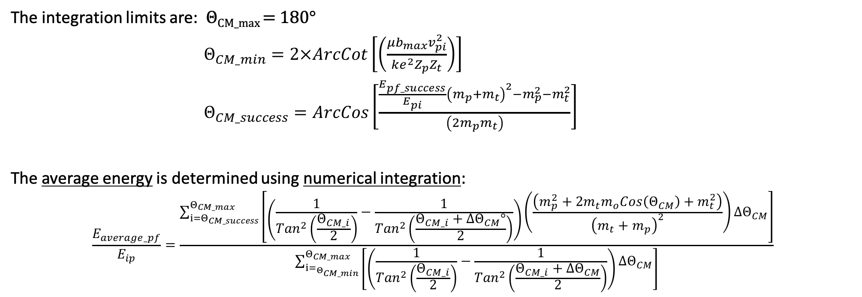
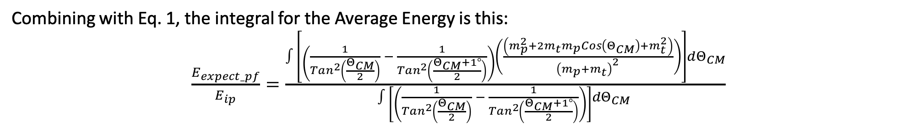
The angle for Θ_{CM_success} is solved using this equation. These integrals are then solved using numeric integration.
Continued--Particle Scattering for Charged Particles
Combining with Eq. 1, the integral for the Average Energy is this:
$\frac{E_{expect_pf}}{E_{ip}}=\frac{∫\left[\left(\frac{1}{{Tan}^{2}\left(\frac{Θ_{CM}}{2}\right)} − \frac{1}{{Tan}^{2}\left(\frac{Θ_{CM}+1°}{2}\right)}\right)\left(\frac{\left(m_{p}^{2}+2m_{t}m_{p}Cos\left(Θ_{CM}\right)+m_{t}^{2}\right)}{{\left(m_{p}+m_{t}\right)}^{2}}\right)\right]dΘ_{CM}}{∫\left[\left(\frac{1}{{Tan}^{2}\left(\frac{Θ_{CM}}{2}\right)} − \frac{1}{{Tan}^{2}\left(\frac{Θ_{CM}+1°}{2}\right)}\right)\right]dΘ_{CM} }$
The integration limits are: Θ_{CM_max} = 180°
$Θ_{CM_min}=2×ArcCot\left[\left(\frac{{μb}_{max}v_{pi}^{2}}{ke^{2}Z_{p}Z_{t}}\right)\right]$
$Θ_{CM_success}=ArcCos\left[\frac{\frac{E_{pf_success}}{E_{pi}}{\left(m_{p}+m_{t}\right)}^{2}−m_{p}^{2}−m_{t}^{2}}{\left(2m_{p}m_{t}\right)}\right]$
The average energy is determined using numerical integration:
$$\frac{E_{average_pf}}{E_{ip}}=\frac{\sum_{{i=Θ}_{CM_success}}^{Θ_{CM_max}}{\left[\left(\frac{1}{{Tan}^{2}\left(\frac{Θ_{CM_i}}{2}\right)}−\frac{1}{{Tan}^{2}\left(\frac{Θ_{CM_i}+∆Θ_{CM}°}{2}\right)}\right)\left(\frac{\left(m_{p}^{2}+2m_{t}m_{o}Cos\left(Θ_{CM}\right)+m_{t}^{2}\right)}{{\left(m_{t}+m_{p}\right)}^{2}}\right){∆Θ}_{CM}\right]}}{\sum_{{i=}_{Θ_{CM_min}}}^{Θ_{CM_max}}{\left[\left(\frac{1}{{Tan}^{2}\left(\frac{Θ_{CM_i}}{2}\right)}−\frac{1}{{Tan}^{2}\left(\frac{Θ_{CM_i}+∆Θ_{CM}}{2}\right)}\right)∆Θ_{CM}\right]}}$$
Notes:
The equation for the average energy is THIS, using the appropriate integration limits. Theta center-of-mass-max is always 180°, theta center-of-mass-min is found using THIS equation, wherein the maximum impact parameter, b-max, is determined from the D-2 density. The angle for theta center-of-mass-success is found using THIS equation. These integrals are then solved using numeric integration.

Slide 10
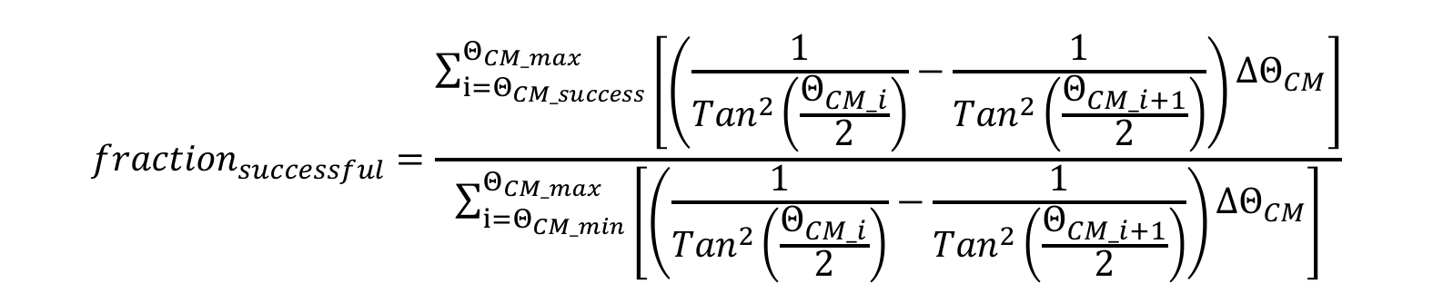
Continued--Particle Scattering for Charged Particles
To find the number of “successful” scattering events, this equation is used, with appropriate integration limits.
$${fraction}_{successful}=\frac{\sum_{{i=Θ}_{CM_success}}^{Θ_{CM_max}}{\left[\left(\frac{1}{{Tan}^{2}\left(\frac{Θ_{CM_i}}{2}\right)}−\frac{1}{{Tan}^{2}\left(\frac{Θ_{CM_i+1}}{2}\right)}\right){∆Θ}_{CM}\right]}}{\sum_{{i=Θ}_{CM_min}}^{Θ_{CM_max}}{\left[\left(\frac{1}{{Tan}^{2}\left(\frac{Θ_{CM_i}}{2}\right)}−\frac{1}{{Tan}^{2}\left(\frac{Θ_{CM_i+1}}{2}\right)}\right)∆Θ_{CM}\right]}}$$
With these equations, the number and the average energy of the successfully scattered ²D can be calculated.
Here’s a small sample of the very large table used for the numeric integrations. This one is just for protons. A similar table must be made for every projectile type.
These numeric integrations must be done for every energy that the projectile passes through, as it thermalizes.
Notes:
To find the number of “successful” scattering events, this equation is used. Again, this is solved with numeric integration. Here’s a small sample of the very large table used for the numeric integrations. This table is just for protons. A similar table must be made for every projectile type. These numeric integrations are done for every energy that the projectile passes through, as it thermalizes. I show this in the next slide.

Slide 11
Calculate the scattering rate of energetic protons with ²d
The results, for every energy from 3.03 MeV to 0.1 MeV, in steps of 0.1 MeV.
There are 3.058x10¹² energetic ²d energized per second. The average final energy of the ²d targets is 0.2784 MeV.
Notes:
I realize these numbers are too small to see, but I want to show you that I have done these calculations, and these numbers are real. Here, the numerical integrations for the protons are done as the energy steps down from 3.03 to 0.1 MeV. The results are shown HERE. The number of successful scattering events is 3.058 times 10 to the 12, with an average energy of 0.278 MeV.

Slide 12
Calculate the scattering rate of energetic ³T with ²d 7.95E11 at 0.208MeV
Calculate the scattering rate of energetic ³He with ²d 6.07E11 at 0.197MeV
Notes:
Here, I have repeated everything—all calculations, numeric integrations, and energy ranges—for the projectiles of tritium and He-3. The values are highlighted in green for the number and average energy of the successful scatters. For T-3, there are 7.95 times 10 to the 11, at 0.2084 MeV. For He-3, there are 6.07 times 10 to the 11 at 0.197 MeV

Slide 13
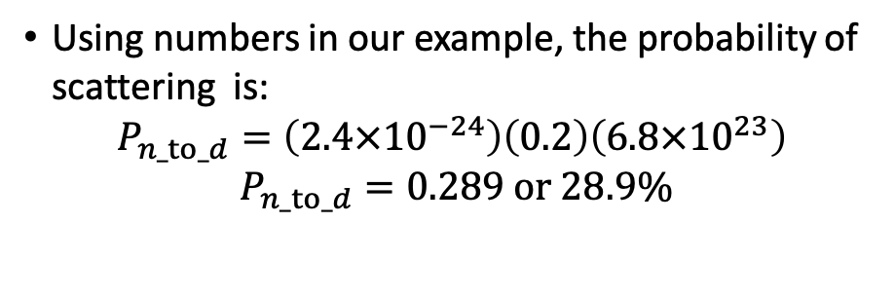
Neutron Scattering:
Neutron scattering is different.
  Easier
  Tables, graphs, experimental data
For ²d, the logarithmic energy decrement is 72.53.
  Average neutron energy after one scatter is 1.188 MeV.
  Average energy transferred to the ²d is 1.265 MeV.
As before, only energy transfers over 0.1 MeV are important.
Using numbers in our example, the probability of scattering is:
$$P_{n_to_d}=\left({2.4×10}^{−24}\right)\left(0.2\right)\left(6.8×{10}^{23}\right)$$
$$P_{n_to_d}=0.289 or 28.9\%$$
This is repeated for all neutrons that do not escape.
  The number of successful scatters is 3.581 x 10¹¹
  The average energy is 1.026 MeV.
Neutron loss is taken into account.
Notes:
Next we look at neutron scattering, different from charged-particle scattering, and easier. It uses experimental data for the cross sections. A fixed amount of energy, called the logarithmic energy decrement, is lost, on average, for each scatter. As before, we are only interested in energy transfers of 0.1 MeV or more. The table shows this information. The number of successful scattering events is 3.58 times 10 to the 11, and the average energy is 1.026 MeV.

Slide 14
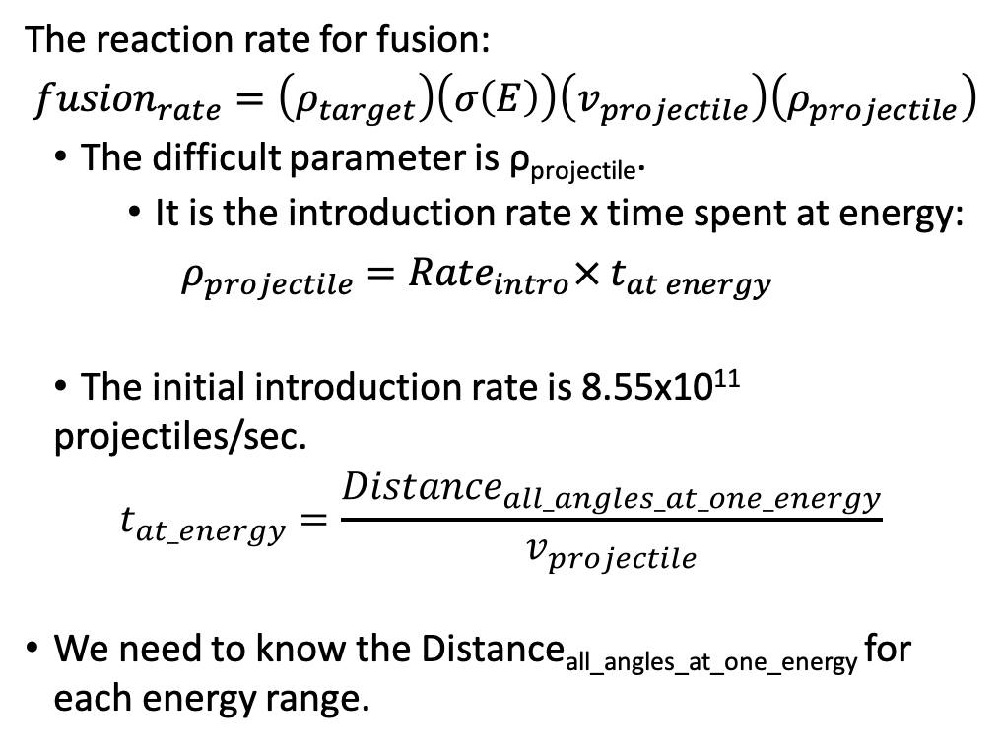
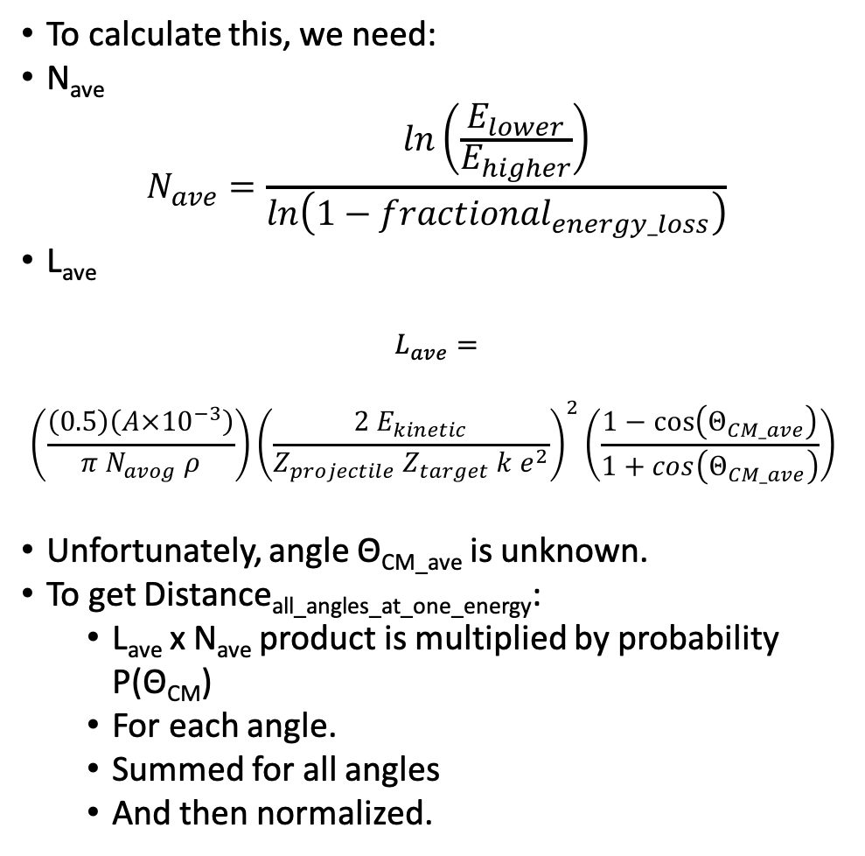
Understanding Reaction Rates
To calculate this, we need:
N_{ave}
$$N_{ave}=\frac{ln\left(\frac{E_{lower}}{E_{higher}}\right)}{ln\left(1−{fractional}_{energy_loss}\right)}$$
L_{ave}
$$L_{ave}=$$
$$\left(\frac{\left(0.5\right)\left({A×10}^{−3}\right)}{π N_{avog} ρ}\right){\left(\frac{{2 E}_{kinetic}}{Z_{projectile} Z_{target} {k e}^{2}}\right)}^{2}\left(\frac{1−cos⁡\left(Θ_{CM_ave}\right)}{1+cos\left(Θ_{CM_ave}\right)}\right)$$
Unfortunately, angle Θ_{CM_ave} is unknown.
To get Distance_{all_angles_at_one_energy}:
  L_{ave} x N_{ave} product is multiplied by probability P(Θ_{CM})
  For each angle.
  Summed for all angles
  And then normalized.
The reaction rate for fusion:
$${fusion}_{rate}=\left(ρ_{target}\right)\left(σ\left(E\right)\right)\left(v_{projectile}\right)\left(ρ_{projectile}\right)$$
The difficult parameter is ρ_{projectile}.
  It is the introduction rate x time spent at energy:
$$ρ_{projectile}={Rate}_{intro}×{ t}_{at energy}$$
The initial introduction rate is 8.55x10¹¹ projectiles/sec.
$$t_{at_energy}=\frac{{Distance}_{all_angles_at_one_energy}}{v_{projectile}}$$
We need to know the Distance_{all_angles_at_one_energy} for each energy range.
Notes:
Next, in Part 2, we need to calculate reaction rates for the secondary reactions. The standard EQUATION is the product of the density of the target, the cross section for the reaction at that energy, the projectile velocity, and the projectile density, at that energy. The difficult parameter here is the projectile density. The projectile density is…its introduction rate, at that energy, multiplied by the time spent, at that energy. To solve this, we need to know the average number of times, N, the projectile scatters and the average length between scatters, L, for the average angle. However, the average angle is unknown. Thus, the L times N product must be multiplied by the probability for that angle. Then summed. And then normalized. This will be the distance the average projectile travels in the core for all angles—for one energy.

Slide 15
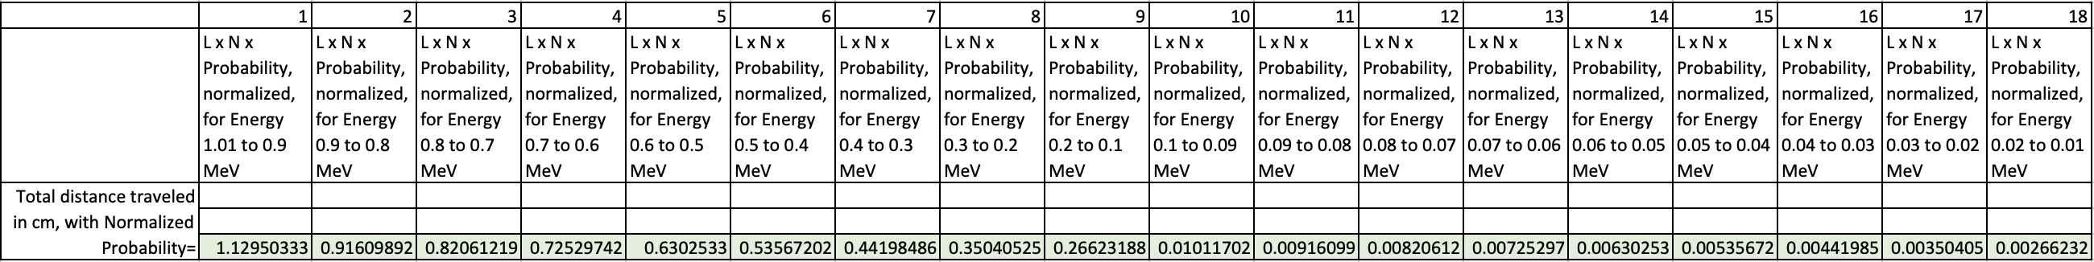
Reaction Rates for ³t to ²d
The calculations for Distance_{all_angles_at_one_energy} is for
1 MeV is shown to the right, in yellow.
  That one value can be used to determine the reaction rate for that one energy step.
For ³t to ²d, the threshold value for the reaction the cross section is about 0.01 MeV.
This whole procedure is then repeated for every energy step from 1 MeV to 0.01 MeV.
These values in green are used to calculate the fusion rate.
Notes:
That distance for 1 MeV is calculated and summed for all angles, highlighted in yellow. That one value can now be used to determine the reaction rate for that one energy step. For the T-3 to D-2 reaction, the energy range is from 1 MeV down to about 0.01 MeV, as indicated by the red arrow. That distance for one energy, all angles, is solved for 18 different energy steps within this range, shown HERE in green. We use these values, at the bottom of this table, to calculate the fusion reaction rates.

Slide 16
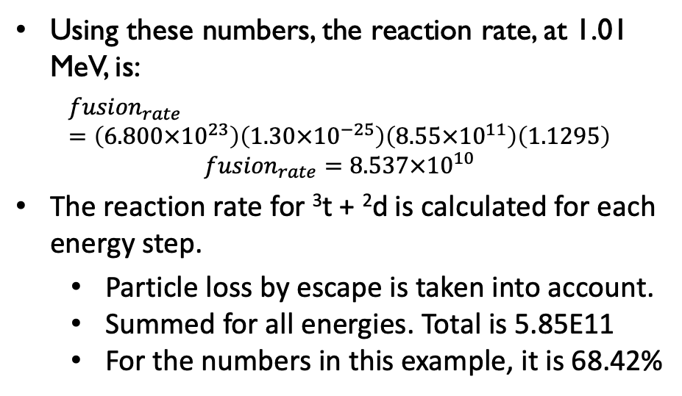
Continued--Reaction Rates
Using these numbers, the reaction rate, at 1.01 MeV, is:
$${fusion}_{rate}=\left(6.800×{10}^{23}\right)\left({1.30×10}^{−25}\right)\left(8.55×{10}^{11}\right)\left(1.1295\right)$$
$${fusion}_{rate}=8.537×{10}^{10}$$
The reaction rate for ³t + ²d is calculated for each energy step.
  Particle loss by escape is taken into account.
  Summed for all energies. Total is 5.85E11
  For the numbers in this example, it is 68.42%
Reaction Rates for ³He + ²d.
This entire procedure is repeated for the
³He to ²d reaction (table not shown).
The percentage for this reaction is 21.741%.
An additional 2.197 watts are generated from secondary reactions. Total power=3.197 watts.
Four new secondary child products: ⁴He, neutrons, more ⁴He, and protons.
The energy/⁴He ratio of the Pd core is 3.197 joules / (7.71E11) ⁴He atoms = 25.88 MeV/⁴He.
Notes:
The reaction rate for the T-3 to D-2 reaction is calculated for each energy step, then summed for all energies. For the numbers used in this example, the reaction rate is 68.4%. This entire procedure is repeated for the He-3 to D-2 reaction, giving a reaction rate of 21.74%. A total of 2.19 watts is generated from these two secondary reactions. And four new energetic child products are produced: Helium-4, neutrons, more Helium-4, and protons. The overall heat to helium-4 ratio for the palladium core is 25.88 MeV per He-4.

Slide 17
Scattering of the Secondary Child Products.
These 4 energetic child products scatter with ²d
  Like previous child products.
The same equations and procedures apply
  with appropriate values.
The details are not repeated here.
The final results, for both the primary and secondary reactions are shown in table, right.
There are 1.0821 x 10¹³ energetic ²d
Average energy of 0.3993 MeV.
Chain Reaction Determination.
NAE is 10X the 100% loading value.
  Nice round number.
This example reactor is able to a get a chain reaction.
  We need 1.71 x 10¹² or more.
  We get 1.752 x 10¹².
Notes:
These four energetic child products scatter with the D-2, just as the previous child products did. The same equations and procedures apply, using the appropriate values. The final results, for both the primary and secondary reactions are shown HERE. There are 1.082 times 10 to the 13 energetic D-2, with an average energy of 0.3993 MeV.
Recall that I picked the D-2 density in the NAE for this example to be 10 times the value for 100% loading. A chain reaction requires at least 1.71 times ten to the 12 reactions per second or more. We get 1.752 times 10 to the 12. With this density, a chain reaction IS able to occur.

Slide 18
The Calculations Regarding the Neutrons Emission
For Thermal Neutrons, these reactions absorb them:
In the set-up--three reactions
⁶Li + n→⁴He + ³t.
  This has a cross section of 941 barns.
  Used in hot fusion reactors to stop neutrons.
¹⁰B + n→⁴He + ⁷Li.
  Cross section is 3840 barns.
  Used as neutron moderator in fission reactors.
  Contained in Pyrex or Dewars in the set-up.
¹H + n→²H
  High density in water bath.
  Used as moderator in fission reactors.
Inside the Core--two reactions
¹⁰⁵Pd+n→¹⁰⁶Pd.
  The reaction rate not high enough to change isotopic ratio.
³He+n→³t+p.
  Thermal neutron cross section, 5330 barns.
  This is the reaction used in neutron detectors.
  A thermal neutron in the core, does not escape the core.
  A thermal neutron inside the set-up does not escape the LENR set-up.
Notes:
Before we make any conclusions, let’s examine the neutron emission from the LENR set-up. I want to consider two types of neutrons--thermal and energetic. Thermal neutrons have a much larger reaction cross section. There are not many thermal neutrons in the core--but for the few that are in the core, there are two main reactions that absorb thermal neutrons, shown HERE.
For thermal neutrons outside the core, but still in the set-up, there are three reactions of importance. This lithium reaction is used in hot fusion reactors to prevent the neutrons from escaping, due to its large cross section. And lithium is typically used in an electrolytic LENR set-up. And, more He-4 results from this reaction.
Also, the boron-10 in the borosilicate glass removes thermal neutrons, with a huge cross section of 3840 barns. For a setup that contains any borosilicate glass, thermal neutrons will get absorbed by it. Boron-10 is used in fission reactors as a moderator. As you can see, there is more He-4 released.
The third reaction is the water bath, with a high density of hydrogen. Again, this is a moderator for fission reactors, and it is also used in most LENR set-ups. Deuterium is created. The result is that thermal neutrons will not escape the LENR setup. But what about energetic neutrons?

Slide 19
Continued--The Calculations Regarding the Neutrons Emission
For Energetic Neutrons, scattering will thermalize them before they escape.
Energetic neutrons have a high scattering rate in electrolyte and thermal bath.
  When a neutron scatters with deuteron, it loses roughly half its energy.
  When a neutron scatters with proton, it loses roughly all its energy.
If a neutron scatters once:
  Its scattering cross sections become larger and it is more likely to re-scattered.
Can the typical set-up scatter the energetic neutrons at least once?
Do the math, in an example calculation. Here are the assumptions.
One watt of power from primary reactions, and 68% of the hot t-3 reacts with d-2.
The most energetic neutrons are 14.07 MeV.
The electrolyte is in a cylinder with an inner radius of 2.5 cm, and 25 cm tall.
There is 0.1 mole, 0.694 gm, of lithium in the heavy water.
The borosilicate glass beakers are 1/2 cm. thick.
The thermal water bath extends 25 cm (about 10”) beyond the the first beaker.
The whole set-up has a radius of 28.5 cm, roughly 1 foot.
Notes:
Most energetic neutrons will escape the palladium core before they thermalize. When they enter into the electrolyte or the water bath, they scatter. If they scatter ONCE, they lose about half their energy. So…if a neutron scatters ONCE, its scattering cross section becomes larger, and it is more likely to scatter again. And again, and again, until it thermalizes. The test, then, is to see if all the highest energy neutrons, at 14.07 MeV, scatter AT LEAST once in the set-up. Let’s do the math.
Here are the conditions for an example calculation, again using reasonable values.

Slide 20
Under these conditions, all the neutrons are scattered. If they scatter at least once, they will likely scatter again without escaping. Then, they react. More ⁴He and more heat are released.
Notes:
Here are the results of the calculations. The rows of numbers represent the percentage of scattering that will occur in the palladium core, the electrolyte, the Pyrex, the water bath, and the second Pyrex.
As the energetic neutrons move through these layers of the set-up, all the elements in these layers are included in the calculations for the scattering probability. In green on the right, the total percentage of neutrons that do not scatter is calculated in a running total. The water is the main component that scatters the neutrons.
For the set-up in this example, all neutrons scattering at least once. The negative numbers circled in red means that some of the neutrons have scattered twice. The net result is that no neutrons arrive at the outer Pyrex beaker without scattering at least once.
Some neutrons may indeed be able to escape, but only a minimal amount. The reason we don't see many neutrons leaving the set-up is because the typical set-up scatters and absorbs them--just like in a fission reactor.
Now, it is time to make some conclusions.

Slide 21
Conclusions
All the so-called “miracles” of LENR are explained.
  The Coulomb barrier is overcome by the transferrence of kinetic energy to the cold ²d.
  Neutrons are emitted from the reactions, but they do not escape the set-up.
  No gamma radiation occurs, because neither the primary nor secondary reactions create them.
  The predicted energy per ⁴He ratio is right on target.
No strange or new physics is needed. Simply apply conventional nuclear engineering calculations to the LENR.
The answer is Yes, Low-Energy Nuclear Reactions are possible.
  There are primary and secondary reactions in the palladium core.
  The higher density of ²d within the NAE must be considered.
Notes:
All the quote miracles of LENR are explained, seen here. No unusual theories or new physics are needed, just apply conventional nuclear engineering and standard physics to the issue, and the answer is YES, LENR is possible. What is different in this analysis--is the inclusion of the secondary reactions in the palladium core, and the understanding that the NAE must be considered.

Slide 22
Low Energy Nuclear Reactions are theoretically possible.
LENR is explained.
Thank you for your attention.
Q & A
Notes:
Most important, no longer can anyone say that there is no conventional theory for LENR. It is explained, using standard physics and conventional engineering. Thank you.

Slide 23
Experiment to test this:
  While the reactor is running in steady state, drain out the water from the thermal bath and electrolyte.
  Then measure the neutrons coming out of the set-up with no water.
  Do this via remote control, without getting near it.
  Simple…but not easy!

Slide 24
Why are Low Energy Nuclear Reactors so intermittent?
Start up.
  Reactors need a start up mechanism. Otherwise it is at the mercy of random external influences. (Sunspots, Radon, Cosmic rays, etc.)
  A well-shielded reactor, with lots of water and lead around it, will not start.
  Put some Am-241or U-238 inside the core.
The high ²d density is difficult to obtain. --This is an excellent place where more experimental reseach is needed, to determine how best to achieve this high density.

Slide 25
Why is no gamma radiation coming out of the reactor?
The primary and secondary reactions do not create gamma radiation.
One reaction that might create gamma radiation is the Pd-105 + n_{thermal} → Pd-106 + γ. However, this reaction will be small, since there are not many thermal neutrons in the Pd core.

Slide 26
Why is there not a lot of He-3?
Because of this reaction:
  ³He+n → ³t+p.
  Cross section is 5330 barns for thermal neutrons.
  Even for 1 MeV neutrons, it is high.
However, this reaction does not release much energy at all.
  Thus, the child products are not energetic enough to aid in increasing the number of successful scattering events.
  Nor does it add much to the overall energy output of the reactor.
  Nor does it increase the percentage of the T-3 to D-2 reaction, since the child T-3 is produced at fairly low energy.
Also, this reaction can only occur if the density of He-3 is high enough.
  For example, if the reactor has been running in steady state for several hours.
  Thus, this reaction can only occur if the reactor is already running in a chain reaction.
    This reaction doesn’t help to establish the chain reaction.
About the only thing it does do…
  …is to change the He-3 into H-3.

Slide 27
What about voltages?
For the steady state of an LENR reactor, the incoming flow of ²d must be enough to sustain the reaction. You will need enough voltage for that.
For the loading process, the voltage matters, but the optimum voltage is unknown. Again, this needs to be researched. What voltage makes the best NAE, and what voltage makes the densest ²d in the NAE? The details of the loading process are in need of more research and documentation.

Slide 28
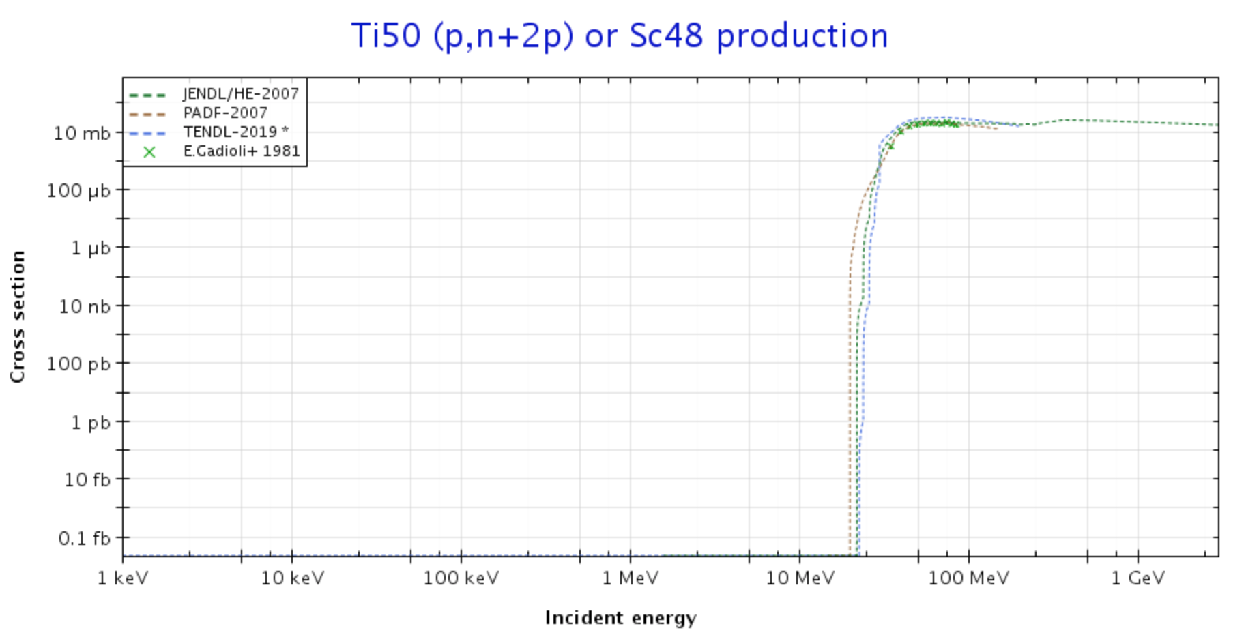
Here is an example of a reaction with a cliff-like drop off.
The ²d to ²d reactions do not behave this way. For the reactions in this presentation, there is a non-zero probability that the reactions still occur at low energies.

