Slide 1
The ‘LEC EFFECT’
Dr. Matt Lilley, Alan Smith. Net Zero Scientific Ltd.(UK)

Slide 2
Thanks for content extracts and support to:-
Dr. Frank E. Gordon, Dr. Harper Whitehouse (USA)
Antonio Di Stefano (Italy)
Jean-Paul Biberian (France)
LENR-forum.com, Matthew Neimerg, Mike Hill.

Slide 3
WTF is a LEC?
LEC Stands for ‘Lattice Energy Converter’ - discovered and developed by Frank Gordon and Harper Whitehouse.
It produces DC electrical output from co-deposited metals/hydrogen using simple and flexible geometries.
While output so far is several orders of magnitude below ‘commercially interesting’ this could be improved.
Potentially a ‘lab rat’, LEC reactors can use cheap materials and do not require sophisticated or costly lab facilities.

Slide 4
LEC – Design (Di Stefano) : LEC Construction Gordon/Whitehouse.
Working Electrode
Counter Electrode
Gas Inlet Valve

Slide 5
PREPARATION, TESTING, PERFORMANCE.
The working electrode (WE), is partly comprised of a hydrogen host material. The counter electrode (CE) may be copper, zinc, or brass.
When hydrogen occluding metal is electrodeposited onto the WE it becomes 'active' and emits ionizing radiation.
WE activity can be verified by in air by placing the WE in close proximity to a CE and connecting a digital multimeter (DMM) between the two electrodes.
Multiple LEC configurations have been tested.
The LEC self-initiates and self-sustains the production of a voltage and current in the absence of any applied external voltage and current.
Prolonged tests in a hydrogen show sustained voltage may persist for long periods.
Outputs from the small systems shown are typically 150-350 mV and micro-amps.

Slide 6
WORRYINGLY ROBUST?
The LEC works with a range of plating substrates, electrolyte types and physical forms.
Gordon/Di Stefano plated working WE’s using 25% HCl, with iron wire anodes, Others have used sodium bicarbonate and potassium hydroxide, lithium etc. with mild steel or other anodes. NZS used iron sulphate/citrate/ammonia based electrolytes and mild steel anodes.
WE substrate materials include iron, mild steel, copper, nickel, palladium and brass.
No distilled water or high purity chemicals are required.
Calorimeters are replaced with a digital multimeter, reducing calibration times.
The low cost/low hazard nature of the LEC could make replication a student project.
There have been at least 4 independent replications so far.
This is

Slide 7
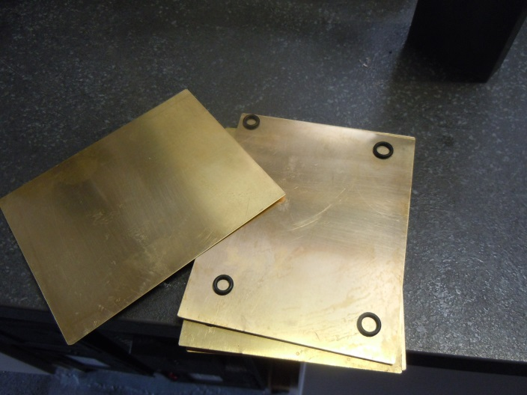
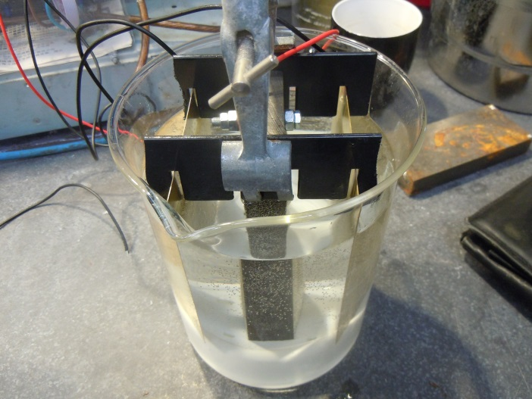
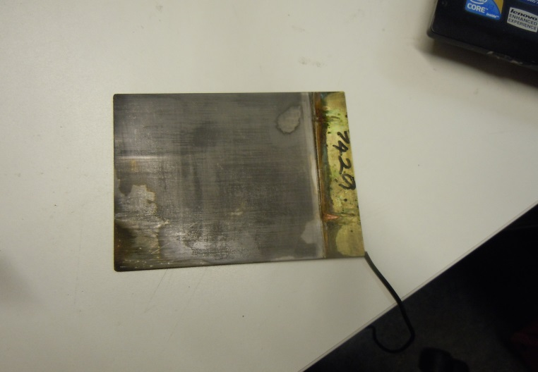
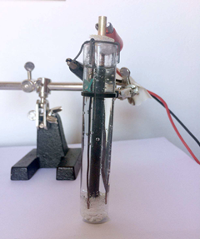
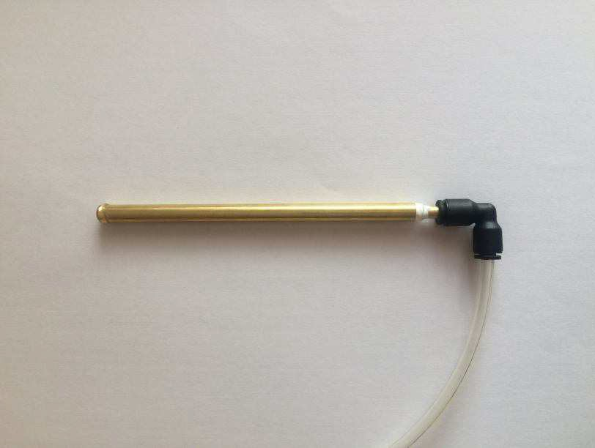
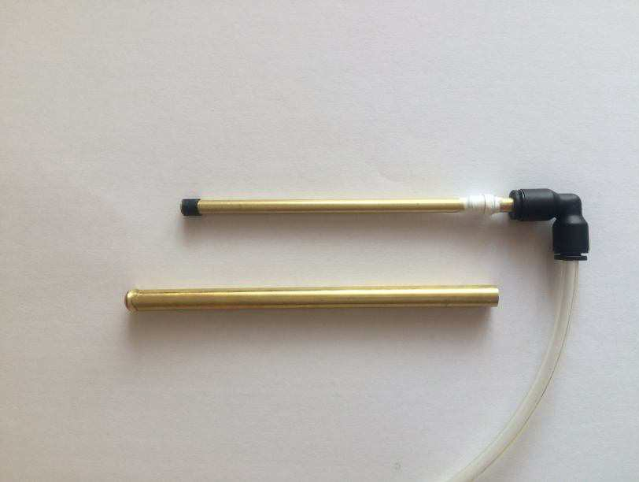
FORM FACTORS- PLATES OR TUBES?
Above – NZS, stacked brass plates: Below- Di Stefano tubes

Slide 8
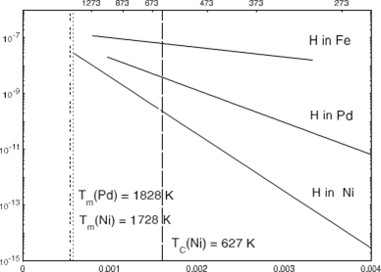
NOT ONLY PALLADIUM, BUT ALSO………..IRON
The graphic below is from the work of Mehrer, who like Thomas Tomas Graham 150 years earlier measured the capacity of Iron to occlude H2
HOW DOES IT WORK?
Gordon/Whitehouse hypothesize that the co-deposited surface emits radiation which ionises the free hydrogen/air between the WE and the CE. These ions separate into positive and negative species and produce a voltage across the electrodes.
Confirmation of this idea can be found in the work of Rout, et al (1994) who studied energetic emissions from palladium hydride. Energy levels appeared small, able to affect X-ray films, but was not detectable using a Geiger counter.
TIME -seconds OUTPUT mV.
0 100mV (instantly)
30 140
60 132
90 146
120 152
150 158
180 152

Slide 9
When the WE and CE are separated and then re-united the output recovers only slowly.
The closer the WE/CE are the higher the output, The best spacers are both thin, and porous, lightweight fly-screen nylon mesh being the most effective separator tested so far.
Impervious film –like polythene- cuts output to zero.
The table is of interest, it shows output vs time for a
WE/CE pair in air after short circuiting with an earthed
wire, the intention being to drain away stray charges etc.
This is not galvanism, and some other little-known effect
cannot be ruled out entirely, but tests are eliminating
them one by one.
Is it scale-able? NZC intend to find out, as do the inventors.
WHAT DOES IT DO?
TIME – Secs | Output - mV
0 | 100 (instantly)
30 | 140
60 | 132
90 | 146
120 | 152
150 | 158
180 | 152

Slide 10
SOME REFERENCE MATERIALS
LEC Presentation 2021:- < https://www.youtube.com/watch?v=J4dzTWY_aWM>
T. Graham, Phil. Trans R. Soc. 156 (1866) 415.
F.A. Lewis, The Palladium Hydrogen System, (Academic Press, 1967).
H. Mehrer, Diffusion in Solids, Springer 2007
R. K. Rout, et al. Reproducible anomalous emissions from palladium deuteride/hydride Fusion Technol. 1996. 30: p. 273.
J.J. Thomson, XL. On the Passage of Electricity through Gases exposed to Röntgen Rays, Phil. Mag. S5 42:258 (1896) 392.
J.J. Thomson, XIX. On the theory of the conduction of electricity through gases by charged ions, Phil. Mag. S5 47:286 (1899) 253-268.
LENR-forum.com. Search for ‘Frank Gordon’.
THANK YOU FOR YOUR ATTENTION

Slide 11
Inventors and Patent Holders, Lattice Energy Converter. Frank Gordon, Harper Whitehouse. Inovl Inc. San Diego, CA, USA. Email: feg@inovl.com. Phone +1-858-349-7869
Net Zero Scientific Ltd. Research and Development Laboratory, Romford,
Essex UK . Email: lubetkin1934@yahoo.co.uk. Phone +44 7944 847870.

