Slide 1
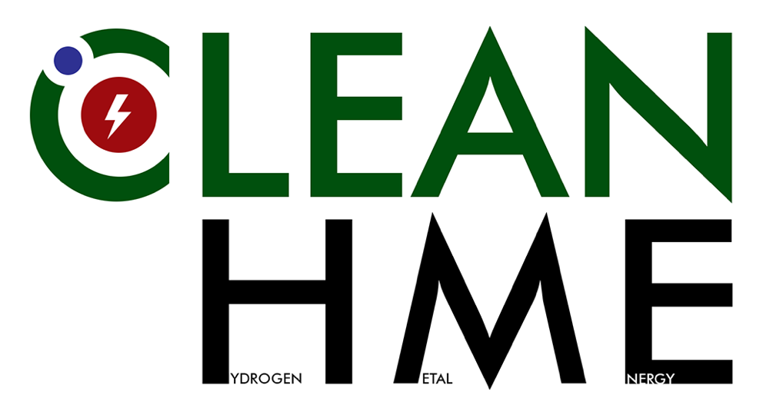
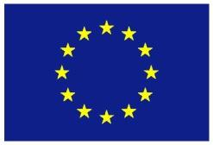
Enhanced reaction rates for proton induced reactions on natural Li isotopes
Natalia Targosz-Ślęczka
University of Szczecin, Szczecin, Poland
natalia.targosz-sleczka@usz.edu.pl
Agata Kowalska, Maritime University of Szczecin, Szczecin, Poland
University of Szczecin, Szczecin, Poland
Konrad Czerski, University of Szczecin, Szczecin, Poland

Slide 2
Motivation
What we understand from accelerator study of low-energy nuclear reactions?
For particle induced nuclear reactions at room temperature few points are interesting:
Penetration through the Coulomb barrier determines the phenomena and changes drastically due to electron screening effect
Energy excess is produced in decay channels with charged particles
Experiments are not easily reproducible because of the specific conditions and materials used
Understanding of the process of cold fusion is necessary = theoretical description giving direction for further experimental studies
29/08 - 01/09/2021
14th International Workshop on Anomalies in Hydrogen Loaded Metals, Assisi, Italy

Slide 3
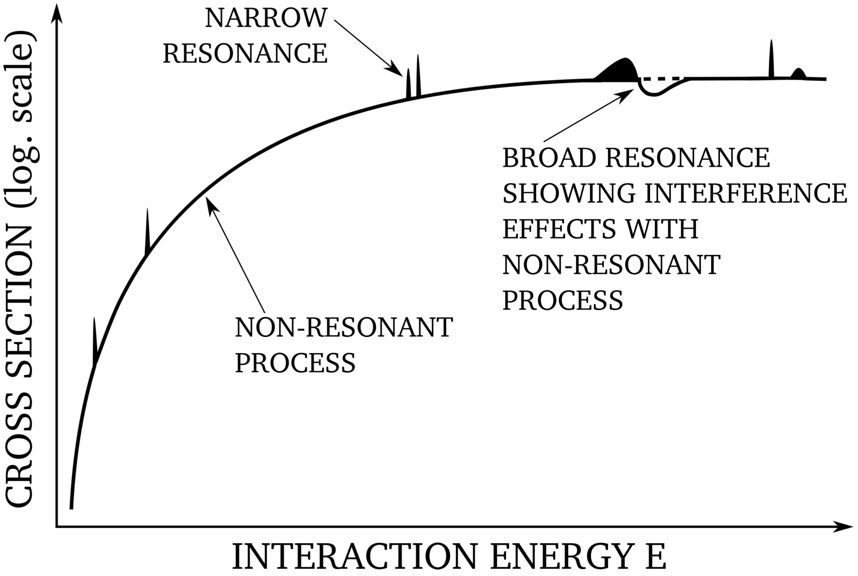
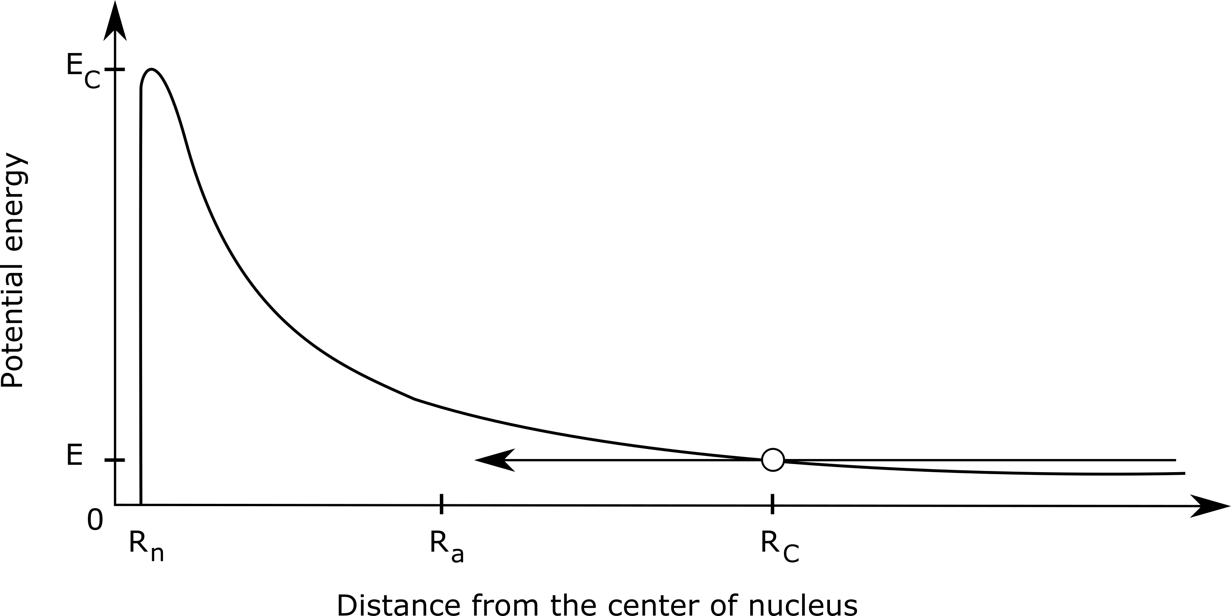
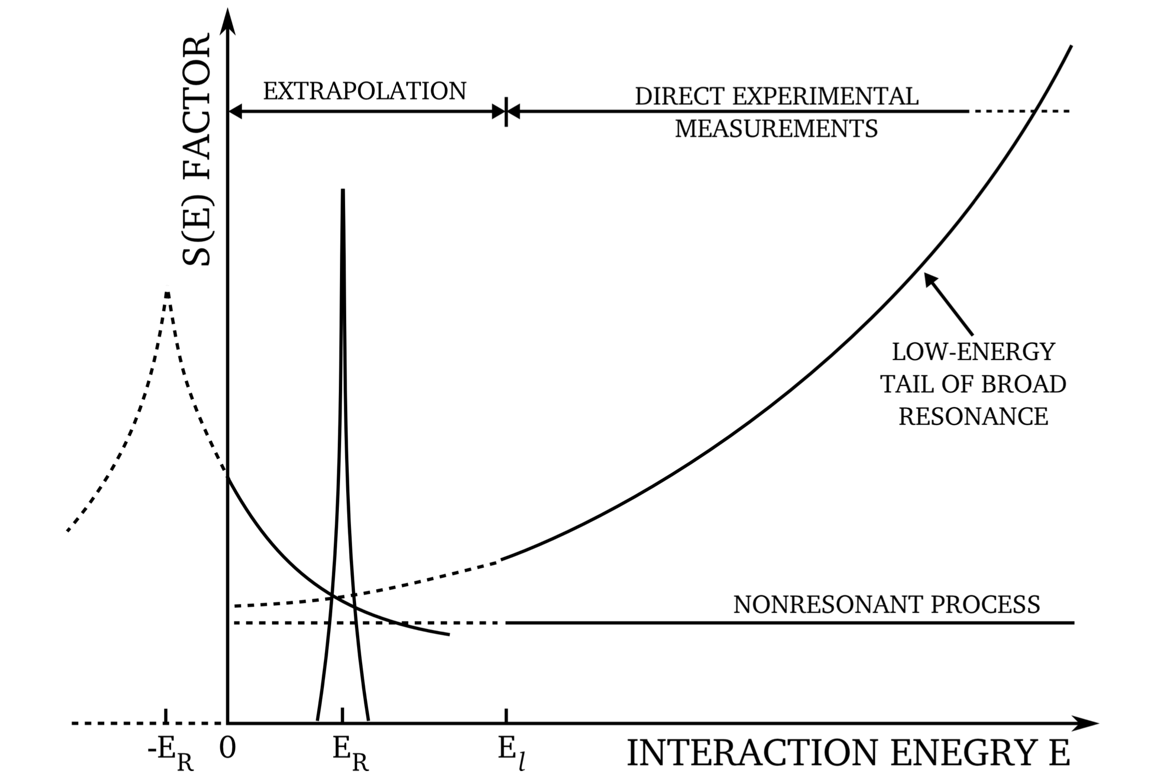
Members of WP7
Nuclear reactions below Coulomb barrier
Tunnelling effect through the barrier
$$V(R)=\frac{Z_{1}Z_{2}e^{2}}{R}$$
Rolfs C E and Rodney W S, Cauldrons in the Cosmos, Univ. Chicago Press, (1988)
Electrostatic repulsion
$$P(E)=\sqrt{\frac{E_{G}}{E}}exp\left(−\sqrt{\frac{E_{G}}{E}}\right)$$
Probability of
transition
$$σ(E)=\frac{1}{E}S(E)exp\left(−\sqrt{\frac{E_{G}}{E}}\right)$$
Cross section
Astrophysical S(E) factor
$$E→0$$
$$S(E)=S_{0}+S_{1}⋅E+S_{2}⋅E^{2}→S(E)=S_{0}$$
29/08 - 01/09/2021
14th International Workshop on Anomalies in Hydrogen Loaded Metals, Assisi, Italy

Slide 4
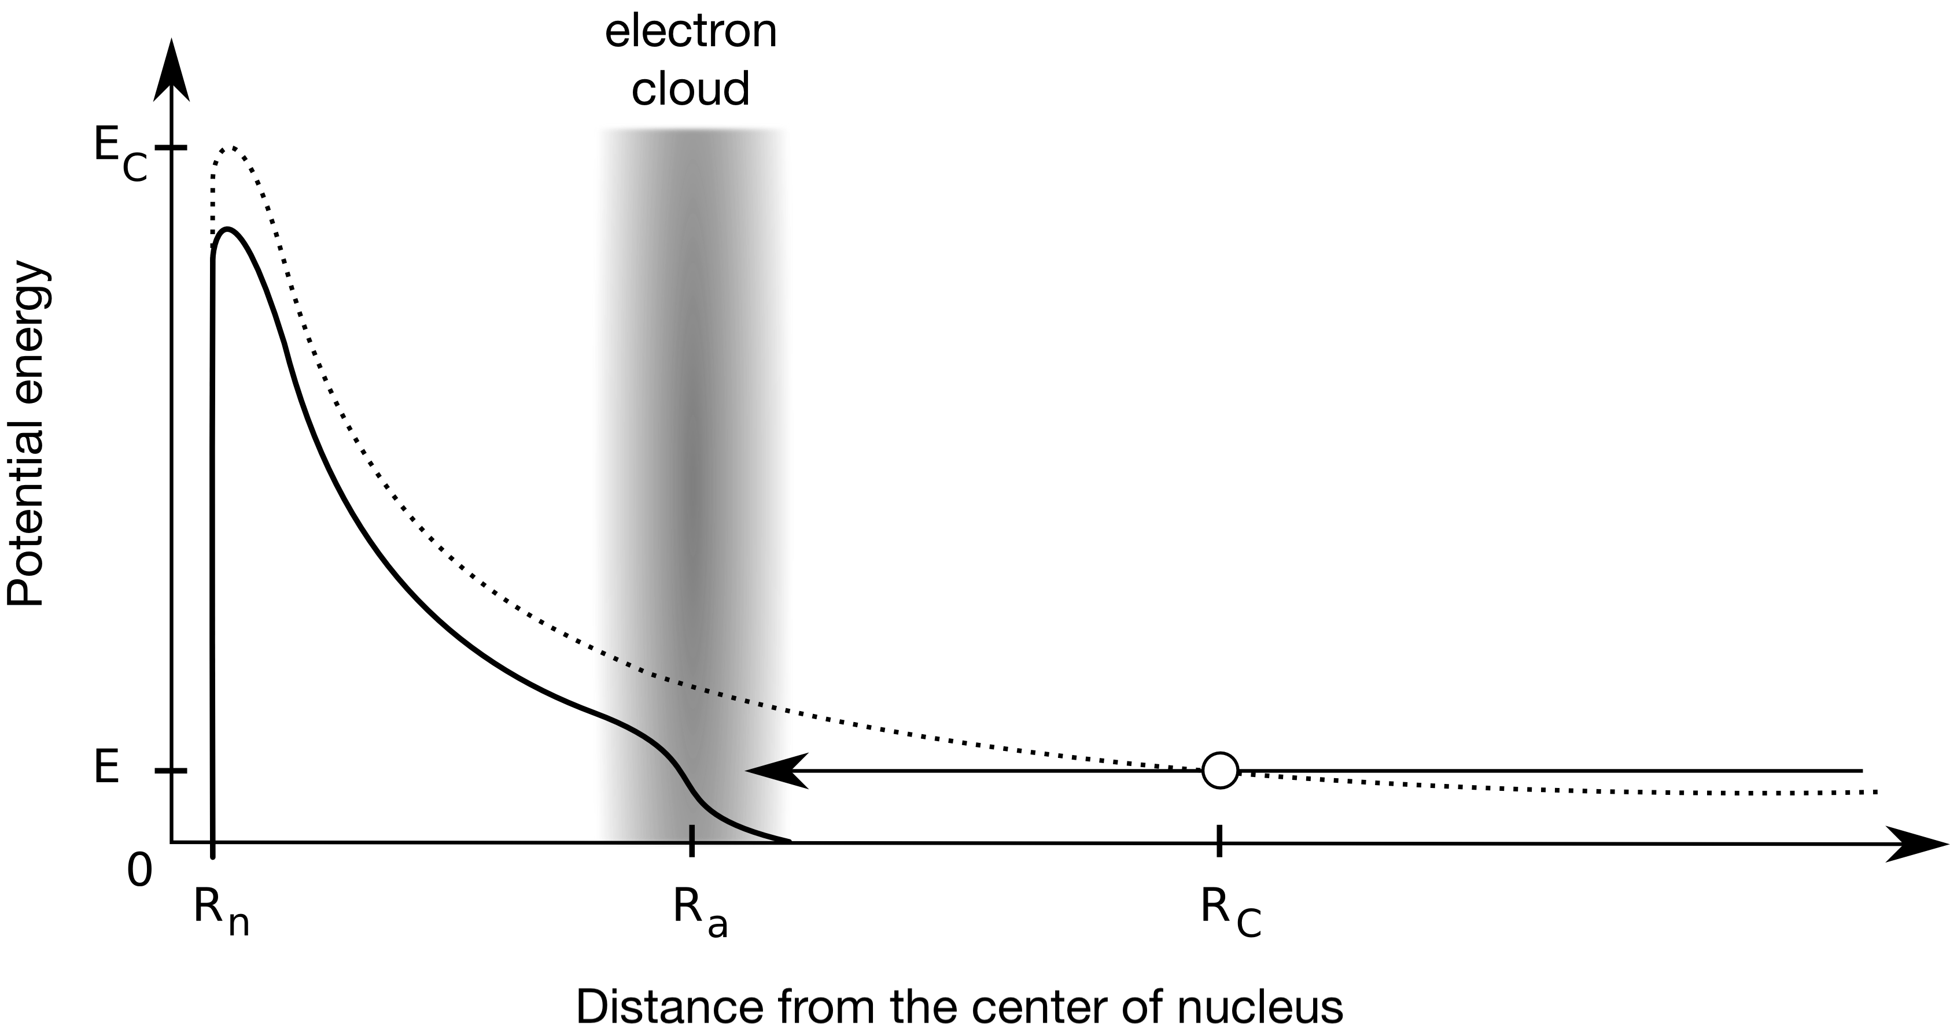
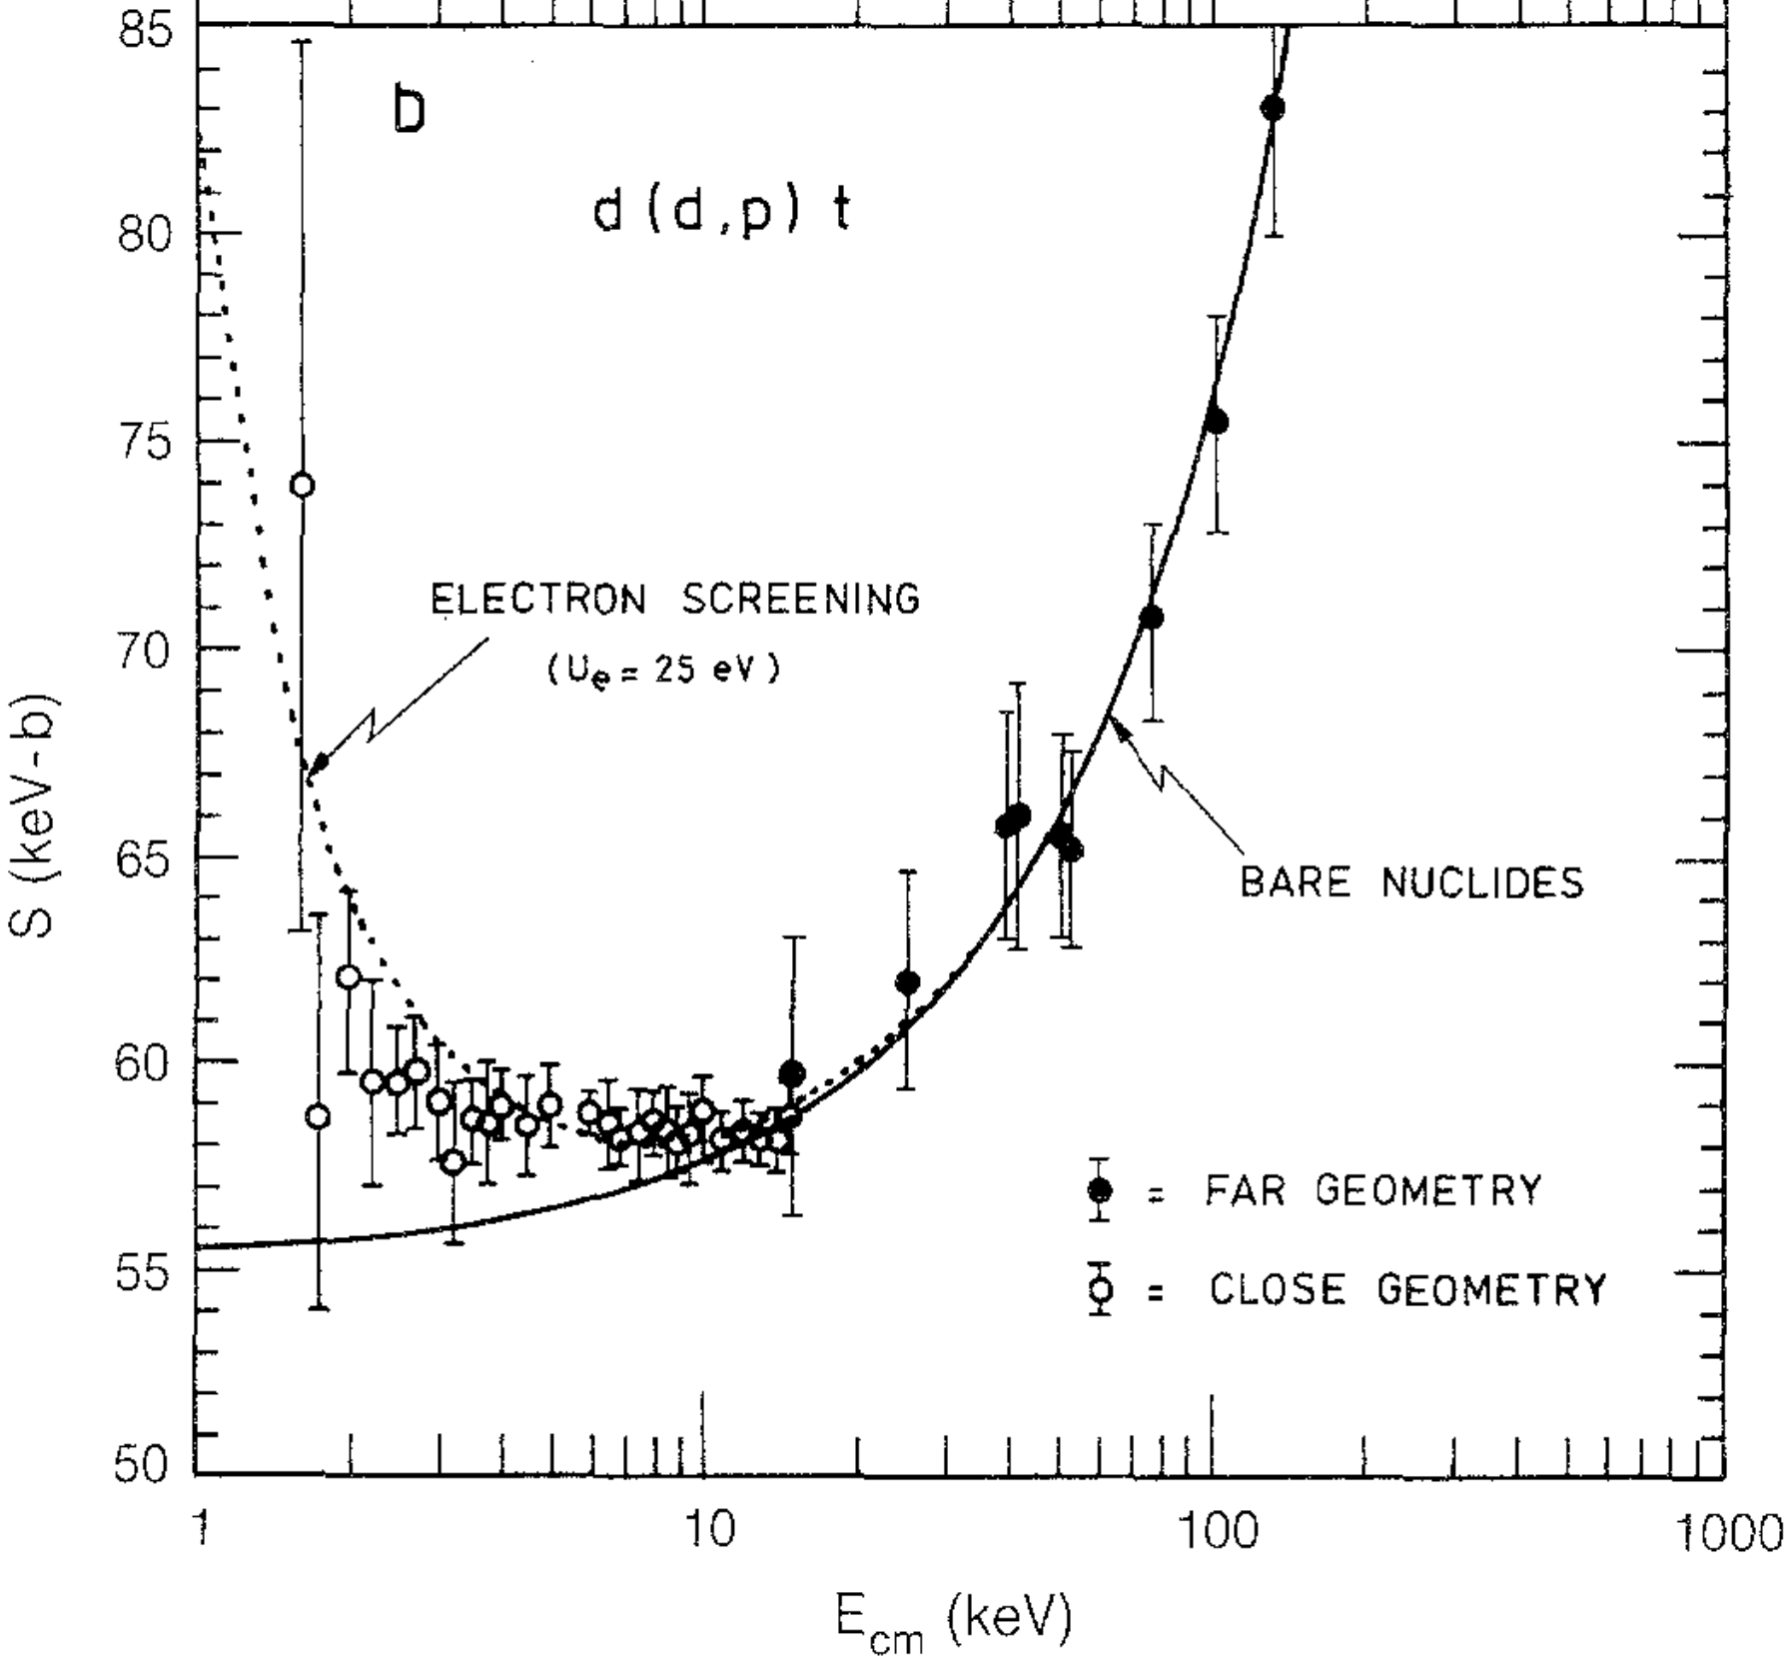
Members of WP7
Electron screening effect
$$V(R)=\frac{Z_{1}Z_{2}e^{2}}{R}exp\left(−\frac{R}{R_{a}}\right)$$
Electrostatic potential with screening function
$$U_{e}=\frac{Z_{1}Z_{2}e^{2}}{R_{a}}$$
Screening energy
$$P_{scr}(E)=\sqrt{\frac{E_{G}}{E+U_{e}}}exp\left(−\sqrt{\frac{E_{G}}{E+Ue}}\right)$$
$$σ_{scr}(E)=\frac{1}{\sqrt{E(E+U_{e})}}S(E)exp\left(−\sqrt{\frac{E_{G}}{E+U_{e}}}\right)$$
Greife U, Z. Phys. A 315 (1995)
For details on theoretical description see K. Czerski’s talk
29/08 - 01/09/2021
14th International Workshop on Anomalies in Hydrogen Loaded Metals, Assisi, Italy

Slide 5
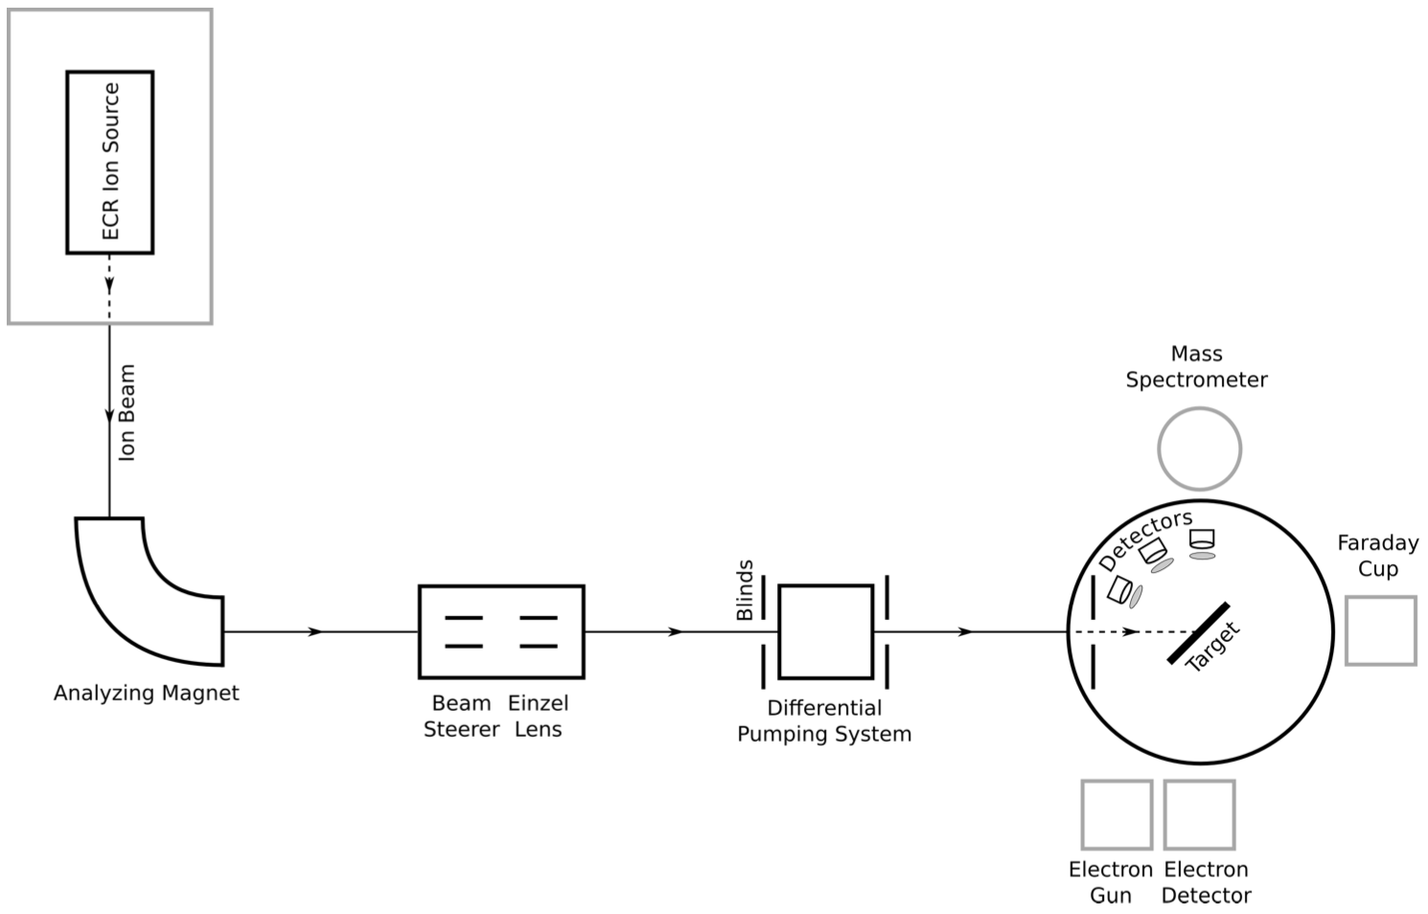
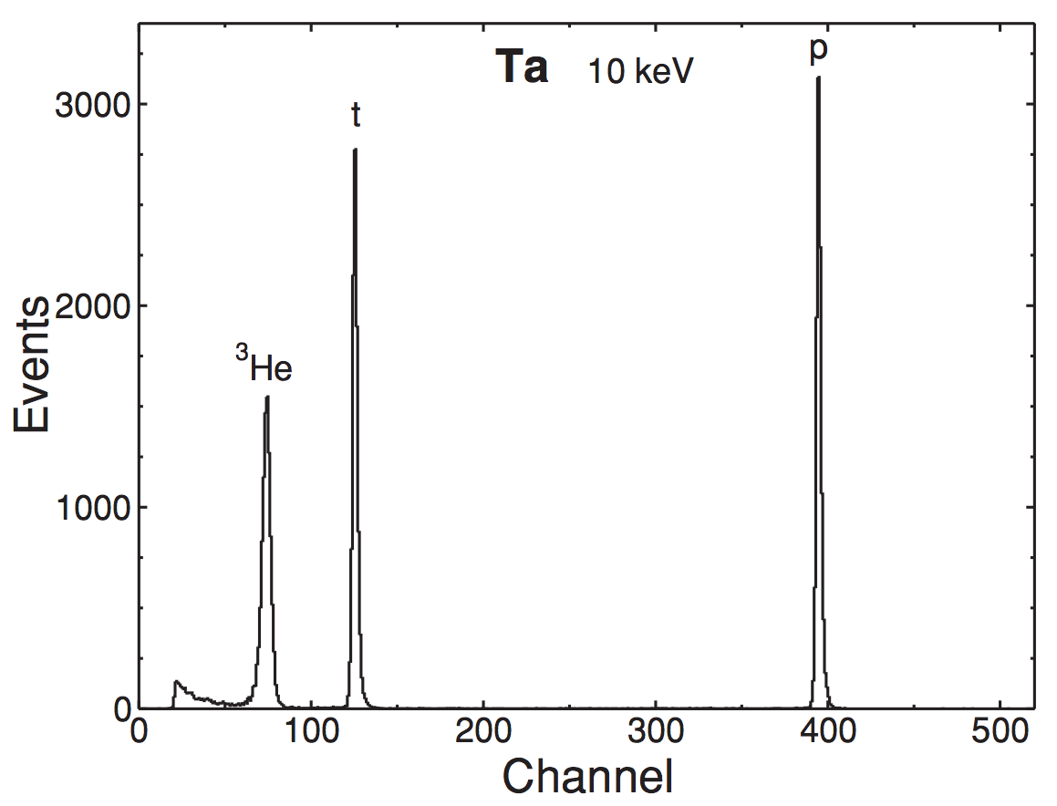
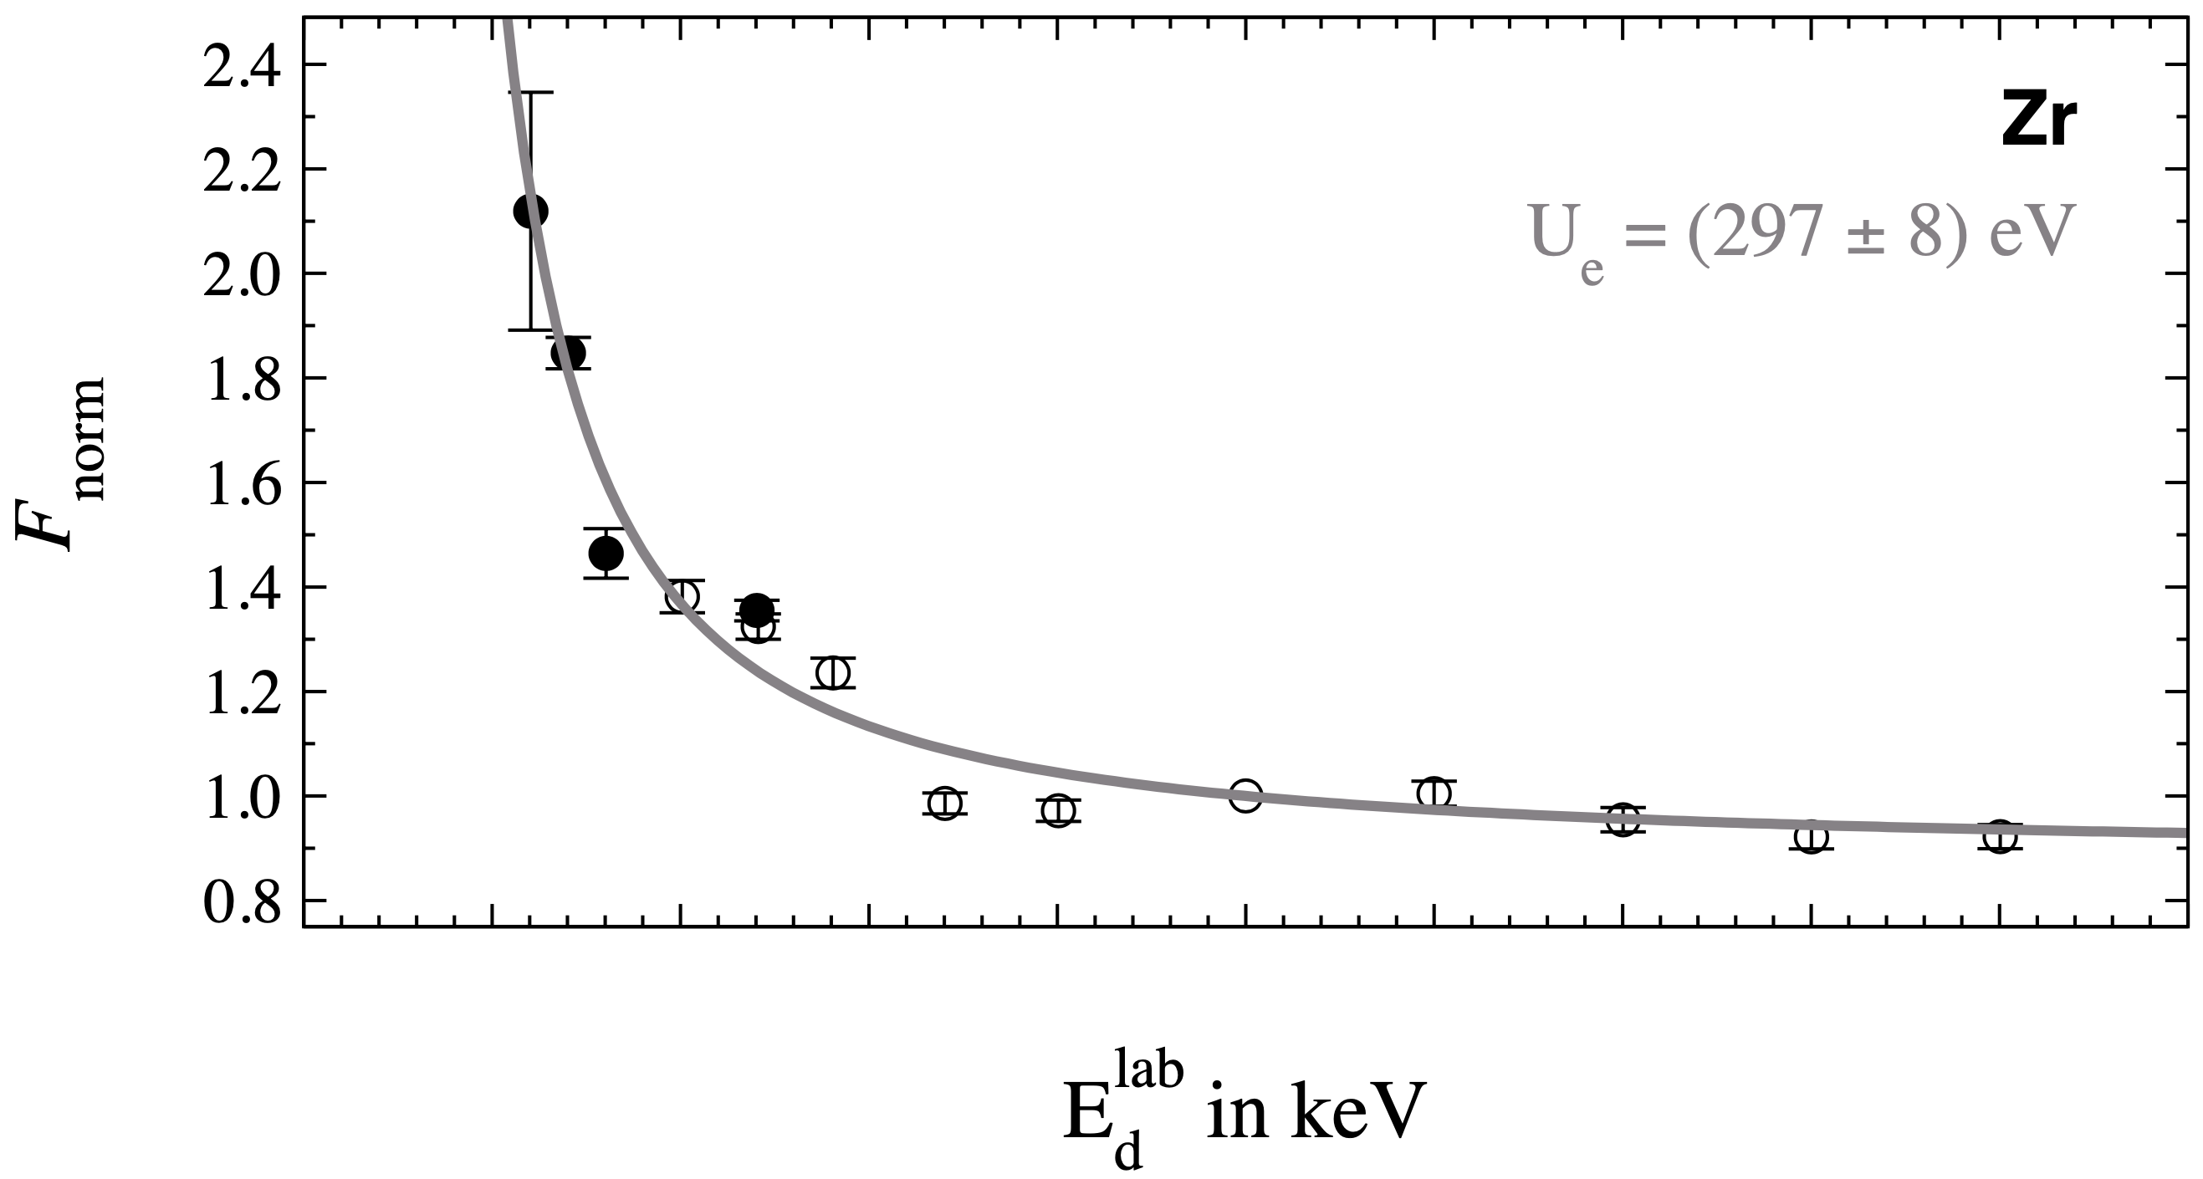
Members of WP7
Accelerator driven experiments
Huke A, Phys. Rev. C 78, 015803 (2008)
Targosz-Ślęczka N, PhD Thesis, University of Szczecin (2012)
For details on experimental procedure see M. Kaczmarski’s talk
29/08 - 01/09/2021
14th International Workshop on Anomalies in Hydrogen Loaded Metals, Assisi, Italy

Slide 6
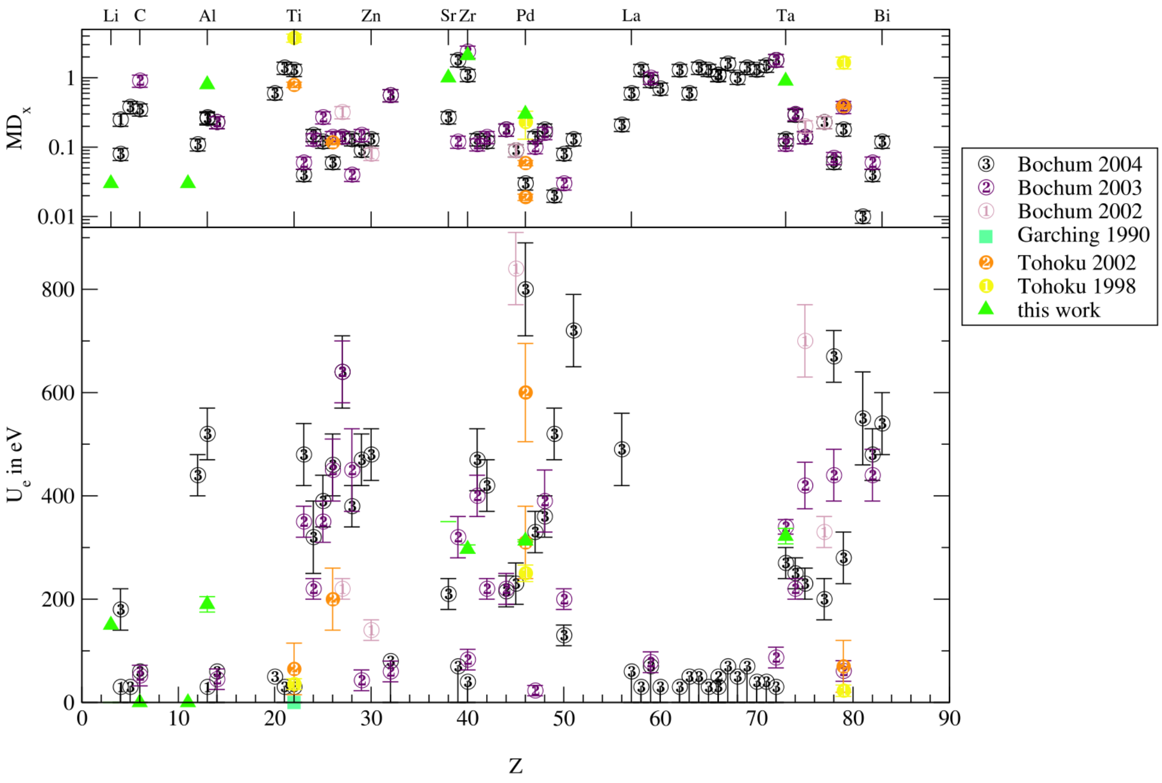
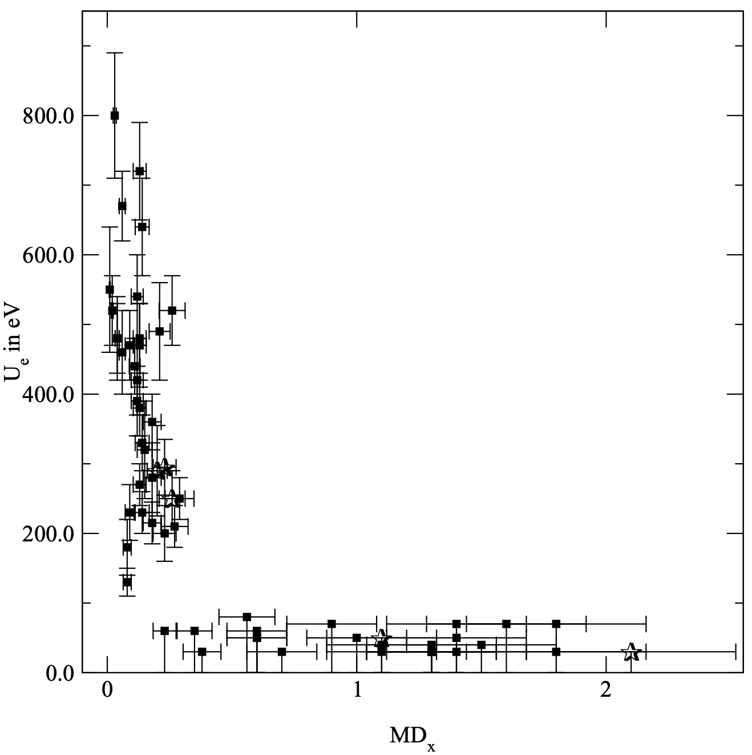
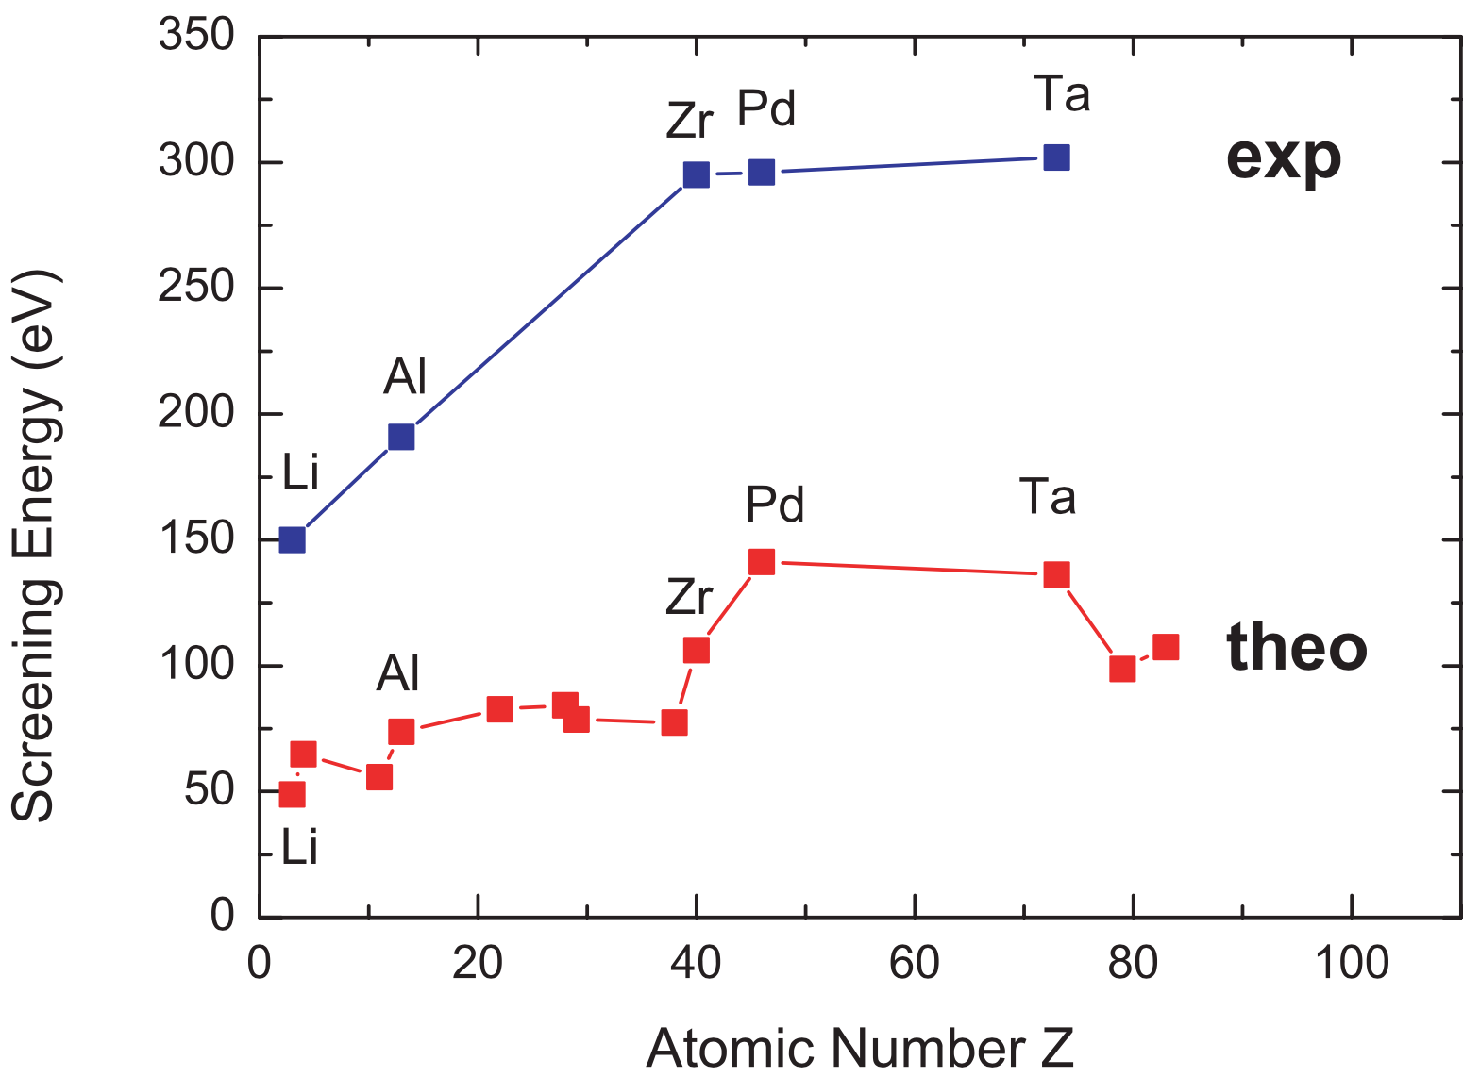
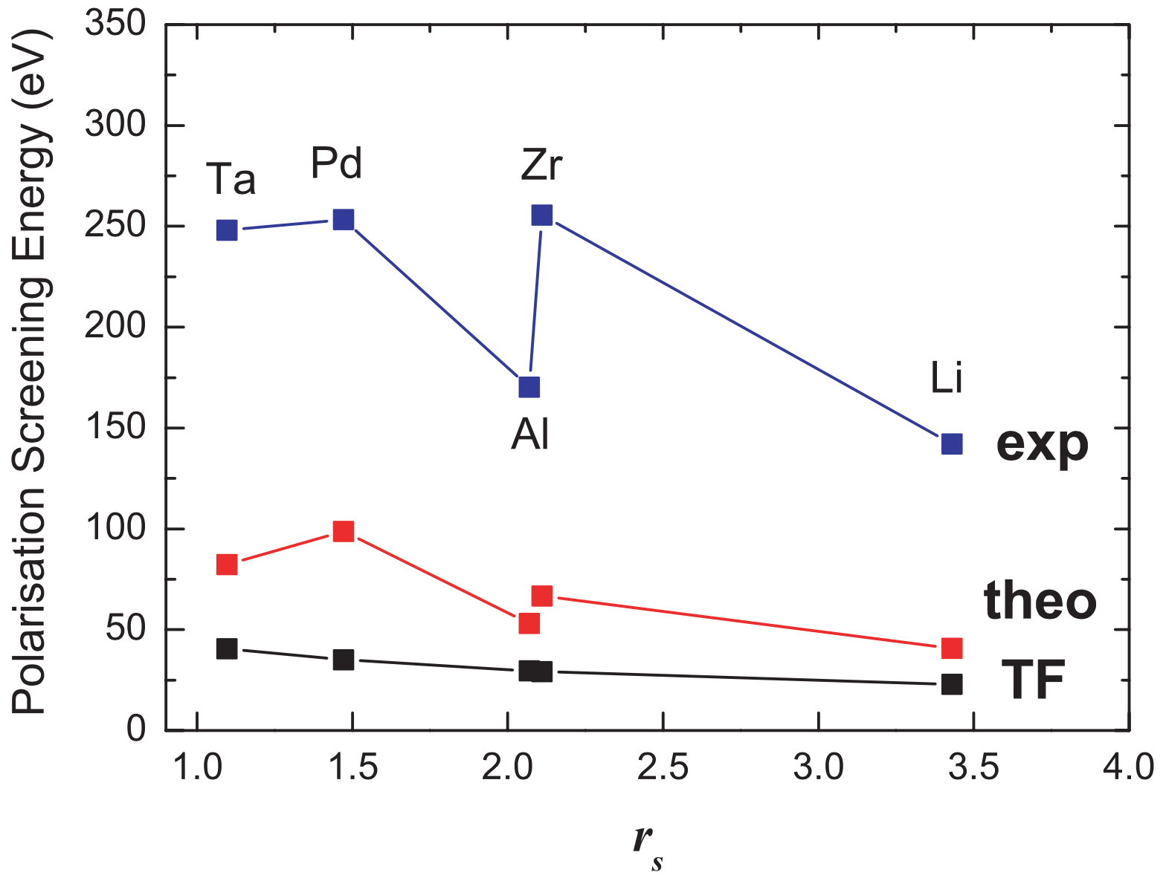
Members of WP7
Experimental results for screening
HV
Czerski K, Eur. Phys. J. A 27, 83 (2006)
Huke A, Phys. Rev. C 78, 015803 (2008)
HV
29/08 - 01/09/2021
14th International Workshop on Anomalies in Hydrogen Loaded Metals, Assisi, Italy

Slide 7
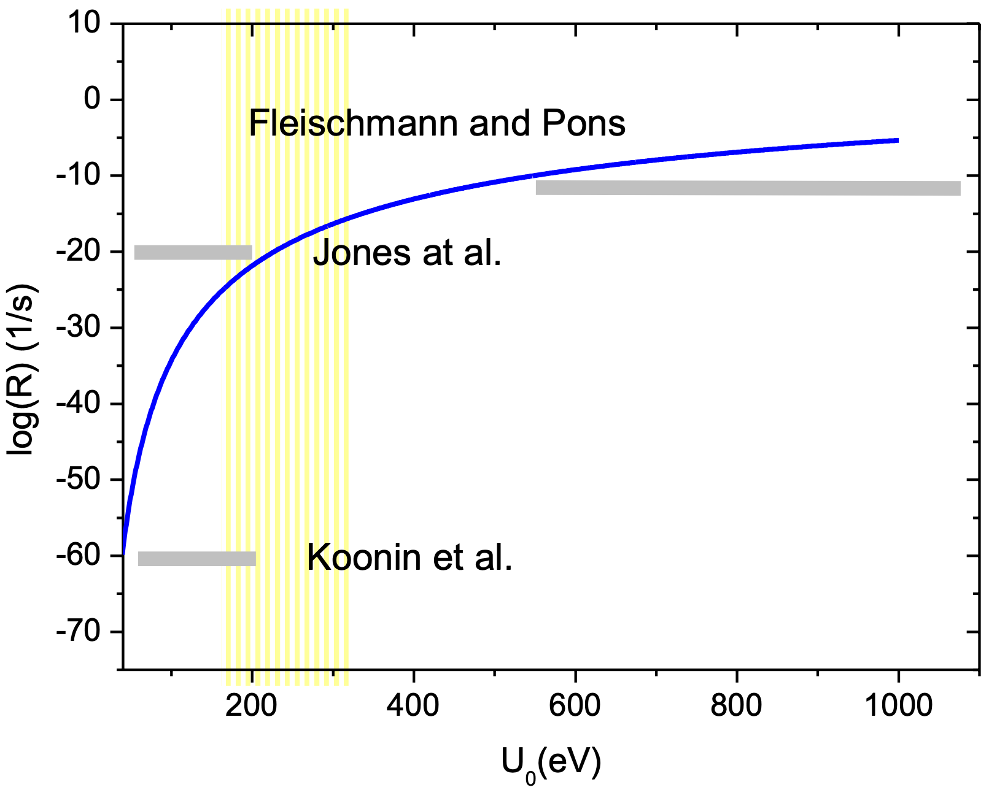
Members of WP7
Nuclear reaction rates
Calculation of reaction rates depending on different screening energies for d+d reaction in Pd in comparison to other authors
$$σ_{scr}(E)=\frac{1}{\sqrt{E(E+U_{e})}}S(E)exp\left(−\sqrt{\frac{E_{G}}{E+U_{e}}}\right)$$
$$→\frac{1}{\sqrt{EU_{e}}}S_{0}exp\left(−\sqrt{\frac{E_{G}}{U_{e}}}\right)$$
$$E→0$$
$$R_{scr}=Nσ_{scr}(E)v_{rel}=Nσ_{scr}(E)\sqrt{\frac{2E}{μ}}$$
Czerski K, Europhys. Lett. 68, 3 (2004)
$$→\frac{\sqrt{2}N}{\sqrt{μU_{e}}}S_{0}exp\left(−\sqrt{\frac{E_{G}}{U_{e}}}\right)$$
$$E→0$$
29/08 - 01/09/2021
14th International Workshop on Anomalies in Hydrogen Loaded Metals, Assisi, Italy

Slide 8
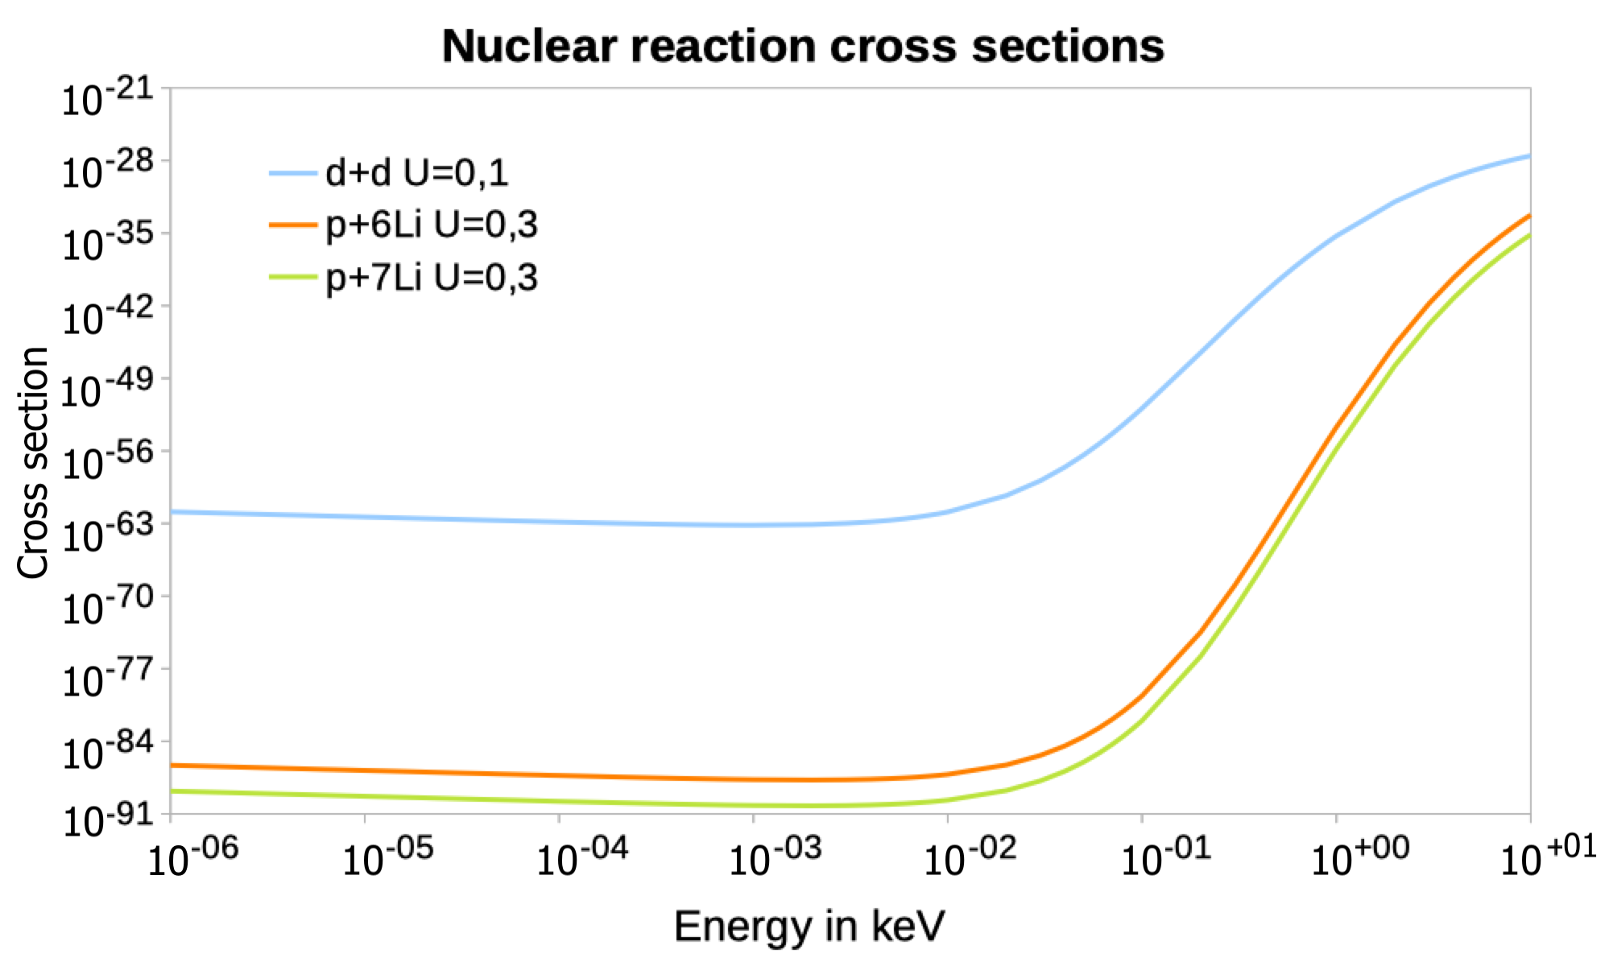
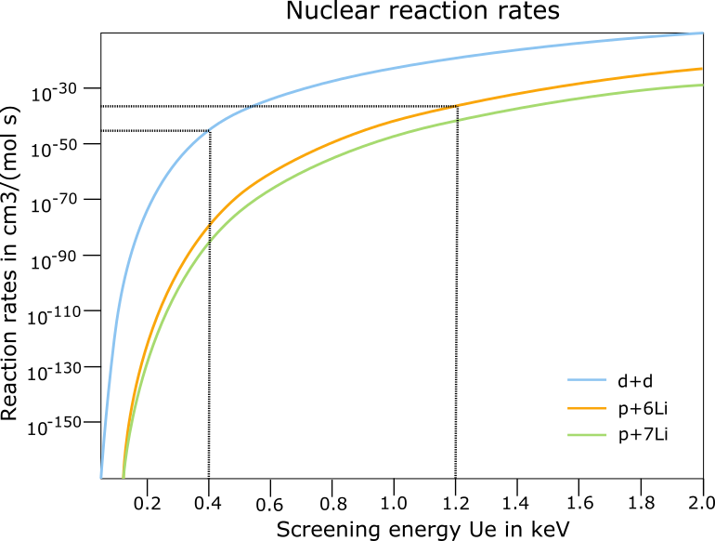
Comparison of deuteron and proton induced reactions
Members of WP7
$$d+d→p+^{3}H$$
$$p+^{6}Li→^{3}He+^{4}He$$
$$μ=0.8632 u$$
$$μ=1.0071 u$$
$$S_{0}=3.6 MeV b$$
$$S_{0}=5.6⋅{10}^{−2} MeV b$$
$$E_{G}=7603 keV$$
$$E_{G}=986 keV$$
$$p+^{7}Li→^{4}He+^{4}He$$
$$μ=0.8812 u$$
$$S_{0}=6.2⋅{10}^{−2} MeV b$$
Czerski K, in prep.
$$E_{G}=7762 keV$$
29/08 - 01/09/2021
14th International Workshop on Anomalies in Hydrogen Loaded Metals, Assisi, Italy

Slide 9
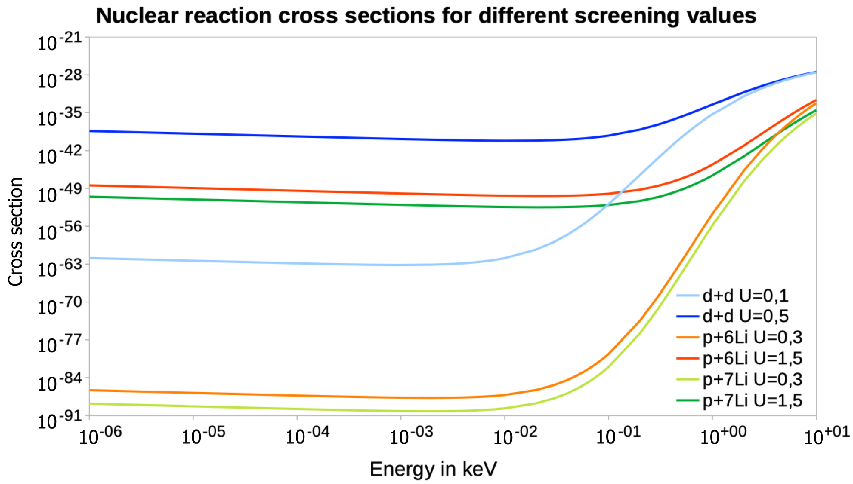
Members of WP7
How screening changes cross section?
Czerski K, in prep.
29/08 - 01/09/2021
14th International Workshop on Anomalies in Hydrogen Loaded Metals, Assisi, Italy

Slide 10
Members of WP7
Screening dependence on atomic charge
The cross section for a screened reaction is defined as
At $E→0$ the strength of the screening can be simplified to
If we assume that $U_{e}∝Z_{1}Z_{2}$ it implies $\sqrt{\frac{E_{G}}{U_{e}}}∝\sqrt{Z_{1}Z_{2}}$
If we assume that $U_{e}∝(Z_{1}Z_{2})^{2}$ it implies $\sqrt{\frac{E_{G}}{U_{e}}}$ is independent on $Z_{1}Z_{2}$
$$σ_{scr}(E)=\frac{1}{\sqrt{E(E+U_{e})}}S(E)exp\left(−\sqrt{\frac{E_{G}}{E+U_{e}}}\right)$$
$$E_{G}=\frac{2π^{2}}{(137)^{2}}(Z_{1}Z_{2})^{2}μ$$
$$exp\left(−\sqrt{\frac{E_{G}}{U_{e}}}\right)$$
The lower the charges the better cross section
The same probability for all nuclear reactions
29/08 - 01/09/2021
14th International Workshop on Anomalies in Hydrogen Loaded Metals, Assisi, Italy

Slide 11
Members of WP7
Conclusions
Proton induced reactions on Li are interesting alternative to d+d reactions
The p+⁶Li and p+⁷Li reactions produce only the charged particles (the whole reaction Q value will be absorbed in the sample), no radioactive products
With known channels and energies of charged products those reactions cross sections should not be difficult to be determined
The screening energy for p+⁶Li reaction in metallic media is estimated to be 3 times higher than for the d+d reaction
Nuclear reactions in natural Li will be studied next in the accelerator-driven experiments in the Centre for Experimental Physics eLBRUS at the University of Szczecin (Poland) in the frame of the CleanHME project
29/08 - 01/09/2021
14th International Workshop on Anomalies in Hydrogen Loaded Metals, Assisi, Italy

Slide 12
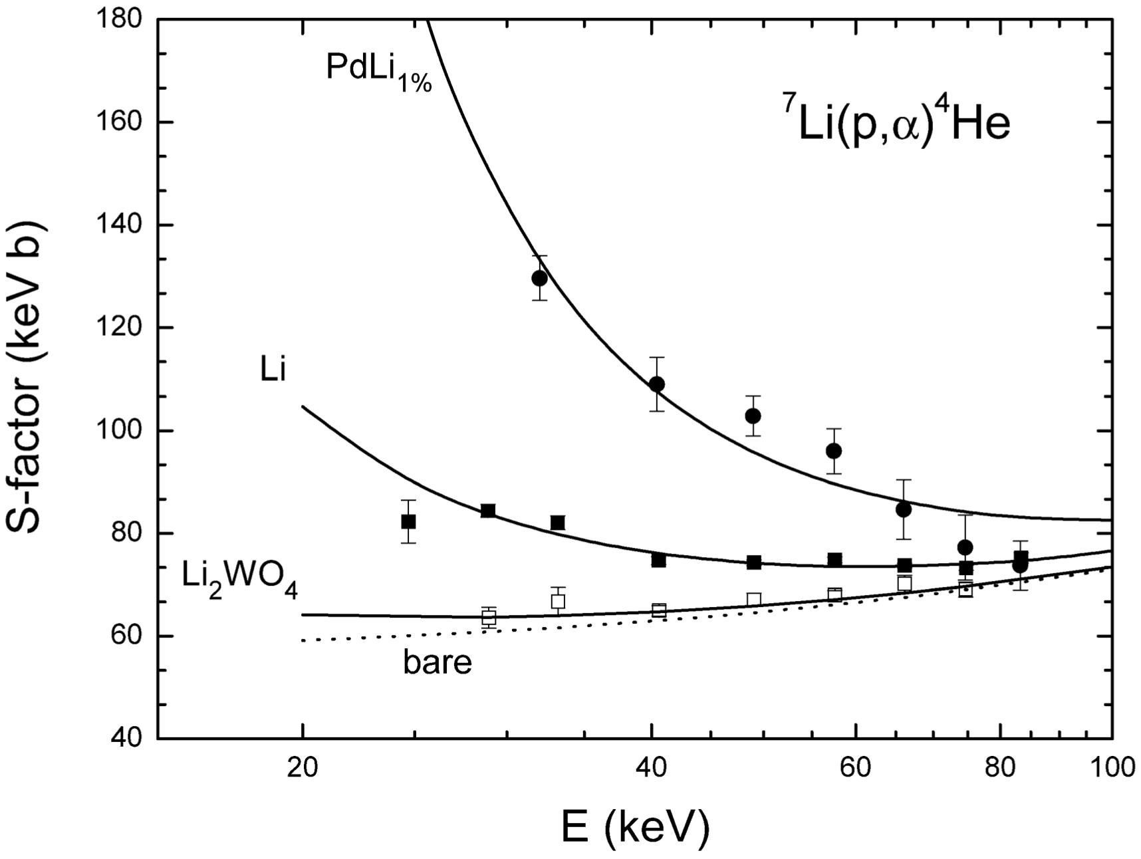
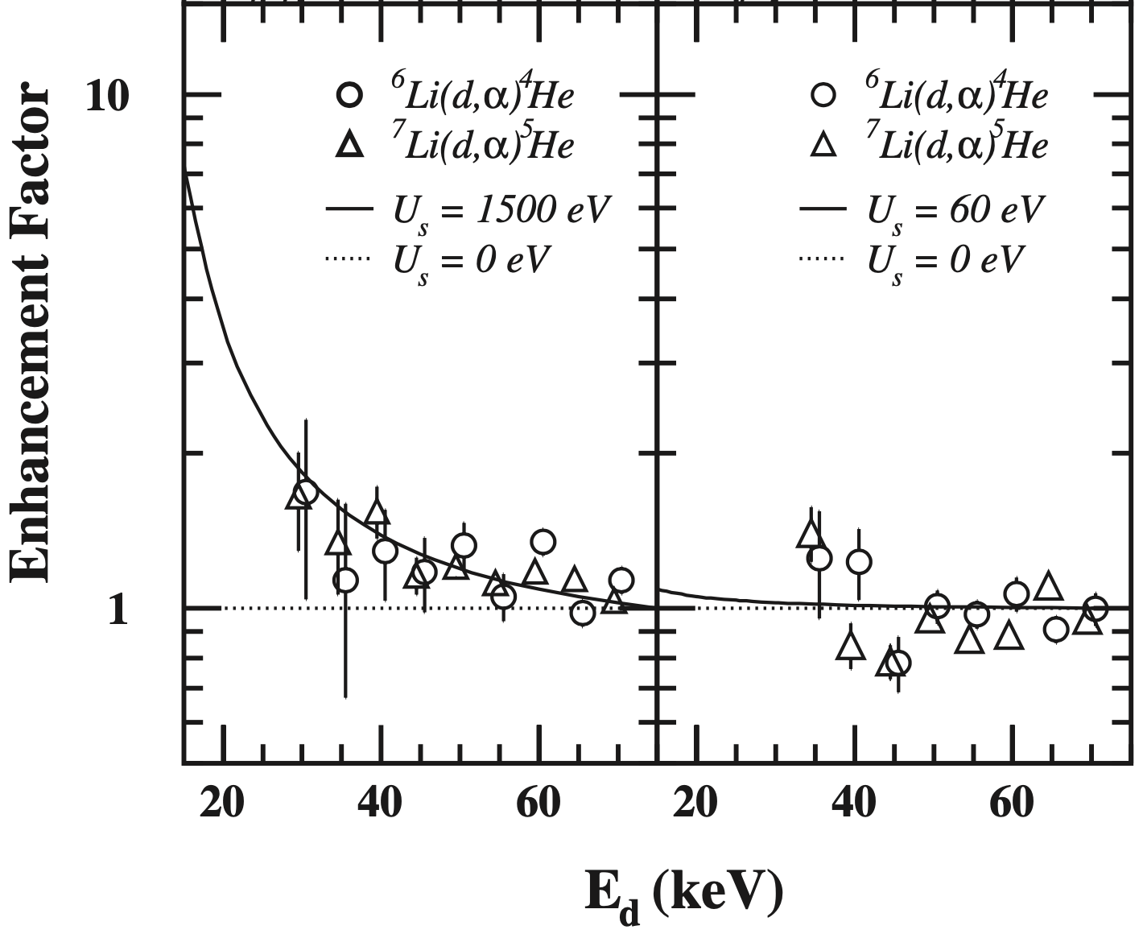
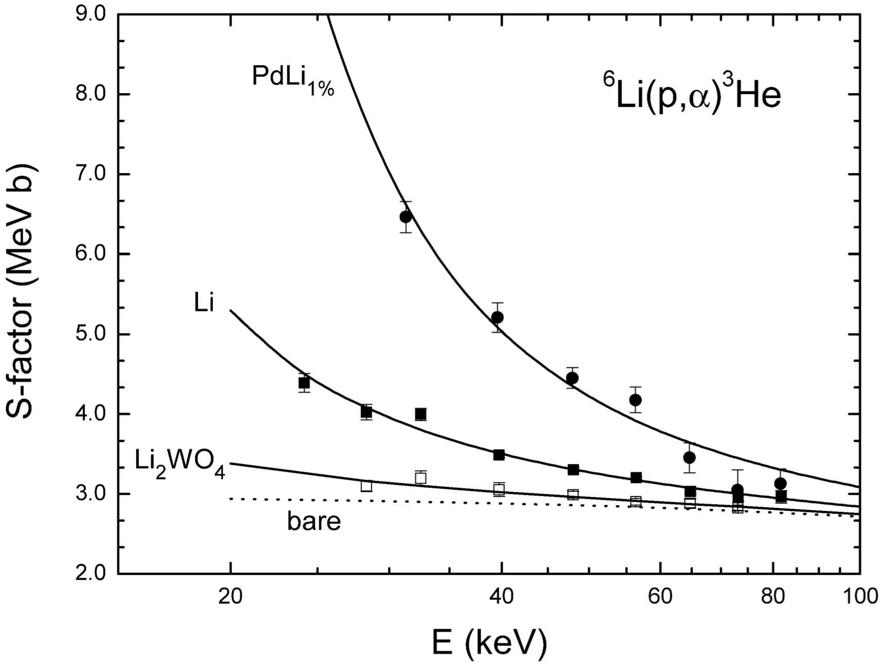
Members of WP7
Previous studies
3790 eV
1280 eV
185 eV
Pd
Au
3760 eV
1230 eV
320 eV
J. Kasagi et al., J. Phys. Soc. Jpn., 73 (2004) 608
J. Cruz et al., Phys. Lett. B, 624 (2005) 181
29/08 - 01/09/2021
14th International Workshop on Anomalies in Hydrogen Loaded Metals, Assisi, Italy

Slide 13
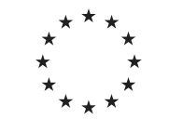
Thank you! Any questions?
This project has received funding from the European Union’s Horizon2020 research and innovation programme under grant agreement no 951974.
This work reflects only the author's view and the European Commission is not responsible for any use that may be made of the information it contains.

