Slide 1
Standard Model and Beyond
for LENR
Jean-Luc Paillet
Aix-Marseille University, France
jean-luc.paillet@club-internet.fr
IW.AHLM 14

Slide 2
Why talk about the Standard Model in this Workshop ?
• LENR processes are misunderstood
• Many theories appear, some of which challenge the
the Standard Model (SM)
• Other theories try to explain the phenomena
without calling into question the SM
• Before calling everything into question, we think it wise to
look for the right theory within the well-established
framework of the SM
• So what is the standard model ?
IW.AHLM 14

Slide 3
Standard Model Brief reminders
The 4 fundamental interactions
• Electro-magnetic
• Strong Nuclear
• Weak Nuclear
• Gravitation (General Relativity)
- Starting point: Classical Lagrangian Mechanics
- Extension to Relativistic Classical Fields
- Then Quantization(s)
IW.AHLM 14

Slide 4
General path in Particle Theory
1. Lagrangian (formula): Potentials --> Dynamics
2. Symmetries --> Conservation laws (Noether's theorem)
Symmetry: Transformation of parameters with invariance of some features of a physical system. For particle theory, invariance of Lagrangian
3. Interaction : Potentials --> Dynamics on Matter (Fermions)
4. Gauge Theory: Interaction + Conservation laws (slide #10)
Force carrier mediators: Bosons
IW.AHLM 14

Slide 5
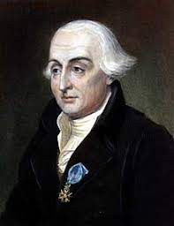
Classic Lagrangian Mechanics
• Lagrangian: L = T - V
T: kinetic energy, contains squared time derivatives
of coordinates.
V: potential energy, contains coordinates.
Ex.: Classical Gravitation (Newton)
- Potential energy V = mgh, m: mass , h: weak height from ground
- Kinetic energy T = ½ mv², depends on v: speed
But why the sign “-” in T - V ? Because “it works” ??
• Start: What is the natural path of a body subjected to a potential ?
Newton's 3d law: any action --> equal and opposite reaction
=> forces have to be balanced and opposed
- Driving force F_{V} = - grad V, potential variation along the path => force
- Réactive force F_{T} = (d/dt) mv [Newton’s 2d law] and F_{T} = - F_{V}
ds: path element => (d/ds)T = (d/dt)mv = F_{T} = - F_{V} = (d/ds)V => (d/ds)(T-V) = 0 =>
• Result: T – V = L is stationary along the path
Joseph-Louis Lagrange
IW.AHLM 14

Slide 6
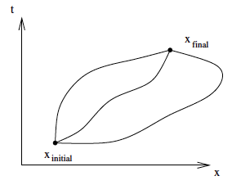
Summary reminder of Analytical Mechanics
• Classic Lagrangian --> Equations of motion
Stationary Action for THE path --> Euler-Lagrange Equations
Action S = ∫_{[t1,t2]} L dt , t1: temps initial, t2: final
Stationary action ⬄ δS = ∫_{[t1,t2]} δL dt = 0
δL : variation of L, function of variations δz_{n} and δż_{n}
along a path s = z_{n} (t) with fixed ends. Here z_{n}= x
Euler-Lagrange eq. ∂L /∂z_{n} - (d/dt) (∂L /∂ż_{n}) = 0 , with ż_{n} = (d/dt)(z_{n}) , z_{n} : generalized coord.
• Momentum conjugate to z_{n}: p_{n} = ∂L /∂ż_{n} --> Phase space : coord. of p and z
• Example: L = ½ mv² - V(z) => ∂L /∂z = - grad V, (∂L/∂ż) = mv, (d/dt)mv = mγ
=> F = - grad V = mγ [Newton’s 2d law] and p = mv : classic momentum
• Lagrangian --> Hamiltonian (Total energy)
Hamiltonian H = Σ_{(n)} ż_{n} p_{n} - L(z_{n ,} ż_{n} , t)
Hamilton equations: ż_{n} = ∂H/∂p_{n} , dp_{n} /dt = - ∂H/∂z_{n} , ∂H/∂t = - ∂L/∂t
IW.AHLM 14

Slide 7
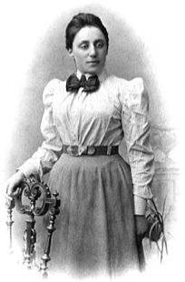
Symmetries and Noether's theorem
Symmetry : transformation of parameters leaving the Lagrangian invariant
=> Conservation of a physical quantity associated
with this transformation
Examples in classic mechanics
• Invariance / time => Conservation of Energy
• Invariance / spatial translation => Conservation of Momentum
• Invariance / rotation => Conservation of Angular Momentum
Noether’s theorem is the basis of gauge theories
Emmy Noether
IW.AHLM 14

Slide 8
Relativistic Classic Field Theory
•Special Relativity --> The z coordinates contain the time variable
Galilean transformation are replaced by Lorentz transformation
Lorentz indices for coordinates: μ = 0,1,2,3 0 : for time, 1,2,3 : for space
• Field φ(z): a function of z =>
Use of Lagrangian density L(φ^{r},∂_{μ}φ^{r},z^{μ}) ---> Lagrangian L = ∫L d³z
• Ex.: φ, a massive scalar (spin 0) field, L = ½ [(dφ/dt)² - (grad φ)² - m² φ²]
- (dφ/dt)²: quadratic term of time derivative ≈ T “Kinetic term”
- Quadratic term in φ and space derivatives ≈ V “Potential term”
Lagrangian --> Klein-Gordon eq. : [d²/dt² - Δ + m²] φ = 0 with Δ: Laplace operator
- Multiply L by K, a constant, or add K does not change the Theory
- Noether's theorem in Field Theory
L(φ^{r},∂_{μ}φ^{r}) invariant for a transformation --> deduce J a 4-current vector
--> J satisfies continuity equation --> conservation of Q associated charge
IW.AHLM 14

Slide 9
Quantizations
“1st Quantization”: Quantization of parameter values in quantum states
• Commutator Algebra in Quantum Mechanics (QM)
[a,b]: Commutator of a and b elements : a b – b a
Canonical Quantization (Lagrange formulation) --> pairs of conjugate variables (z_{n} , p_{n}) p_{n} = ∂L/∂ż_{n} momentum conjugate to z_{n} :
[z_{n} , p_{m}] = z_{n} p_{m} - p_{m} z_{n} = iħδ_{nm} δ_{nm} Kronecker symbol = (if n=m then 1 else 0)
• Wave function of a free particle: ψ(x,t) = A exp i [( p.x – E t )/ħ]
A Proba amplitude --> |A|² = Proba density p momentum = ħ k, E energy = ħ ω
• Wave functions equations
Start form: Hψ = Eψ H: Hamiltonian, unknowns: E energy, ψ wave
--> E: eigenvalue associated with the eigenvector ψ (in Hilbert space)
- bra-ket notation (Dirac). ket : |ψ > : quantum state, bra : < ψ| : ψ* conjugate of ψ
A operator applied on φ : A|φ > , scalar product : <ψ |φ > , < φ|A|ψ > = < φ|Aψ >
< φ|A|φ > = average value of A for physical system in φ state
IW.AHLM 14

Slide 10
Quantizations (cont’d)
“2d Quantization”---> Quantum Field Theory (QFT)
States with N particles --> Quantization of number of particles in states
• Field operator: sum of waves weighted with a(k), a*(k) operators, k : wave vector
a : destruction operator of particle, a*: creation operator (a*: adjoint of a)
• Commutators for field operators
Example: Commutator of a, a*: [a (k) , a*(k')] = δ_{kk’} Kronecker symbol
The Commutators are used in boson fields (integer spin, including 0)
• Fermions fields (half integer spin) --> Fermi statistics --> Anti-commutators (replace ‘ – ‘ with ‘+’) --> {op1, op2} = op1.op2 + op2.op1
• Vacuum: no particle --> state: |0 >. For any φ_{k} field , we have
a*(k)|0> = |φ_{k}> state with one particle --> first state above ground state (vacuum)
- VEV (Vacuum Expectation Value) of a field operator A : <0|A|0>
Very important, VEV is used to define interaction propagators, symmetry breaking …
- Notes 1. Any particule is in fact an excitation, a ripple of a field.
2. In QFT, we use in general “natural units” by putting c = ħ = 1 dimentionless
IW.AHLM 14

Slide 11
Electromagnetic Interactions Theory : Quantum Electrodynamics (QED)
Fermions: charged leptons, mediator Bosons: photons
• Dirac eq. for free fermions: (iγ^{μ}∂_{μ}-m)Ψ = 0, Ψ: “spinors”, γ^{μ} : Dirac matrices.
It can be deducible from L₀ , Lagrangian of free spinors
L₀ = (iγ^{μ}∂_{μ}-m)Ψ with = Ψ * γ⁰ Dirac adjoint of Ψ, γ^{μ}∂_{μ} : sum on μ (Einstein notation)
“Kinetic term”: containing the derivatives (while developing the products)
• Maxwell eq. --> Lagrangian of EM field: L_{EM} = -½ (∂_{ν} A_{μ})(∂^{ν} A^{μ}), A^{μ}: 4-vector potential
• Interaction Lagrangian for spinors and EM field:
L_{I} = - e γ^{μ} A_{μ}Ψ --> Initial Lagrangian for QED: L =L₀ + L_{EM} + L_{I}
- Gauge symmetry: Transformation of potentials leaving the Lagrangian invariant
- “Covariant” derivative for a gauge --> to build a Lagrangian invariant/gauge
Ex. “Minimal” substution: replace ∂_{ν} derivation with D_{μ} = ∂_{μ}- ie A_{μ} , e: fermion charge, =>
L_{EM} absorbed --> L becomes L’ = (iγ^{μ}D_{μ}-m)Ψ - (e γ^{μ} A_{μ} )Ψ, usual QED Lagrangian
• This process scheme is generalizable to any QFT
IW.AHLM 14

Slide 12
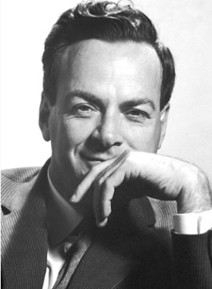
Feynman diagrams and rules
Diagrams: coding software to represent interactions
Rules: decode diagrams to compute probability amplitudes
S Matrix : initial states --> final states amplitudes. Proba = |amplitude|²
• Perturbation methods
H_{I}(t) : interaction Hamiltonian, |Φ(t)> : state of system. S_{FI} op: initial state -> final state
i(d/dt)|Φ> = H_{I} |Φ> => S_{FI} = e^{-i I} , with I=∫_{Ti}^{Tf} ∫H_{I} d⁴z
- H_{I} energy is weak (α coupling cst =1/137) = > I can be computed iteratively (Taylor series)
- Temporal order of integrands: “normal ordering”
• Wick’s theorem --> Dyson series: perturbative expansion
of time evolution operator --> increasing precision
• Feynman Propagators
TR amplitude of transition : Input (x,t) --> Output (y,t’)
TR = -i VEV (T), T: Time Ordering Operator
TR (x-y) = <0|T{φ(x), φ*(y)}|0> ----Math---> TR expressed in 4-momentum space
Richard Feynman
IW.AHLM 14

Slide 13
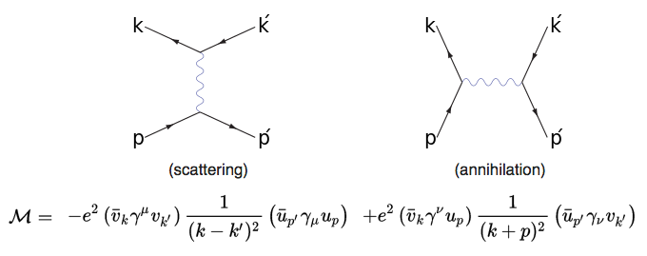
Example of loopless diagrams
Bhabha interaction: scattering or annihilation
Note: “virtual particles” (internal edges) are unobservables, they are not particles but fleeting disturbances.
Diagrams are not the reality, but a calculation tool
f+
virtual photon
f-
Decoding
Vertex
Input
Output
Internal edge
p, p’, k, k’: 4-momenta, 1/(k + p)² : photon propagator
: destruction in input
: creation in output
IW.AHLM 14

Slide 14
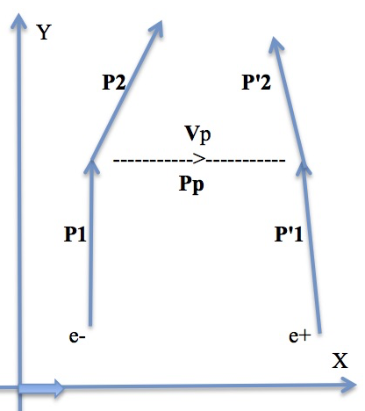
Feynman diagrams (cont’d)
How to explain repulsion/attraction between charged particles, from photon exchanges ? Of course, this can be calculated,
but we can propose a very simplified heuristic explanation
- At each vertex, the Feynman rules impose the conservation of momenta =>
- On each edge, the "virtual photon" carries its moment from one vertex to another one
(i) Particles at the outer edges of both vertices with same sign => virtual photon has positive 3-momentum. It is subtracted from the particle arriving at the photon creation vertex, and added to the particle leaving the other vertex => repulsion.
(ii) Particles with opposite signs => negative 3-moment (momentum direction opposite to the trajectory!). The trajectories of the particles
at the outputs converge => attraction
To simplify, suppose|P1| ∼ |P’1|, Proj_{X} P1=0 , 3-momenta >> E/c = m_{e}c
Conserved moments => P1 = Pp + P2 => P2 = P1 – Pp . P’2 = Pp +P’1
Attraction: P2 leans towards increasing X => Proj_{X} P2= (P2)_{X} > 0 ,
(P1)_{X} = 0 => (Pp)_{X} <0 , (P’2)_{X} < (P’1)_{X} => P'2 is leans more towards
decreasing X then P’1 => confirmed attraction
IW.AHLM 14

Slide 15
Problem of diagrams including closed loops
Elementary loops
• In a loop, one of 4-momenta can be anything => need to integrate over all values
of involved momenta. So loops --> divergent integrals
• Solution: Renormalization avec regularization of primary integrals
(i) Renormalization (Physics):
- In the interactions, we consider the particles are “bare”: without a cloud of pairs (e-, e+)
For bare particles: Change of charge, mass, coupling constant α (--> α_{r} “running” constant )
- Roughly: after the interaction, the renormalization converts them back into observable physical particles, i.e. surrounded by a cloud of virtual particles
- Use of a cut-off : in fact, unlimited values are not physical
The normalization group ---> several energy scales K. Wilson (Nobel 82)
(ii) Regularization (Math.) to facilitate the calculation of integrals
Ex.: Dimentional regularization, Fractal integrals, Pauli-Villars, Gauge lattice, cut-off, …
• β(α_{r}): Beta function expressing the dependence of the “running” α_{r} on μ energy scale :
β(α_{r}) = μ (∂α_{r} /∂μ) ---> β > 0 => coupling increases with increasing μ energy .
True for QED --> perturbations methods can be used
Electron Self-energy
Vacuum polarization
Vertex Loop
IW.AHLM 14

Slide 16
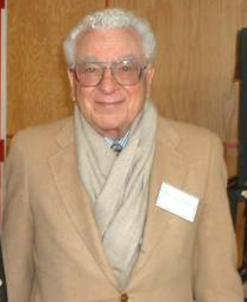
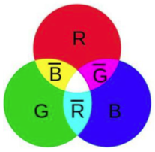
Strong Nuclear Interaction (QCD) Fermions: quarks, electric & color charges. Mediators Bosons: gluons, color charge
Quarks (“Three Quarks for Muster Mark!”) in Finnegans Wake, James Joyce
• 6 flavors, grouped by 3 for each sign of electric charge {+ , –}
- (charge –e/3) : d (down), s (strange), b (bottom) [increasing masses]
- (charge +2e/3): u (up), c (charm), t (top) [idem]
• Why 3 color charges ? R , B, G. At least two reasons:
1- Pauli's Theorem would be violated in the confined space of
baryons (contain 3 quarks) if only electric charge and spin =>
Need for an additional quantum parameter: “color”charge
Extreme case: Baryon Ω: {sss} contains 3 quarks of flavor s
2- To hold protons and neutrons together => Need for additional force >> EM
• Anti-baryons: made up of anti-quarks, with 3 “anti-colors”
anti-R <-> C (cyan)= B+G, anti-B <-> Y (yellow)= R+G , anti-G <-> M (magenta )=R+B
• Mesons: symmetric combination {quark + anti-quark}
• All types of hadrons have color charge “0” (sum : white color)
- Baryons --> the 3 colors, Anti-Baryons -> the 3 anti-colors
- Mesons --> a color plus associated anticolor
• β(g_{s}) < 0 => - Coupling increases with decreasing energy => Color confinement
- Coupling decreases with increasing energy => Asymptotic freedom
Murray Gell-Mann
Nobel 1969
IW.AHLM 14

Slide 17
QCD (cont’d)
• Allowed combinations of color wavefunctions: obtained by color operators from the eight 3x3 matrices λ_{i} of Gell-Mann, generalizing the three 2x2 matrices σ_{i} of Pauli
Gauge invariance determined by the SU(3) group, generalizing the SU(2) group in QED
Color Operators: F_{i}= ½ λ_{i} , with commutation relations [F_{i} ,F_{j}] = i f_{ijk} F_{k} f_{ijk}: structure constants
• Gluons: gauge bosons. Electric charge = 0, spin = 1, two colors (col_{i} + anti-col_{j}) i≠j
8 possible gluons, linear combinations of color operators eigenstates
=> mutual interactions between gluons => combinatorial complexity
• Lagrangian, similar to QED Lagrangian
L = [iγ^{μ} D_{μ} - m_{f}] Ψ ^{f} - ¼ G_{iμν}G_{i}^{μν}. Superior f index : flavor
G operators: gluons potentials invariant for gauge, including strong coupling coeff g_{s} and structure constants
• At low energy => strong coupling => perturbative methods cannot be used --> look for non-perturbative methods. Lattice QCD, a promising approach:
Lattice QCD --> cut-off =1/a where a: lattice spacing. Then make a -> 0 --> numeric simulations, randomized techniques, … Discrete space-time lattice --> non perturbative regularization scheme
• At high energy => weak coupling => perturbation methods can be applied
f
IW.AHLM 14

Slide 18
Residual Strong Interaction (between nucleons)
Similar to London forces between atoms derived from electron-nucleus bonds
• Mediators bosons: neutral or charged pions, possible heavy mesons ?
Interaction described by several potentials, according to (very factual) models...
Very promising modern search: Ab initio No Core Shell Model
- Ab initio (--> “microscopic”): describe all the properties of the nucleus from the basic interactions between nucleons. Solution of the many-body problem, starting from "realistic" forces between nucleons --> includes multi-particle interactions
- No core : All nucleons are active in the same way (as d° of freedom of expressions)
- Non perturbative method --> no problem for the convergence of expressions
(≠ Dyson series in low energy QCD )
- Original formulation of the Shell Model. Potential associated with a harmonic oscillator, basis of energy states. The states increase rapidly with the number of levels --> Shell
- Principle analogous to the electron orbitals governed by the Pauli’s theorem
- Hamiltonian: can be built in an effective chiral QCD: at low energy, the QCD d° of freedom are hadrons (here: mesons). Effective field theory: taking a chosen energy scale
Requires a lot of computing power (remedies: algebraic geometry, amplituhedron...)
IW.AHLM 14

Slide 19
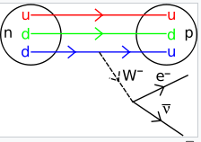
Weak (nuclear) interaction
Subtle interactions acting on all fermions
Bosons: massive neutral Z boson or charged W+ or W- --> Higgs boson
• The only interaction capable of changing the flavor of a quark
Ex.: Beta decay, involving
- flavor change: d quark --> u quark
- Leptonic decay of W- boson into electron and anti-neutrino
• Breaks the spatial Parity P symmetry (/mirror image)
=> chirality, and breaks Charge Parity CP symmetry too
• Weak interaction does not bind particles
• In the near Big-Bang Universe (T° of order 10¹⁵ K) where energy > ∼ 246 Gev --> EM and weak interaction fields were unified in Electroweak interaction
- 246 Gev = VEV of Higgs field = (G_{F} √2)^{-1/2}, G_{F}: Fermi weak interaction coupling cst
Energy scale of electroweak symmetry breaking
- Below this energy, the epoch of quarks begins (the temperature is still too high to form hadrons)
IW.AHLM 14

Slide 20
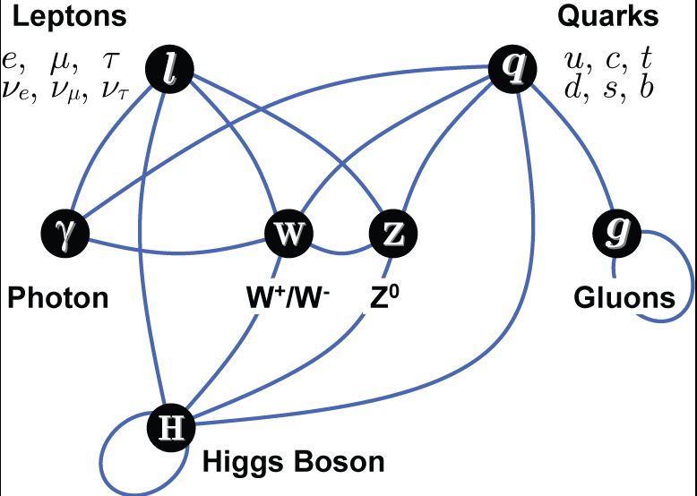
A few words about Higgs fields
Symmetry puzzle => All fondamental particles should be massless
Interactions of elementary particles with the Higgs Boson
Spontaneous symmetry
breaking --> a vacuum state
which is not unique =>
There is c ≠ 0 in vacuum
to characterize the ground
state of φ, a complex field -->
one supposes:
VEV(φ) = <0|φ(x)|0> = c ≠ 0
This field can only be scalar
(the VEV of a spinor or vector field is 0)
The Higgs mechanism allows to decompose the complex scalar field
into a massive boson field (with spin 0), the Higgs, and a real vector field
made massive in this process
The mass of a particle: its interaction with the Higgs field
IW.AHLM 14

Slide 21
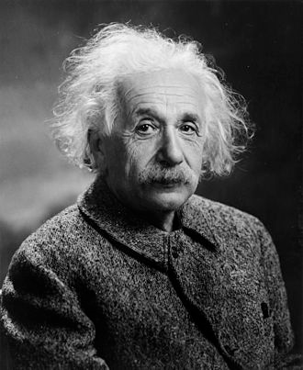
Gravitational interaction
General Relativity: the laws are preserved while changing
the reference
Geometrical nature of the gravitation, determined by
the intrinsic curvature produced by the matter in interaction
with the Energy Impulsion Tensor (governing the movement)
• Einstein's intuition: to generalize Poisson's equation in Newtonian mechanics
Δ Φ = 4 π G ρ, Φ: gravit. potential, ρ: volumic mass, G: gravit. constant, Δ: Laplace operator
--> Einstein’s eq.: (R_{μν}  g_{μν} R/2) – Λ g_{μν} = kT_{μν} , where R_{μν} : Ricci’s tensor (curvature),
R : scalar curvature, g_{μν}: metric tensor (the “unknown”), k = gravitation coupling constant
Λ : Cosmological constant (--> Universe expansion ?), T_{μν} : energy-impulsion tensor
• Einstein’s equation can be obtained by Lagrangian mechanics method
Gravitation Lagrangian: L_{G} = R √(- g), with g = det(g_{μν})
• No unification yet accepted with the Particle Theory based on QFT
• Most advanced attempts to quantize gravitation
- String theory & Superstrings (Planck’s length, 10⁻³³ m) --> could unify with Particle Theory
- Loop gravity: quantized space-time, with quanta connected by a spin network
IW.AHLM 14

Slide 22
Puzzles 1. On the way to resolution?
Examples of Experiments
Physics Beyond Collider at CERN 2019 (PBC initiative) --> 10 -20 years
• EMC effect. Deep inelastic scattering experiment of European Muon Collaboration
Bound nucleons seem to occupy more space than free ones.
Recent attempts of explanation (February 20)
- Nuclear Mean-Field Theory. The combined forces of quark fields between neighboring nucleons, would deform their structure (the nucleons are not tight). Moreover, possible interactions between spins
- Temporary formation of nucleon pairs with quarks mixtures
This would lead the nucleons to stretch, because of recoil with high moments
Experiments (January 20) --> 20% of the bound nucleons are outside their orbitals, paired with other nucleons (short range correlations)
IW.AHLM 14

Slide 23
Puzzles 1. On the way to resolution? (cont’d)
• Proton Spin. lattice QCD seems to approach the solution
• Mass of light hadrons. It seems (Quanta, May 20) that Lattice QCD predicts the experimental values, within a few %.
But technical details of the theory are very complex and poorly understood, mainly the passage from discrete network to continuous (“smooth”) space.
One can also invoke a Spontaneous Symmetry Breaking affecting the (almost) chiral symmetry of QCD.
Note: QCD symmetry is exact when assuming mass of quarks -> 0
IW.AHLM 14

Slide 24
Puzzles 2. Unsolved ones (not exhaustive list)
• Why do the particles of matter (fermions) go by 3 for each family? and with increasing masses without apparent “regular”relationships?
-Electron, Muon, Tau
- Electron Neutrino , Muon Neutrino, Tau Neutrino
- Positive Quarks (+2e/3): Up, Charm, Top
- Negative Quarks (-e/3): Down, Strange, Bottom
• Symmetry CP (Charge,Parity ) problem for the strong nuclear interaction,
QCD should allow CP breaking, but it is not observed (see slide #22)
• Dissymmetry: Abundance of matter /almost no presence of anti-matter.
Baryon number breaking in early universe ? C/CP breaking?
Thermal balance breaking ? (Sakharov conditions for baryogenesis -->
question about electroweak transition, in relation with Higgs mechanism)
• Black matter ? Standard Model --> 5% of the Universe as we see it.
• Cosmological inflation and dark energy? (or cosmological constant Λ of Einstein ?)
• Origin of mass (≠0?) and oscillations of neutrinos ?
• Exploration of forbidden decays, Electric Dipolar Moments, …
IW.AHLM 14

Slide 25
Much debated question: neutrino oscillations
- Neutrinos seem to oscillate between their 3 flavors
- Matrix representation [flavors x mass eigenstate]
- Conjecture: Seesaw mechanism --> sterile neutrino? only grav. interact.
=> no isospin weak charge, heavy and with right-handed helicity
Computation with a hypersimplified seesaw matrix (only 2 flavors)
eigenvector equation: A v = λ Ι v , M: masse , λ: eigenvalue
v: eigenvector => det(A - λ Ι) = 0 => λ =½ [-B ±( B² + 4 M²)^{½}]
λ₊ λ₋ = - M². If B >> M => λ₊ ∼ B, and smallest eigenvalue λ₋ ∼ −Μ²/Β
For ex., with B = Majorana mass, of order GUT scale ∼10¹⁵ GeV, M = Dirac mass, of order electroweak scale ∼ 246 GeV= VEV(v) => λ₋ ∼ 6 10⁻² eV: very small mass.
- By the way, if neutrinos have a mass, why a mass << other leptons ?
- Why do we observe oscillations ? No problem: Neutrinos of the 3 flavors are emitted--> linear combination of 3 wave functions with 3 different eigenmasses
=> 3 different wavelengths => interferences => after long path --> oscillations
IW.AHLM 14

Slide 26
Beyond the Standard Model (SM)?
•Hidden sector physics: look for new particles with mass lower than Electroweak (EW) scale, very weakly coupled to SM particles via portals --> Need for high intensity sources --> “intensity frontier” approach
• New Physics (NP)
- Above EW scale, explored via indirect effect in rare or forbidden process in SM, electric dipole moments of nucleons, etc…
• Possible experiments for NP
- (1) Mass order sub-eV or MeV-GeV --> weak coupling with SM particles
- (2) Mass order >TeV--> strong coupling with SM, or rare /forbidden process
• NP with minimal modification of Standard Model
- WIMP (weakly Interacting Massive Part.) Dark Matter models. Eff. section ∼ pbarn
- Axion DM model. Solves CP pb of QCD, Mass order < eV.
Generalizable to Axion-Like-Particles, without relation between mass and coupling const. High masses (MeV-GeV) realizable in colliders.
• Beyond SM. Fine tuning pb for Higgs mass --> quantum corrections
Possible solution: supersymmetry (SuSy): Deep relationship fermions <--> bosons
IW.AHLM 14

Slide 27
Portals: Mediators SM <-->Hidden Sectors
Portal: Interaction Lagrangian between SM and “hidden sector”
L_{portal} = Σ (O_{SM} O_{DS}) /Λ
O_{SM}: SM field operator, O_{DS}: counterpart in Dark Secteur or New Physics
Λ: cut-off coefficient at various energy scales (e.g.: TeV)
Examples of portals
• Dark photon portal: use A'_{μ} similar to A_{μ} electro- magnetic 4-vector potential
Coupling to electroweak field by F'_{μν} force tensor of dark photon, similar
to F_{μν} tensor of EM photon, and by B^{μν} weak hypercharge boson (EW field)
Note: Hypercharge is involved because of charged W bosons --> charged currents interactions
• Neutrinos model portals : contains one/several Dark neutrinos, or heavy neutral leptons, plus mass generation mechanism for neutrinos
• Axions model portals: consider QCD axions, as solution to the Strong (nuclear)
CP problem --> gluon coupling
IW.AHLM 14

Slide 28
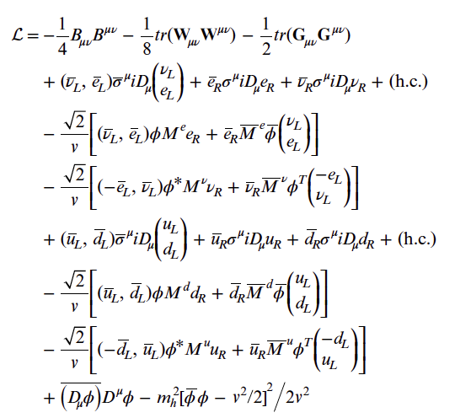
Standard Model Lagrangian
A possible form of SM Lagrangian.
(Extracted by Shifflet, from An Introd. to the S.M. of Particle Phys., Cottingham et al, uptated from pdg.lbl.gov, 2015)
U(1), SU(2), SU(3) gauge terms
lepton dynamical term
electron, muon, tauon mass t.
neutrino mass t.
quark dynamical t.
down, strange, bottom mass t. up, charm, top mass t.
Higgs dynamical and mass t.
h.c.: hermitian conjugate of preceding terms in the line
IW.AHLM 14

Slide 29
Some References
• Analytical Mechanics
D. Tong: Lectures on Classical Dynamics, University of Cambridge.
http://www.damtp.cam.ac.uk/user/tong/dynamics.html (updated Jan. 2015)
• Quantum Field Theories
- R. D. Klaubert: Student Friendly Quantum Field Theory, 2^{d} Ed. (rev. 2015)
- D. Tong: Lectures on Quantum Field Theory, University of Cambridge.
(essentially QED) http://www.damtp.cam.ac.uk/user/tong/qft/qft.pdf
- F. Mandl, G. Shaw: Quantum Field Theory. 1st Ed. /2^{d} Ed.(2010) Wiley.
(the 2e Ed contains “Path Integrals” methods)
- A. Zee: Quantum Field Theory in a Nutshell, Princeton Univ. 2^{d} Ed. (2010) (contains “Path Integrals”method, Q. Field Theory in Condensed Matter, …)
- M.E. Peskin, D.V. Schroeder: Quantum Field Theory.
• General Relativity
Course of General Relativity, J. Fric, from Lectures notes on General Relativity of S.M. Carrol, Inst. for Theor. Phys., Univ. of California. http://www.preposterousuniverse.com/grnotes/
• Beyond SM. Fundamental Physics at the Intensity Frontier, Workshop Rockville MD 2011
• The Meaning of the Wave Function - In Search of the Ontology of Quantum Mechanics,
Shan Gao (Sanxi Univ.), Cambridge Univ. Press, 2017 ; DOI: https://doi.org/10.1017/9781316407479
• On-line “Quanta Magazine”
IW.AHLM 14

Slide 30
Thanks for your attention
Higgs Boson, CMS experiment simulation, CERN
IW.AHLM 14

