Slide 1
ATOMIC NUCLEI BINDING ENERGY
Similarities between binding energy values of chemical elements
Example of Palladium and Silver
Philippe Hatt, independent researcher
E-mail : pcf.hatt@gmail.com
IWAHLM 14

Slide 2
Several authors predict that α particle structures could be present in atomic nuclei. Convincing arguments of such structures are provided by systematics of the binding energies of the even-even nuclei with equal number of protons and neutrons.
According to my theory, the nuclei of the various elements are constituted with α particles and other nucleons grouped in order to create sub-nuclei linked by four types of bonds called NN, NP, NNP, NPP.
The binding energy values of Deuterium (NP), Tritium (NNP), Helium3 (NPP), and NN are related through the following equations:
    -EB Tritium (NNP) = 2NN - 1.25 NP/2
    -EB He3 (NPP) = NN + 1.25 NP
    -2NN forming the neutronic part of the binding energy of α particle.

Slide 3
For more details, please refer to my former presentations⁽¹⁾ where it is shown that the hypothesis of α structures describe the binding energy systematics. In such an approach, the system in its ground state has stationary configuration and shape, and defined bond values between the various α particles and other sub-structures.
So, according to my hypothesis the binding energy of every nucleus is the sum of the binding energy of its different sub-structures and the binding energy among these sub-structures.
The examples presented today are the various isotopes of Palladium and Silver.
⁽¹⁾ Philippe Hatt, J. Condensed Matter Nucl. Sc. 26 (2018) 45-53, J. Condensed Matter Nucl. Sc. 29 (2019) 260-274,
J. Condensed Matter Nucl. Sc. 31 (2020) 113-146.

Slide 4
6. The values used for the calculations of the binding energy are the following:
7. Remarks:
The NN and NP are the most used bonds. Generally, they oscillate to form an “A” bond equal to
(NN/2 + NP/2).
The NN value (4.9365 MeV) is comparable to the mass of quark down (4.8 MeV) and the NP value (2.2246 Mev) is comparable to the mass of quark up (2.4 MeV).
EB α and EB NN are defined in my documents on internet under www.philippehatt.com. Also, the definition of the lines and their relationships with their values in MeV is given.

Slide 6
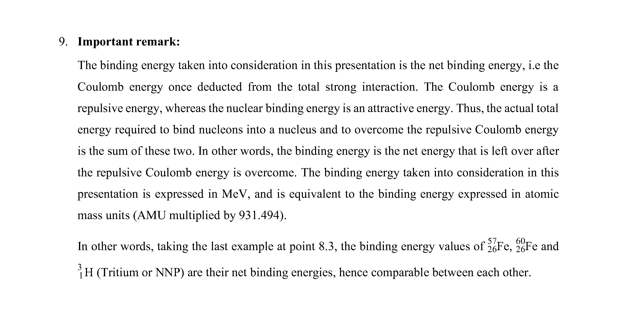

Slide 7
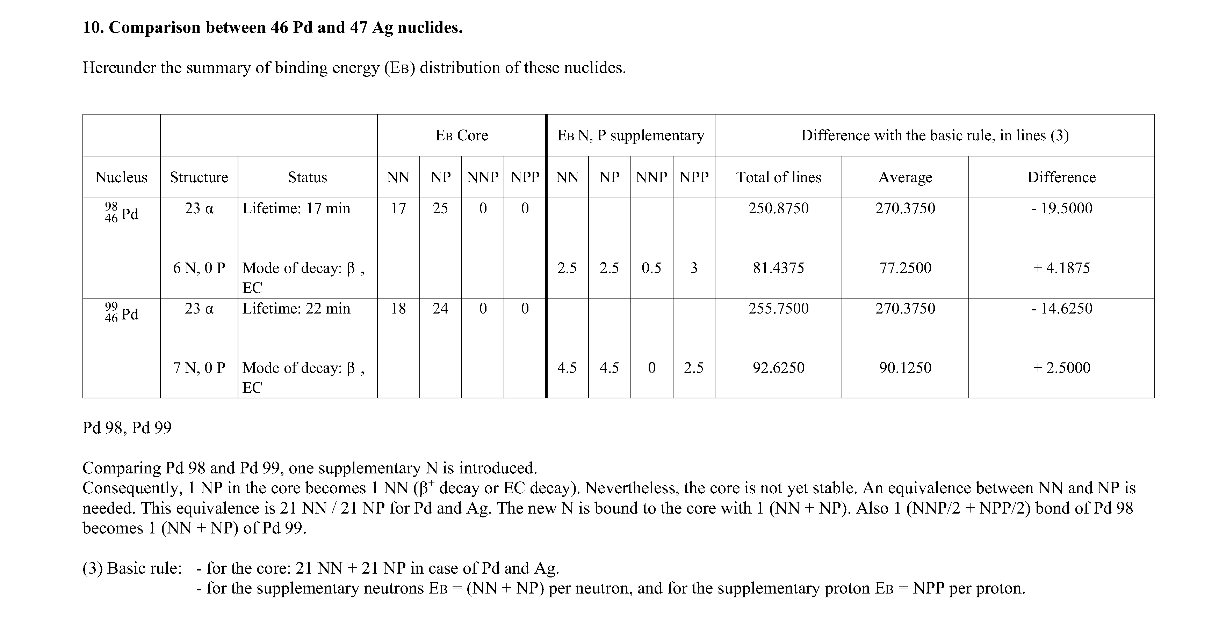

Slide 8
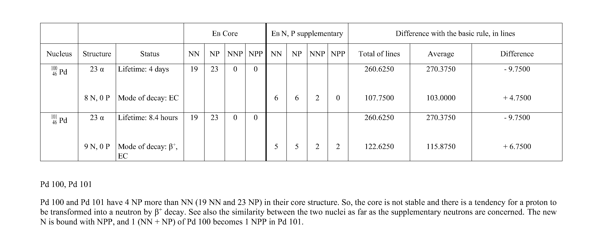

Slide 9
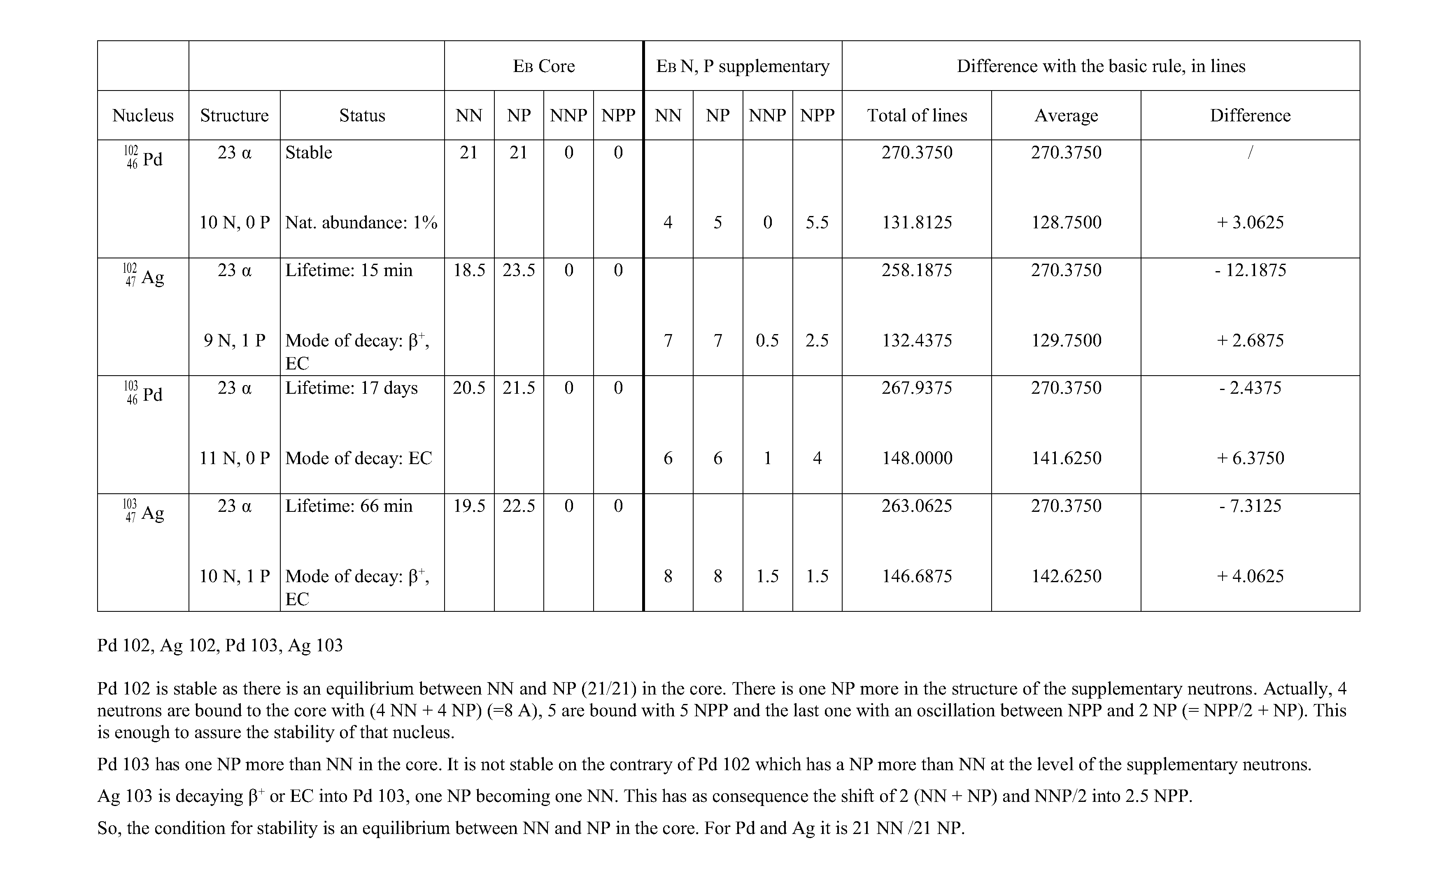

Slide 10
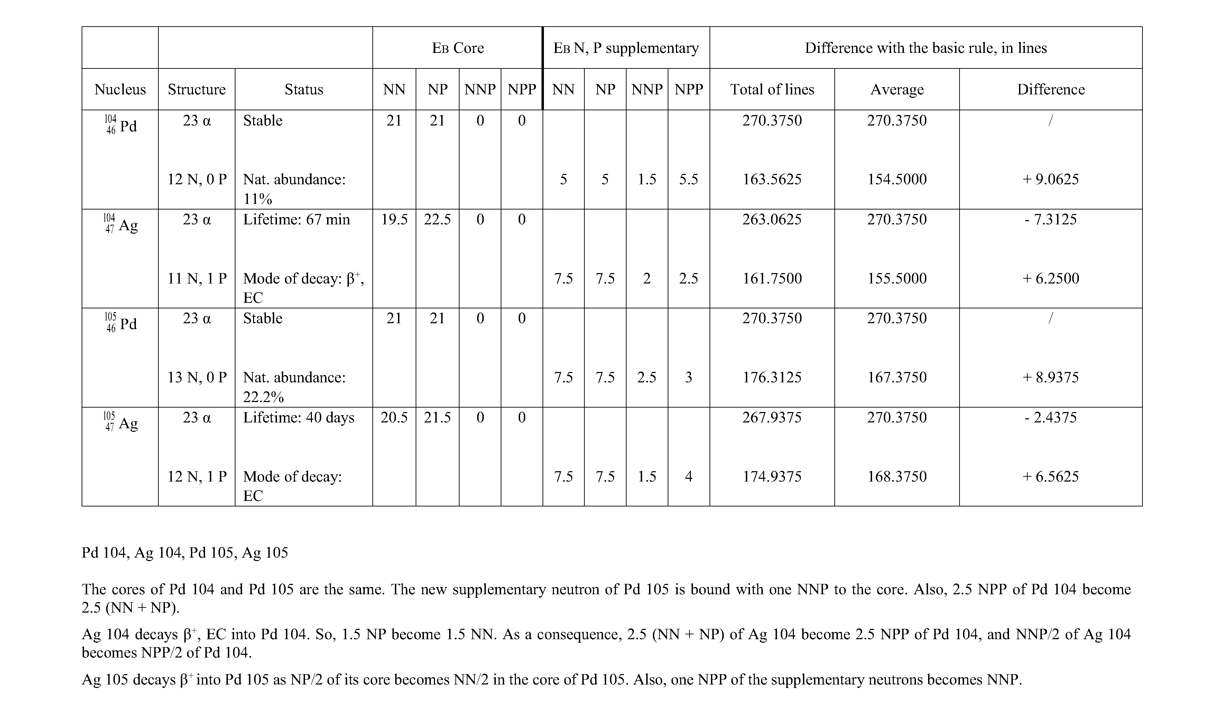

Slide 11
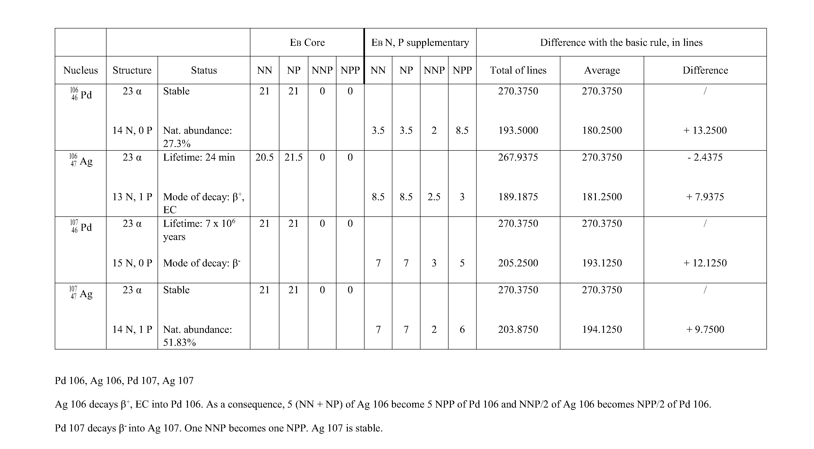

Slide 12
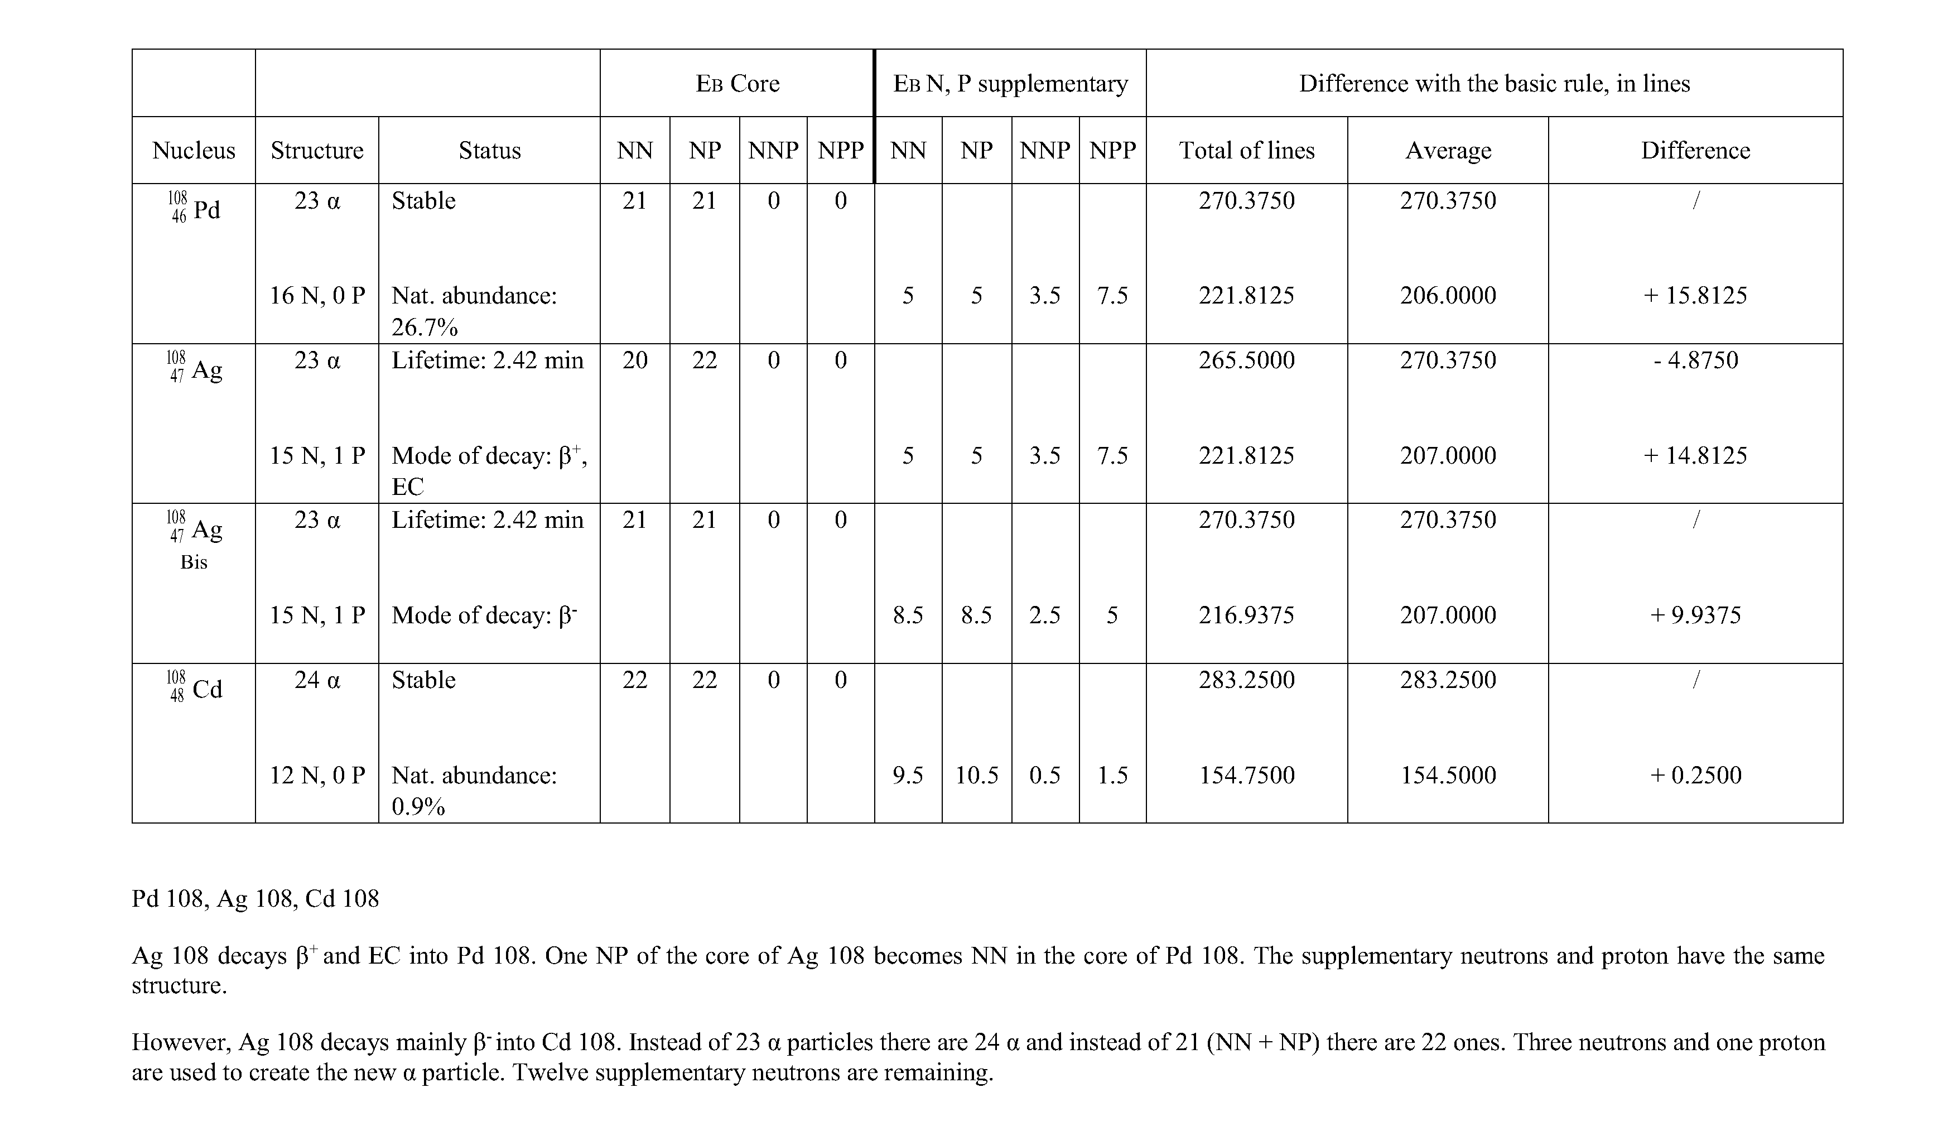

Slide 13
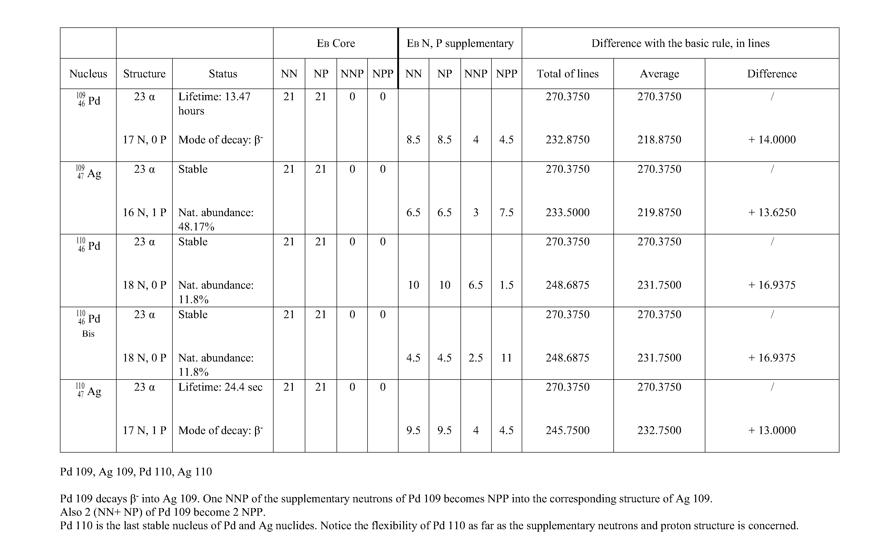

Slide 14
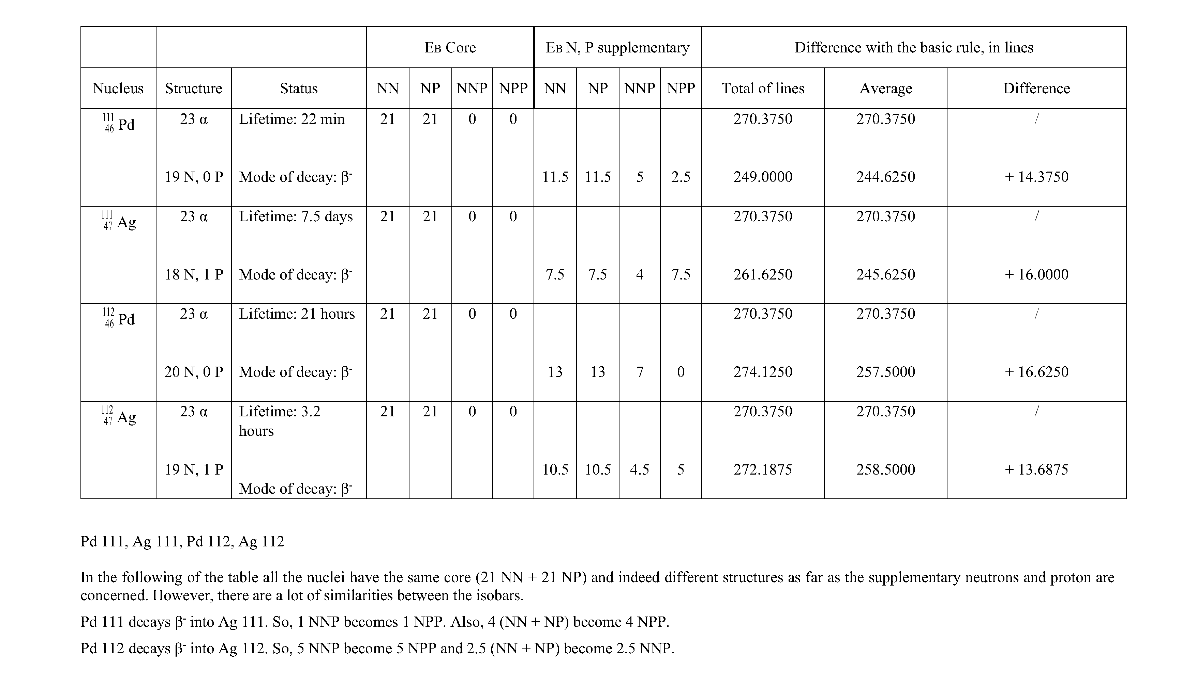

Slide 15
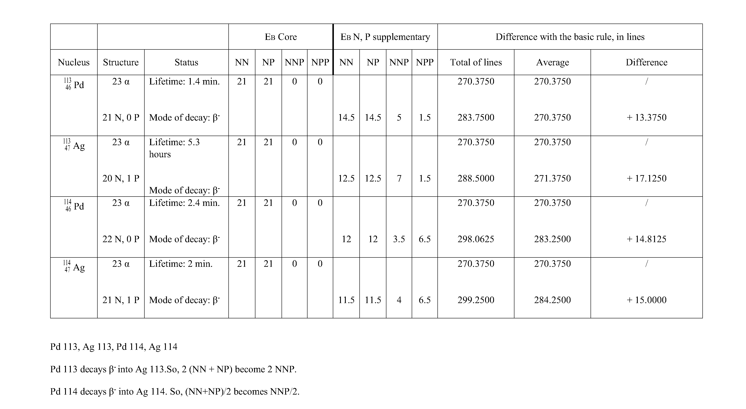

Slide 16
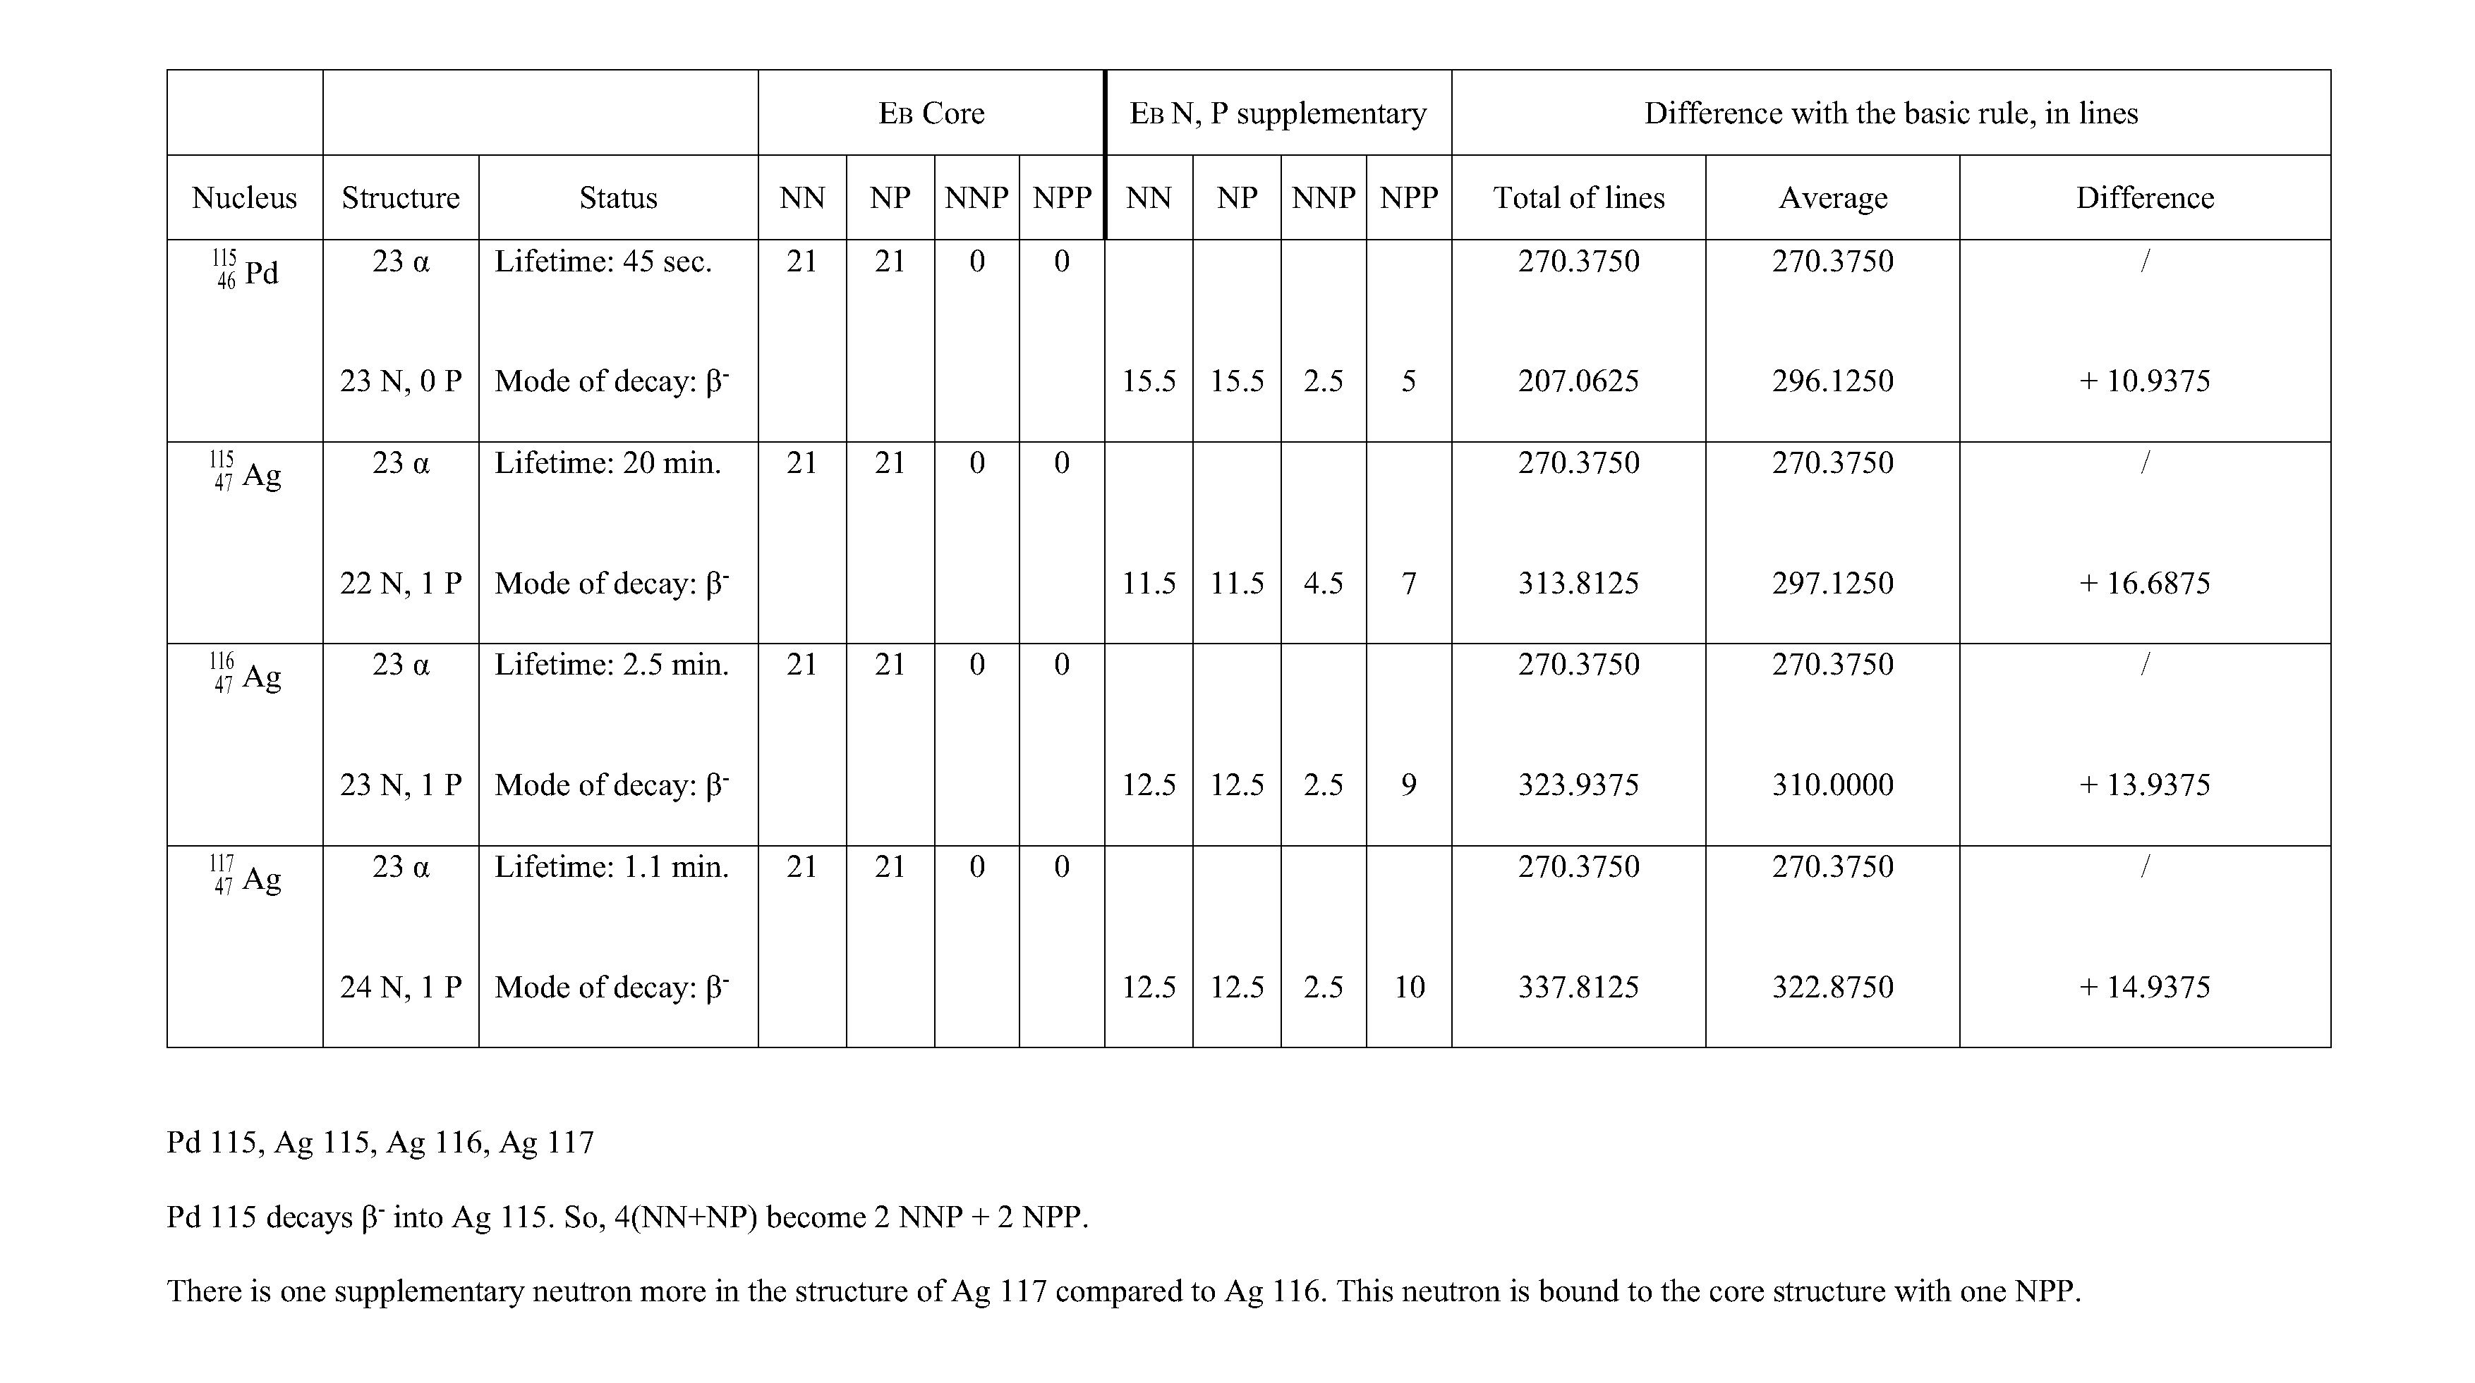

Slide 17
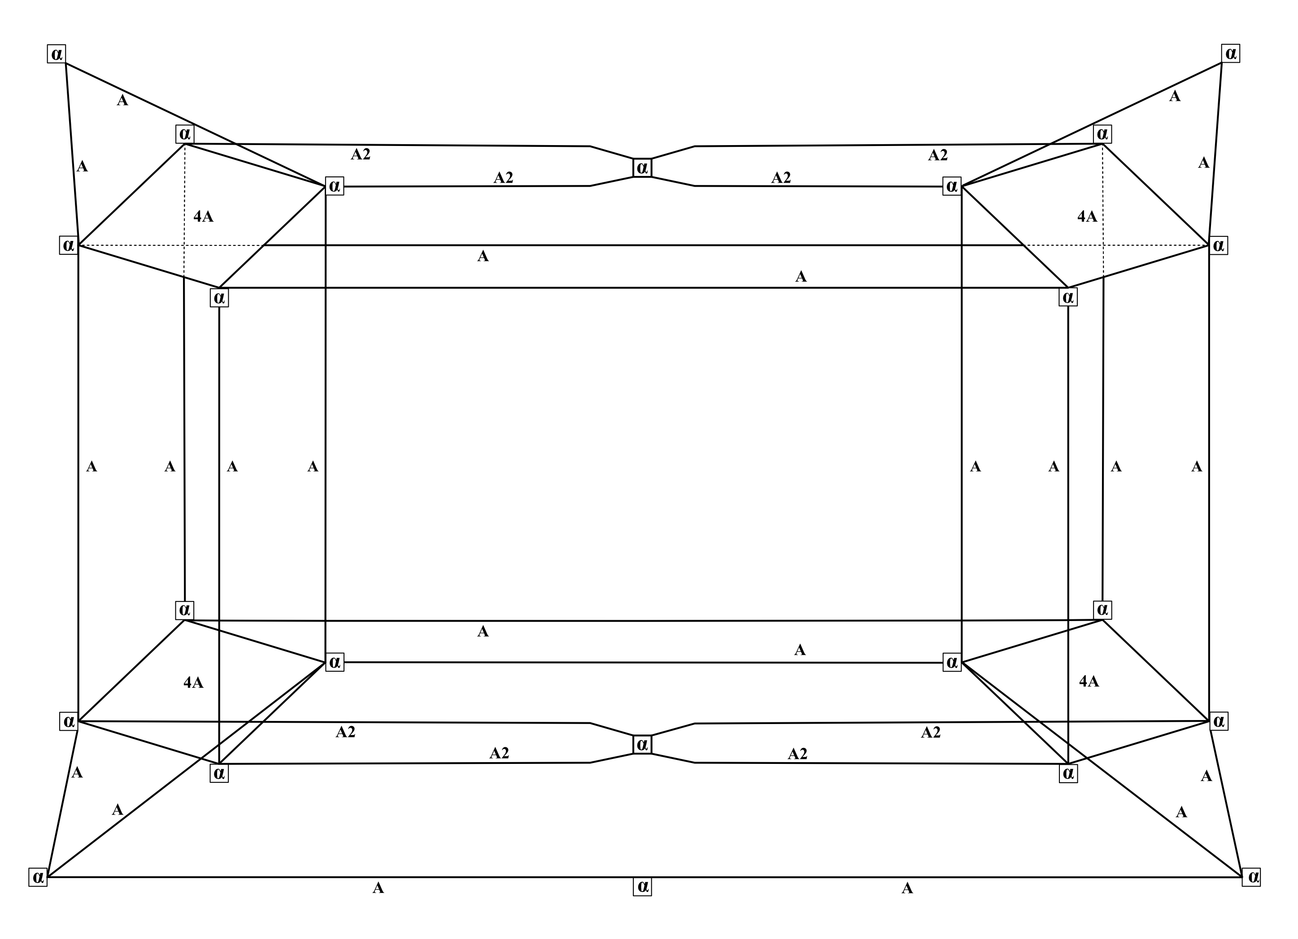
11.
Core structure for Pd and Ag
Structure stabilized with
21 NN + 21 NP (= 42A)

Slide 18
12. Examples of nuclides structure: Pd 108, Ag 110.

Slide 19
13. Hypothesis of creation of one α particle.
If a deuteron merges with the structure of Pd 108 the result is Ag 110. Ag 110 decays β⁻ into Cd 110.
Actually, Cd 110 has 14 supplementary neutrons. Ag 110 has 17 supplementary neutrons and one supplementary proton.
The β⁻ decay of Ag 110 transforms one neutron into one proton. So, 2 neutrons, and 2 protons of Ag 110 create a new α particle, and 110 Ag is transmuted into Cd 110.

Slide 20
14. Comparison of Ag 110 and Cd 110.

Slide 21
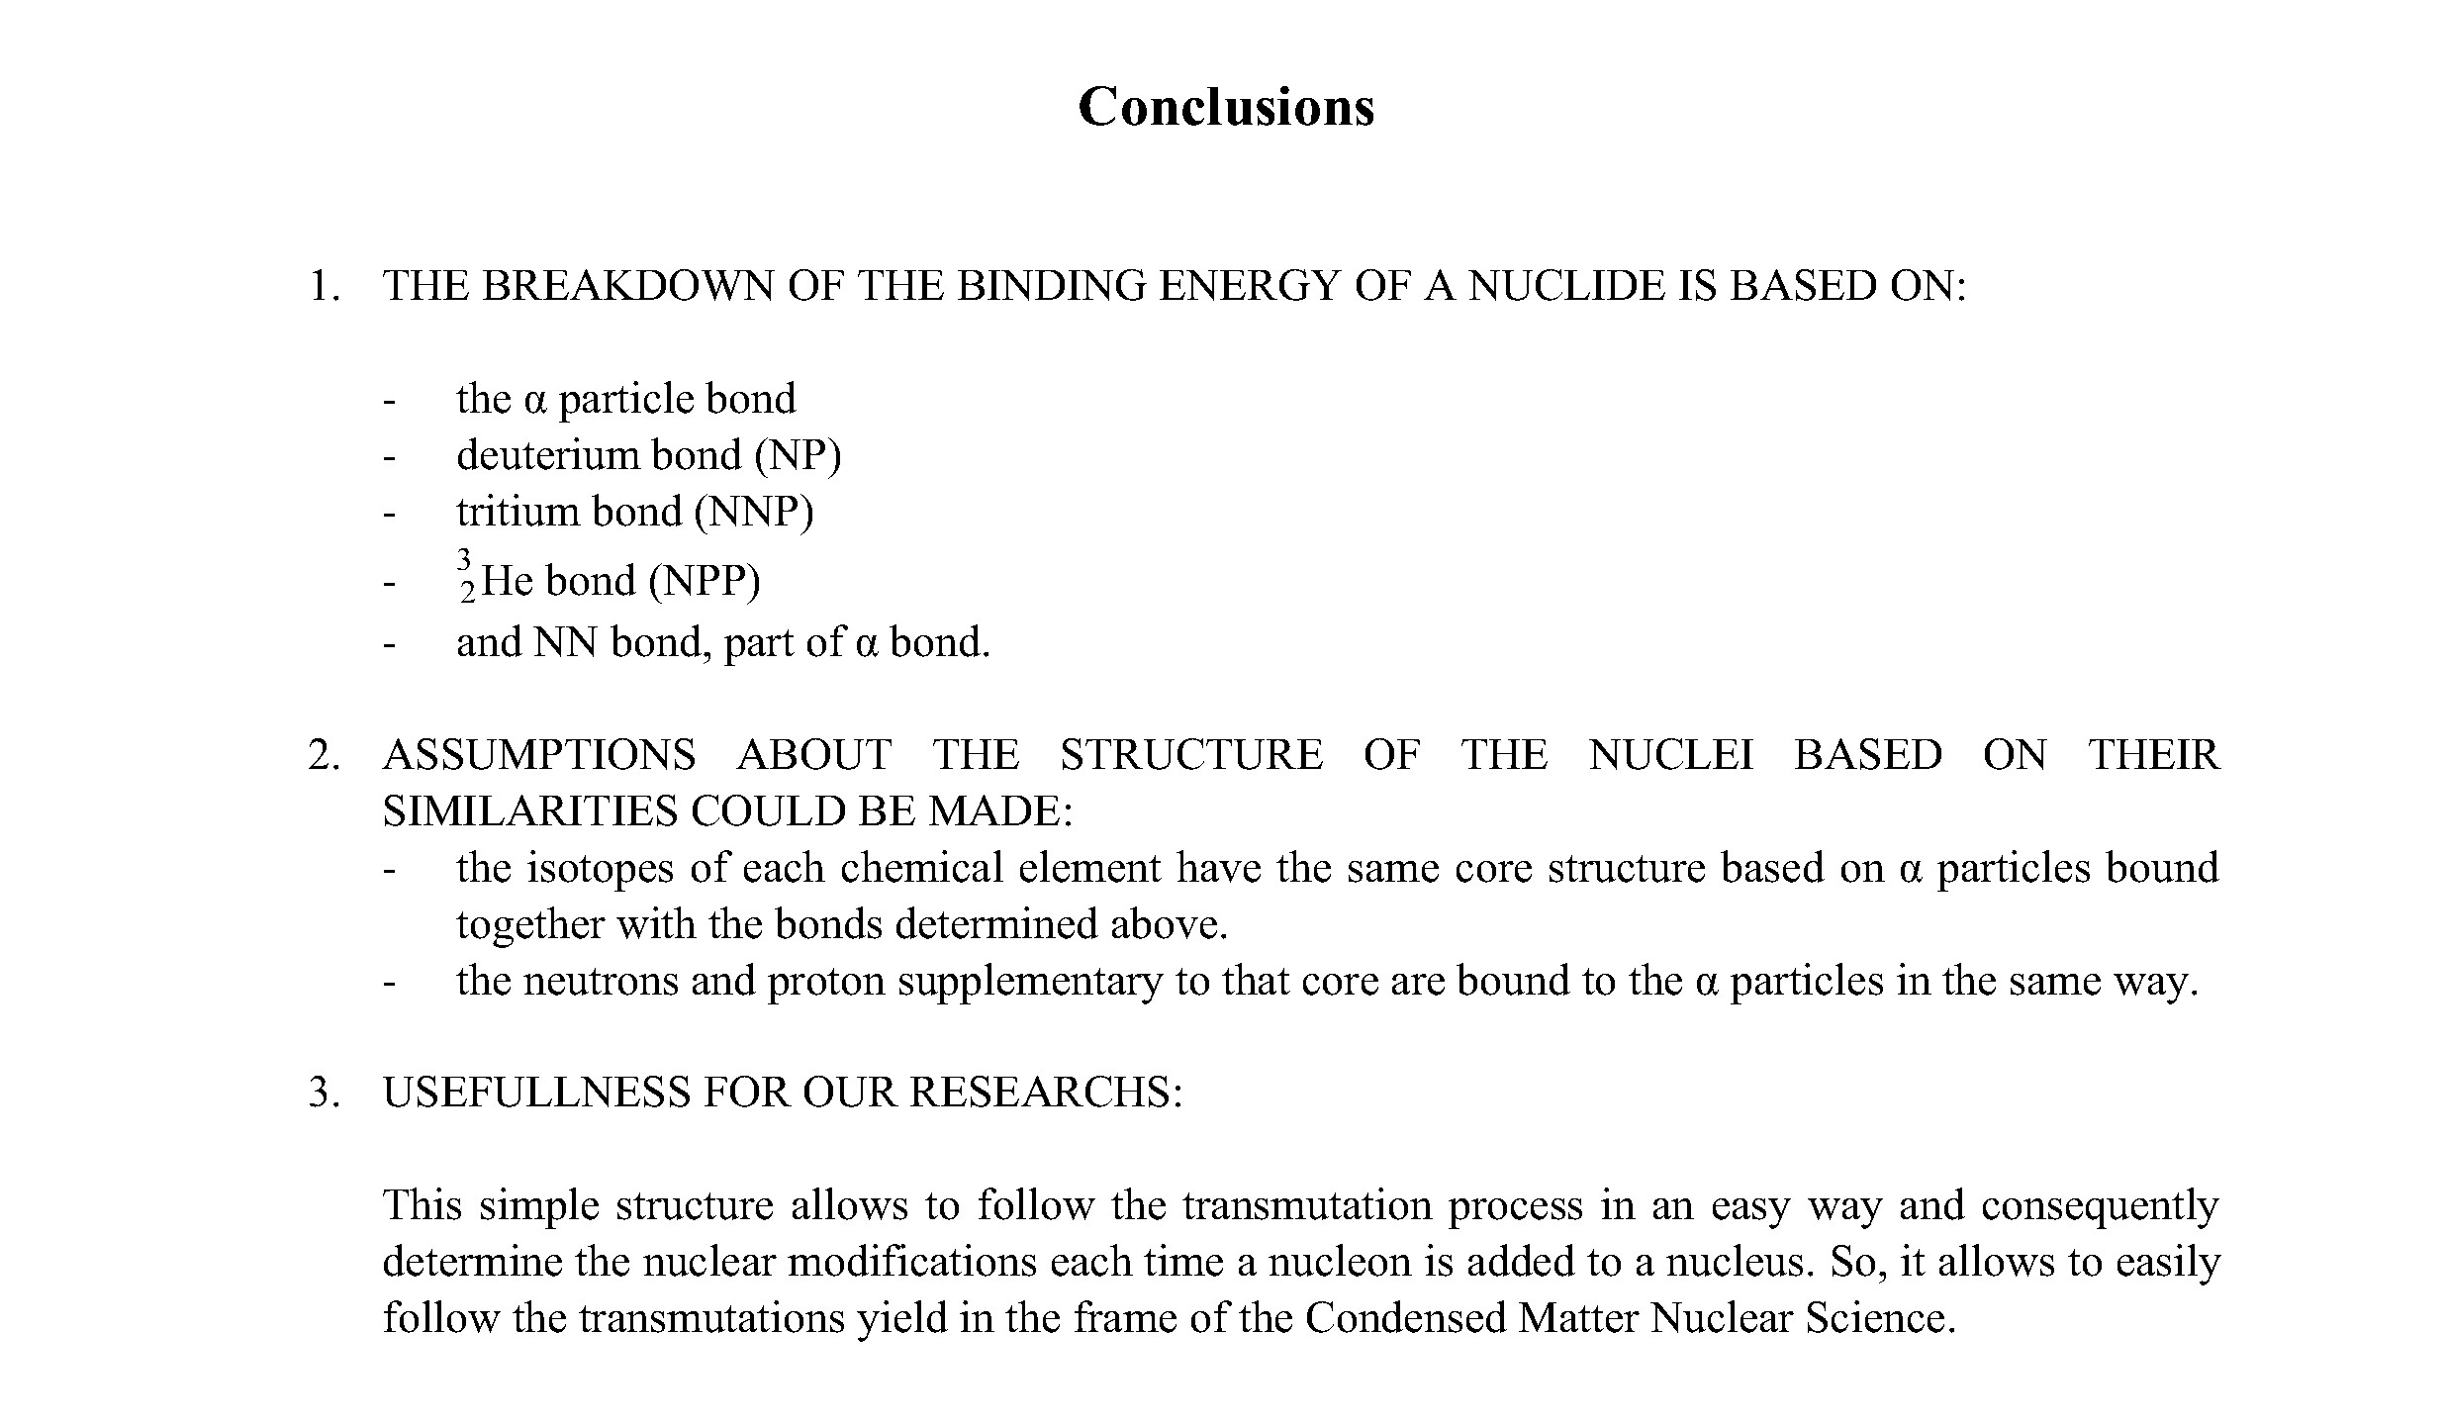
15.

