Slide 1
The 14th International Workshop on Anomalies in Hydrogen Loaded Metals

Slide 2
Opening Address
Considerate la vostra semenza: fatti non foste a viver come bruti, ma per seguir virtute e conoscenza.
119 del canto XXVI dell’Inferno di Dante
Consider your origins: you were not made to live like brutes, but to follow virtue and knowledge.

Slide 3
28 years of Workshops
Nov 1993 Asti
Nov 1995 Asti
Nov 1997 Asti
Oct 1999 Asti
Mar 2004 Asti
May 2005 Siena
Sep 2006 Asti
Sep 2007 Catania
Sep 2010 Siena
April 2012 Siena
Oct 2015 Toulouse
Jun 2017 Asti
Oct 2018 Greccio
Aug 2021 Assisi

Slide 4
What’s special about this Workshop?
Economical, thanks to economies of scale.
“Package” solution with everyone staying in a self contained conference centre.
No dispersal of participants for meals or accommodation. Better “net-working”
Open bar 20:30-22:00 in hotel foyer Monday & Tuesday
Meals in basement restaurant.

Slide 5
Statistics
25 Participants from Europe only
22 Oral Papers
We will survive COVID-19!
Financial break even!

Slide 6
Meals
Conference fee includes breakfast, lunch and dinner
Meals are served in the gardens.
Registered non-residents may have lunch and dinner.
Please inform waitresses of any special dietary requirements. Be punctual! Lunch is at 13:00. Dinner at 19:30.

Slide 7
Workshop Publications
All material submitted to this workshop may be published online at iscmns.org after 1st November 2019 unless withdrawn.
Contribute your digital photos too!
Publication will be only electronic.
Submit to JCMNS

Slide 8
Power Point Presentations
30 minutes including question time.
Moderators will enforce time limits!
Please load your presentation with the appropriate file name (shown on the program in red) on the workshop PC. (Ask for help if necessary).
www.iscmns.org/work14/program
Number your slides!

Slide 9
Certificates of Attendance

Slide 10
Getting Help
Ask at the conference reception
Ask any “old timer”
Read the Notice Board
Workshop program updated frequently but on display and available at online
http://www.iscmns. org/program.htm

Slide 11
Getting back home after the Workshop
By train: You can look up the train time table at www.trenitalia.it
Ask any member of staff.

Slide 12
Departure
Please ensure your room is vacated by 10:00 on the day you leave.
Ensure that all personal debts are settled (e.g. Drinks from fridge).

Slide 13
Feedback on Workshop
Any comments, suggestions, complaints?
Speak up privately (or publicly at the closing discussion on Wednesday).
Or email workshop@iscmns.org

Slide 14
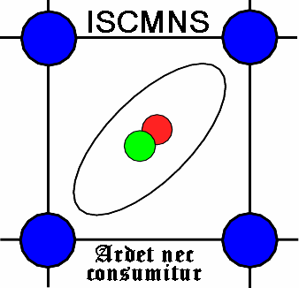
Sponsors – Thank you.

Slide 15
In Italy no smoking is permitted inside any public building (restaurants, train, shops, hotel, bus).
You may smoke outside.

Slide 16
Covid Rules
These are fairly standard all over the world.
Wear masks inside (when not eating)
Respect distancing. (1.5 m)
Disinfect your hands.
“Green passport” not required for hotel residents.

Slide 17
Some “default” questions for presenters.
Do your experimental results support any theoretical model?
Are your theoretical predictions consistent with experimental results?
If not, why not?

Slide 18
Suggestions for discussion at the end of the Workshop
What kind of experiments should we be doing and why?
Is there still any point in doing calorimetry uncorrelated with nuclear measurements?
How can we identify the processes underlying CMNS?
How can different groups collaborate?
Notes:
Feel free to discuss other topics too.

