Slide 1
Direct Electrical Power Generation with Palladium and Iron in a Hydrogen Atmosphere
Jean-Paul Biberian
Aix-Marseilles University, France

Slide 2
Summary
1 – Introduction
2 – Experimental set-up
3 – Experiments with palladium
4 – Experiments with iron
5 – Conclusion

Slide 3
1 – Introduction

Slide 4
1 - Introduction
This work follows the pioneering work of Frank Gordon and Harper Whitehouse on Lattice Energy Conversion. Experiments have been made with palladium and iron in hydrogen and deuterium atmospheres.

Slide 5
2 – Experimental Set-up

Slide 6
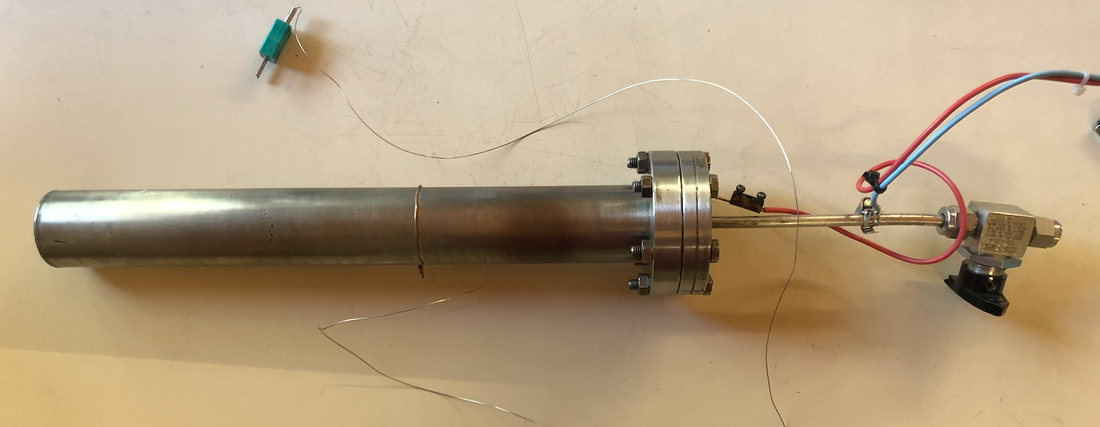
Use of coaxial tubes

Slide 7
3 – Experiments with palladium

Slide 8
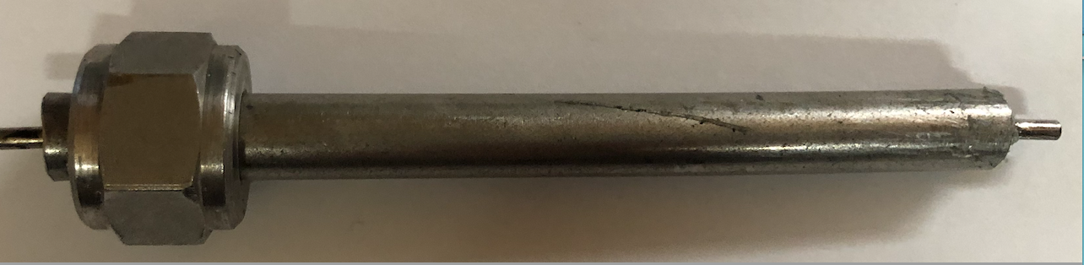
2mmx100mm Pd-Ag rod
Swagelok fittings for pumping and H2/D2 filling
Epoxy
6mm OD stainless steel tube
First set-up MG-4

Slide 9
Resistance effect
355mV with 10 Mohm 12 nano Watts
155mV with 1.5 Mohm 16 nano Watts
33mV with 15 kOhm 73 nano Watts
330 mV with 10 Mohm 11 nano Watts
120 mV with 1 Mohm. 14 nano Watts
65 mV with 500 kOhm 8.5 nano Watts
5 mV with 30 kOhm 0.8 nano Watts
.15mV with 1 kOhm 0.02 nano Watts

Slide 10
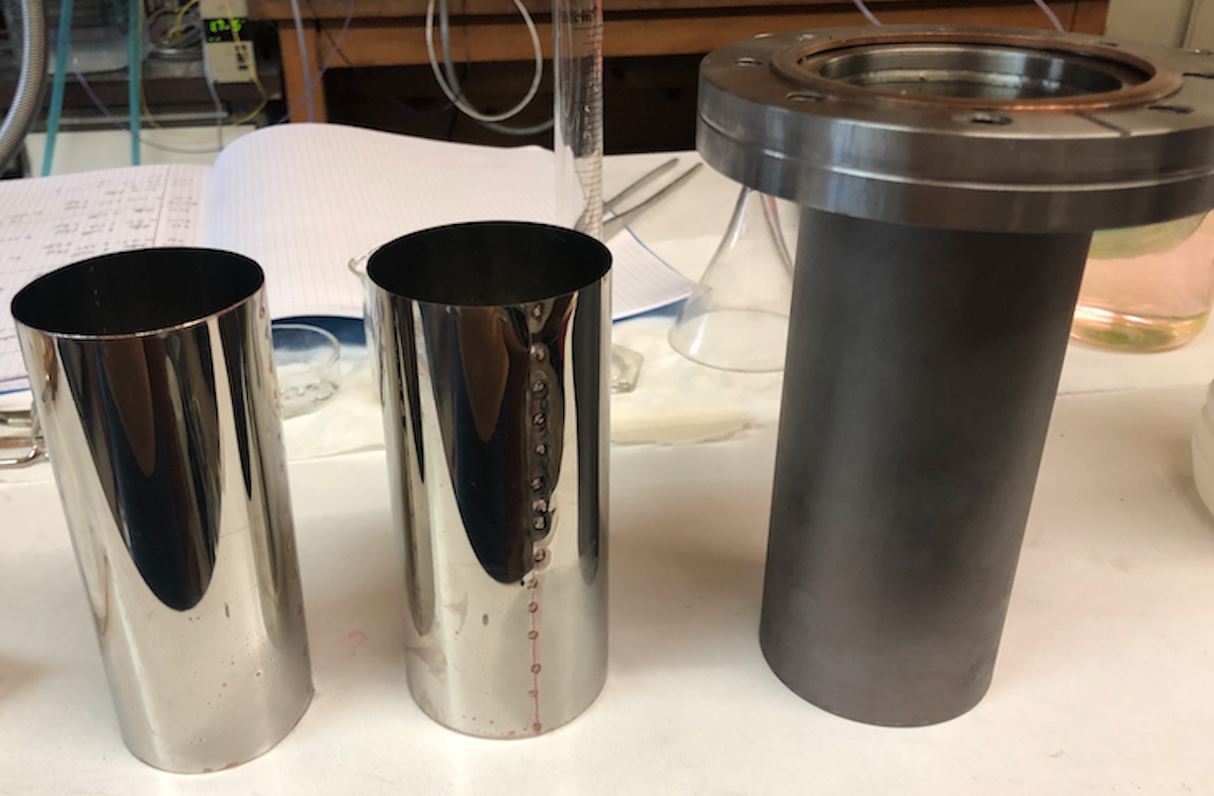
Second set-up MG-5

Slide 11
New experiment with two coaxial cylinders 10 cm of length ant about 5 cm in diameter. The outer cylinder is made of a silver foil with on the inner surface a Pd deposit by electrolysis. The inner cylinder is made of stainless steel. Under vacuum, there is no voltage. However, under hydrogen, the voltage measured with a voltmeter (10 MOhm) shows a Voltage of 740mV!
Power measurements :
R=1.5MOhm 734mV 0.36 micro Watt
R=150kOhm 640mV. 2.7 micro Watts
R=56kOhm 500mV. 4.5 microWatts
R=1kOhm 50mV. 2.5 micro Watts
After pumping out the hydrogen the voltage drops to zero. Adding again hydrogen or deuterium, the voltage increases slowly

Slide 13
After pumping out the cell, addition of hydrogen, then deuterium

Slide 14
Voltage reversal with temperature

Slide 15
4 – Experiments with iron

Slide 16
Deposition of Iron
Trials:
Electrolysis with FeCl3 did not work at all, the two stainless-steel tubes got etched
I added iron in the FeCL3 solution in order to produce FeCl2. Did not work
Electrolysis of a stainless-steel 6mm in diameter tube as anode and a 12mm copper tube as cathode in HCl: 10% HCl and 90% H2O
Maximum voltage observed 13mV

Slide 17
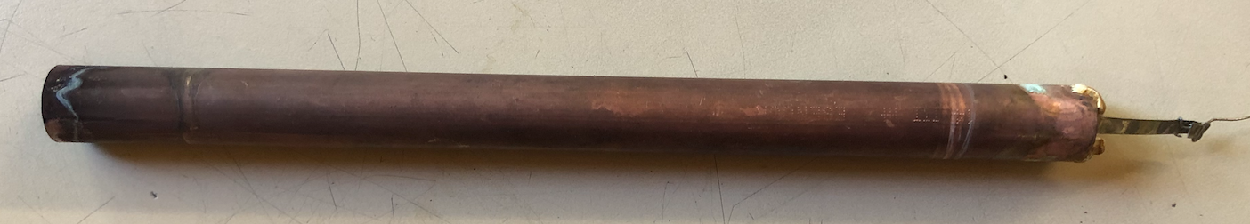
Copper working electrode and stainless-steel counter electrode

Slide 18
Voltage reversal with temperature

Slide 19
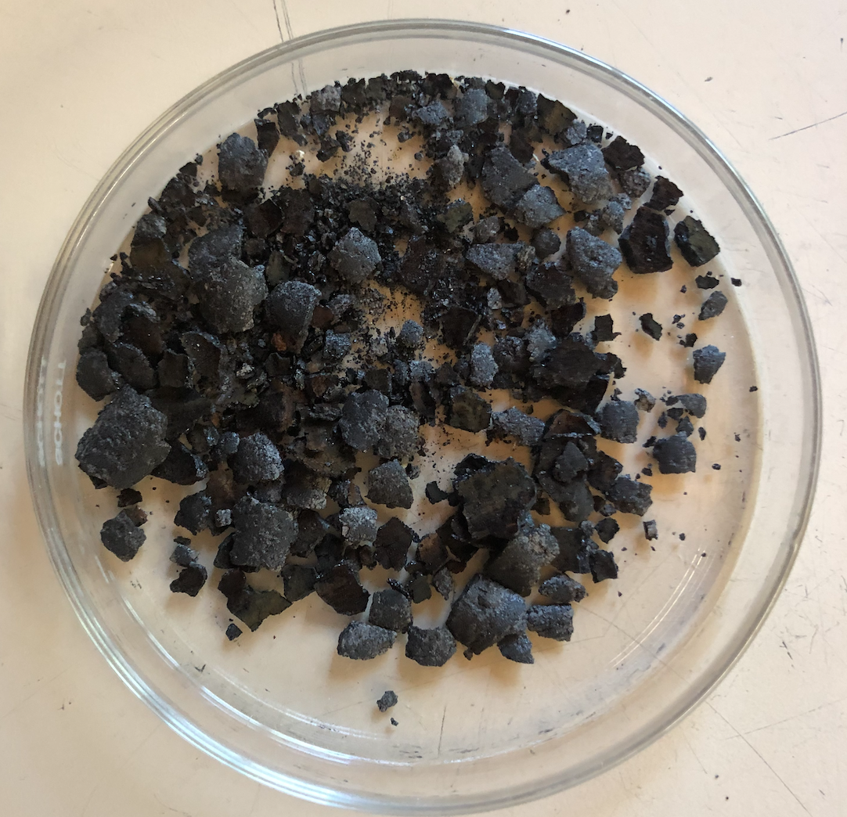
Black powder coming out of the device after use
The powder is magnetic

Slide 20
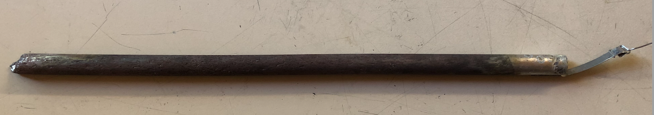
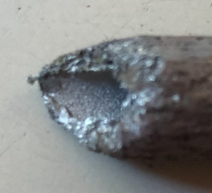
Stainless steel counter electrode after usage

Slide 21
5 – Conclusion

Slide 22
Conclusion
No doubt a new phenomenon has been discovered
Palladium, iron and hydrogen are key elements, but maybe more will be found
Electrical power varies with resistive load
Voltage varies with temperature and seems to increase with temperature.
The metal deposits are very critical, and not well understood
By increasing the surface of the electrodes and by putting them in series, it should be possible to light an LED.

Slide 23
Thank you for your attention

