Slide 1
Theory of Bose-Einstein Condensation Nuclear Fusion and Cryogenic Ignition of Deuteron Fusion in Micro/Nano-Scale Metal Particles:
Alternate Approach to Clean Fusion Energy Generation
Yeong E. Kim
Department of Physics, Purdue University
West Lafayette, Indiana 47907 http://www.physics.purdue.edu/people/faculty/yekim.shtml
Presented at
The 10th Workshop
Siena, Italy
April 10 -14, 2012

Slide 2
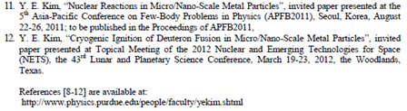

Slide 3
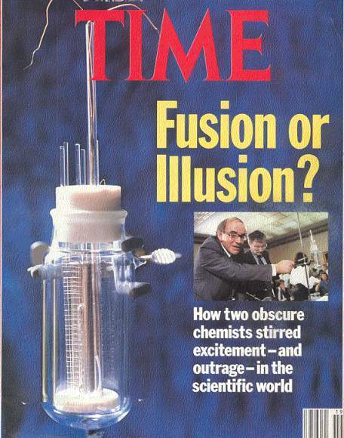
Initial Claim by Fleischmann and Pons (March 23, 1989): radiationless fusion reaction (electrolysis experiment with heavy water and Pd cathode)
D + D → ⁴He + 23.8 MeV (heat) (no gamma rays)
The above nuclear reaction violates three principles of the conventional nuclear theory in free space:
(1) suppression of the DD Coulomb repulsion (Gamow factor) (Miracle #1),
(2) no production of nuclear products (D+D → n+ ³He, etc.) (Miracle #2), and
(3) the violation of the momentum conservation in free space (Miracle #3).
The above three violations are known as “three miracles of cold fusion”.
[John R. Huizenga, Cold Fusion: Scientific Fiascos of the Century, U. Rochester Press (1992)]
Defense Analysis Report:DIA-08-0911-003 (by Bev Barnhart):
More than 20 international labs publishing more than 400 papers, which report results from thousands of successful experiments that have confirmed “cold fusion” or “low-energy nuclear reactions” (LENR) with PdD systems.

Slide 4
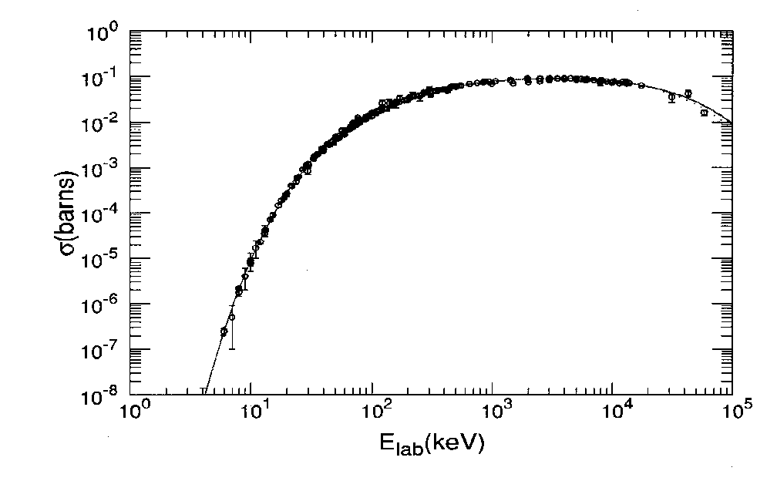
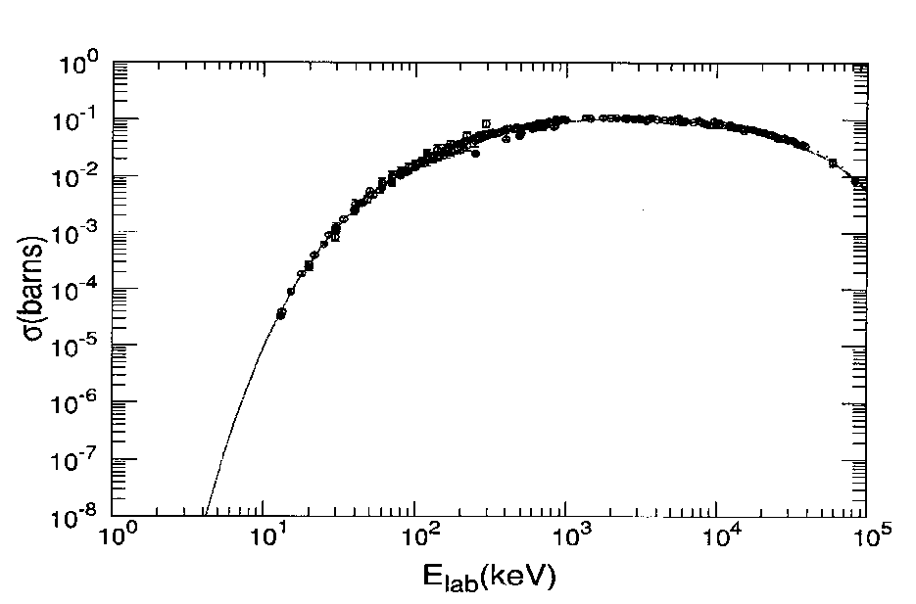
Conventional DD Fusion Reactions in Free-Space
[1] D + D→ p + T + 4.033 MeV
[2] D + D→ n + ³He + 3.270 MeV
[3] D + D→ ⁴He + γ(E2) + 23.847 MeV
Measured branching ratios: (σ [1], σ[2], σ[3]) ≈ (0.5, 0.5, 3.4x10⁻⁷)
In free space it is all about the Coulomb barrier!
The three well known “hot”
dd fusion reactions
Reaction [1]
Reaction [2]
For E_{lab} < 100 keV, the fit is made with σ(E) =

Slide 5
The following experimental observations need to be explained either qualitatively or quantitatively.
Experimental Observations from both electrolysis and gas loading experiments (as of 2011, not complete) (over several hundred publications):
[1] The Coulomb barrier between two deuterons is suppressed (Miracle #1)
[2] Production of nuclear ashes with anomalous low rates: R(T) << R(⁴He) and R(n) << R(⁴He) (Miracle #2)
[3] ⁴He production commensurate with excess heat production, no 23.8 MeV gamma ray (Miracle #3)
[4] Excess heat production (the amount of excess heat indicates its nuclear origin)
[5] More tritium is produced than neutron R(T) >> R(n)
[6] Production of hot spots and micro-scale craters on metal surface
[7] Detection of radiations
[8] “Heat-after-death”
[9] Requirement of deuteron mobility (D/Pd > 0.9, electric current, pressure gradient, etc.)
[10] Requirement of deuterium purity (H/D << 1)
5

Slide 6
Generalization of the Optical Theorem Formulation of LENR to Non-Free Confined Space (as in a metal) (V^{s} + V^{confine} + V^{c} ): Derivation of Fusion Probability and Rates
For a trapping potential (as in a metal) and the Coulomb potential, the Coulomb wave function is replaced by the trapped ground state wave function ψ as
(15)
where is given by the Fermi potential,
is the solution of the many-body Schroedinger equation
with
H = T + V^{confine} + V^{c}
(16)
(17)
The above general formulation can be applied to proton-nucleus, deuteron-nucleus, deuteron-deuteron LENRs, in metals,
and also possibly to biological transmutations !
6
6

Slide 7
One Application of Optical Theorem Formulation of LENRs: Theory of Bose-Einstein Condensation Nuclear Fusion (BECNF) in Metal
In metal, hydrogen (deuterium) atom is ionized and becomes mobile as proton (deuteron) in metal, as proven experimentally by Coehn 1929!
This implies that we can achieve a very high density (~10²²/cm³ !) of deuteron-electron plasma in a metal !!
For BECNF theory, assume one single basic physical concept that deuterons form Bose-Einstein condensates in metal (nuclear BEC), and
Develop a consistent physical theory which
  is capable of explaining “Coulomb barrier suppression” (Miracle #1) and other experimental observations (Miracles #2 and #3, etc.), and
  has predictive powers, capable of making theoretical predictions, which can be tested experimentally

Slide 8
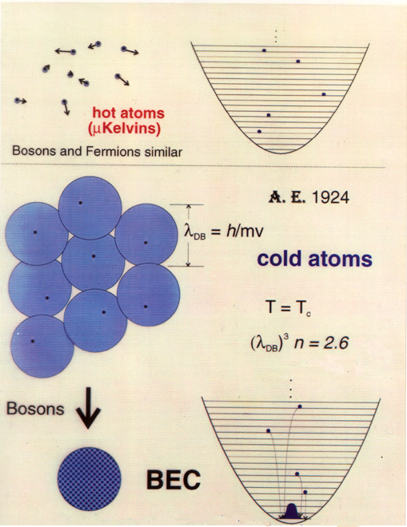
Requirement for
Bose-Einstein
Condensation (BEC):
λ_{DB} > d
where d is the
average distance
between neighboring
two Bosons.
8
8

Slide 9
Atomic BEC vs. Nuclear BEC λ_{DB} > d , λ_{DB} =
Atomic BEC: d ≈ 7 x 10⁴ Å (for n_{Rb} = 2.6 x 10¹²/cm³)
v_{c} ≈ 0.6 cm/sec near T ≈ 170 nano-Kelvin
(~2000 atoms in BEC out of ~2 x 10⁴ atoms → 10% in BEC)
Increase λ_{DB} by slowing down neutral atoms using laser cooling and evaporation cooling
Nuclear BEC: d ≈ 2.5 Å (for n_{D} = 6.8 x 10²²/cm³ in metal)
v_{c} ≈ 0.78 x 10⁵ cm/sec (v_{kT} ≈ 1.6 x 10⁵ cm/sec at T= 300 K)
(1) Increase λ_{DB} by cooling deuterons or by applying EM fields
(2) Decrease d further by increasing density, using ultrahigh pressure device such as Diamond Anvil Cell (DAC), etc.
9

Slide 10
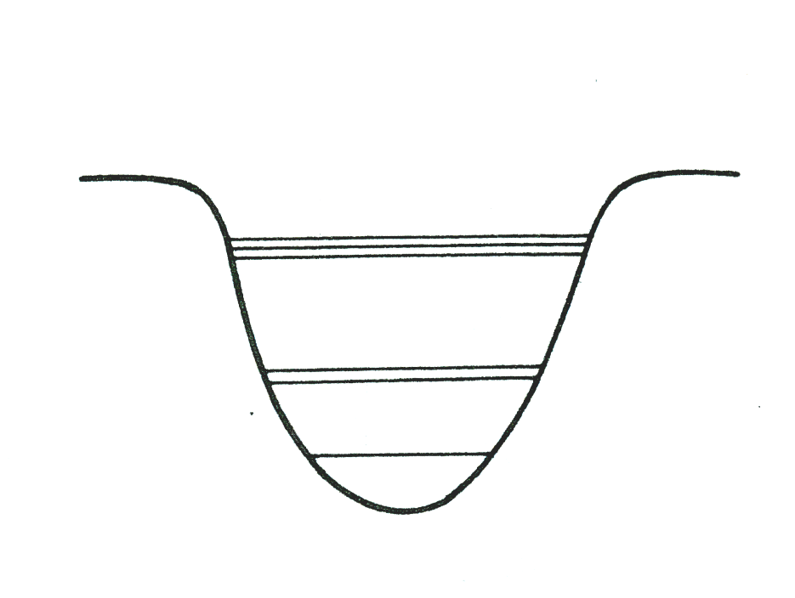
Bose-Einstein Condensation (BEC) Mechanism
N-body Schrödinger equation for the system is
(1)
(2)
where m is the rest mass of the nucleus.
The electron degrees of freedom can be incorporated by using the electron-screened Coulomb potential (Debye screening).
The BEC state is the ground state occupied
by nearly all N deuterons (N bosons)
A Pd particle of diameter ~10 nm will
contain N = 10⁴ – 10⁵ deuterons
For the atomic BEC case, a single trap
contained ~10⁴ atoms at T = ~170 nK
Excited States
Ground State
10

Slide 11
Theoretical Derivation of Reaction Rate for (D+D) fusion in BEC state
N-body Schrödinger equation for the system:
(1)
(2)
Once we obtain a solution for the ground state from Eqs. (1) and (2), the nuclear reaction rate can be calculate by
where
The S is the astrophysical S-factor, which appears in
and is the Gamow factor with
(3)
(4)
The delta function represents the short-range nuclear force
For details, see Kim, et al., “Optical Theorem Formulation of Low Energy Nuclear Reactions”, Phys. Rev. C 55, 181 (1997); Kim and Zubarev, Fusion Technology 37, 151 (2000)
11

Slide 12
We now seek a reliable approximate solution of satisfying N-body Schrödinger equation
(1)
(2)
Method 1: Equivalent Linear Two-Body (ELTB) Method
Kim and Zubarev, J. Phys. B: At. Mol. Opt. Phys. 33, 55 (2000); Phys. Rev. A 64, 013603-1 (2000); Phys. Rev. A 66, 053602 (2002)
Method 2: Mean-Field Theory
Kim and Zubarev, Italian Physical Society Proceedings 70, 375 (2000); Phys. Rev. A 64, 013603-1 (2000)
These two are two independent theoretical methods, developed to investigate the atomic BEC systems.
Both methods provided reliable theoretical descriptions of experimental data for the atomic BEC systems (⁷Li, ²³Na, and ⁸⁷Rb),
We used both methods to calculate the reaction rates for DD fusion using (agree within a factor of 2!!)
12

Slide 13
Reaction Rates for Large N
(3)
(6)
(7)
where S is the S-factor in units of keV-barn, proportional to nuclear force strength B = 2ħ / (π me²) = 1.4 x 10⁻¹⁸ cm³/sec x (keV-barn)⁻¹, D_{trap} is the average diameter of the trap, N_{D} is the total number of deuterons, N is the number of deuterons in a trap, and n_{D} is the deuteron density. S and Ω are only two unknown parameters!

Slide 14
Theoretical Significance
Nuclear fusion rate R for large N does not depend on the Gamow factor in contrast to the reaction rate for nuclear fusion in free space! (Miracle #1)
This provides theoretical explanation of Coulomb barrier suppression for large N
Simple classical physical analogy: For a spherical uniform charge distribution, the Coulomb field diminishes toward the center and vanishes at the center.

Slide 15
BECNF theory can explain the following experimental observations either qualitatively or quantitatively.
Experimental Observations from both electrolysis and gas loading experiments (as of 2011, not complete) (over several hundred publications):
[1] The Coulomb barrier between two deuterons is suppressed (Miracle #1)
[2] Production of nuclear ashes with anomalous low rates: R(T) << R(⁴He) and R(n) << R(⁴He) (Miracle #2)
[3] ⁴He production commensurate with excess heat production, no 23.8 MeV gamma ray (Miracle #3)
[4] Excess heat production (the amount of excess heat indicates its nuclear origin)
[5] More tritium is produced than neutron R(T) >> R(n)
[6] Production of hot spots and micro-scale craters on metal surface
[7] Detection of radiations
[8] “Heat-after-death”
[9] Requirement of deuteron mobility (D/Pd > 0.9, electric current, pressure gradient, etc.)
[10] Requirement of deuterium purity (H/D << 1)
15

Slide 16
Deuteron fusion reactions in metal:
[4] D + D → ⁴He + 23.847 MeV
where ψ_{BEC} is the Bose-Einstein condensate ground-state (a coherent quantum state) with N deuterons, and ψ* are continuum final states.
Average Kinetic Energy <T> per deuteron:
This mechanism can provide an explanation for constraints imposed on the secondary reactions by energetic ⁴He
Other open exit channels are suppressed:
[1] D + D→ p + T + 4.033 MeV
[2] D + D→ n + ³He + 3.270 MeV
The exit channels [1] and [2] are expected to have much lower probabilities than that of the exit channel [4] since both [1] and [2] involve centrifugal and Coulomb barrier transmissions of exit particles in the exit channels, while [4] does not. (Miracle #2)

Slide 17
For a single metal particle containing N deuterons, we have [4] D + D → ⁴He + 23.847 MeV
Total momentum conservation (Miracle #3):
Initial total momentum:
Final total momentum:
Excess energy (Q value) is absorbed by the BEC state and shared by (N-2) deuterons and reaction products (⁴He, etc.)
→ Star-like symmetric micro/nano-scale explosion!
This implies that the BEC state of deuterons in the micro/nano scale metal particle is destroyed once a DD fusion occurs.
This provides a prediction that the fusion rate for smaller particles per unit volume will be larger than that for larger particles per unit volume.
17

Slide 18
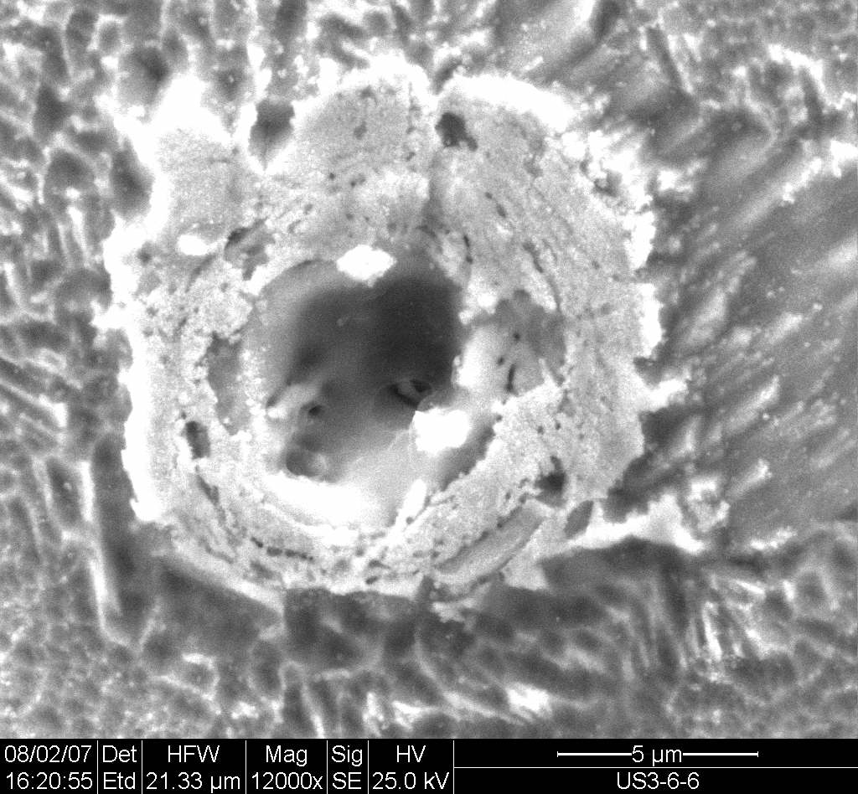
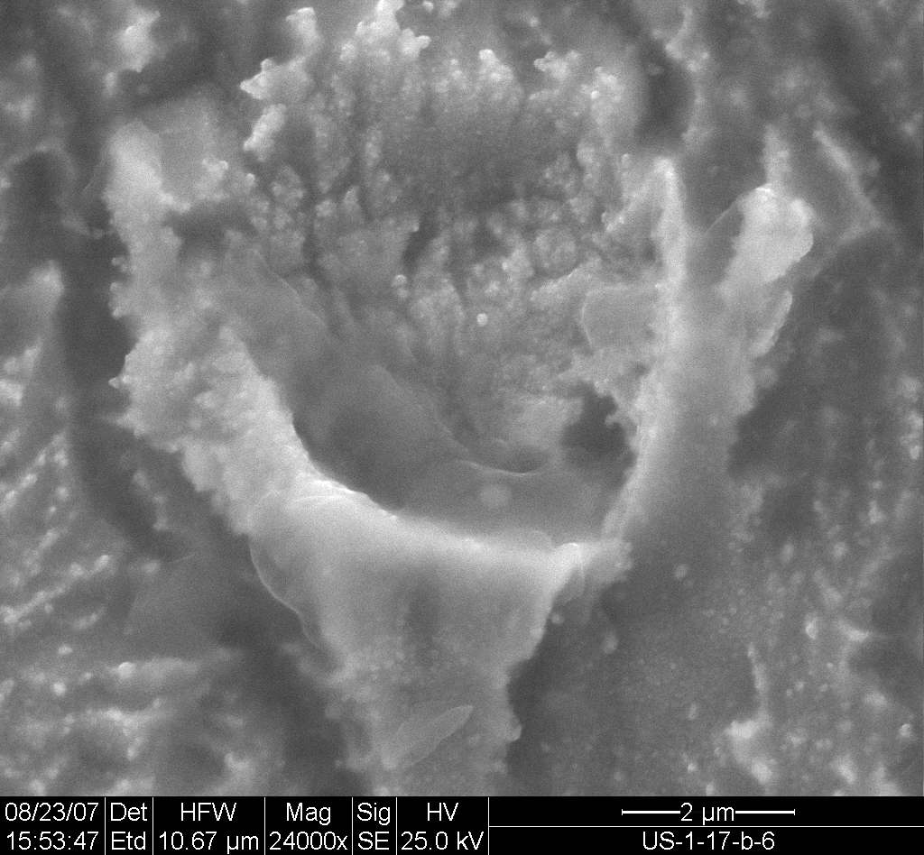
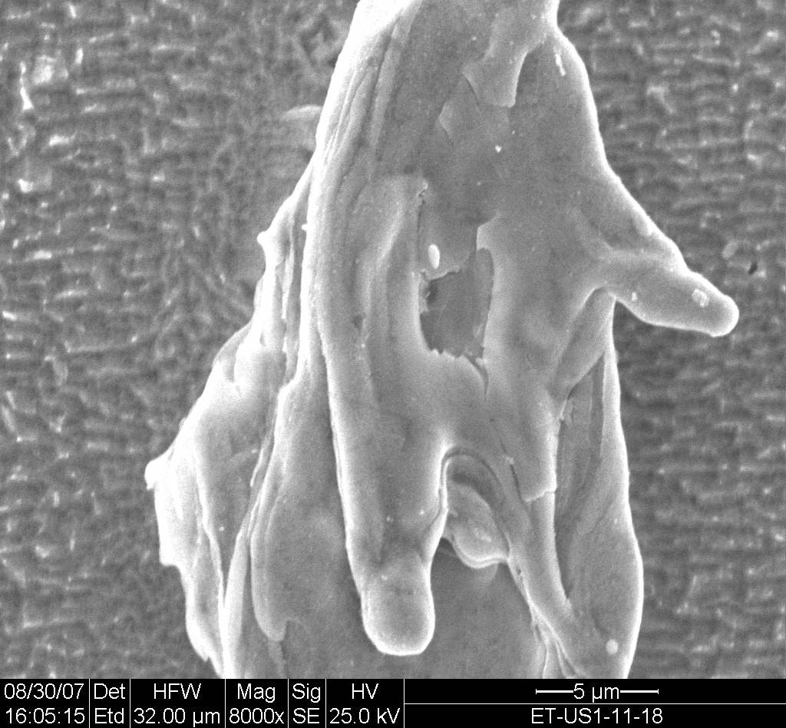
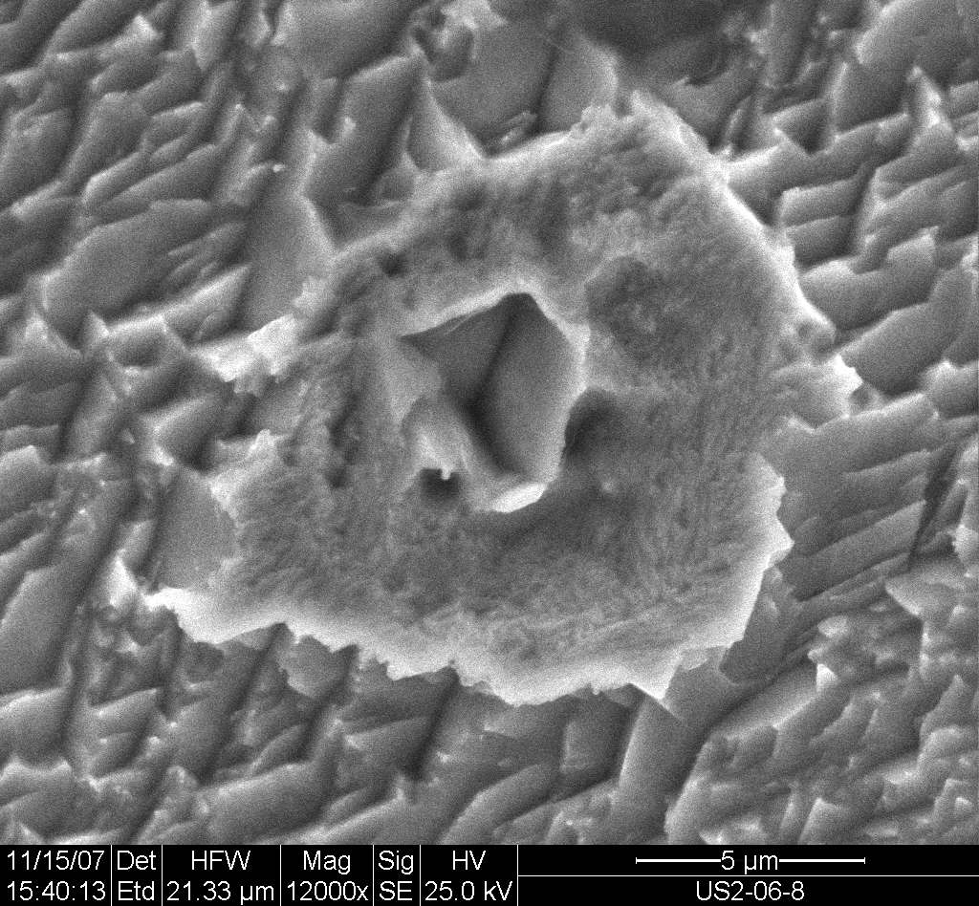
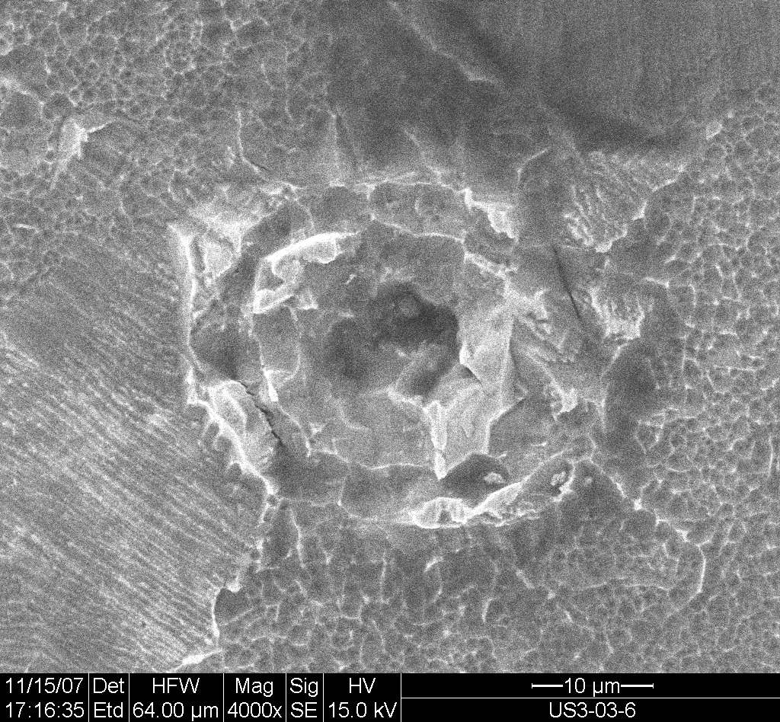
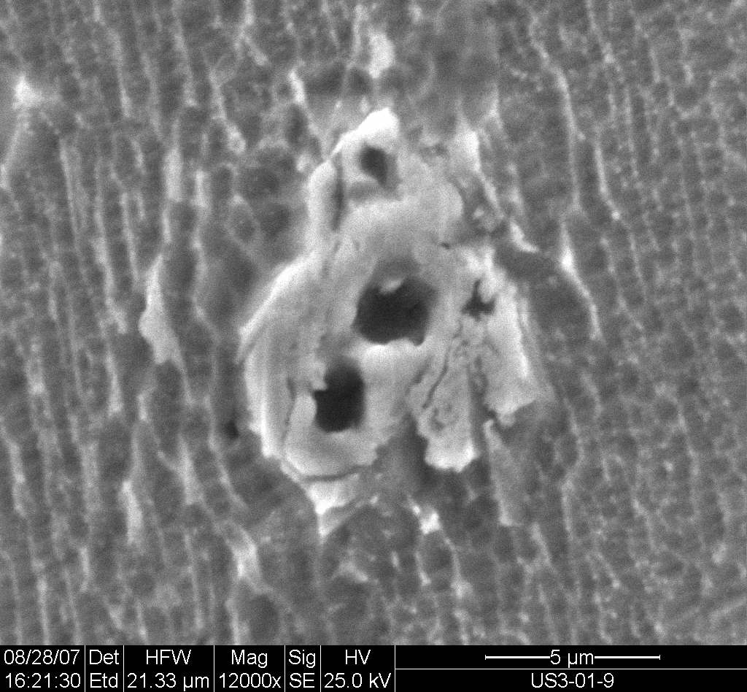
SEM images from Energetic Technologies Ltd. in Omer, Israel
Micro-craters produced in PdD metal in an electrolysis system held at 50 C in which excess heat and helium was produced. A control cell with PdH did not produce excess heat, helium or micro-craters. The example in the upper left-hand SEM picture is a crater of 4 micron diameter and 6 micron depth.
D=4 μm
18
Notes:
18

Slide 19
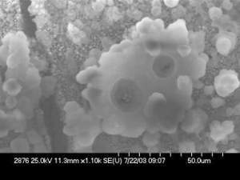
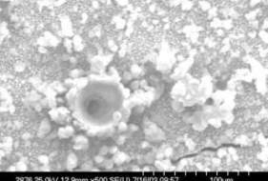
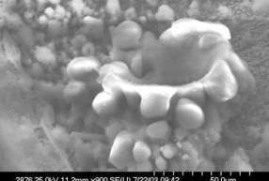
SEM Images Obtained for a Cathode Subjected to an E-Field Showing Micro-Crater Features
D=50 μm
All data and images are from Navy SPAWAR’s released data, presented at the American Chemical Society Meeting in March, 2009.
Included here with the permission of Dr. Larry Forsley of the SPAWAR collaboration
19
Notes:
19
Dr. John Bockris previously showed that heat events could be triggered by subjecting bulk Pd to external stimuli such as electric fields, magnetic fields, as well as RF.
As shown in slide 2, in the absence of an external field, SEMs show that the Pd deposit has a cauliflower-like morphology.
When Pd/D co-deposition experiments were done in the presence of an external electric field, micro-volcano like features were observed in the SEMs that were suggestive of localized melting of the Pd metal under water.

Slide 20
(a) 0.1-μmφ Pd
A. Kitamura et al./ Physics Letters A 373 (2009) 3109-3112
R_{t} (10.7-nmφPd) > R_{t} (0.1μmφPd)
(c) Mixed oxides of Pd⋅Zr
        Consistent with Observation [9]: the requirement of deuteron mobility (D/Pd > 0.9, electric current, pressure gradient, etc.)
20

Slide 21
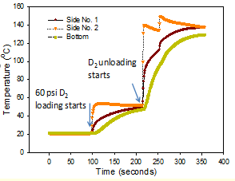
Fraction of Deuterons in the BEC State in Metal at Various Temperatures
For Maxwell-Bolzmann distribution, a fraction F(T) of deuterons below the temperature T or E_{c} satisfying
can be calculated as:
With
F (300º K) = 0.084 (~8.4%)
→ F(77.3º K) = ~0.44 (~44%)
F(20.3º K) = ~0.94 (~94 %)
F(4.2º K) = ~0.99 (~99 %)
Miley, et al.
However, the velocity distribution of deuterons is expected
to be different from Maxwell-Bolzmann distribution, and
F(300º K) could be much larger. This could provide a
theoretical explanation of the excces heat generation with dueterated metal nano-particles observed by Miley et al., Swartz, Kitamura/Takahashi, et al., etc.
21
21

Slide 22

Experiment 1: Measure the velocity distribution of deuterons by low-energy neutron scattering
As is the case for the atomic BEC experiments, experiments are proposed to measure the velocity distribution of deuterons in metal. An enhancement of low-velocity deuterons in the deuteron velocity distribution is expected when the BEC of deuterons occurs.
This experimental demonstration of the BEC of deuterons in a metal may lead to a new discovery.
In 1995, measurement of the velocity distribution was used to establish the existence of the BEC of atoms in a magnetic trap at extremely low temperatures, for which the Nobel prize was awarded in 2001 to C. Wieman, E. Cornell, and W. Ketterle.
~400 nK ~200 nK ~50 nK

Slide 23
Experiment 2: Measure the diffusion rate of deuterons to establish possible superconductivity.
To explore the superfluidity of the BEC of deuterons in metal, experiments are proposed to measure the diffusion rates of both deuterons and protons in a metal as a function of temperature.
When the BEC of deuterons in a metal occurs, it is expected that the deuteron diffusion rate will increase substantially more than that of proton.
Experimental demonstration of the superfluidity of deuterons in the BEC state in metal may lead to a new discovery.
In 1996, the Nobel prize was awarded for discovery of superfluidity of ³He.

Slide 24
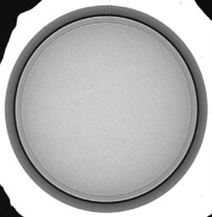
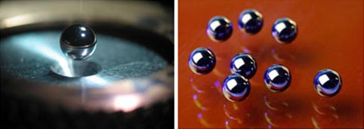
Experiment 3: Temperature dependence of the reaction rate - mini-ignition at extremely low temperatures
D-T targets at National Ignition facility
Proposed Experiment 3:
D-Pd targets for BECNR
Radiograph of a high-density carbon capsule with a smooth, frozen layer of D-T inside.
For BECNR, use 1-cm diameter container
filled with micro/nano- scale metal particles pre-loaded with deuterons
Left: A 2-mm-diameter polished beryllium ICF capsule
with a 10-micron fill tube attached.
Right: 2-mm polished high-density carbon ablator
capsules with the silicon mandrel inside.

Slide 25
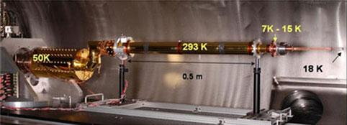
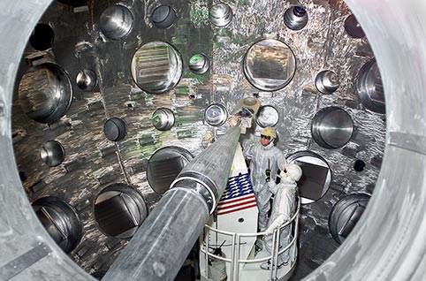
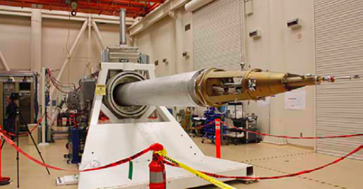
Cryogenic Target System (NIF)
Proposed Experiment 3: Adopt the NIF’s cryogenic target system for BECNR
A NIF target is suspended at the end of its cryogenic cooling system via a copper support beam.
Precise temperature control is achieved by sub-cooling the target to below requirements and then using small electric heaters to precisely raise the temperature to the exact level required.
Ignition target inserter cryostat
Cryogenic Target Positioner (cryoTARPOS)
Target Chamber at National Ignition Facility

Slide 26
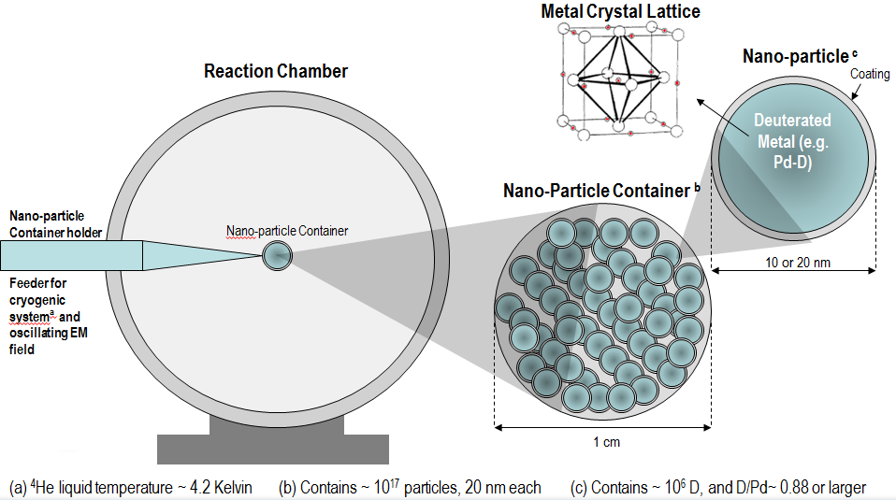
Conceptual Design for Cryogenic Ignition of Deuteron Fusion Experiment
(Not to Scale)

Slide 27
Observed productions of hot spots and micro-craters and episodes of “Melt Down” reported by Fleischmann and Pons in 1989
Total Fusion Rate for D(m) + D(m) → ⁴He(m) + 23.85 MeV
For 1 cm³ Palladium containing 6.8 x 10²² deuterons,
R_{t} = ~ 10²⁹ /sec with =1 and S= 55 KeV-barn, under optimal conditions
At this rate, ignition/explosion will occur !
For slower burns, fuel lifetimes are listed below.
Power | DD Fusion Rate | Fuel Lifetime
100 HP (419 Watt) | 2.6x10¹³ /sec | 165 years
1 KW | 6.2x10¹³ /sec | 69 years
1 MW | 6.2x10¹⁶ /sec | 25 days

Slide 28
Concluding Remarks
Conventional nuclear theory for LENRs has been developed based on the optical theorem, which can be applied to many types of LENRs.
As an application, theory of Bose-Einstein condensation nuclear fusion (BECNF) is developed for deuteron fusion in micro/nano-scale metal particles. The theory provides theoretical explanations of the Fleischmann-Pons effect (“cold fusion”) and LENRs in metals.
Proof-of-concept/proof-of-principle experiments are proposed to test the basic assumption and theoretical predictions.
As a practical application, cryogenic ignition of deuteron fusion in micro/nano-scale metal particles is proposed as an alternate technology for clean fusion energy generation.
This may become a disruptive revolutionary technology.
The optical theorem formulation of LENRs is now being applied to
hydrogen-nucleus LENRs in metals.

Slide 29
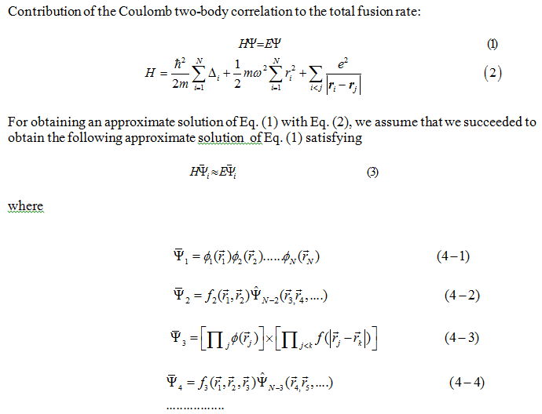

Slide 30
