Slide 1
Optical Theorem Formulation of Low-Energy Nuclear Reactions in Deuterium/Hydrogen Loaded Metals
Yeong E. Kim
Department of Physics, Purdue University
West Lafayette, Indiana 47907 http://www.physics.purdue.edu/people/faculty/yekim.shtml
Presented at
The 10th Workshop
Siena, Italy
April 10 -14, 2012

Slide 2
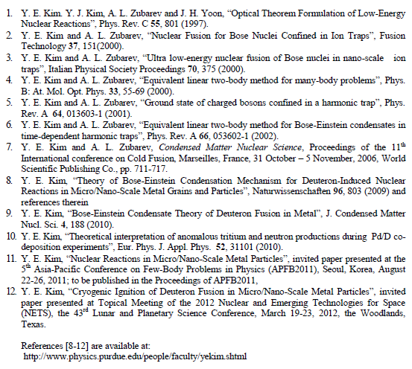

Slide 3
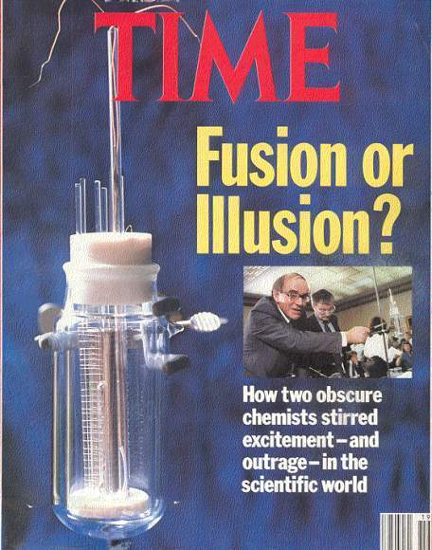
Initial Claim by Fleischmann and Pons (March 23, 1989): radiationless fusion reaction (electrolysis experiment with heavy water and Pd cathode)
D + D → ⁴He + 23.8 MeV (heat) (no gamma rays)
The above nuclear reaction violates three principles of the conventional nuclear theory in free space:
(1) suppression of the DD Coulomb repulsion (Gamow factor) (Miracle #1),
(2) no production of nuclear products (D+D → n+ ³He, etc.) (Miracle #2), and
(3) the violation of the momentum conservation in free space (Miracle #3).
The above three violations are known as “three miracles of cold fusion”.
[John R. Huizenga, Cold Fusion: Scientific Fiascos of the Century, U. Rochester Press (1992)]
Defense Analysis Report:DIA-08-0911-003 (by Bev Barnhart):
More than 20 international labs publishing more than 400 papers, which report results from thousands of successful experiments that have confirmed “cold fusion” or “low-energy nuclear reactions” (LENR) with PdD systems.

Slide 4
The following experimental observations need to be explained either qualitatively or quantitatively.
Experimental Observations from both electrolysis and gas loading experiments (as of 2011, not complete) (over several hundred publications):
[1] The Coulomb barrier between two deuterons is suppressed (Miracle #1)
[2] Production of nuclear ashes with anomalous low rates: R(T) << R(⁴He) and R(n) << R(⁴He) (Miracle #2)
[3] ⁴He production commensurate with excess heat production, no 23.8 MeV gamma ray (Miracle #3)
[4] Excess heat production (the amount of excess heat indicates its nuclear origin)
[5] More tritium is produced than neutron R(T) >> R(n)
[6] Production of hot spots and micro-scale craters on metal surface
[7] Detection of radiations
[8] “Heat-after-death”
[9] Requirement of deuteron mobility (D/Pd > 0.9, electric current, pressure gradient, etc.)
[10] Requirement of deuterium purity (H/D << 1)
4

Slide 5
SRI
Labyrinth
(L and M)
Calorimeter and Cell
Over 50,000 hours of calorimetry to investigate the Fleishmann–Pons effect have been performed to date, most of it in calorimeters identical or very similar to this.
Notes:
99.3% Thermal efficiency. Only the remaining 0.7% needs independent calibration (for high accuracy). Also, only this 0.7% can drift (it did not).
The cell from the previous slide goes inside the labyrinth.
Two or 4 of these objects are placed in a constant temperature bath (±0.003K) in a constant temperature room (±1K - on a good day).

Slide 6
P13/14 Simultaneous Series Operation of Light & Heavy Water Cells;
Excess Power & Current Density vs. Time
P_{In} = 10 W
200mA/cm²

Slide 7
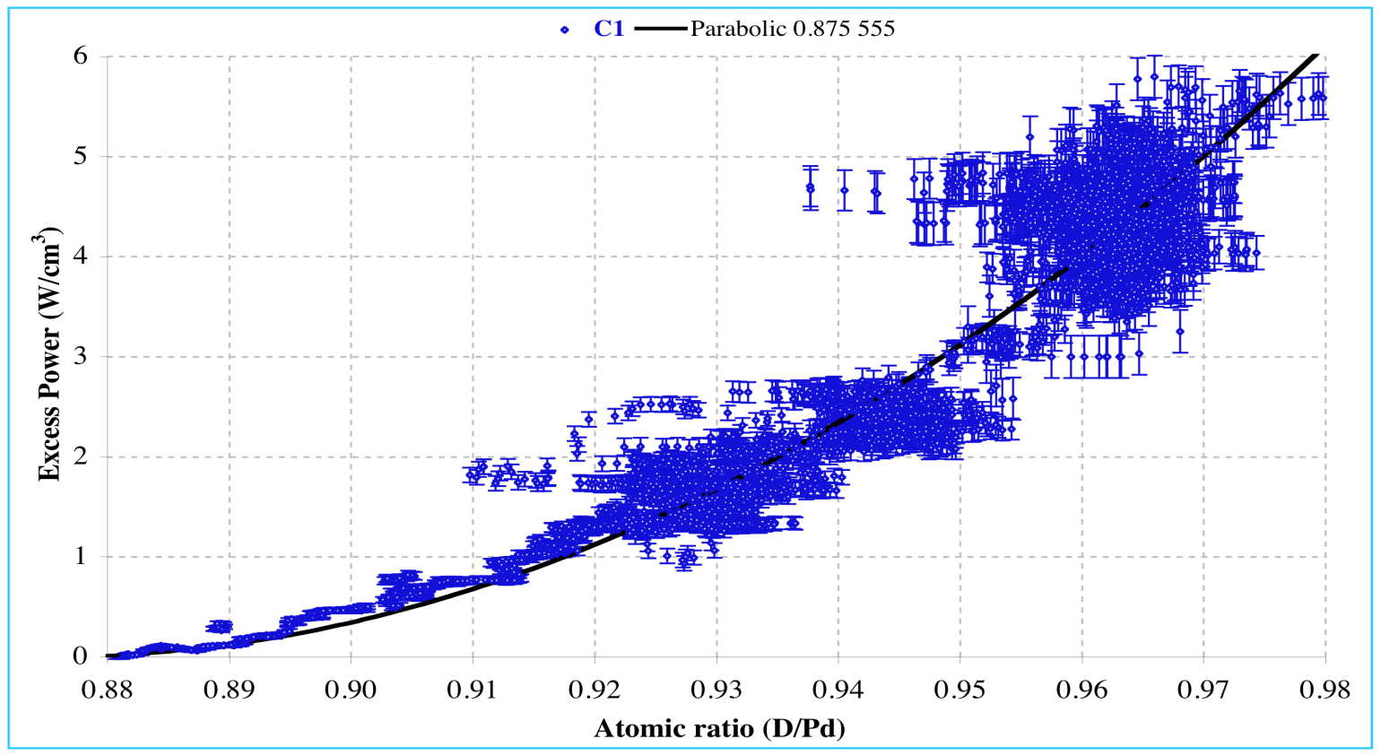
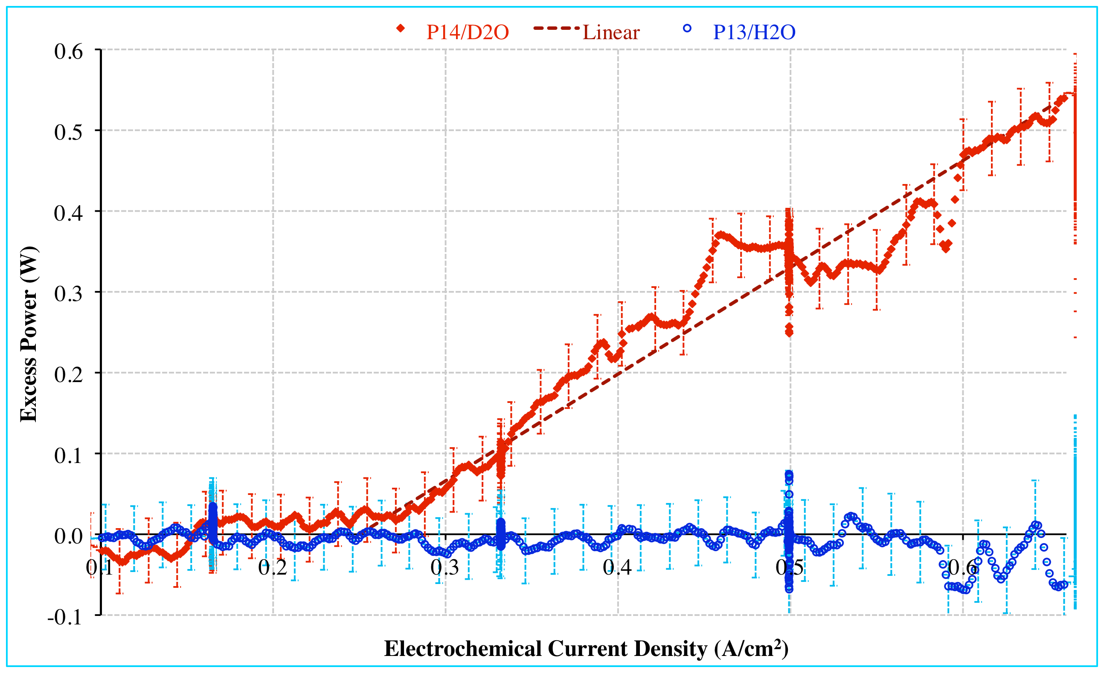
Stanford Research Institute (SRI) replication of
the Fleischmann-Pons effect (FPE)
I_{c} =250mA/cm²
  Current threshold I_{c} = 250mA/cm² and linear slope.
  Loading threshold
  D/Pd > 0.88
D/Pd = 0.88

Slide 8
The conditions required for positive electrolysis results:
(1) Loading ratio D/Pd > 0.88 and
(2) Current density I_{c} > 250 mA/cm²
The following experiments reporting NULL results did not satisfy the required D/Pd ratio (D/Pd > 0.88) and/or the critical current density (I_{c} > 250 mA/cm² )!!!
Caltech (1989/90): N.S. Lewis, et al., Nature 340, 525(1989)
Harwell (1989): Williams et al., Nature 342, 375 (1989)
MIT (1989/90): D. Albagli, et al., J. Fusion Energy 9, 133 (1990)
Bell Labs (1989/90): J. W. Fleming et al., J. Fusion Energy 9, 517 (1990)
GE (1992): Wilson, et al. J. Electroanal. Chem. 332, 1 (1992)

Slide 9
Coulomb potential and nuclear square well potential
V(r)
B
U = E_{screening}
(Electron Screening Energy)
E
(E+U)
U
r_{b}
r
R
r_{a}
Gamow Factor – WKB approximation for Transmission Coefficient
≈
≈
-V₀

Slide 10
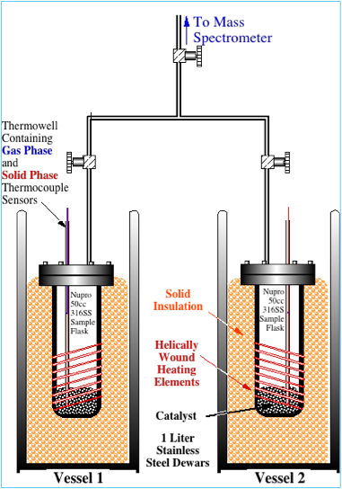
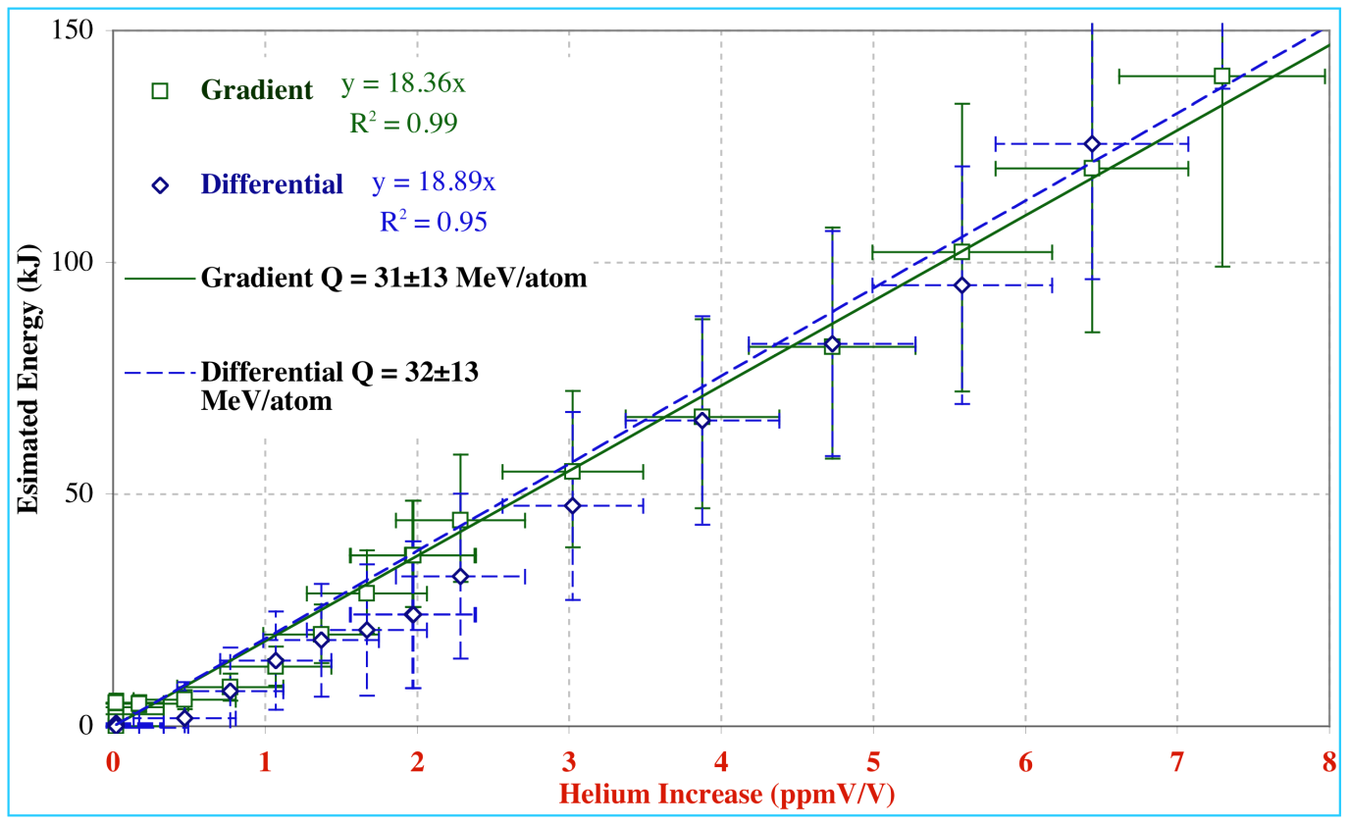
SRI Case Replication
  Correlated Heat and ⁴He
  Q = 31 ± 13 MeV/atom
  Discrepancy due to solid phase retention of ⁴He.
10
Notes:
10

Slide 11
A. Kitamura et al./ Physics Letters A 373 (2009) 3109-3112
11

Slide 12
Fig. 3(c): A. Kitamura et al., Physics Letters A, 373 (2009) 3109-3112.
(c) Mixed oxides of Pd⋅Zr
10.7-nmφPd
1MPa = 9.87 Atm
Output power of 0.15 W corresponds to R_{t} ≈ 1 x 10⁹ DD fusions/sec for
D+D → ⁴He + 23.8 MeV
12

Slide 13
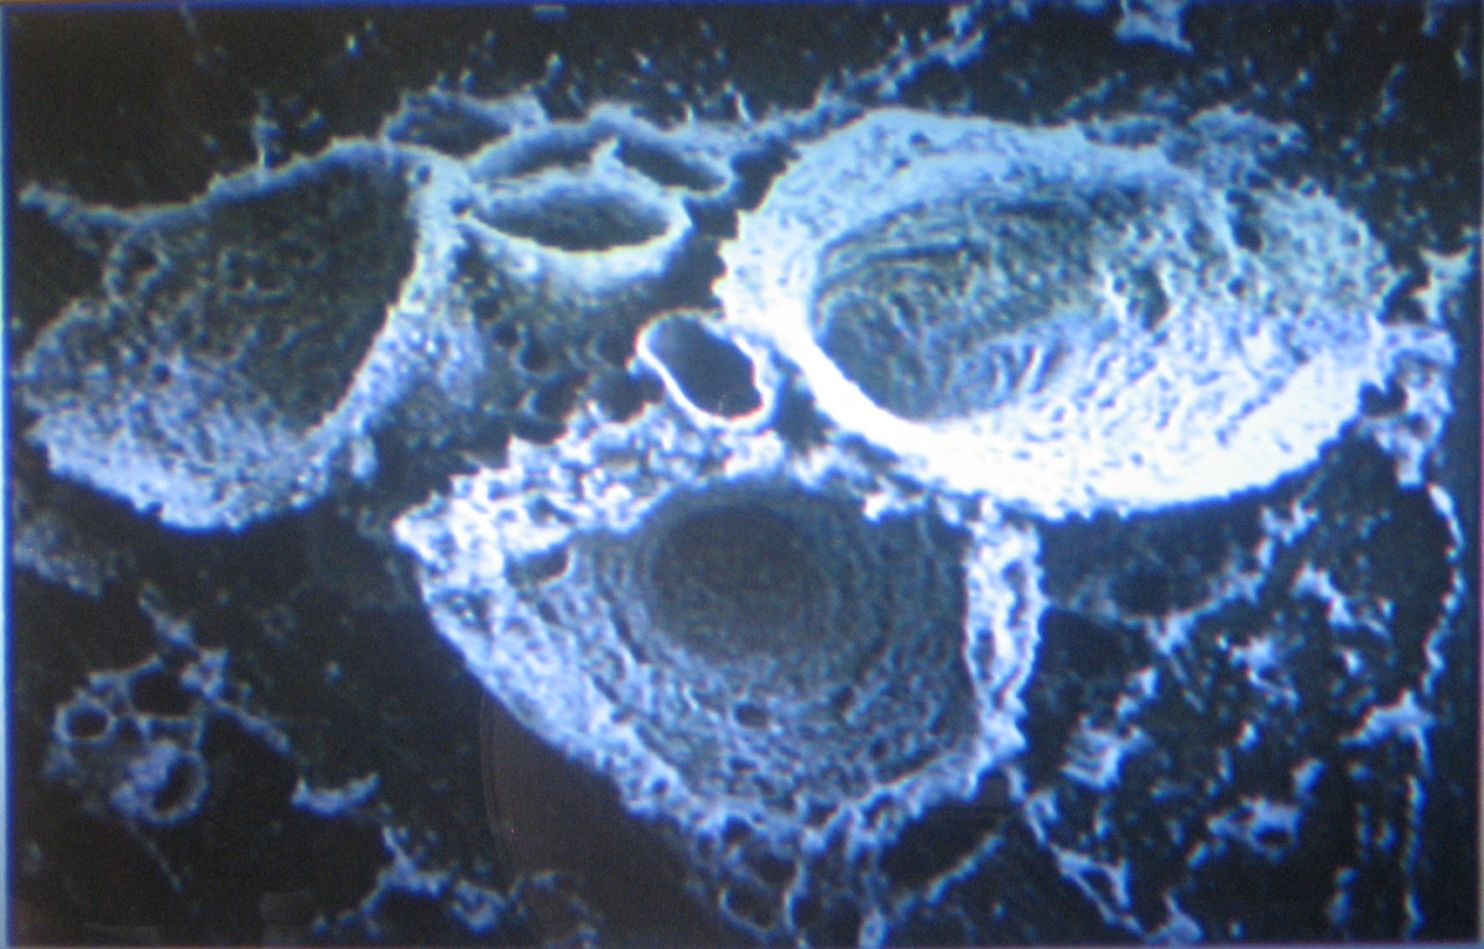
One of many reproducible examples of Explosive Crater Formation observed in excess heat and helium production in PdD
Y. Iwamura, et al.[2002,2008]
D=4 μm

Slide 14
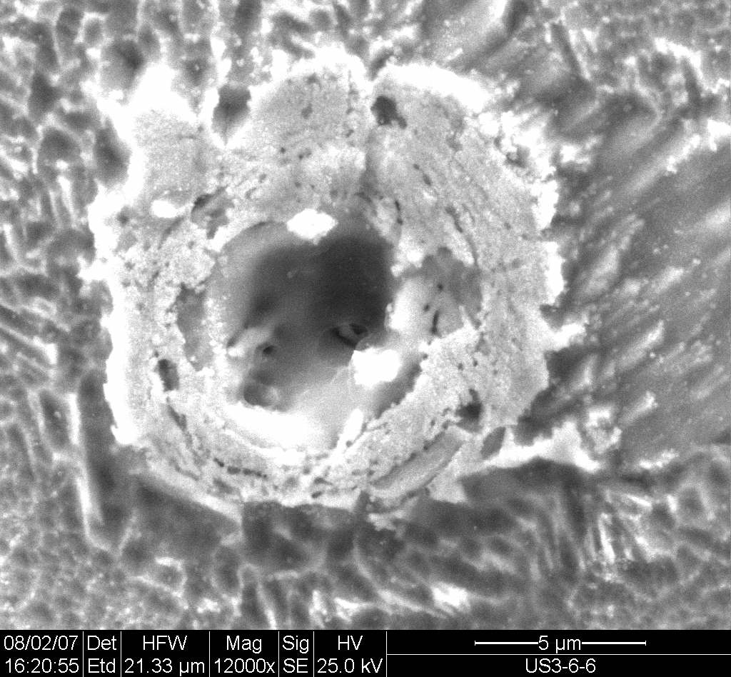
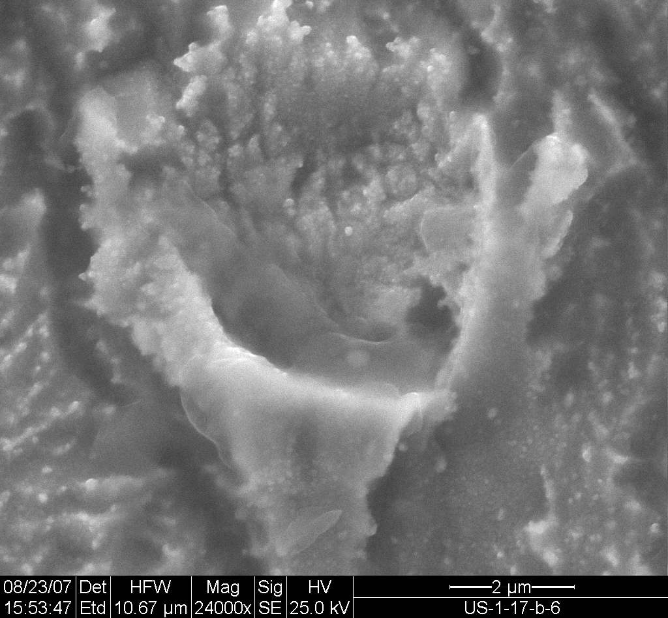
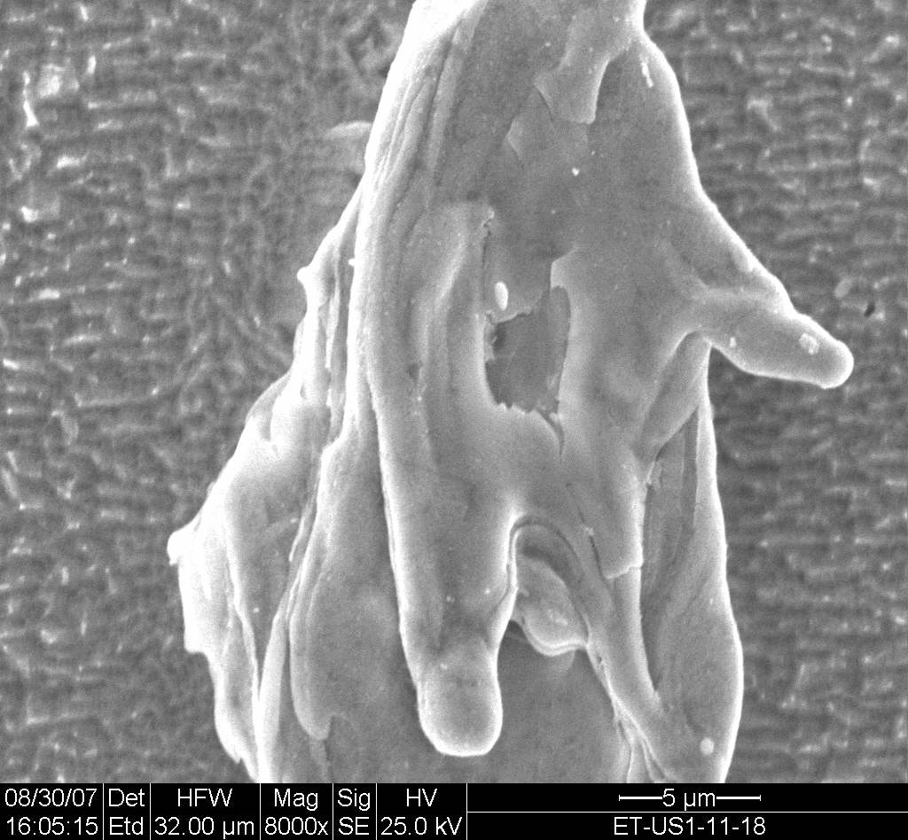
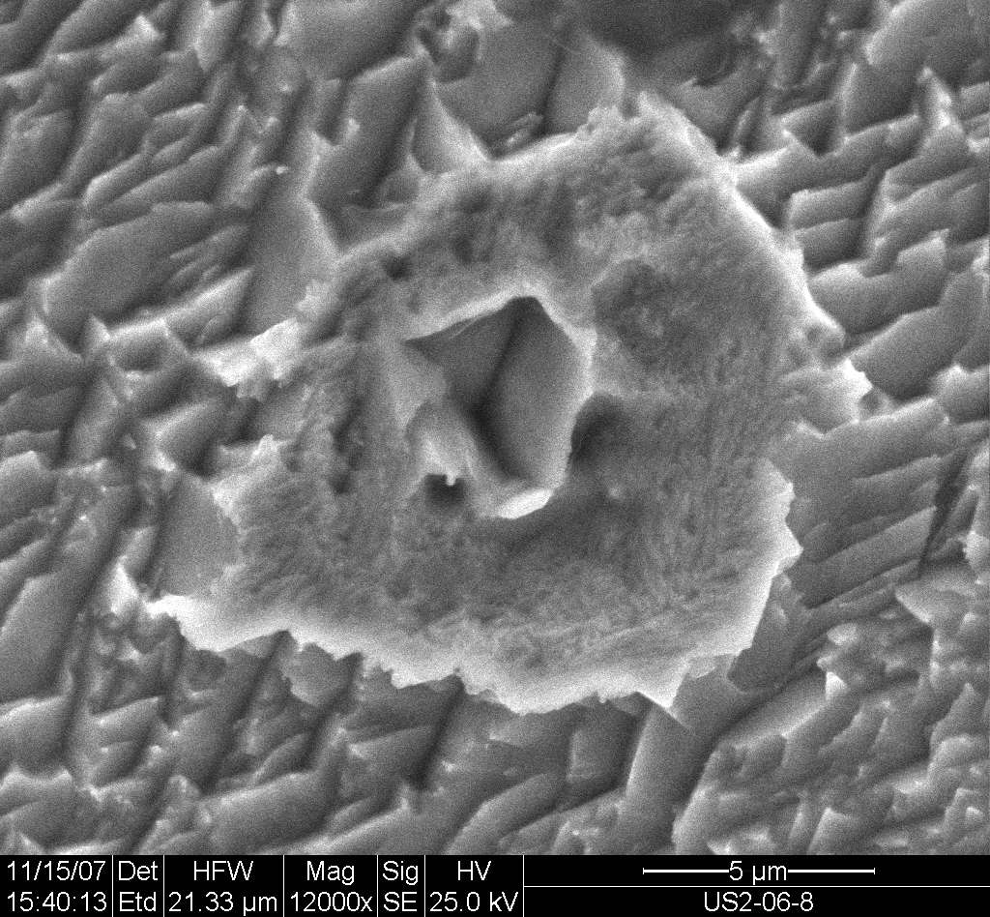
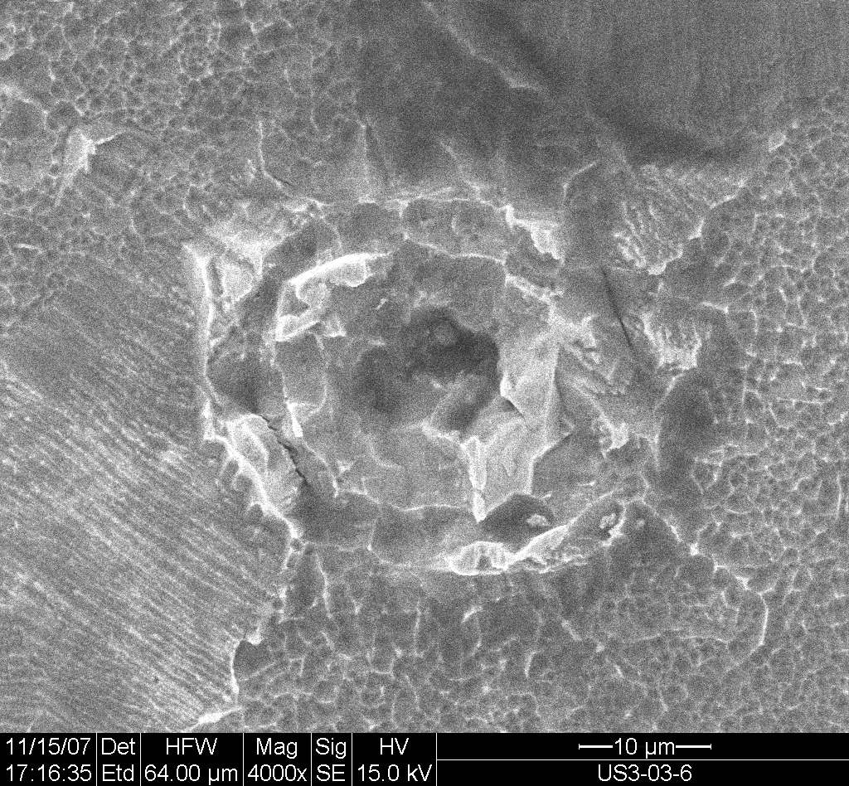
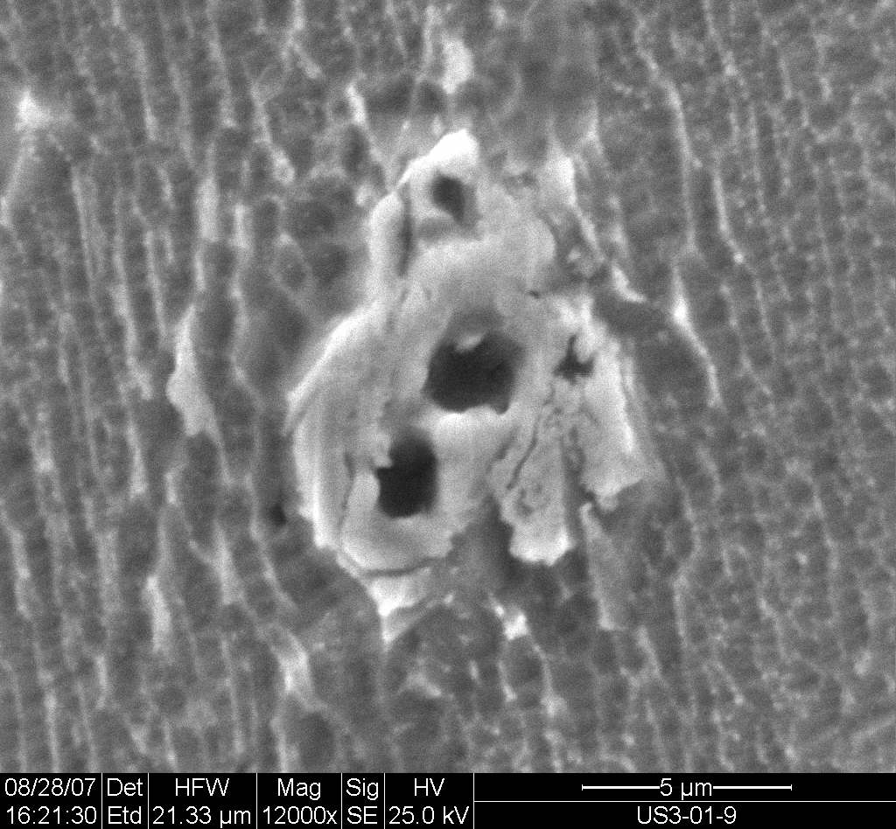
SEM images from Energetic Technologies Ltd. in Omer, Israel
Micro-craters produced in PdD metal in an electrolysis system held at 50 C in which excess heat and helium was produced. A control cell with PdH did not produce excess heat, helium or micro-craters. The example in the upper left-hand SEM picture is a crater of 4 micron diameter and 6 micron depth.
D=4 μm
14
Notes:
14

Slide 15
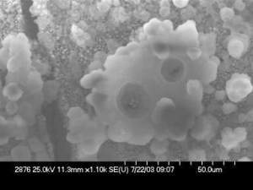
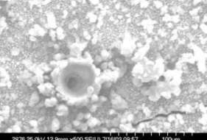
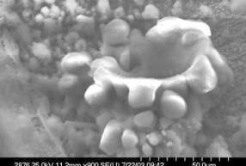
SEM Images Obtained for a Cathode Subjected to an E-Field Showing Micro-Crater Features
D=50 μm
All data and images are from Navy SPAWAR’s released data, presented at the American Chemical Society Meeting in March, 2009.
Included here with the permission of Dr. Larry Forsley of the SPAWAR collaboration
15
Notes:
15
Dr. John Bockris previously showed that heat events could be triggered by subjecting bulk Pd to external stimuli such as electric fields, magnetic fields, as well as RF.
As shown in slide 2, in the absence of an external field, SEMs show that the Pd deposit has a cauliflower-like morphology.
When Pd/D co-deposition experiments were done in the presence of an external electric field, micro-volcano like features were observed in the SEMs that were suggestive of localized melting of the Pd metal under water.

Slide 16
The following experimental observations need to be explained either qualitatively or quantitatively.
Experimental Observations from both electrolysis and gas loading experiments (as of 2011, not complete) (over several hundred publications):
[1] The Coulomb barrier between two deuterons is suppressed (Miracle #1)
[2] Production of nuclear ashes with anomalous low rates: R(T) << R(⁴He) and R(n) << R(⁴He) (Miracle #2)
[3] ⁴He production commensurate with excess heat production, no 23.8 MeV gamma ray (Miracle #3)
[4] Excess heat production (the amount of excess heat indicates its nuclear origin)
[5] More tritium is produced than neutron R(T) >> R(n)
[6] Production of hot spots and micro-scale craters on metal surface
[7] Detection of radiations
[8] “Heat-after-death”
[9] Requirement of deuteron mobility (D/Pd > 0.9, electric current, pressure gradient, etc.)
[10] Requirement of deuterium purity (H/D << 1)
16

Slide 17
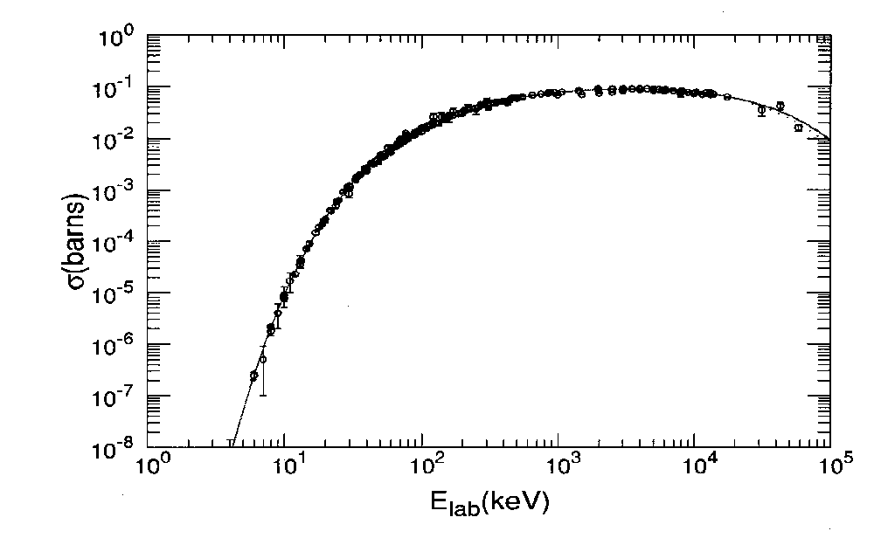
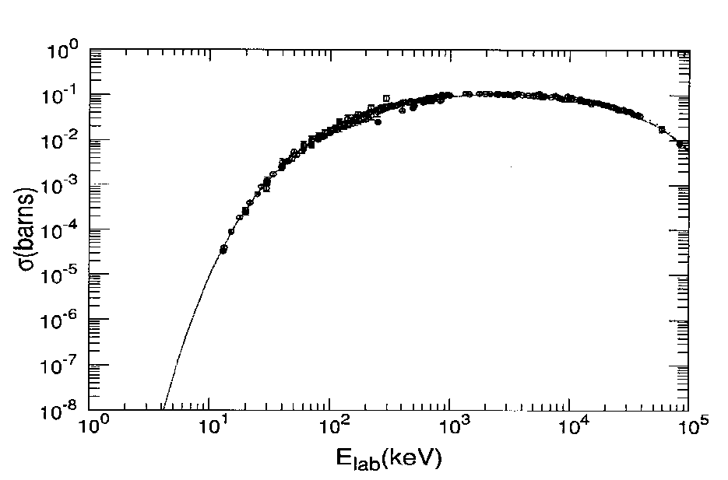
Conventional DD Fusion Reactions in Free-Space
[1] D + D→ p + T + 4.033 MeV
[2] D + D→ n + ³He + 3.270 MeV
[3] D + D→ ⁴He + γ(E2) + 23.847 MeV
Measured branching ratios: (σ [1], σ[2], σ[3]) ≈ (0.5, 0.5, 3.4x10⁻⁷)
In free space it is all about the Coulomb barrier!
The three well known “hot”
dd fusion reactions
Reaction [1]
Reaction [2]
For E_{lab} < 100 keV, the fit is made with σ(E) =

Slide 18
Coulomb potential and nuclear square well potential
V(r)
B
U = E_{screening}
(Electron Screening Energy)
E
(E+U)
U
r_{b}
r
R
r_{a}
Gamow Factor – WKB approximation for Transmission Coefficient
≈
≈
-V₀

Slide 19
Estimates of the Gamow factor T_{G}(E) for D + D fusion
with electron screening energy U_{e}
E+U_{e} | T_{G}(E + U_{e}) | U_{e} | r_{screening}
1/40 eV | 10⁻²⁷⁶⁰ | 0
14.4 eV | 10⁻¹¹⁴ | 14.4 eV | 1 Å
43.4 eV | 10⁻⁶⁵ | 43.4 eV | 0.33 Å
~300 eV | 10⁻²⁵ | 300 eV
~600 eV | 10⁻¹⁸ | 600 eV
Values of Gamow Factor T_{G}(E) extracted from experiments
T_{G}(E)^{FP} ≈ 10⁻²⁰ (Fleischmann and Pons, excess heat, Pd cathode)
T_{G}(E)^{Jones} ≈ 10⁻³⁰ (Jones, et al., neutron from D(d,n)³He, Ti cathode)
19

Slide 20
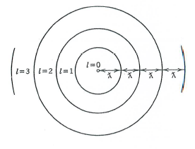
Cross-Section for Nuclear Reacion Between Two Charged Nuclei
(p: projectile nucleus t: target nucelus)
Classically, the cross-section can be written as
Quantum mechanically, the above geometrical cross-section must be replaced by
where is the de Broglie wave length,
with the relative velocity v between p and t.
The cross-section also depend on the Coulomb barrier
penetration probability P
and also depends on the nuclear force factor (called S-factor) after the Coulomb barrier penetration occurs.
Incorporating
into the cross-section, we write
Notes:
20

Slide 21
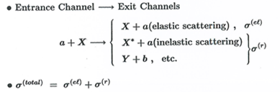
Formulation of Theory of Low-Energy Nuclear Reactions (LENR)
in Hydrogen/Deuterium Loaded Metals Based on Conventional Nuclear Theory
I. Nuclear Theory for LENR in Free Space
Instead of using the two-potential formula in the quantum scattering theory,
we develop the optical theorem formulation of LENR, which is more suitable
for generalization to scattering in confinrd space (not free space) as in a metal.
Quantum Scattering Theory with Two Potentials (Nuclear and Coulomb Potentials, V^{s} +V^{c} )
The conventional optical theorem (Feenberg(1932):
where f(0) is the the elastic scattering amplitude in the forward direction

Slide 22
Kim, et al., “Optical Theorem Formulation of Low-Energy Nuclear Reactions”, Physical Review C 55, 801 (1997))
For the elasstic scattering amplitude involving the Coulomb interaction and nuclear potential can be written as
(1)
where is the Coulomb amplitude, and is the remainder which can be expanded in partial waves
(2)
In Eq. (6), is the Coulomb phase shift, , and is the l-th partial wave S-matrix for the nuclear part.
For low energies, we can derive the following optical theorem:
(3)
where is the partial wave reaction cross section. Eq. (3) is a rigorous result. For low energies, we have
which is also a rigorous result at low energies.
(4)
22
22

Slide 23
Parameterization of the Short-Range Nuclear Force (in Free Space) (V^{s} +V^{c})
For the dominant contribution of only s-wave, we have
can be written as
where t₀ is the s-wave T-matrix, and is the s-wave Coulomb wave function.
From Eqs (5) and (6), we have
At low energies, we have and is conveniently parameterized as
where
(5)
(6)
(7)
(8)
is the Gamow factor.
S is called the S-factor for the nuclear reaction (S=55 KeV-barn for D(d,p)T or D(d,n)³He )
23
23

Slide 24
Parameterization of the Short-Range Nuclear Force (in Free Space) (V^{s} +V^{c}) (continued)
(9)
( is the Gamow factor.)
The above results for free-space case can be generalized to the case of confined
space for protons and deuterons in a metal:
(10)
where is the solution of the many-body Schroedinger equation
with
H = T + V^{confine} + V^{c}

Slide 25
Generalization of the Optical Theorem Formulation of LENR to Non-Free Confined Space (as in a metal) (V^{s} + V^{confine} + V^{c} ): Derivation of Fusion Probability and Rates
For a trapping potential (as in a metal) and the Coulomb potential, the Coulomb wave function is replaced by the trapped ground state wave function ψ as
(15)
where is given by the Fermi potential,
is the solution of the many-body Schroedinger equation
with
H = T + V^{confine} + V^{c}
(16)
(17)
The above general formulation can be applied to proton-nucleus, deuteron-nucleus, deuteron-deuteron LENRs, in metals,
and also possibly to biological transmutations !
25
25

